Slide 1
Project Q5 – Quantum Mechanical Description of Molecules in Magnetic Fields:
Recent Developments and Outlook
Workshop Bad Herrenalb 31.03.-01.04.2016
Kevin Reiter
Supervisor: Florian Weigend
Work packages PB1-PB4

Slide 2
Q5-B: Extension of TURBOMOLE`s module for the calculation of chemical shieldings
PB1: heavy elements (Z>36): relativistic core potentials
PB1a: vibrational circular dichroism (VCD) spectra
PB2: solvent effects: COSMO-model
PB3: efficiency: RI-approximation
PB4: paramagnetic systems, all-electron-relativistic

Slide 3
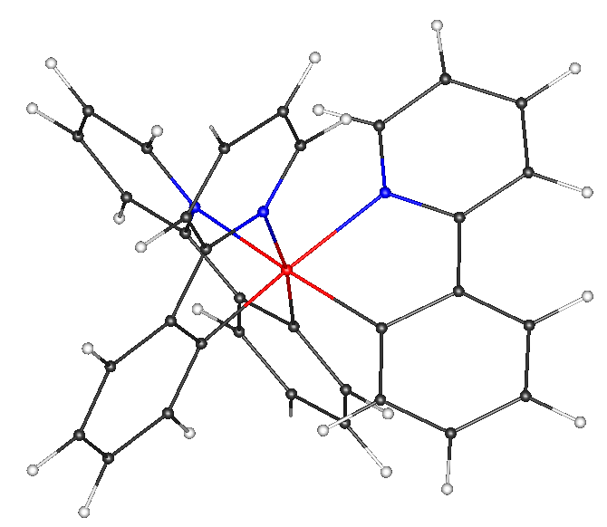
Effective core potentials: implementation
Heavy elements (→ metallopolymers): relativistic effects (also) affect the valence shell and hence the chemical shieldings at the neighboring atoms
Those effects can be treated by the use of Effective Core Potentials (ECPs) V^{C} and Gauge Including Atomic Orbitals (GIAOs):
Has been implemented in TURBOMOLE`s module mpshift and tested in detail e.g. at M(ppy)₃, M = Ir, Co ppy = 2-Phenylpyridine

Slide 4
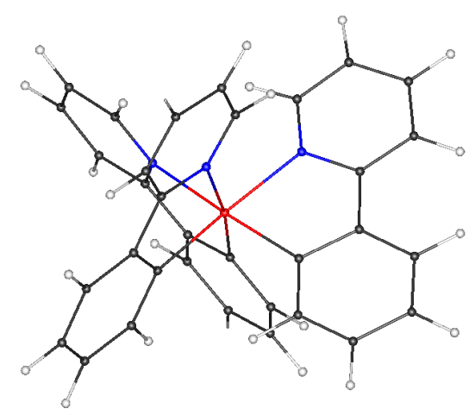
Effective core potentials: application
method: BP86/SV(P)
CPU time: 8 min (ECP)
8 min (all-electron)
N
C3
C2
C1
M(ppy)₃)
60
60
tr(σ)
tr(σ)
40
40
C2
20
Co(ppy)₃
C3
Co(ppy)₃ (ECP)
20
0
0
C1
C1
-20
N
-20
N
-20
0
20
40
60
-20
0
20
40
60
Co(ppy)₃ (all-electron)
tr(σ)
Ir(ppy)₃
tr(σ)

Slide 5
VCD-spectra: theory and implementation
Determination of the absolute configuration of chiral molecules through measurement and calculation of VCD-intensities:
transition dipole moments: ground state → vibrational state
Atomic Axial Tensor (AAT): with
Necessary for : Change of the orbitals with respect to the magnetic field:

Slide 6
VCD-spectra: theory and implementation
also necessary for chemical shieldings (module mpshift)
Gauge including atomic orbitals (GIAOs)
Extension of the module (aoforce) for the calculation of the vibrational states:
→ Calculation of a VCD-spectrum: 1. call mpshift, 2. call aoforce

Slide 7
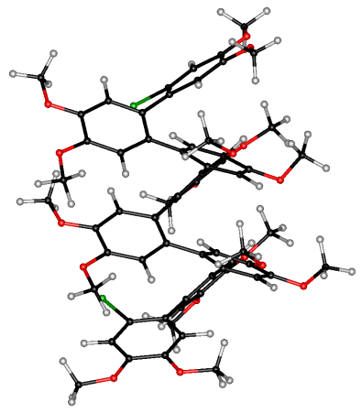
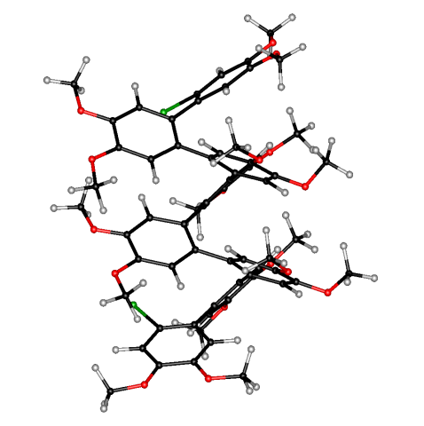
VCD-spectra: application
Br₂C₆₄O₁₆H₆₄
CPU time / h: mpshift aoforce(1 CPU) aoforce(10 CPUs)
BP86/SV(P) 0.7 97 13

Slide 8

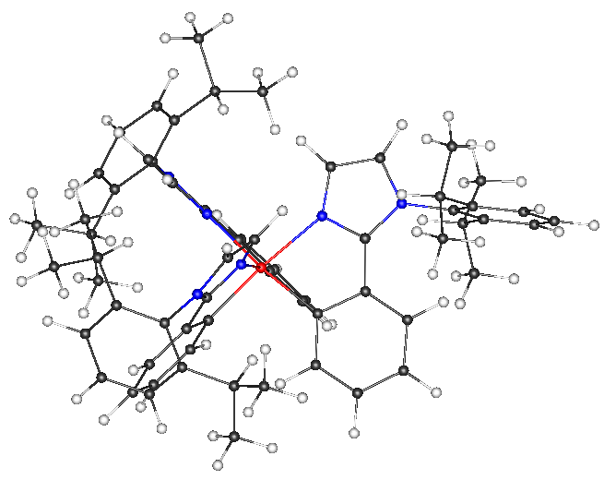
VCD with effective core potentials: application
(1)
(2)
CPU time / h: mpshift aoforce(8 CPUs)
1 (61 atoms) 0.1 1.7
2 (139 atoms) 0.5 12.7

Slide 9
Q5-B: Extension of TURBOMOLE`s module for the calculation of chemical shieldings
PB1: heavy elements (Z>36): relativistic core potentials
PB1a: vibrational circular dichroism (VCD) spectra
PB2: solvent effects: COSMO-model
PB3: efficiency: RI-approximation
PB4: paramagnetic systems, all-electron-relativistic

Slide 10
References
van Wüllen, Christoph, Int. J. Quant. Chem. 58 (1996) 147-152.
Cheeseman, J. R., et al., Chem. Phys. Lett. 252 (1996) 211-220.
Nicu, Valentin Paul, et al., Theor. Chem. Acc. 119 (2008) 245-263.

