Slide 1

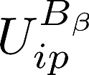

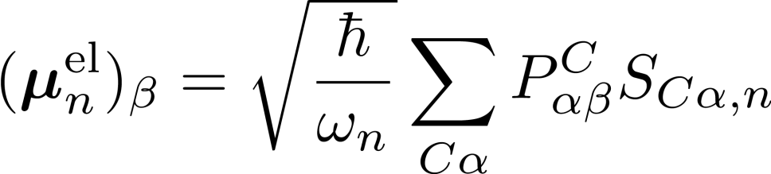
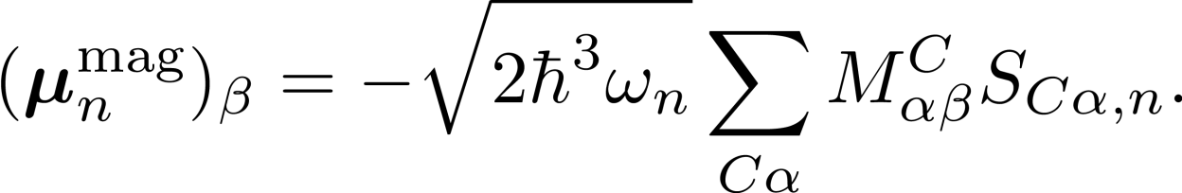
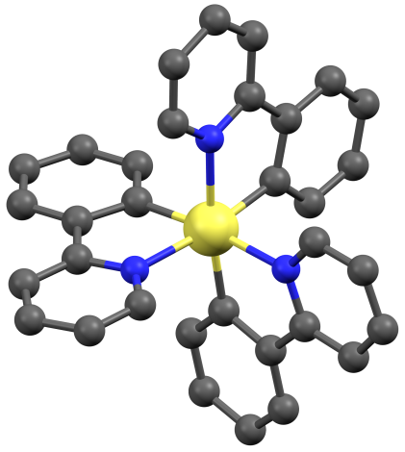
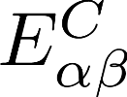
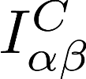
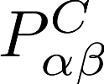
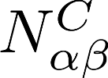
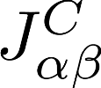
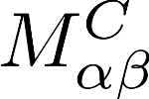
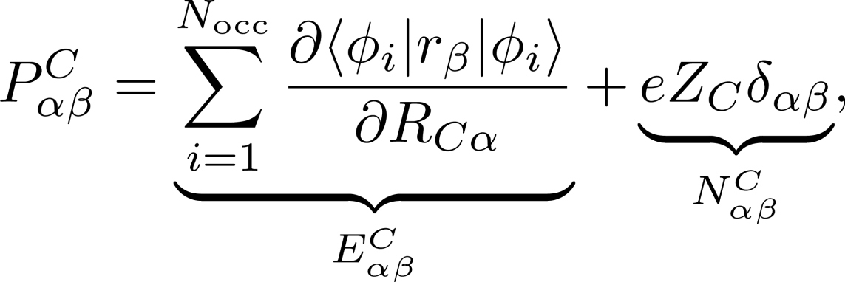
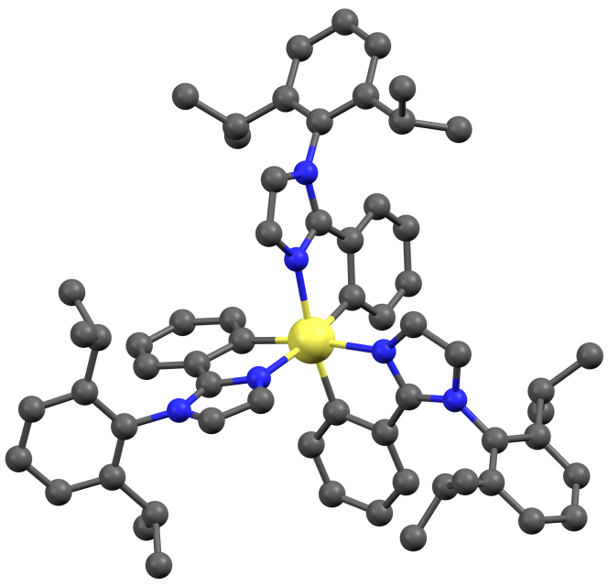
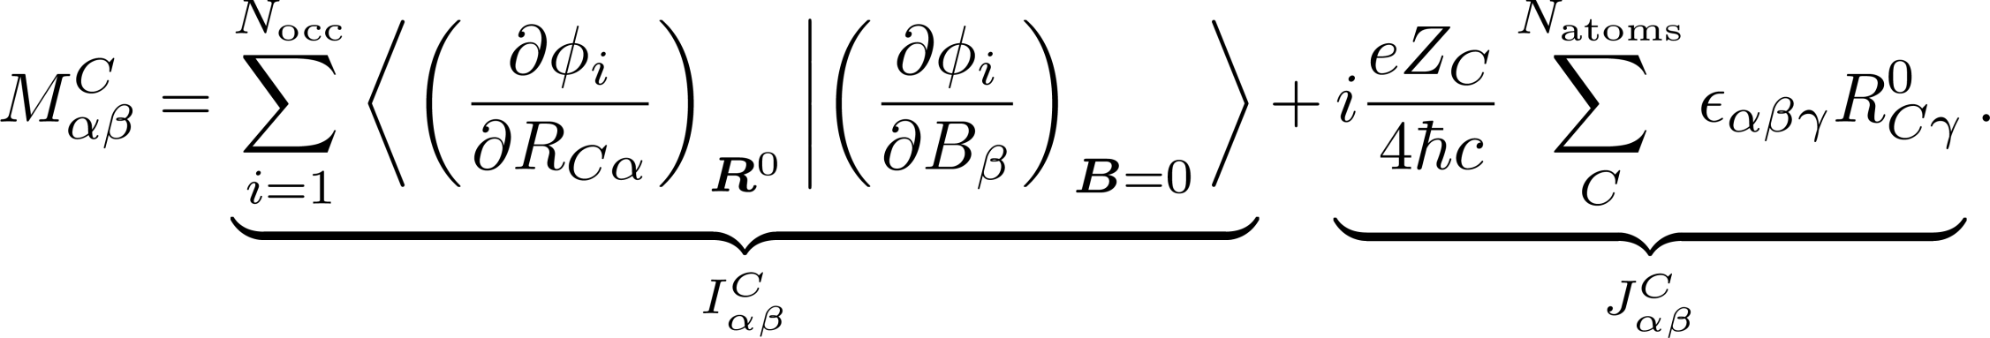
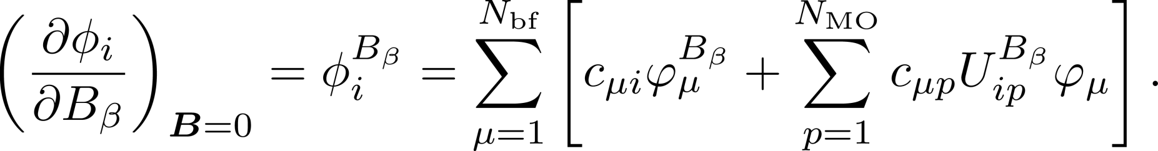
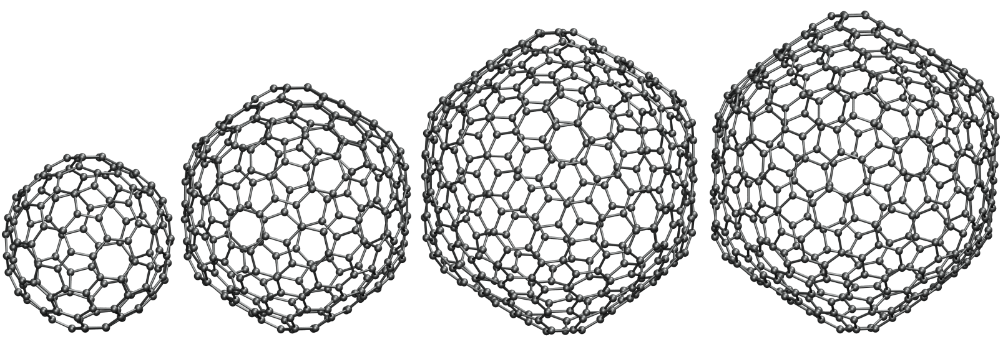
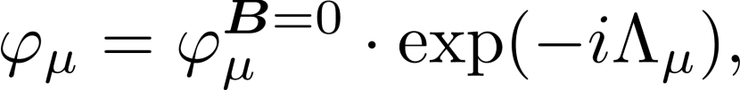
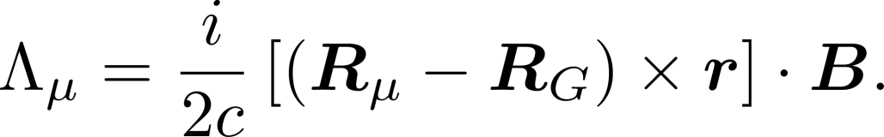

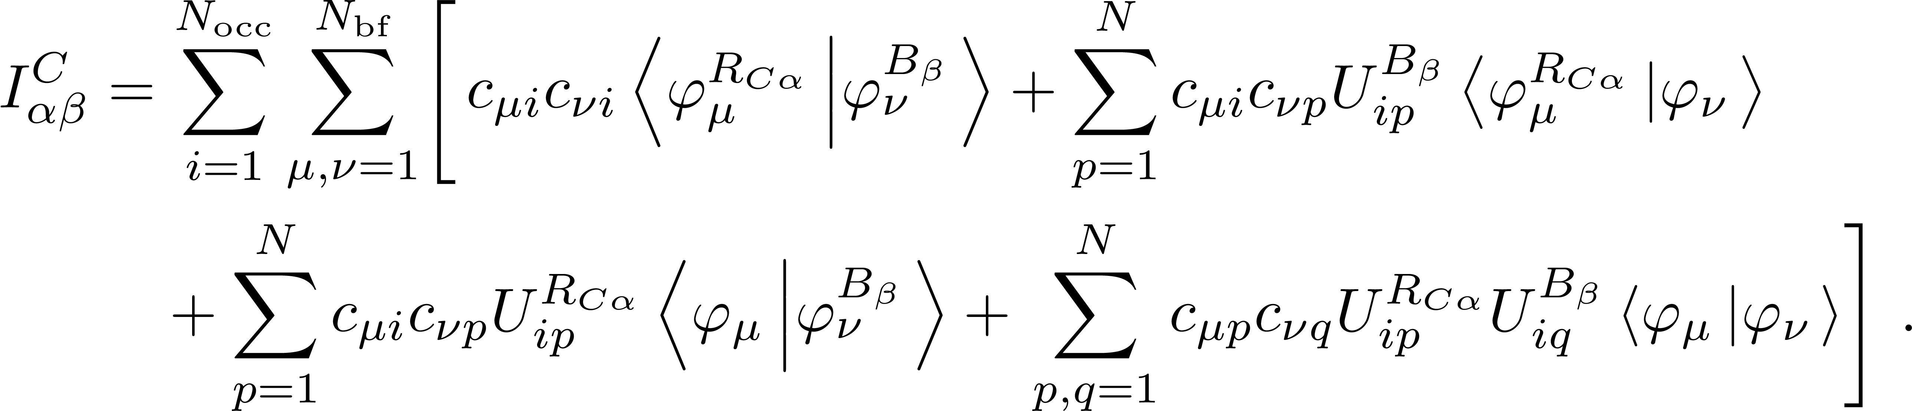



Vibrational circular dichroism spectra
for large systems and systems with heavy elements
Kevin Reiter†, Michael Kühn‡, Florian Weigend†‡
†Institute of Nanotechnology, Karlsruhe Institute of Technology, Hermann-von-Helmholtz Platz 1, 76334 Eggenstein-Leopoldshafen, Germany
‡Institute of Physical Chemistry, Karlsruhe Institute of Technology, Fritz-Haber-Weg 2, 76131 Karlsruhe, Germany
1. Motivation
The spectroscopy of vibrational circular dichroism (VCD) experienced increasing popularity in the recent past. As noted by Magyarfalvi et al. [1], “the comparison of computed and measured VCD spectra gives a very useful tool in the hands of chemists interested in determining absolute configurations or studying the conformational landscape of molecules”. We have implemented the calculation of VCD spectra as proposed by Cheeseman [2] in TURBOMOLE by extending the modules mpshift (for the magnetic part) and aoforce (for the vibrational/electric part).
2. Theory and implementation
VCD intensities I_{n} are proportional to the rotational strengths R_{n} [3,4]:
μ^{el} and μ^{mag} are the electric and magnetic transition dipole moments [2,5]:
and
S_{Cα,n} is the transformation matrix from Cartesian to normal coordinates, ω_{n} is the frequency of the n^{th} normal mode, α and β describe Cartesian coordinates and C counts the nuclei.
The atomic polar tensor and the atomic axial tensor can be divided in electronic ( and ) and nuclear contributions ( and )
Z_{C} and R_{C} are the nuclear charge and the position of the nucleus C, the superscript 0 symbolizes the evaluation at the equilibrium geometry, ε_{αβγ} is the Levi-Civita-tensor and ϕ_{i} are occupied molecular orbitals (MOs).
In the coupled perturbed Hartree-Fock (CPHF) formalism MO derivatives can be written as
describe change of molecular orbitals upon perturbation by a magnetic field B.
Gauge including atomic orbitals (GIAOs) [6,7] are used for origin independence:
are usual, atom centered basis functions. The final expression for reads
describe the response of molecular orbitals upon displacement of atom C.
Rewriting the third integral leads to the following expression:
In the same way one can proceed with the first integral. These two types of integrals can be written as linear combinations of standard dipole integrals or standard dipole derivative integrals , respectively.
To efficiently calculate VCD spectra for systems with heavy elements the usage of ECPs is advantageous but also for them gauge invariance has to be ensured. For this we implemented the ECP-GIAO-formalism suggested by van Wüllen [8], which finally results in
Analogous to , this is evaluated from standard ECP and ECP gradient integrals.
3. Symmetry exploitation
Chiral molecules may belong to the point groups: C_{n}, D_{n}, T, O and I. Symmetry is exploited by using the existing implementation of symmetry exploitation [9] in the modules mpshift and aoforce. In the latter, time demanding step, the exploitation of all of these point groups is supported. In contrast, symmetry exploitation in mpshift [10] is not possible for groups with reducible e-representations ( C_{n>2} and T ). For these cases, the MO-coefficients are transformed to C₁ symmetry and mpshift is carried out without symmetry exploitation. is transformed to the basis of Cartesian atomic orbitals (CAO) before filed to disc. In the second step is transformed to the symmetry adapted orbital (SAO) basis after being read from file and VCD intensities are calculated.
4. Demonstrative applications
VCD intensities can be calculated with the current version of TURBOMOLE by first writing $vcd into the control file, second calling mpshift and third calling aoforce. The additional effort is negligible (< 1%).
5. References
[1] Magyarfalvi, G., Tarczay, G., Vass, E., Wiley Interdiscip. Rev.: Comput. Mol. Sci., 2011, 1, 403.
[2] Cheeseman, J.R., Frisch, M.J., Devlin, F.J., Stephens, P.J., Chem. Phys. Lett., 1996, 252, 211.
[3] Stephens, P.J., Lowe, M.A., Annu. Rev. Phys. Chem., 1985, 36, 213.
[4] Stephens, P.J., J. Phys. Chem., 1985, 89, 748.
[5] Nicu, V.P., Neugebauer, J., Wolff, S.K., Baerends, E.J., Theor. Chem. Acc., 2008, 119, 245.
[6] Ditchfield, R., Mol. Phys., 1974, 27, 789.
[7] London, F., J. Phys. Radium, 1937, 8, 397.
[8] van Wüllen, C., J. Chem. Phys., 2012, 136, 114110.
[9] Häser, M., J. Chem. Phys., 1991, 95, 8259.
[10] Häser, M., Ahlrichs, R., Baron, H.P., Weis, P., Horn, H., Theor. Chim. Acta, 1992, 83, 455.
Rotational strengths |R| for Co(ppy)₃. Top: All-electron vs. ECP calculation. Bottom: ECP vs. ECP calculation with molecule displaced by 10 a.u. in (1,1,1) direction.
BP86/def2-TZVP simulated VCD spectra of Ir(ppy)₃ (top) and Ir(L)₃ (bottom) (ppy = 2-Phenylpyridine, L = 1-(2,6-diisopropylphenyl)-2-phenyl-1H-imidazole) with Lorentzian band shapes. The full width at half maximum is 4cm⁻¹.
BP86/def2-SV(P) simulated VCD-spectrum of with Lorentzian band shapes. The full width at half maximum is 4cm⁻¹.
Selected CPU times in hours for the modules aoforce and mpshift.
Molecule | Symmetry | Functional | Basis | mpshift | aoforce
Ir(ppy)₃ | C₃ | B3LYP | TZVP | 4.9 | 167.5
Ir(ppy)₃ | C₃ | B3LYP | SV(P) | 0.3 | 10.1
Ir(ppy)₃ | C₁ | B3LYP | SV(P) | 0.3 | 16.3
Ir(ppy)₃ | C₃ | BP86 | TZVP | 0.9 | 16.6
Ir(ppy)₃ | C₃ | BP86 | SV(P) | 0.1 | 2.1
Ir(ppy)₃ | C₁ | BP86 | SV(P) | 0.1 | 4.4
 | C₁ | BP86 | SV(P) | 1.5 | 124.7
 | I | BP86 | SV(P) | 0.2 | 4.5
 | I | B3LYP | SV(P) | 0.6 | 25.6
 | I | BP86 | SV(P) | 0.7 | 29.6
 | I | BP86 | SV(P) | 1.6 | 115.9
 | I | BP86 | SV(P) | 2.0 | 167.6
CPU time vs. system size for aoforce and mpshift. A linear fit leads to a slope of 2.33 ± 0.01 for mpshift and 3.28 ± 0.11 for aoforce.

