Slide 1
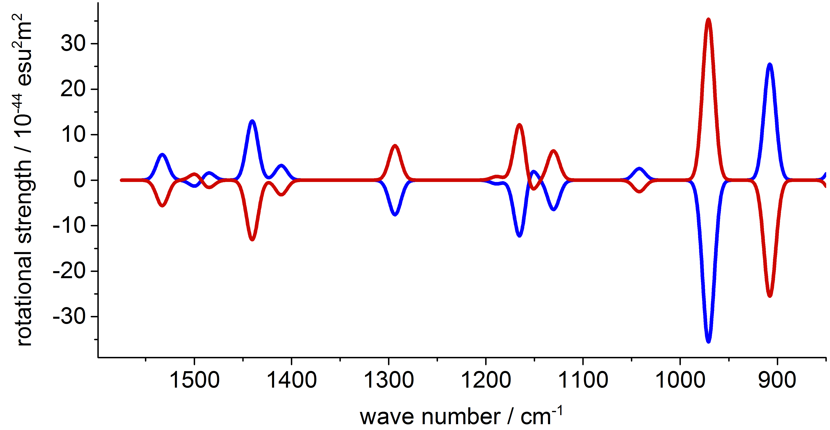
Vibrational circular dichroism spectra:
Theory, implementation and applications
Kevin Reiter

Slide 2
Vibrational circular dichroism spectra: Theory, implementation and applications
Vibrational circular dichroism (VCD): general theory and implementation
VCD: Symmetry exploitation
VCD and chemical shielding tensors: effective core potentials
Summary and outlook

Slide 3
Vibrational circular dichroism: General theory and implementation

Slide 4
VCD: General theory and implementation
Determination of the absolute configuration of chiral molecules through measurement and calculation of VCD-intensities:
transition dipole moments: ground state → vibrational state n
S_{Cα,n}: transformation matrix from Cartesian to normal coordinates
Atomic Polar Tensor (APT):
nuclear contribution
electronic contribution

Slide 5
VCD: General theory and implementation
Atomic Axial Tensor (AAT):
Necessary for : Change of the orbitals with respect to the magnetic field:
nuclear contribution
electronic contribution

Slide 6
VCD: General theory and implementation
also necessary for chemical shieldings (module mpshift)
Gauge Including Atomic Orbitals (GIAOs)
Extension of the module (aoforce) for the calculation of the vibrational states:

Slide 7
VCD: General theory and implementation
new integrals to be calculated:
linear combination of dipole integrals
linear combination of dipole derivative integrals

Slide 8
How to run
write $vcd into the control file
Call mpshift
same steps as for chemical shielding tensors
+ is written to file
call aoforce
same steps as for IR spectra
+ is read from file
+ VCD-intensity calculation as sketched above
Automatic version: Script vcd
Additional effort for the calculation of VCD spectra is negligible (< 1%)

Slide 9
Vibrational circular dichroism: symmetry exploitation

Slide 10
Symmetry exploitation
Only molecules with chiral point groups have non-vanishing VCD intensities:
→ C₁, C_{n}, D_{n}, T, O and I
All these point groups are supported by aoforce (time-dominating step)
Symmetry exploitation in mpshift is not possible for groups with reducible e-representations (C_{n>2} and T )
1. Transform MO-coefficients to C₁ symmetry
2. mpshift without symmetry exploitation: transformed to CAO basis and filed to disk
3. aoforce with symmetry: transformed to SAO basis after being read
The script vcd does these steps automatically and stops the execution
for all the other, nonchiral point groups.

Slide 11
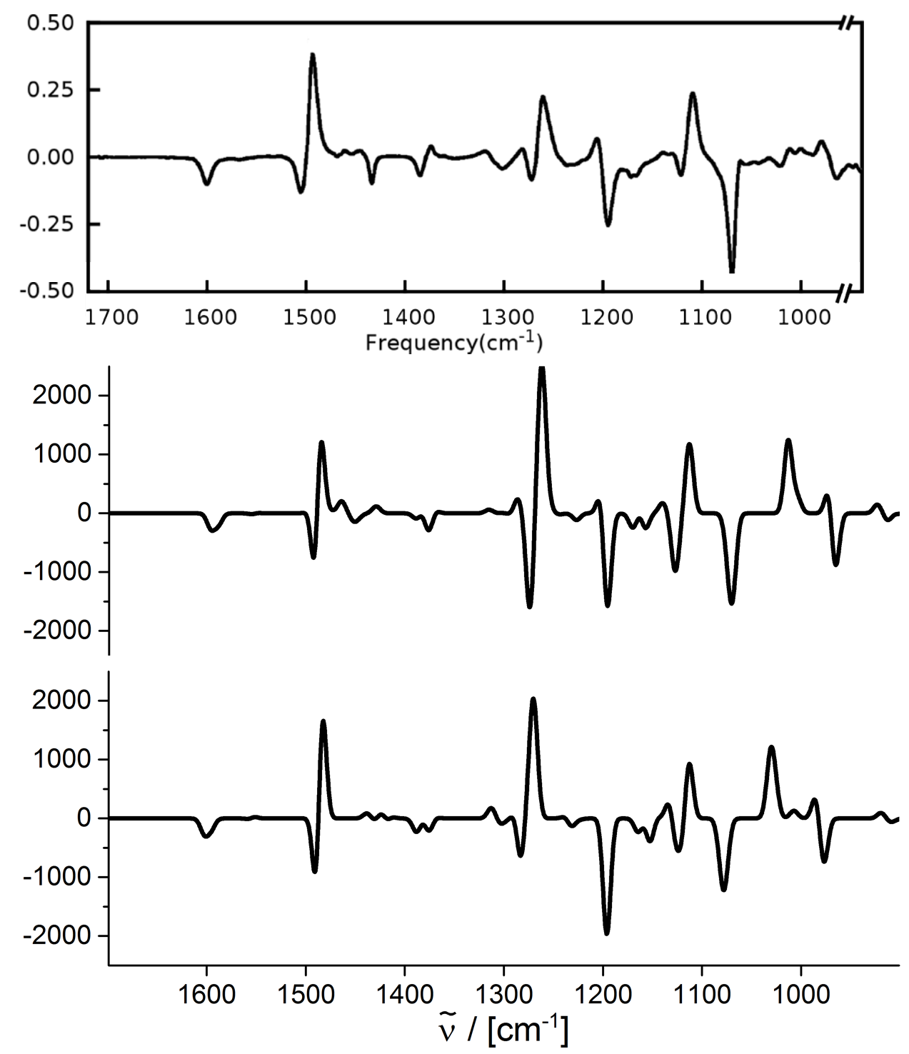
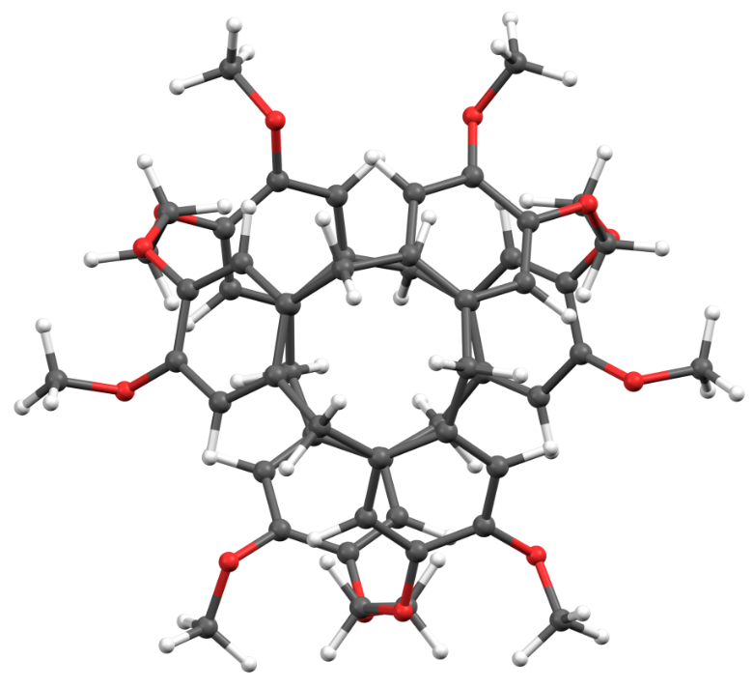
Application: (+)-cryptophane-A (D₃ symmetry)
Δε
experiment
B3LYP/def2-TZVP
R / [10⁻⁴⁴ esu²cm²]
4 CPUs: mpshift: 2.5 h aoforce: 89.5 h
B3LYP/def2-SV(P)
4 CPUs: mpshift: 0.1 h aoforce: 5.5 h

Slide 12
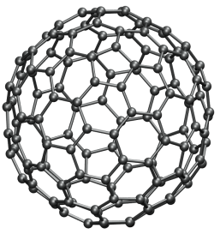
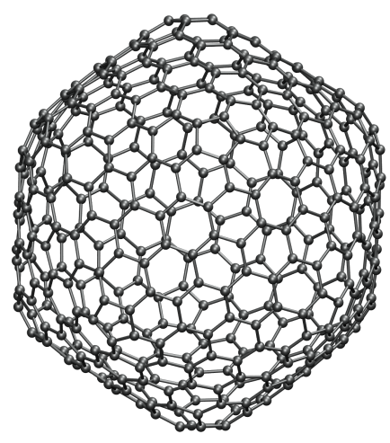
Application: Fullerenes with I symmetry
BP86/def2-SV(P)
B3LYP/def2-SV(P)
BP86/def2-SV(P)

Slide 13
Application: Fullerenes with I symmetry
Molecule | Sym. | Func. | Basis | mpshift | aoforce
 | C₁ | BP86 | SV(P) | 1.5 | 124.7
 | I | BP86 | SV(P) | 0.2 | 4.5
 | I | B3LYP | SV(P) | 0.6 | 25.6
 | I | BP86 | SV(P) | 0.7 | 29.6
 | I | BP86 | SV(P) | 1.6 | 115.9
 | I | BP86 | SV(P) | 2.0 | 167.6
slopes
mpshift: 2.33 ± 0.01
aoforce: 3.28 ± 0.11

Slide 14
VCD and chemical shieldings with effective core potentials

Slide 15
Effective core potentials
Heavy elements: relativistic effects also affect the valence shell and hence the chemical shieldings at the neighboring atoms
Those effects can be treated by the use of Effective Core Potentials (ECPs) V^{ECP}
Also for them gauge invariance has to be ensured Gauge Including Atomic Orbitals (GIAOs):
ECP-GIAO-formalism by van Wüllen finally results in:

Slide 16
Effective core potentials
Derivative of V^{ECP} with respect to x-component of B
Expanding the integral in the first term
First integral standard ECP integral
Second integral: z-component of the angular moment for basis function is raised by one can be evaluated from standard ECP gradient integrals

Slide 17
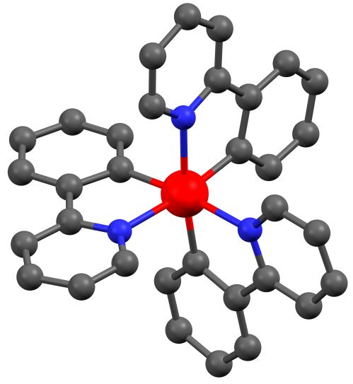
Shieldings with ECPs
Has been implemented in TURBOMOLE`s module mpshift and tested e.g. at M(ppy)₃, M = Ir, Co ppy = 2-Phenylpyridine
M=Co
)
σ
)
60
(
60
σ
tr
(
)
tr
)
40
40
ECP
ECP displ.
(
3
20
(
20
(ppy)
3
Co
0
(ppy)
0
Co
-20
-20
-20
0
20
40
60
-20
0
20
40
60
Co
(ppy)
all-electron
σ
(
)
tr
(
)
Co
(ppy)
ECP
σ
(
)
tr
3a
3
(
)

Slide 18
VCD with effective core potentials
M=Co

Slide 19
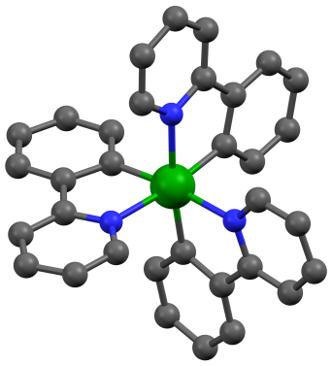
VCD with effective core potentials
BP86/def2-SV(P)
B3LYP/def2-SV(P)
1 CPU: mpshift: 0.1 h aoforce: 2.1 h
1 CPU: mpshift: 0.3 h aoforce: 10.1 h
BP86/def2-TZVP
B3LYP/def2-TZVP
1 CPU: mpshift: 0.9 h aoforce: 16.6 h
1 CPU: mpshift: 4.9 h aoforce: 167.5 h
M=Ir

Slide 20
Summary
Calculation of VCD spectra with symmetry exploitation implemented
VCD spectra for molecules with heavy elements by the use of ECPs
Calculation of chemical shieldings for molecules with heavy elements
Treatment of solvent effects with COSMO for chemical shieldings and VCD spectra
Outlook

Slide 21
Acknowledgement
Florian Weigend
Michael Kühn
Paola Nava
DFG for funding
Thank you for your attention!

Slide 23
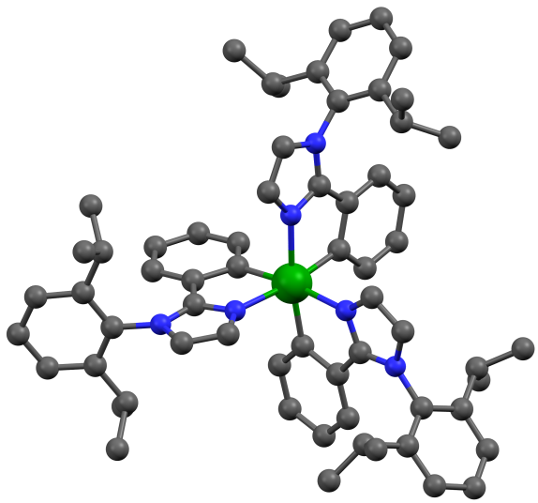
VCD with effective core potentials
BP86/def2-TZVP
4 CPUs: mpshift: 4.1 h aoforce: 68.9 h
M=Ir

