Slide 1

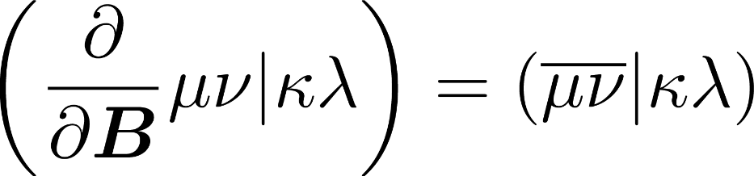
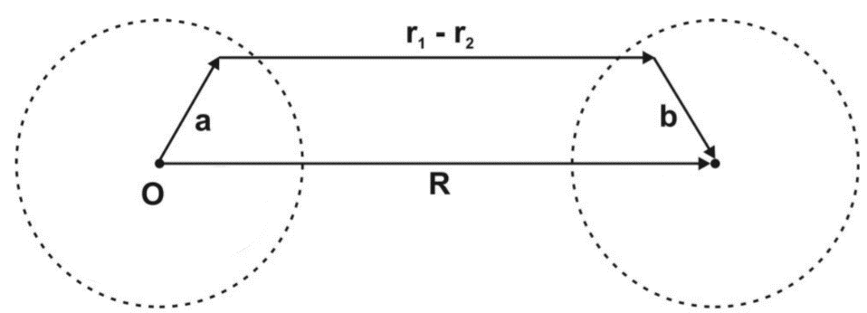
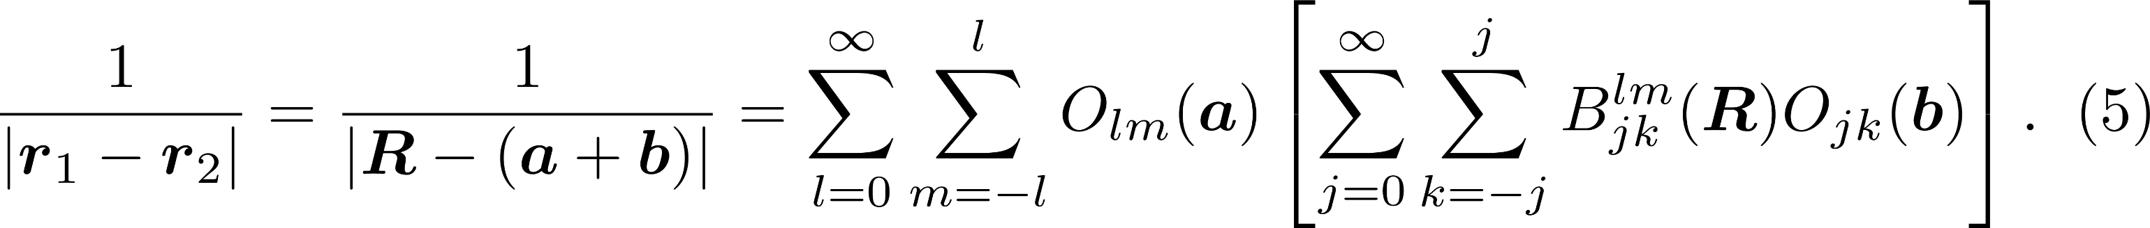
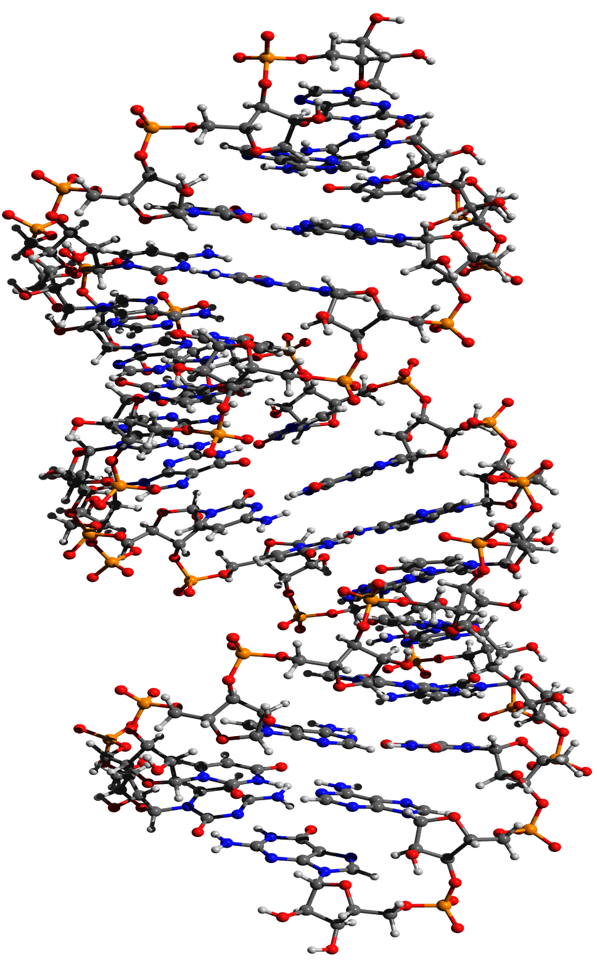
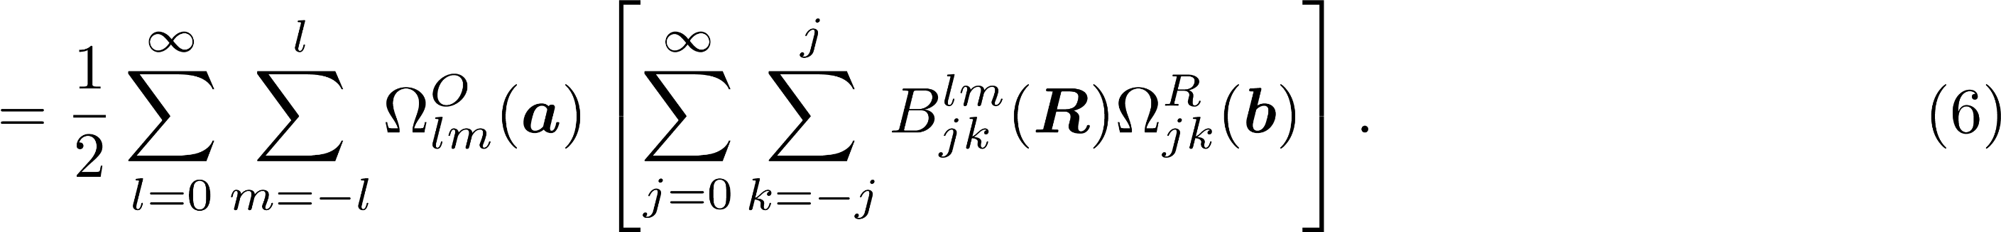
Efficient calculation of NMR shieldings including environmental effects
Kevin Reiter†, Fabian Mack‡, Florian Weigend†‡
†Institute of Nanotechnology, Karlsruhe Institute of Technology, Hermann-von-Helmholtz Platz 1, 76334 Eggenstein-Leopoldshafen, Germany
‡Institute of Physical Chemistry, Karlsruhe Institute of Technology, Fritz-Haber-Weg 2, 76131 Karlsruhe, Germany
1. Motivation
In calculations of chemical shieldings (CS) the Coulomb part can easily become the time-dominating step. To reduce the computational effort, we implemented the multipole-accelerated resolution of the identity (MARI-J) [1,2] in TURBOMOLE’s NMR module.
Further, to treat environmental effects, in particular counter ions, we implemented the conductor like screening model (COSMO) analogously to the related polarizable continuum model [3].
2. Theory and implementation
For pure DFT functionals the calculation of the derivative of the Coulomb part with respect to the magnetic field
becomes the most demanding step. The derivative of the two-electron-four-center-integrals read
The second term in equation (1) vanishes and for the first term we employ the resolution-of-the-identity (RI) approximation [1]
The intermediate quantity Γ_{Q}=(Q|R)⁻¹(R| κλ) D_{κλ} is obtained in the same way as in energy calculations and Γ_{Q} is contracted with the derivatives of the three center integrals to get
Integrals are calculated by employing standard Cartesian gradient routines for three center integrals, extended by the (R x r) term in the same way as shown in equation (2).
Further gain in efficiency is achieved by employing the multipole-acceleration [2]. The distance of two electrons |r₁-r₂| is expressed by the disctance of two nuclei, R, and the respective electron-nucleus distances a and b. The inverse is expanded in products of functions of a,b and R
In this way, the Coulomb interaction between two (distant) charge distributions may be expanded as follows
For the derivative with respect to the magnetic field (at B=0) one obtaines
which is inserted into equation (6) to get the mulipole approximated contribution to the derivative of the Coulomb part. For further details see reference [2].
For environmental effects, in particular counter ions, the conductor like screening model (COSMO) [4] is a pragmatic tool. In the calculation of chemical shieldings, the screening charges q_{i} located at position t_{i} on the surface of a cavity defined by the molecule, are added to the one-electron-part, see reference [3].
3. Accuracy and efficiency
RI errors were calculated for C/F/P with def2-TZVP basis using test sets with 19/7/14 compounds. Standard deviations (in ppm):
→ RI error is negligible compared to the error of any DFT procedure.
Additional errors introduced by MARI-J were calculated for H/C for a four-membered chain of α-D-glucose units at level TPSS/def2-TZVP.
Efficiency was tested for (α-D-glucose)_{n} with n = 1, 2, 4, 8, 16, 32, 48, 64 and 128 for the functionals TPSS and B3LYP and 6-31G*/def2-SV(P) orbital/auxiliary basis sets. CPU times on a single CPU for MARI-J calculations:
For B3LYP ca. 1/3 of the time is spent for the CPSCF equations and 2/3 for derived integrals contracted with non-disturbed density matrix.
Comparison: Reference 5: Wall time for n=32 (B3LYP/6-31G*) on 16 CPUs: 9h 44min.
5. References
[1] O. Vahtras, J. Almlöf, M. W. Feyereisen, Chem. Phys. Lett 213, 514 (1993).
[2] M. Sierka, A. Hogekamp, R. Ahlrichs, J. Chem. Phys. 118, 9136 (2003).
[3] R. Cammi, B. Mennucci, J. Tomasi, J. Chem. Phys. 110, 7627 (1999).
[4] A. Klamt, G. Schüürmann, J. Chem. Soc. 2, 799 (1993).
[5] C. Kumar, T. Kjaergard, T. Helgaker, H. Fliegl, J. Chem. Phys. 145, 234108 (2016).
 | C | F | P
RI vs. non-RI (TPSS) | 0.04 | 0.20 | 0.41
TPSS vs. experiment TPSSh vs. experiment PBE vs. experiment | 4.3 2.9 4.7 | 7.4 5.5 9.3 | 25.3 19.9 34.2
 | H | C
Mean signed deviation | 0.00001 | 0.003
Mean absolute deviation | 0.00029 | 0.004
Standard deviation | 0.00068 | 0.008
Maximum absolute deviation | 0.00378 | 0.031
[α -D-glucose]₄
n | N_{atoms} | N_{bf} | TPSS |  | B3LYP
 |  |  | CS | CS/SCF | CS | CS/SCF
1 | 25 | 204 | 0.3 min | 0.71 | 0.6 min | 0.75
2 | 45 | 389 | 0.9 min | 0.74 | 2.3 min | 0.82
4 | 87 | 759 | 2.3 min | 0.61 | 8.3 min | 0.88
8 | 171 | 1499 | 6.7 min | 0.70 | 30 min | 1.20
16 | 339 | 2979 | 22 min | 0.87 | 2 h 17 min | 2.28
32 | 675 | 5939 | 1 h 27 min | 0.88 | 10 h 53 min | 3.81
48 | 1011 | 8899 | 3 h 32 min | 0.80 | 31 h 03 min | 5.01
64 | 1347 | 11859 | 6 h 47 min | 0.73 | 63 h 47 min | 5.29
128 | 2691 | 23699 | 40h 35 min | 0.84
PBE/def2-SV(P) chemical shielding calculation for a DNA sequence: [C₃₀₄H₃₄₆O₂₂₀N₁₁₈P₃₀]³⁰⁻, 10220 basis functions. Since the molecule is negatively charged it is crucial to use COSMO. CPU times on a single CPU:
 | total | Coulomb part
SCF (MARI-J) | 9h 52min
NMR | 43h 11min | 36h 9min
NMR (RI-J) | 10h 42min | 3h 25min
NMR (MARI-J) | 7h 38min | 20 min
→ Multipole-accelerated RI-J leads to a speedup of more than 100 for the Coulomb part and ca. 6 for the total CS calculation.

