Slide 1

Introducing Git Version Control
Daniel Noyes
reiuiji@gmail.com

Slide 2
Agenda
Introduction
What is Git?
Learning Git
Enable Development with Git
Tools/Resources

Slide 3
About Me
Dan Noyes
Dedicated Linux User since 2001
BS in Computer Engineering
BS in Electrical Engineering
Working on a Masters in Computer Engineering

Slide 4
Introduction
Git was developed by Linus Torvalds for the Linux Kernel project back in 2005
Replace the proprietary bitkeeper SCM
Like the Linux kernel, it is free software licensed under GNU GPL v2.

Slide 5




















Who uses git?
Notes:
Can anyone tell me who uses git?
<enter to show logos>

Slide 6
What is Git?
Distributed Version Control System
File system
Decentralized
Maintains History
Content Tracker
Does not delete
Fast
Flexible

Slide 7
Version Control Systems
Notes:
Before we get into git more, lets understand what is a version control system
Three commonly known VCS

Slide 8

Local VCS
GNU Revision Control System (RCS)

Slide 9

Centralized VCS
Concurrent Version System (CVS)
Perforce
Subversion (SVN)
Notes:
This gives us access control as well as a central point for backup
VCS server can lead to a point of failure
Have to merge with other users which can be painful

Slide 10

Decentralized VCS
Bazaar
Bitkeeper
Darcs
Git
Mercurial
Notes:
Every cloned entity is a fork
Each clone retains its own data
Work off line
Fast
Bad for large files since each clone downloads the entire base

Slide 11
Design
Fully distributed
Fast and lightweight
Ensure Integrity
Support several thousands of parallel branches
Handle large projects(Linux kernel)

Slide 12
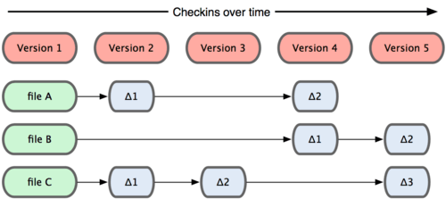

How does git work
Common way for most VCS to track change
How git tracks changes

Slide 13
Git features
File System
Retains Integrity
  Checksummed everything
  Reference tags are SHA-1
Only Add's data and never deletes
  Easily change to previous versions

Slide 14
States of Git
Modified: Make changes to the branch
Staged: Mark changes to be commit
Committed: Add Changes into the branch

Slide 15

Common Workflow

Slide 16

File State Lifecycle

Slide 17
Getting Started With Git
https://git-scm.com/
https://git-cola.github.io/
https://desktop.github.com/

Slide 18
Create a Git Repository
git init

Slide 19
Clone a Git Repository
git clone https://github.com/Reiuiji/ECE565-Operating-Systems

Slide 20
Creating a Commit
Select a change:
git add *.py
git add hw.py
git commit -m 'added'
Grab all changes
git commit -am 'all'

Slide 21
Removing Files
Remove from staging area
git rm –cached file.py
From index and file system
git rm file.py

Slide 22
Moving Files
Git does not track the files, It only tracks the content. Glad there is a move command
  git mv file1 file2
Same as
  mv file1 file2
  git rm file1
  git add file2

Slide 23
Show Status
git status

Slide 24
Show Log
Show everything:
  git log
Filter:
  git log –since=1.weeks
  git log –since=”5 years 3 days 1 min ago”

Slide 25
Showing Difference
Unstaged changes
  git diff
Staged changes
  git diff –cached
Relative to a specific revision
  git diff HEAD^
  git diff 80212f

Slide 26
Showing Commits
Last commit
  git show
Specifig commit
  git show HEAD^
  git show 80212f

Slide 27
Undoing changes
Change last commit
  git commit –amend
Unstage staged file
  git reset HEAD file.py
Unmodify modified file
  git checkout – file.py
Revert a commit
  git revert 80212f

Slide 28
.gitignore
Tells git what to ignore
  Compiled files
  Object code
  Swap
/ specify a directory to ignore
Example:
#comment
*.obj
*.pyc
/debug/
/gen/*.pdf

Slide 29
Remote
Clone other repository(local/remote)
Check which remote for the repo
  git remove -v
  origin git@github.com:Reiuiji/Presentations.git (fetch)
  origin git@github.com:Reiuiji/Presentations.git (push)

Slide 30
Push to a remote branch
Without the default
  git push <remote> <rbranch>
Setting a default
  git push -u <remote> <rbranch>
Push to the remote branch
  git push

Slide 31
Pull from a remote branch
Fetch and Merge
  git pull
  git pull <remote> <rbranch>
Fetch and Rebase
  git pull –rebase [<remote> <rbranch>]
  Warning: Can be very dangerous!!!

Slide 32
Tag versions
Create a Tag
  git tag v1.1.0
Annotated Tags
  git tag -a v1.1.0 -m 'Version 1.1.0'
GPG-signed tags
  git tag -s v1.1.0 -m 'Signed version 1.1.0'
Check version notes
  git tag -v v1.1.0
See available tags
  git tag

Slide 33
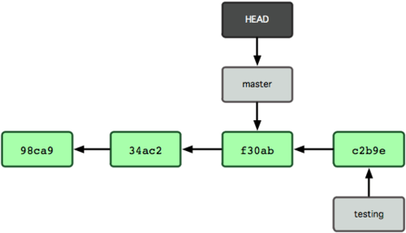
Branches work
Branches are pointers to commits

Slide 34
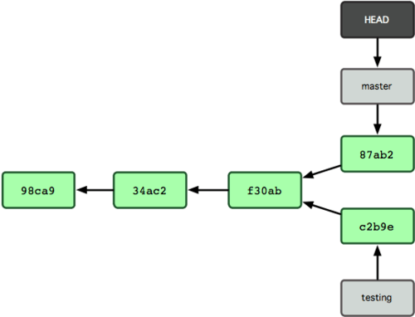
Diverging Branches
Branches can be diverge

Slide 35
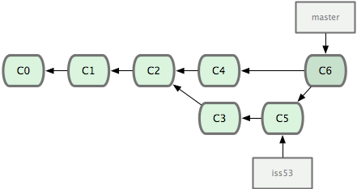
Merging Branches
Branches can be merged.

Slide 36
Merge conflicts
Merging branches can cause conflicts
Different strategies to merge
  Fast-forward
  3 way
Fails → Fix by hand
  Add and commit to mark as resolved

Slide 37
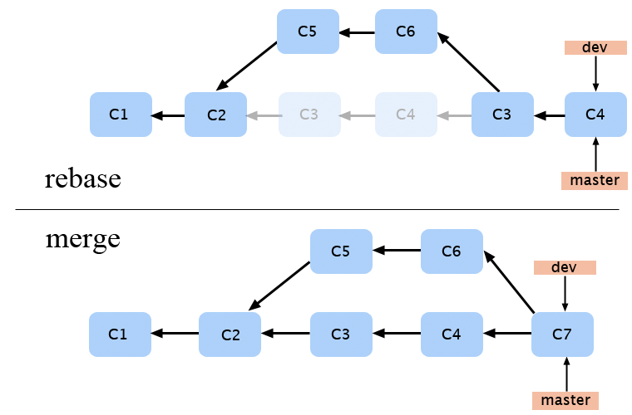
Rebasing
Linear alternative to mergin
Caution: Rewrites tree!!!

Slide 38
Branch Management
Create New Branch
  git branch devel
  git checkout -b devel master
Switch Branch
  git checkout devel
Delete Branch
  git branch -d devel

Slide 39
Branch Management
Show All Branches
  git branch
  devel
  *master
Show Last Branch Commits
  git branch -v

Slide 40
Branch Management
merged Branches
  git branch --merged
  devel
  *master
Unmerged Branched
  git branch --no-merged
  testing

Slide 41
Stashing
Stash your work so you can resume later
Move changes to a separate “stash” .
  git stash
  git stash pop
  git stash list
  git stash apply
  git stash drop
  git stash clear

Slide 42
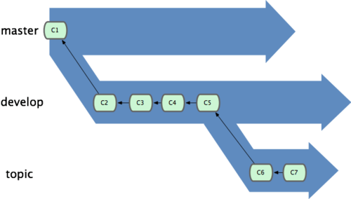
Common Workflow

Slide 43
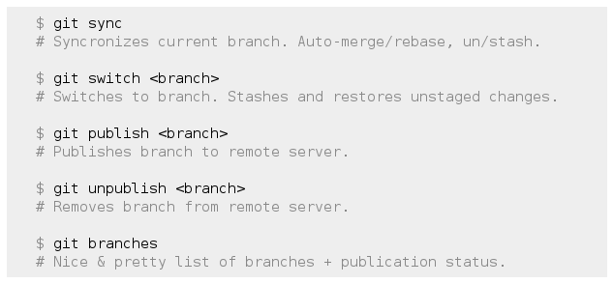
How Easy Workflow with Git

Slide 44
Tools/Resources
http://gitref.org
https://try.github.com
https://training.github.com/kit/
http://www.git-scm.com/book

Slide 45
Acknowledgment
https://git-scm.com
Most illustrations:
  http://git-scm.com/book
Inspiration:
  https://blog.dbrgn.ch/2013/2/7/git-introduction-presentation-slides/
  https://dbrgn.ch/slides/20130207_getting_git/#/

