Slide 1
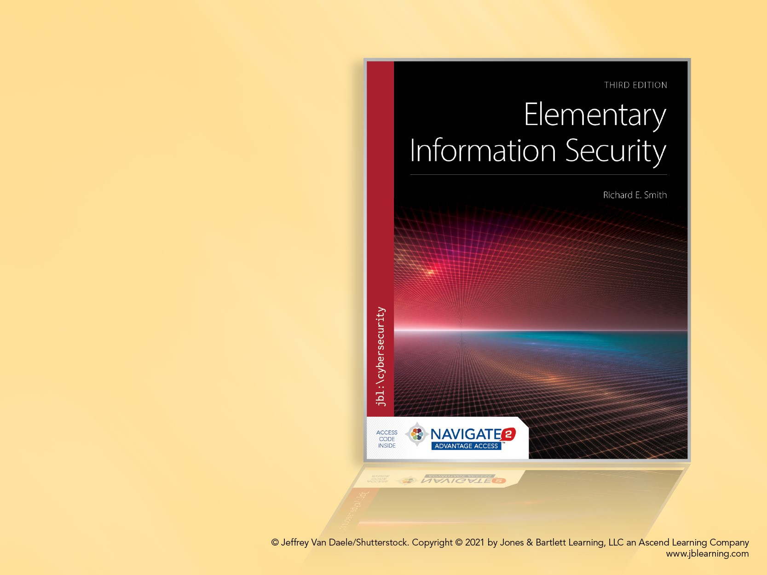
Chapter 1 Security From the Ground Up

Slide 2
Chapter 1 Overview
Strategies for making security decisions
Approach for identifying and prioritizing cybersecurity risks
Process to identify security requirements
Need to monitor and evaluate security measures continuously
Review of ethical issues in cybersecurity practice

Slide 3
Possession, Ownership, and Control
A personal laptop
We possess it. We own it.
We control it because we can install anything
A company laptop
We possess it. We don’t own it.
Our control depends on user access rights
A cell phone
We possess it. We own it. We don’t control it.
Vendor and app developers have control

Slide 4
Examples of Control
Cell phone vendors try to block malware
App stores scan for it, remove malware found
Malware may creep in anyway
“Free” apps often sell user data
Monitor and track location, other details
Sell to third parties = free app
User isn’t the customer of free apps
Apple blocks MAC address access by apps
Privacy protection for others nearby

Slide 5
Making Security Decisions
Do you always lock:
A car door
A room door
A house door
If not always, what decides?
Rule-based decisions – follow a standard
Relativistic decisions – copy others’ behavior
Risk assessment – a calculated risk

Slide 6
Decision-Making Strategies
Relativistic
My friend does it, so I do, too.
My neighbor has a fence and locks his front door. Me, too.
We all use super-strong Kryptonite bike locks
“Security Theater,” hunters’ dilemma
Risk assessment
We look at the risks and choose security measures accordingly
Reassess risks as part of the “life cycle” of the asset

Slide 7
Decision Making in a Life Cycle
Identify your practical goals
What “real” things do you want to accomplish?
Choose the security that fits
What weaknesses exist?
What security measures might work?
What are the trade-offs against goals?
Measure success
Monitor for attacks or other failures
Recover from problems

Slide 8
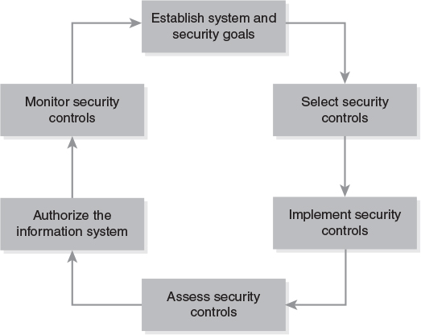
Risk Management Framework (RMF)
Notes:
1. Categorize the information system: identify its goals, security risks, and requirements
2. Select security controls: identify existing controls and additional ones required
3. Implement security controls: construct the system containing the controls
4. Assess security controls: verify that the controls work as required
5. Authorize the information system: approve the system for operation and deploy it
6. Monitor security controls: watch for security incidents and address them; also review the environment for changes that affect security

Slide 9
RMF Risk Assessment
Rule-based
U.S. Federal standards and guidelines
Identify the RMF category
Estimates the impact of cybersecurity failures
Impact in terms of CIA Properties
Confidentiality, Integrity, Availability
Assess each in terms of impact:
Not applicable, Low, Moderate, High
Low = noticeable impact
High = major damage

Slide 10
Example RMF Categorizations
Website to publish product information
Confidentiality – Not applicable
Integrity – Low
Availability – Low
Website for online sales
Confidentiality – Moderate
Integrity – Moderate
Availability – Moderate
Notes:
Amawig’s goal is to sell widgets. We assess two Amawig websites.
The first website contains nothing but public information
1. Confidentiality: Not applicable, since all information is public.
2. Integrity: Low, since a site outage will not prevent customer sales.
3. Availability: Also low, since a site outage doesn’t prevent customer sales.
The second website
1. Confidentiality: Moderate, since the website handles some electronic payment information from customers.
2. Integrity: Moderate, since the website handles some electronic payment information from customers, it specifies product prices, and it directs product shipments.
3. Availability: Moderate, since an interruption would visibly affect sales, but would not cause long-term damage to the company.

Slide 11
RMF Uses Rules to Assign Controls
Published rules recommend controls
NIST Special Publication 800-53
Add controls as impact increases
What about smaller environments?
Smaller impacts yield greater effects
Large businesses absorb “noticeable” events
One such event could ruin a small company
RMF rules aren’t geared for smaller enterprises

Slide 12
Do All Enterprises Do All RMF Steps?
Categorize – NO – smaller ones do it differently
Identify risks, threats, and requirements
Select controls – YES, but a small enterprise…
Combines with the Implement step
Implement controls – See above
Assess controls – YES
Determine if the controls really work
Authorize system – NO, not in small enterprises
Monitor controls – YES

Slide 13
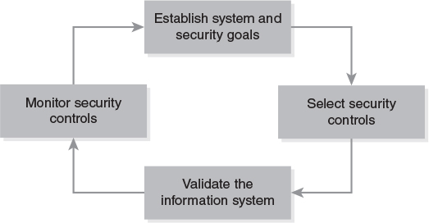
Proprietor’s RMF
Shorter, requirements-based assessment
Notes:
A. Establish system and security goals: identify the system’s goals, security risks, and requirements. We perform a risk assessment and use it to produce a list of security requirements.
B. Select security controls: identify existing controls and additional ones required, and construct the system containing the controls. We use the security requirements to identify the controls we require.
C. Validate the information system: verify that the controls work as required, approve the system for operation, and deploy it. We test the system’s controls against the security requirements to ensure that we address our risks.
D. Monitor security controls: watch for security incidents and address them; also review the environment for changes that affect security. The system must contain security controls that keep records of security-relevant operations and incidents.

Slide 14
PRMF Risk Assessment
A more elaborate process
Addresses the special cases of smaller enterprises and nongovernment organizations
PRMF Step A performs the assessment
Three major parts
Identify risks: assets, threat agents, attacks
Prioritize risks: estimate relative impacts
Establish requirements: identify security goals to address the highest-priority risks

Slide 15
Risk Assessment Detailed Steps
Identifying risks
Step 1: Identify assets
Step 2: Identify threat agents and attacks
Prioritizing risks
Step 3: Estimate the likelihood of attacks
Step 4: Estimate the impact of attacks
Step 5: Calculate their relative significance
Establish requirements
Step 6: Write requirements to address the highest-priority risks

Slide 16
Textbook Basic Principles
Basic Principles of Information Security
Capitalized phrases in the book
Illustrate general rules often followed by secure systems
Continuous Improvement – a basic principle
We identify our basic goals
We measure our success
We adjust our work to better achieve our goals

Slide 17
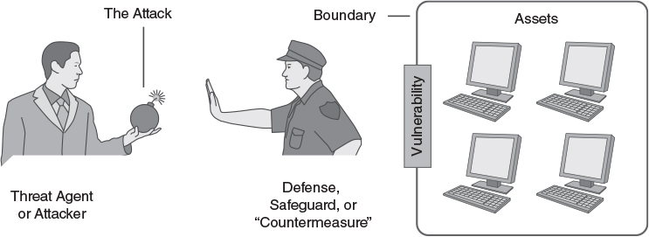
Assets and Risk Assessment

Slide 18
Terminology
Assets are protected by a boundary
Openings in the boundary are vulnerabilities
A threat agent or attacker tries to attack assets
A defense, safeguard, or countermeasure protects the assets
An attacked system that is unsafe to use is a compromised system
Compromised systems on a network, all controlled by a single attacker, is a Botnet

Slide 19
Assets: What Are We Protecting?
Identifying goals
What do we do that requires our computer?
Focus on general, non-computing goals
Making money, operating a store, etc.
These lead to goals
“I need to sell products to customers.”
Identifying assets
What computer assets support these goals?
Those are the important assets

Slide 20
Example: Alice’s Arts
A small retail store
Alice is the sole proprietor
Uses a laptop
Track expenses, pay bills
Manage bank account
Order merchandise
Advertising and social media
Point of Sale (POS) terminal
Record sales

Slide 21
Alice’s Arts: Goals and Assets
Alice’s goals: Stay in business and offer appealing merchandise to customers
Alice’s assets:
Computer hardware: laptop, POS, printer
Purchased software: OS install disk, office software, etc.
Personal arrangement of files and contents
Spreadsheets to track business
Online accounts: Banks, merchandise
Social media accounts

Slide 22
Security Architecture and Boundaries
Room security = walls + doorways
How do we assess a boundary?
Can a threat agent breach a wall?
How do we control doorways?
How can a threat agent pass through a doorway?
How much do we trust those inside the boundary (i.e., the insider threat)?

Slide 23
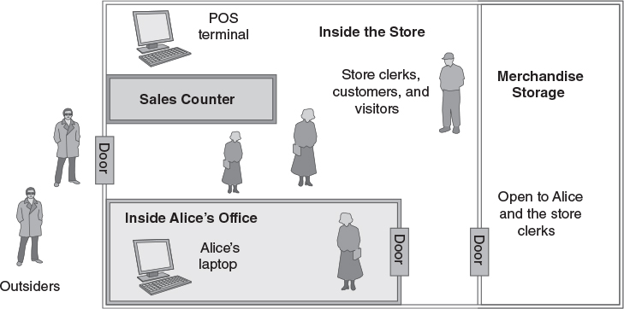
Least Privilege: A Basic Principle
Restrict what people may do to an asset
Provide the minimum privileges required
Example: key opens my store but not yours

Slide 24
Defense in Depth: Another Principle
We improve security by providing layers of defense
Attackers must breach a series of defenses to reach our most valuable assets
Example: stealing Alice’s laptop off-hours
Layer 1: Thief must first enter the outer door
The door is locked when store is closed
Layer 2: Thief must enter the office area
Only Alice can unlock the office
Notes:
Defense in depth provides layers of separate defenses to protect important assets.
Alice often leaves her laptop in her office, and keeps the office locked.
When the store is closed, a thief must break through two door locks to get to her laptop.
There are many examples of layered defenses in commercial spaces and in academic institutions.

Slide 25
Threat Agents
Think about the people who actually perform attacks
We can use published information to produce written profiles of specific groups that represent threat agents

Slide 26
Examples of Specific Threat Agents
Cyber-criminals: Kevin Mitnick, Jerry Schneider
Criminal organizations
Forums used in cyber crime activities
Groups operating identified botnets
Vendors of software used in cyber crime
Independent pressure groups
Anonymous, Lulzsec
National actors

Slide 27
National Actors
Government intelligence agencies
NSA
GCHQ
Other politically active countries
Military cyber operations groups
Quasi-governmental: Syrian Electronic Army

Slide 28
Profiling a Threat Agent
Goals
Typical mode of operation (MO)
Level of motivation
Capabilities and logistical constraints
References – reputable sources for the information

Slide 29
Threat Agents – Typical Goals
News coverage
Financial gain
Ideological victory
Regime change?

Slide 30
Typical Mode of Operation (MO)
How targets are selected
How operations are organized
Preference for broadly targeted attacks or specific targets
Individual versus multiple coordinated attacks
Remote attacks, on-site attacks, insider attacks, social engineering

Slide 31
Level of Motivation
Unmotivated
Scant – will exploit minor vulnerabilities
Stealth – applies effort, but avoids social stigma
Low – causes harm and limited damage to assets
Moderate – cause significant damage to assets or some injury to persons, but not critical injury
High – will cause significant disruptions and/or critical injuries to people to achieve objectives

Slide 32
Capabilities and Logistical Constraints
Size of team, financial resources, geographical limitations
Does their training or skills affect their target choices?
Are their activities simple in structure or complicated?

Slide 33
Attacks and Risks
A vulnerability makes an attack possible
A threat agent implements an attack
In an attack, the threat agent takes actions that could damage one of your assets
Exploiting a vulnerability
A risk is an attack that is likely to happen, and thus is worth protecting against

Slide 34
Types of Attacks
All attacks fall into these categories
Physical theft – an availability attack
Denial of service – availability again
Subversion – modify a system to work for the threat agent
Masquerade – system works on behalf of the wrong user
Disclosure – an attack on confidentiality
Forgery – bogus messages given to computers

Slide 35
Terminology: “CIA” Properties
Confidentiality
Keeping information secret
Avoiding disclosure vulnerabilities
Integrity
Protecting information from improper changes
Avoiding forgery, subversion, and masquerade attacks
Availability
Keeping systems available and in operation
Avoiding Denial of Service (DOS) attacks

Slide 36
Identifying and Prioritizing Risks
Identifying risks
Step 1: Identify assets
Step 2: Identify threat agents and attacks
Prioritizing risks
Step 3: Estimate the likelihood of attacks
Step 4: Estimate the impact of attacks
Step 5: Calculate their relative significance

Slide 37
Alice’s Arts: Step 1
Alice’s goals: stay in business and offer appealing merchandise to customers
Alice’s assets:
Computer hardware and software
Software recovery disks
Computer customization
Spreadsheets
Online business and credentials
Social media and credentials

Slide 38
Step 2: Identify Threats and Attacks
Identify threat agents
Use assets and known attacks to guide you
Create an attack matrix (optional)
Uses generic attack types to help identify more specific attacks the agents might perform
Create a risk matrix
Lists likely attacks against specific assets

Slide 39
Threat Agents
Shoplifters
Malicious employees
Thieves
Could steal computer assets or storage
Identity thieves
Could steal or disrupt online accounts
Botnet operators

Slide 40
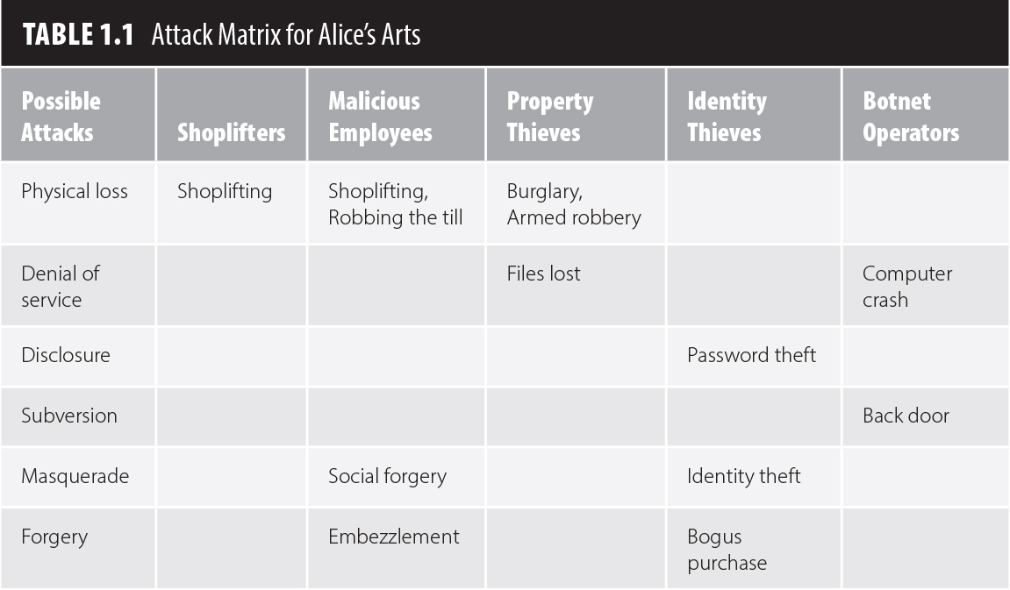
Attack Matrix

Slide 41
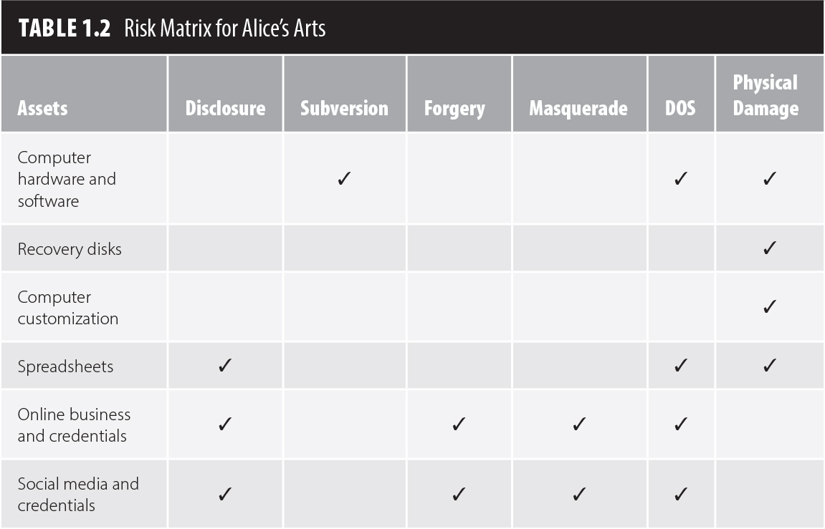
Risk Matrix

Slide 42
Identified Risks
1. Physical damage to computer hardware and software
2. Physical damage to recovery disks
3. Physical damage to computer customization
4. Physical damage to spreadsheets
5. Denial of service for online business and credentials
6. Denial of service for social media and credentials
7. Subversion of computer hardware and software
8. Denial of service by computer hardware and software
9. Disclosure of spreadsheets
10. Identity theft of online business and credentials
11. Identity theft of social media and credentials

Slide 43
Step 3: Estimate Attack Likelihoods
List threat agents and attacks in a spreadsheet
Select a time period – days, months, or years
Estimate how often each attacker is likely to perform each attack
Do practical jokes always and only happen on April Fools Day?
How long can an unprotected laptop sit in an empty classroom until an identified threat steals it?
Will a particular threat steal, or damage, or…?

Slide 44
Step 4: Estimate Impact of An Attack
One attack takes place – how much does it cost Alice to recover from it?
Replacement costs, labor costs
Time or money spent on alternatives
Cost of lost opportunities
Whatever other “costs” arise
Make a numerical estimate
Use consistent estimates
Either “how much money”
Or “how much time”

Slide 45
Time and Money Estimates
Time estimates
Time required to redo lost work, repeat a class
Money estimates
Money required to buy replacements
Make all estimates either in time or money
Converting time to money
Calculate lost income
Convert money to time
Calculate time required to save the money

Slide 46
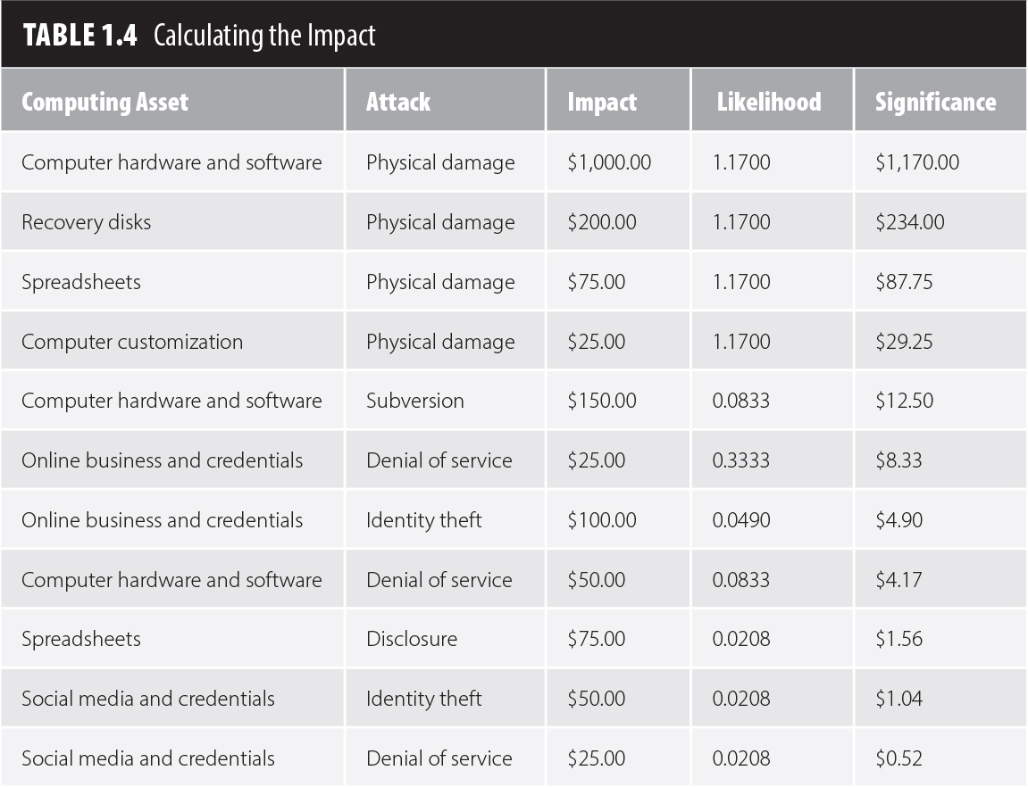
Step 5: Calculate Impacts over Time

Slide 47
Calculating the Impacts
Each row lists a threat agent and attack
For each, we estimated how often it occurred
For each, we estimated the impact of a single attack
Now, we compute the overall impact of each attack – we multiply it by its likelihood
Once we calculate all impacts, we sort the list by impact, with highest impact first
Our principal risks have the highest impacts

Slide 48
Alice’s Final List of Risks
Physical damage of computer hardware or software
Denial of service by hardware or software
Identity theft of online business credentials
Identity theft of social media credentials
Denial of service by social media

Slide 49
Drafting Security Requirements
The last part of PRMF Step A
Requirements say what we want for protection
Writing requirements
Take the prioritized list of risks
For each risk, identify defenses against it
Write a requirement for each defense
Each requirement defends against one or more risks

Slide 50
Writing a Requirement
Number each requirement
Use the word shall
Each requirement should be testable
Each statement identifies the risks it addresses
Phrase the requirement in a positive and specific form

Slide 51
Constructing the List
We derive the policy from the risks
Identify how each risk might occur
Choose a general strategy to protect against it
Focus on risks to Alice’s information, not to Alice
Example: Look at Alice’s top risk:
Physical damage of computer hardware or software

Slide 52
Analyzing Damage Risks (1 of 2)
Equipment resides in the store
Start with physical security
Requirement 1: The store shall be locked up when no store employees are present
Requirement 2: There shall be insurance to cover risks of theft, fire, and natural disasters
POS terminal: prevent its theft
Requirement 3: POS shall be physically secured to the sales counter

Slide 53
Analyzing Damage Risks (2 of 2)
POS terminal configuration must be safe
Requirement 4: Only Alice or a trusted sales clerk is allowed to change the POS configuration
This includes manager overrides for special transactions or error recovery
Alice’s laptop, like all laptops, is a special target
Requirement 5: Alice’s laptop shall be locked in her office when she is not in the store

Slide 54
Ethical Issues in Security Analysis
In security analysis, we seek vulnerabilities
This poses two problems
Is the search potentially damaging or illegal?
If a vulnerability is found, how do we handle the information?
Possible cases of finding vulnerabilities
A search authorized by the system’s owner
An unauthorized search
An unplanned – and unexpected – discovery

Slide 55
An Authorized Analysis
Analyst has written authorization from the authority responsible for the system
Analyst uses appropriate tools
The analyst knows how to use the tools
Tools should provide the most information while posing the lowest risk of interfering with or damaging the system
Analyst protects the results
Keeps the data confidential
Issues report only to the appropriate authority

Slide 56
Issues for Other Analyses
Examples of “freelance” security testing
Academic research of a well-known system
Classroom exercises
Accidental observations or discoveries
Analyst has no prior relationship or agreements with the system’s owner
What laws, regulations, or codes of conduct specify or restrict such analysis?
Can we publish any or all results?

Slide 57
Laws, Regulations, Codes of Conduct
Legal restrictions
US DMCA – restricts “circumvention” of copy protection on copyrighted media
“Anti-hacking” laws in some jurisdictions
“Classified” national security information: Spying
Nondisclosure agreements – may implicitly or explicitly cover such information
Codes of conduct – require compliance with community standards of behavior
Acceptable use policy – restrict network use

Slide 58
Sharing or Publishing Vulnerabilities
A peculiar balance
Publishing may make the system a target
If not published, the flaw might not be fixed
An example publishing practice
Finder reports all vulnerabilities to system owners or vendors
Vendor and finder decide how and when to publish the information
If they can’t agree, finder may publish after 30 or 45 days, depending on situation

