Slide 1


HALL SEAT Management
System
Submitted As,
SRS Document Presentation
Midterm 1
Course: SE 503
Supervised By,
Sumon Ahmed
Associate Professor
Institute of Information Technology, University of Dhaka
Rejaul Karim 1324
Eftiare Ahmed Rimon BSSE 1355

Slide 2
Table of Contents
1
5
2
6
3
7
Overview
Class Based Modeling
Quality Function Development
Behavioral Modeling
Scenario Based Modeling
Flow Oriented Modeling

Slide 3


#1 Overview of Our Project
StakeHolders
The Hall Seat Allotment System is a web-based application designed to streamline the process of allocating seats in university halls of residence. It aims to automate and simplify the process of assigning rooms to students based on their preferences and availability of accommodation.
To automate the process of seat allocation in university halls of residence.
To provide a user-friendly interface for students to submit their accommodation preferences.
To optimize room allocation based on various factors such as student preferences, room availability, and administrative constraints.
Students of University Of Dhaka
01

Slide 4
#2 Quality Function Development
StakeHolders
Normal Requirement
Normal Requirements are generally the objectives and goals that are stated for a product or system during meetings with the customer. The presence of these requirements fulfills customers’ satisfaction. The normal requirements are given below:
Students must register with the system using their registration number, department name, email, and session.
A predefined account will be given to the Super admin.
Super Admin can create multiple accounts for Admins.
Students can apply by filling out an application form.
Admins can manage rooms and seats by adding or removing them from the system.
Admins can prioritize applied students based on established criteria.
The super admin approves or disapproves the students and allocates rooms and seats.
Selected students receive automatic confirmation emails upon seat allocation, providing assurance of their allotted accommodation.
02

Slide 5
#2 Quality Function Development (cont.)
StakeHolders
Expected Requirement
The system provides a user-friendly interface for both students and administrators.
The system efficiently manages student information, room allocation, and seat updates.
Application processing and status updates are handled promptly and accurately.
Users can recover their password if forgotten.
03

Slide 6
Exciting features
The system allows students to customize their profiles and preferences for a personalized experience.
Innovative features, such as virtual room tours or 360-degree seat views, enhance user engagement and satisfaction.
The system automatically updates application statuses and sends notifications accordingly
The system facilitates communication between students, admins, and super admins through integrated messaging features.
Students can provide feedback on their hall accommodation experience, contributing to continuous improvement efforts.

Slide 7
#3 Scenario-Based Modeling
>> Use Case <<

Slide 8
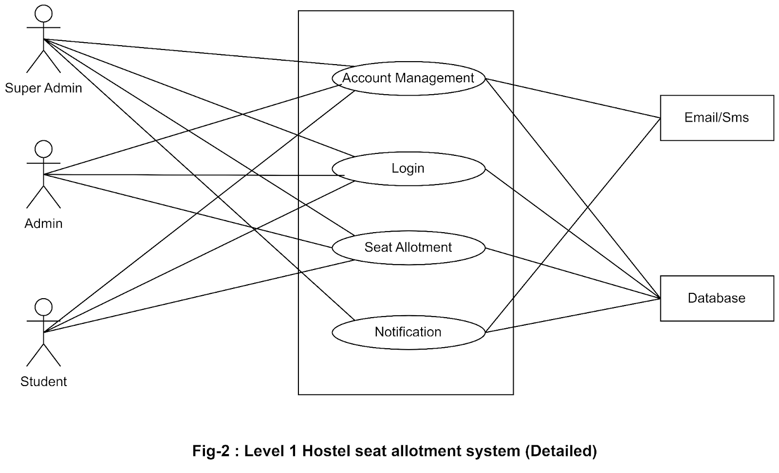
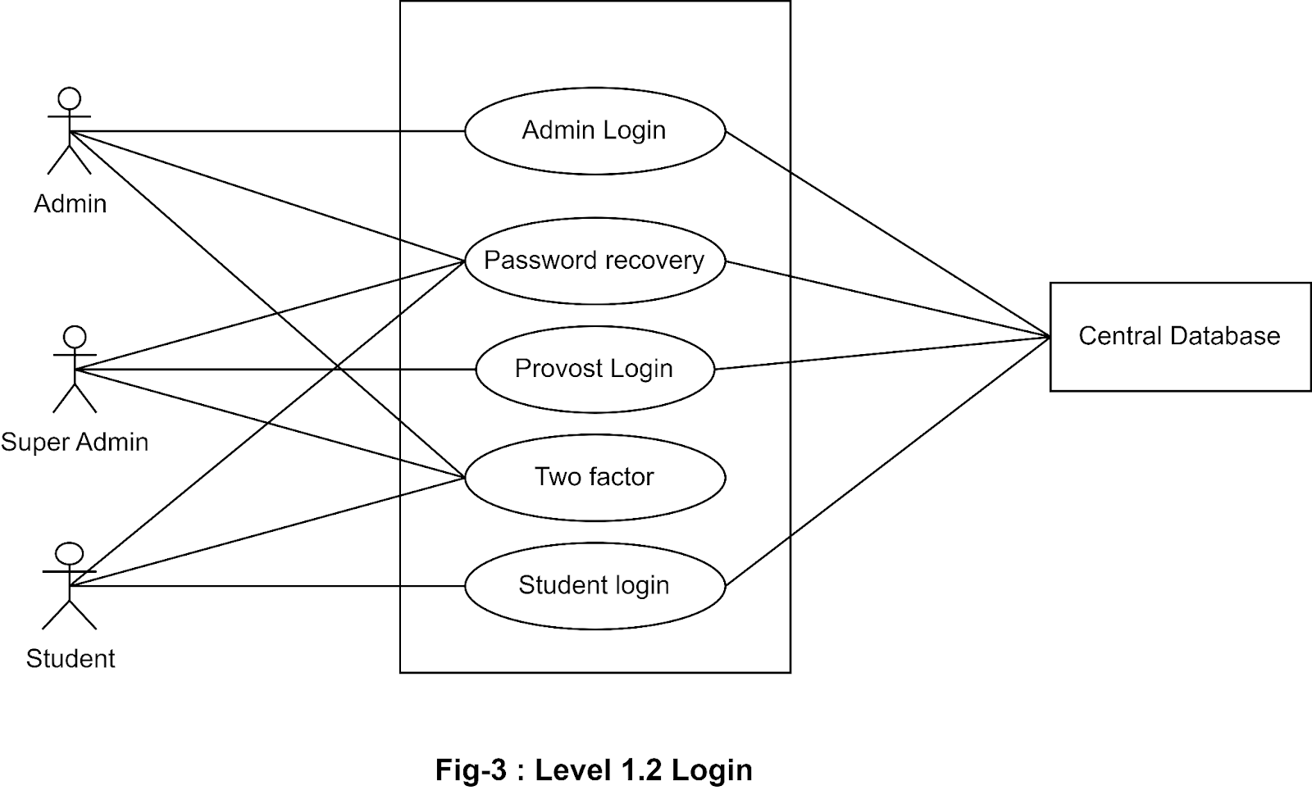
# Use Case Level 1
# Use Case Level 1.2
Hostel Seat Allotment System (HSAS) (Detailed)
Name: Login
04

Slide 9
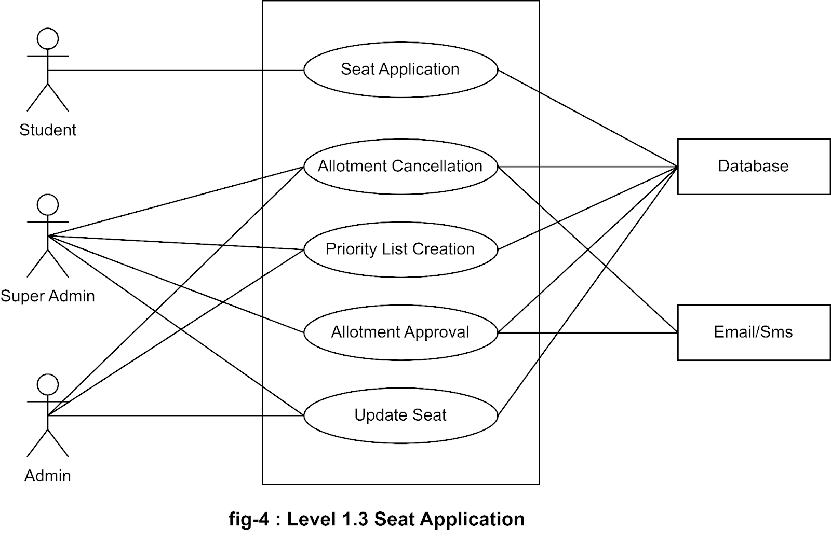
# Use Case Level 1.3.
Name: Seat Application
05

Slide 10
#3 Scenario-Based Modeling
>> Activity Diagram <<

Slide 11
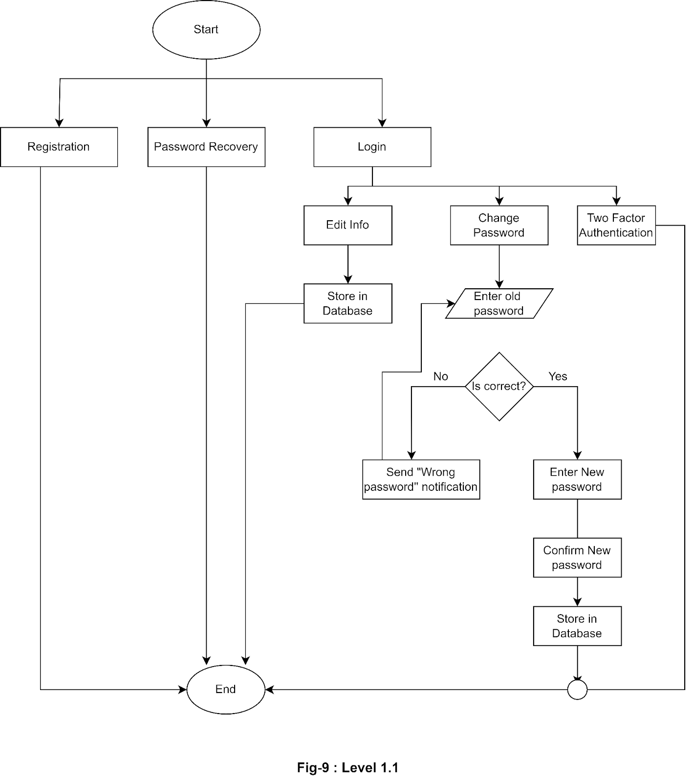
Level:1.1
Account Management

Slide 12
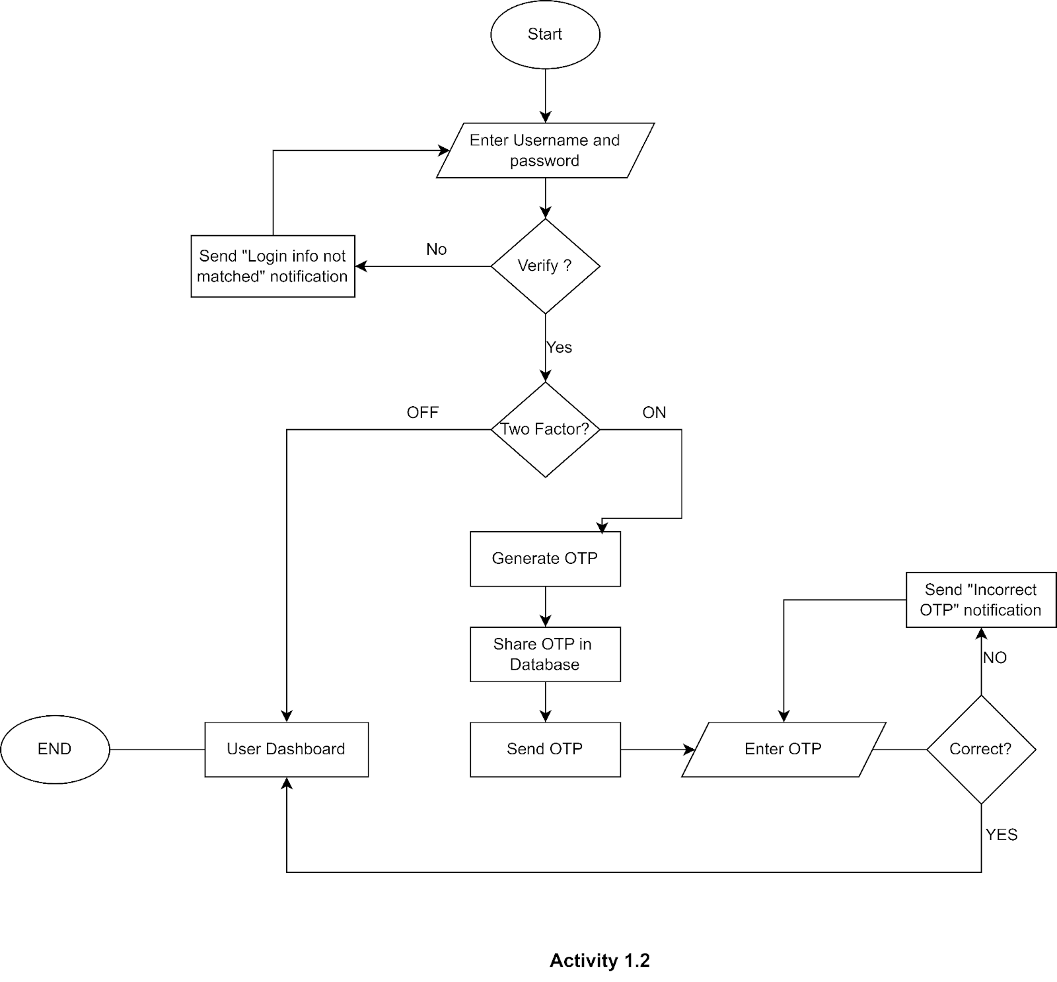
Level:1.2
Login

Slide 13
#3 Scenario-Based Modeling
>> Swimlane Diagram <<

Slide 14
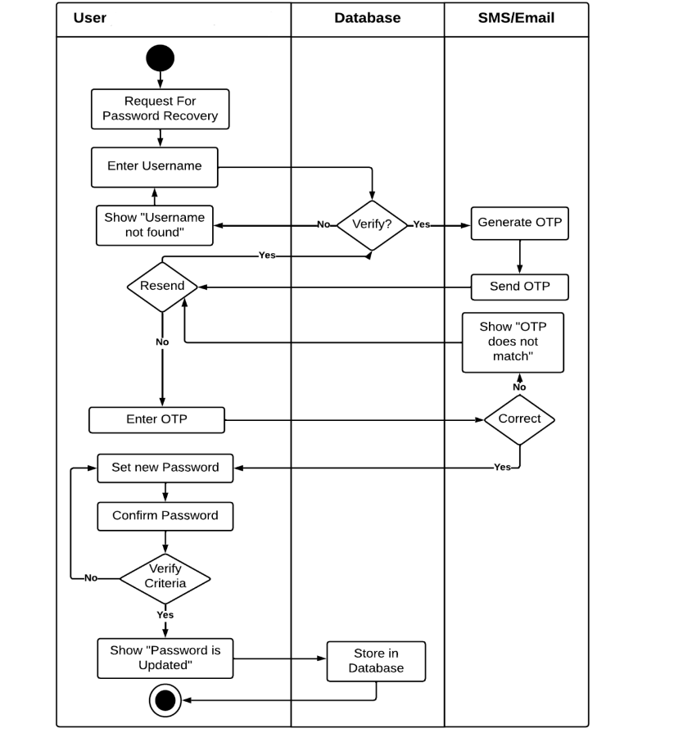
Swimlane id: Level 1.1
Account management
07

Slide 15
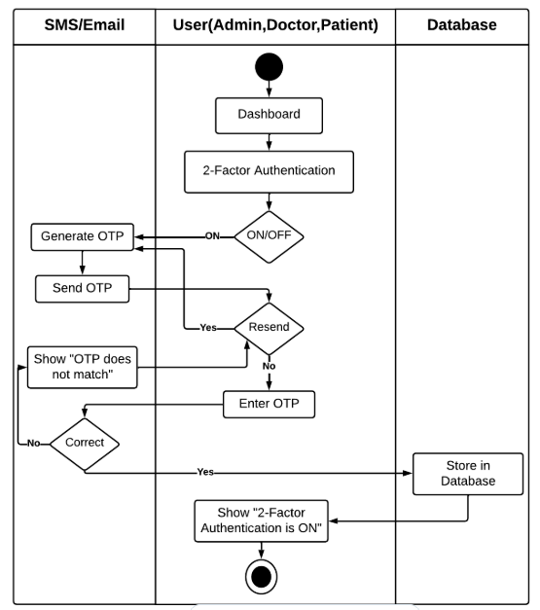
>> Swimlane Diagram <<
Level : 1.1.4
Name : 2 Factor Authentication

Slide 16
#5 Class-Based Modeling

Slide 17
# Steps of Class Based Modeling
12

Slide 18
# Class-Based Modeling (Cont.)
General Classification
Selection Criteria
13

Slide 19
# Class Cards
# Class-Based Modeling (Cont.)
Final Classes After Analysis
Final Classes
15

Slide 20
# CRC Diagram
# Class-Based Modeling (Cont.)
16

Slide 21
#7 Flow Oriented Modeling

Slide 22
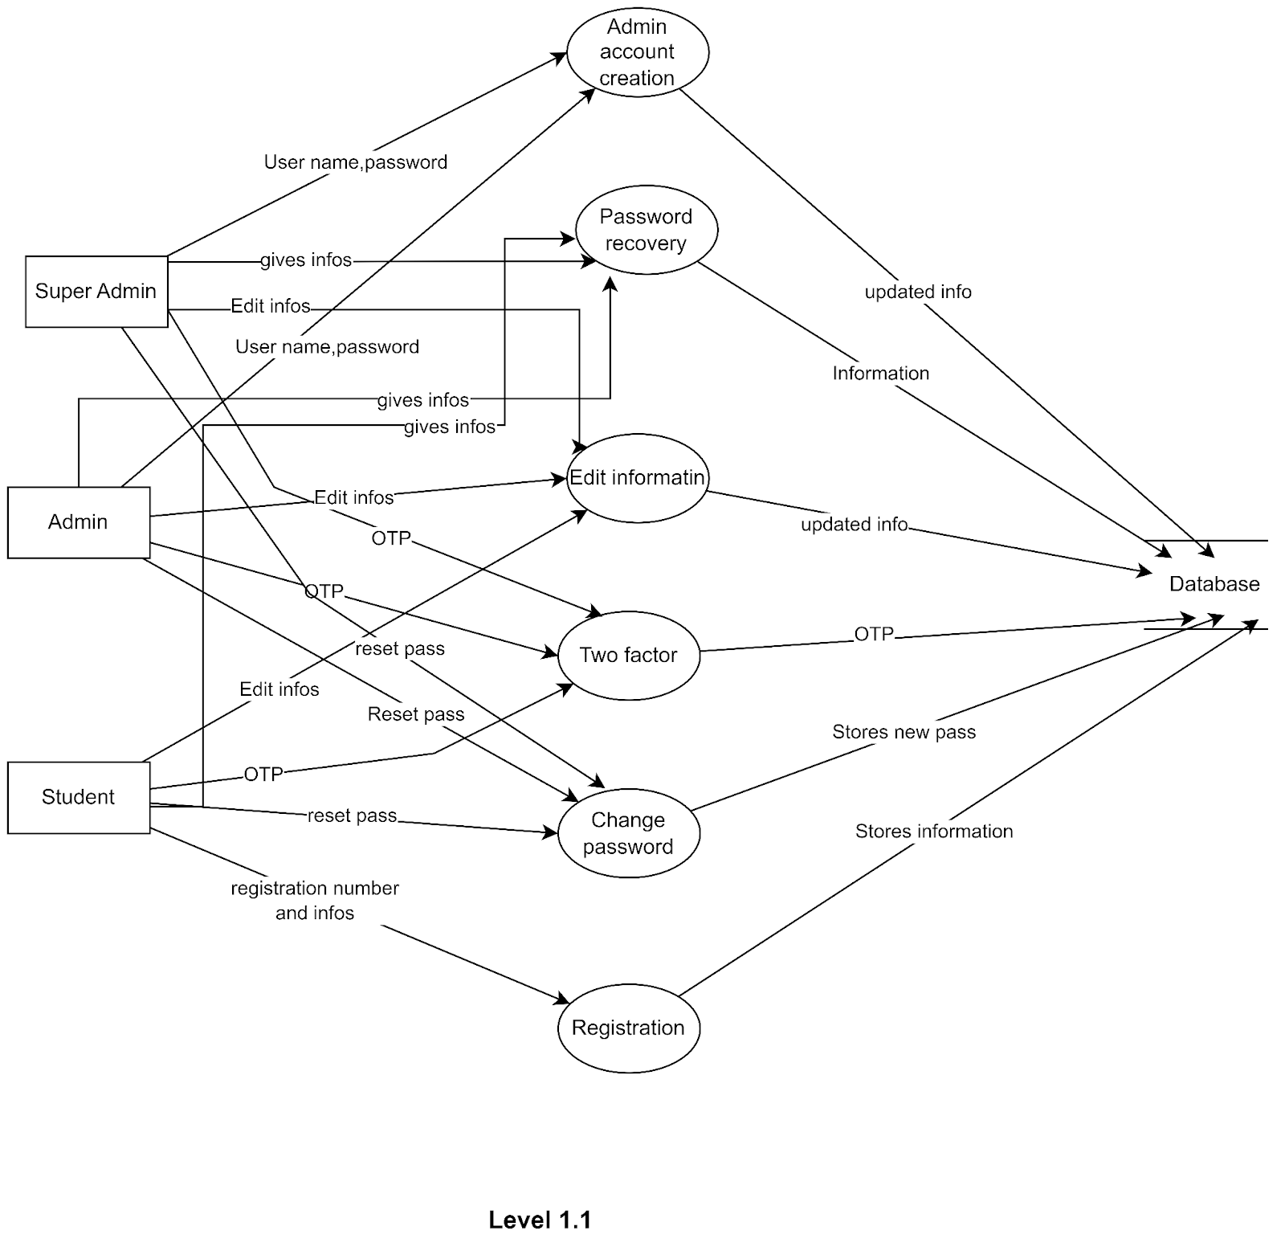
#Data Flow Diagram (DFD
Level 1.1 :
Account Management
20

Slide 23
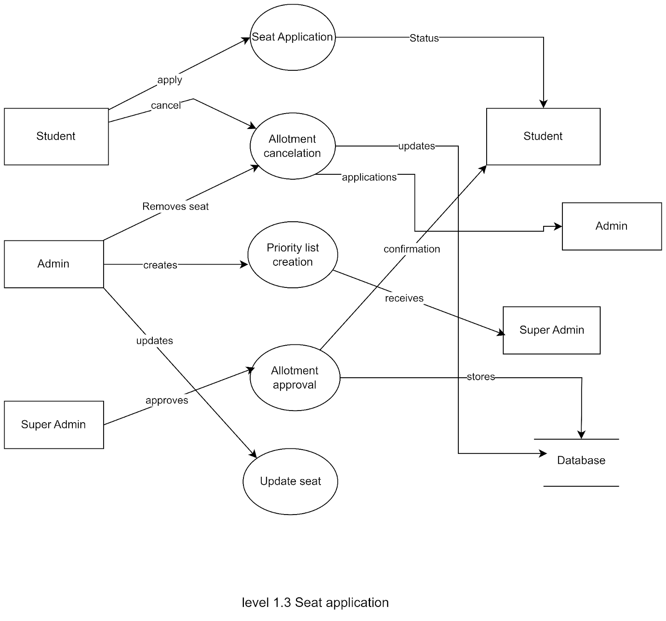
Data Flow Diagram (cont.)
Seat application
22

Slide 24
Thank
You
SRS Ducumentation:

