Slide 1
HEART DISEASE PREDICTION
Submitted By,
Rejitha Ramesh
S4MCA
No: 17

Slide 2
HEART DISEASE
The heart is one of the main parts of the human body after the brain.
Heart Disease is even highlighted as a silent killer which leads to the death of the person without obvious symptoms.
The early diagnosis of heart disease plays a vital role in making decisions on lifestyle changes in high-risk patients and in turn reduces the complications.
This project aims to predict future Heart Disease by analyzing data of patients which classifies whether they have heart disease or not using machine-learning algorithm.

Slide 3
PROBLEM DEFINITION
The major challenge in heart disease is its detection.
There are instruments available which can predict heart disease but either it are expensive or are not efficient to calculate chance of heart disease in human.
Early detection of cardiac diseases can decrease the mortality rate and overall complications.

Slide 4
SUPPORTING LITERATURE
Sl No. | Title | Journal Name/Publisher | Year | Summary
1 | Predicting Heart Disease at Early Stages using Machine Learning: A Survey. | International Conference on Advanced Computing and Communication System (ICACCS). | 2020 | SVM algorithm is used. SVM predicted the disease with 92.22% accuracy.
2 | A Survey on Predicting Heart Disease using Data Mining Techniques. | IEEE Conference on Emerging Devices and Smart Systems (ICEDSS). | 2018 | SVM algorithm is used. SVM predicted the disease with 99.3% accuracy.
3 | Heart Disease Prediction Using Machine using Machine Learning Algorithm. | International Conference on Electrical and Electronics Engineering (ICE3-2020). | 2020 | SVM algorithm is used. SVM predicted the disease with 83% accuracy.

Slide 5
DATASET
1. Source of Dataset
The dataset is “framingham.csv”. The dataset is downloaded from reliable source kaggle.com. It contains sufficient parameters to predict the model.
https://www.kaggle.com/datasets/captainozlem/framingham-chd-preprocessed-data

Slide 6
2. Basic Description About The Dataset
The dataset used for Heart disease prediction.
The dataset is “framingham.csv”. This dataset consists of various attributes like gender, age, current smoker, BP meds, heart rate…etc.
The dataset provides the patients information.
It includes over 4,000 records and 15 attributes. Variables each attribute is a potential risk factor.
The classification goal is to predict whether the patient has 10-year risk of future coronary heart disease (CHD).

Slide 7
3. Feature List & Class of The Dataset
Attribute | Type | Description
Gender | Numerical | Gender of the patient.
Age | Numerical | Age of the patient.
Education | Numerical | No further information provided.
Current Smoker | Numerical | Whether or not the patient is a current smoker.
Cigs Per Day | Numerical | The number of cigarettes that the person smoked on average in one day.
BP Meds | Numerical | Whether or not the patient was on blood pressure medication.
Prevalent Stroke | Numerical | Whether or not the patient had previously had a stroke.
Prevalent Hyp | Numerical | Whether or not the patient was hypertensive.
Diabetes | Numerical | Whether or not the patient had diabetes.
Tot Chol | Numerical | Total cholesterol level of patient.
Sys BP | Numerical | Systolic blood pressure of patient.
Dia BP | Numerical | Diastolic blood pressure of patient.
BMI | Numerical | Body Mass Index of patient.
Heart Rate | Numerical | Heart rate of patient.
Glucose | Numerical | Glucose level of patient.
10 year risk of coronary heart disease (CHD) | Numerical | Binary: “1”, means “Yes”, “0” means “No”

Slide 8
IDENTIFYING AND ANALYSIS OF ALGORITH
Various standard machine learning algorithms are used to predict Heart.
Among the selected algorithms, the Support Vector Machine provided the best accuracy.
Support Vector Machine or SVM is one of the most popular Supervised Learning algorithms, which is used for Classification as well as Regression problems.

Slide 9
SUPPORT VECTOR MACHINE
SVM is directed study model that classifies by separating the objects using a hyperplane.
It can be used for both classification and regression.
The hyperplanes are drawn with the help of the margins.
The main goal is to maximize the distance between the hyperplane and the margin.
The main advantage of SVM is that it can distinguish linear and non linear objects.

Slide 10


Slide 11
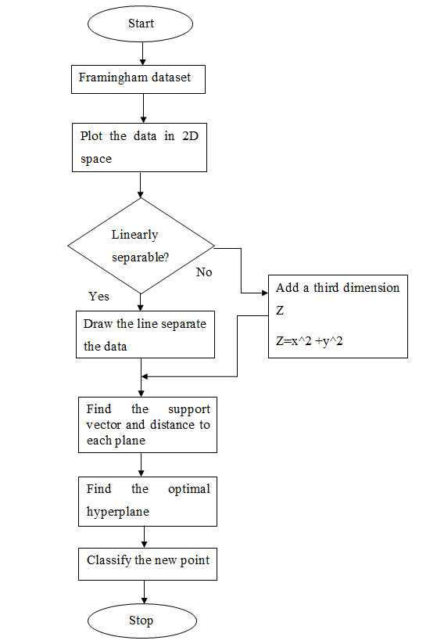
FLOWCHART OF SVM

Slide 12
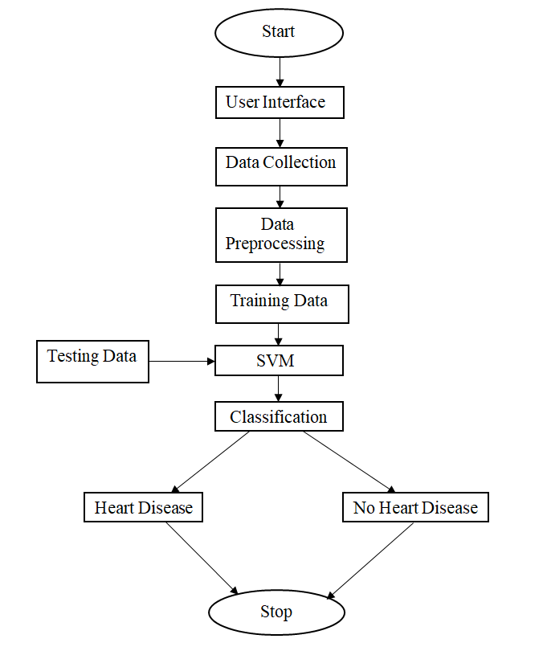
PROPOSED PROJECT PIPELINE

Slide 13
PREPROCESSING OF DATA
The dataset contains missing values in 4 attributes BPMeds, glucose, totChol and CigsPerDay.
Handle the missing data in BPMeds, glucose, totChol and CigsPerDay with mean value.
import numpy as np
df['BPMeds']=df['BPMeds'].replace(np.NaN,df['BPMeds'].mean())
df[24:34]

Slide 14
DATA VISUALIZATION

Slide 15
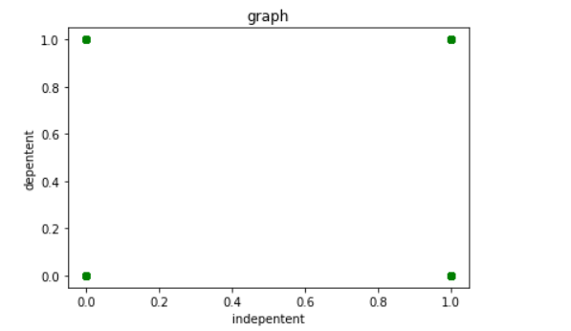
GENDER V/S TENYEARCHD

Slide 16
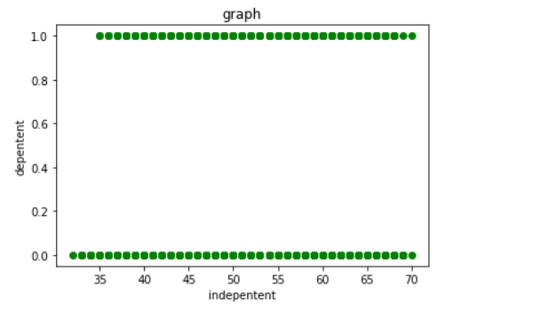
AGE V/S TENYEARCHD

Slide 17
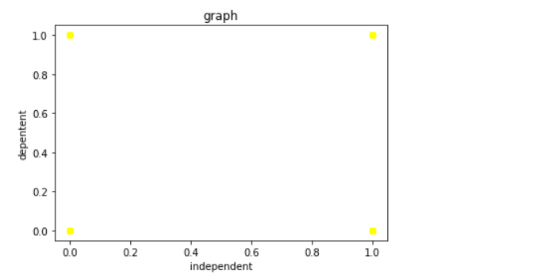
CURRENTSMOKER V/S TENYEARCHD

Slide 18
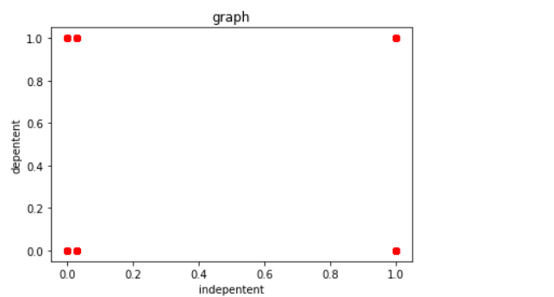
BPMEDS V/S TENYEARCHD

Slide 19
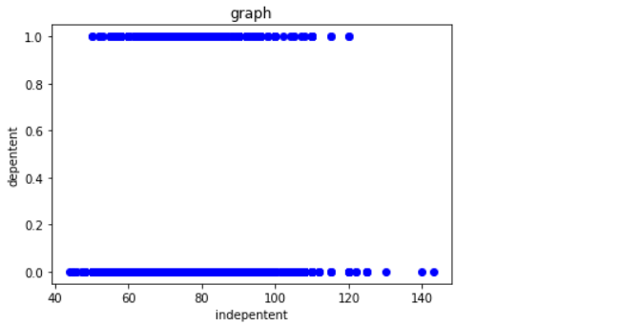
HEARTRATE V/S TENYEARCHD

Slide 20
FEATURES
Demographic:
Gender: male or female
Age: Age of the patient
Behavioral:
Current Smoker: whether or not the patient is a current smoker
Cigs Per Day: the number of cigarettes that the person smoked on average in one day

Slide 21
Information on medical history:
BP Meds: whether or not the patient was on blood pressure medication
Prevalent Stroke: whether or not the patient had previously had a stroke
Prevalent Hyp: whether or not the patient was hypertensive
Diabetes: whether or not the patient had diabetes
Information on current medical condition:
Tot Chol: total cholesterol level
Sys BP: systolic blood pressure
Dia BP: diastolic blood pressure
BMI: Body Mass Index
Heart Rate: heart rate
Glucose: glucose level

Slide 22
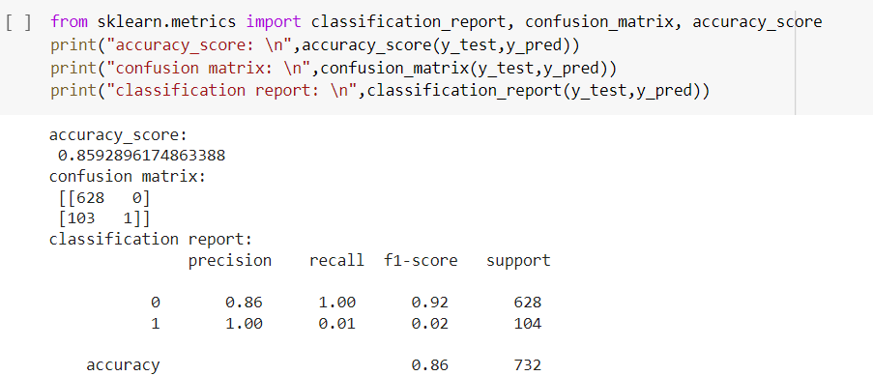
RESULT
The model has an accuracy of 85.92% using the parameters. The accuracy, confusion matrix and classification report are:

Slide 23
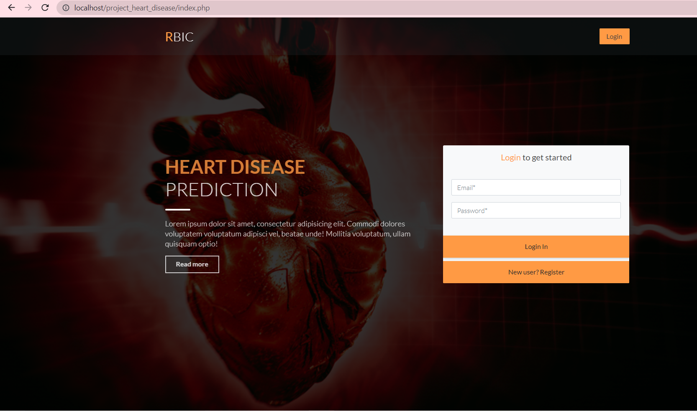
UI DESIGN
Home Page

Slide 24
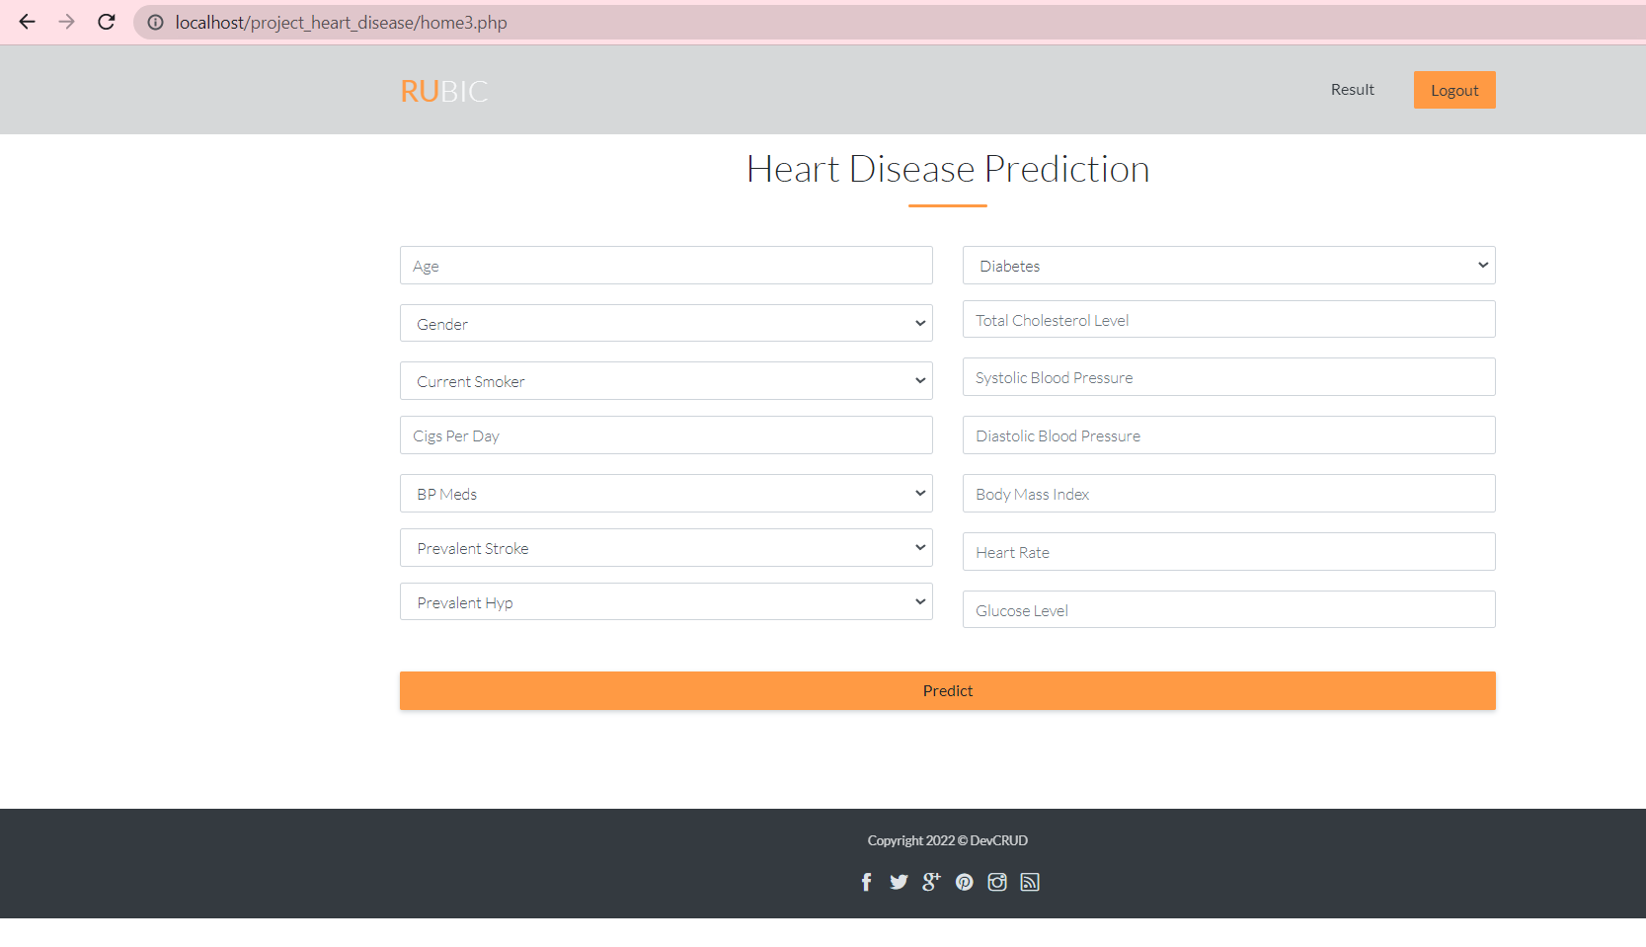
UI Design

Slide 25
CONCLUSION
SVM is used for heart disease prediction.
Various features were trained using the algorithm .
Predictions were made based on the inputs given.
The model gives 85.92% accuracy and predict the result.

Slide 26
Future work
Predict the Actual disease.
Can be incorporated with another diseases like lung disease.
Can be developed as a mobile application.

Slide 27
references
Rahul Katarya, Polipireddy Srinivas (2020), IEEE, Predicting Heart Disease at Early Stages using Machine Learning: A Survey.
Cincy Raju, Philipsy E, Siji Chacko, L Padma Suresh, Deepa Rajan S (2018), IEEE, A Survey on Predicting Heart Disease using Data Mining Techniques.
Archana Singh, Rakesh Kumar (2020), IEEE, Heart Disease Prediction Using Machine Learning Algorithms.
https://www.tutorialspoint.com/php/php_introduction.htm
https://www.w3schools.com/python/python_intro.asp

Slide 28
THANK YOU

