Slide 1
PRODUCT LAUNCH – PHASE 3
AUTO GENERATOR/EXTRACTOR
Enhancing the home of the learning minds
Date: ​14th May. 2026.
Presented by: ​Name
Participants: All disciplines.

Slide 2
AGENDA
Launch RADAI-enabled Auto Generator/Extractor.
Products.
Instrument Index
Valve MTO
Demonstrate Value addition to existing expertise
Productivity Impact and Time Saving
Q&A Session.

Slide 3
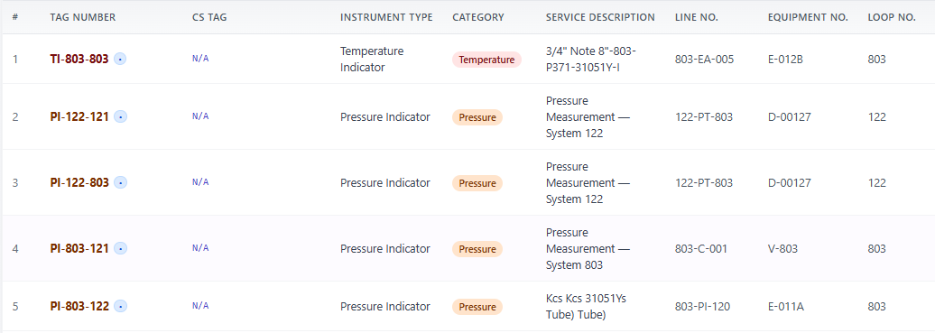
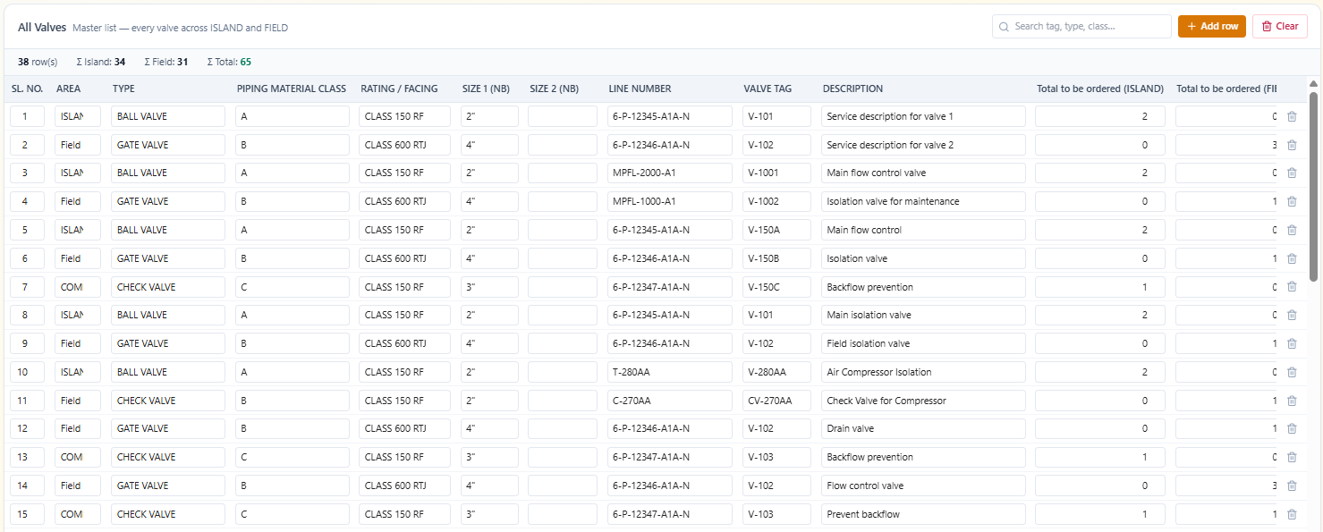
Launch RADAI-enabled AUTO EXTRACTOR

Slide 4
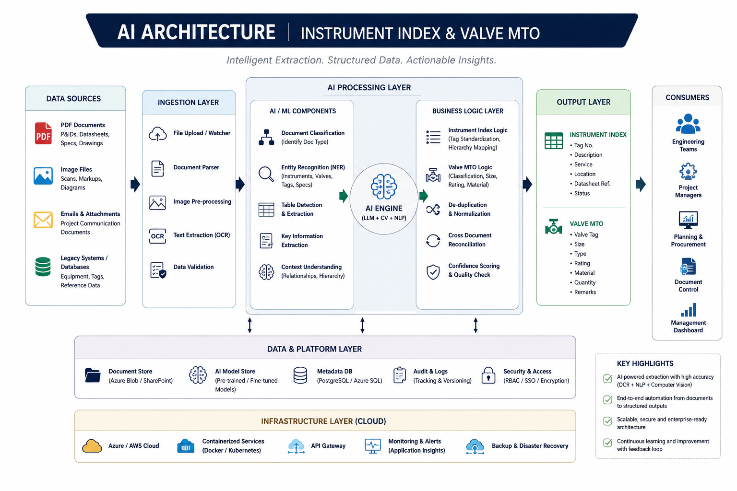

Slide 5
Demonstrate value addition to existing expertise
👉 “KPIs will be tracked through pilot projects and reviewed monthly for continuous improvement.”

Slide 6
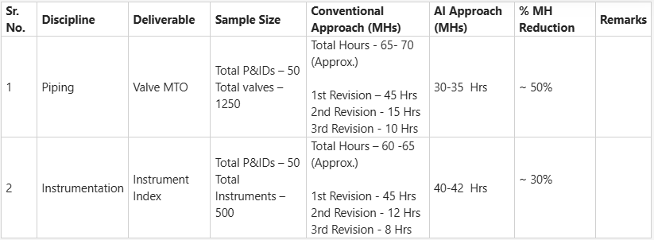
AI TOOL IMPACT
👉 Engineering without geographical limitation

Slide 7
CONCLUSION
Your experience remains the core strength
RADAI is an enabler for Our Efficiency and Competency
Success depends on:
Collaboration
Feedback
Continuous improvement
👉 Let’s build a smarter engineering workflow together

Slide 8
Q&A Session

