Slide 1
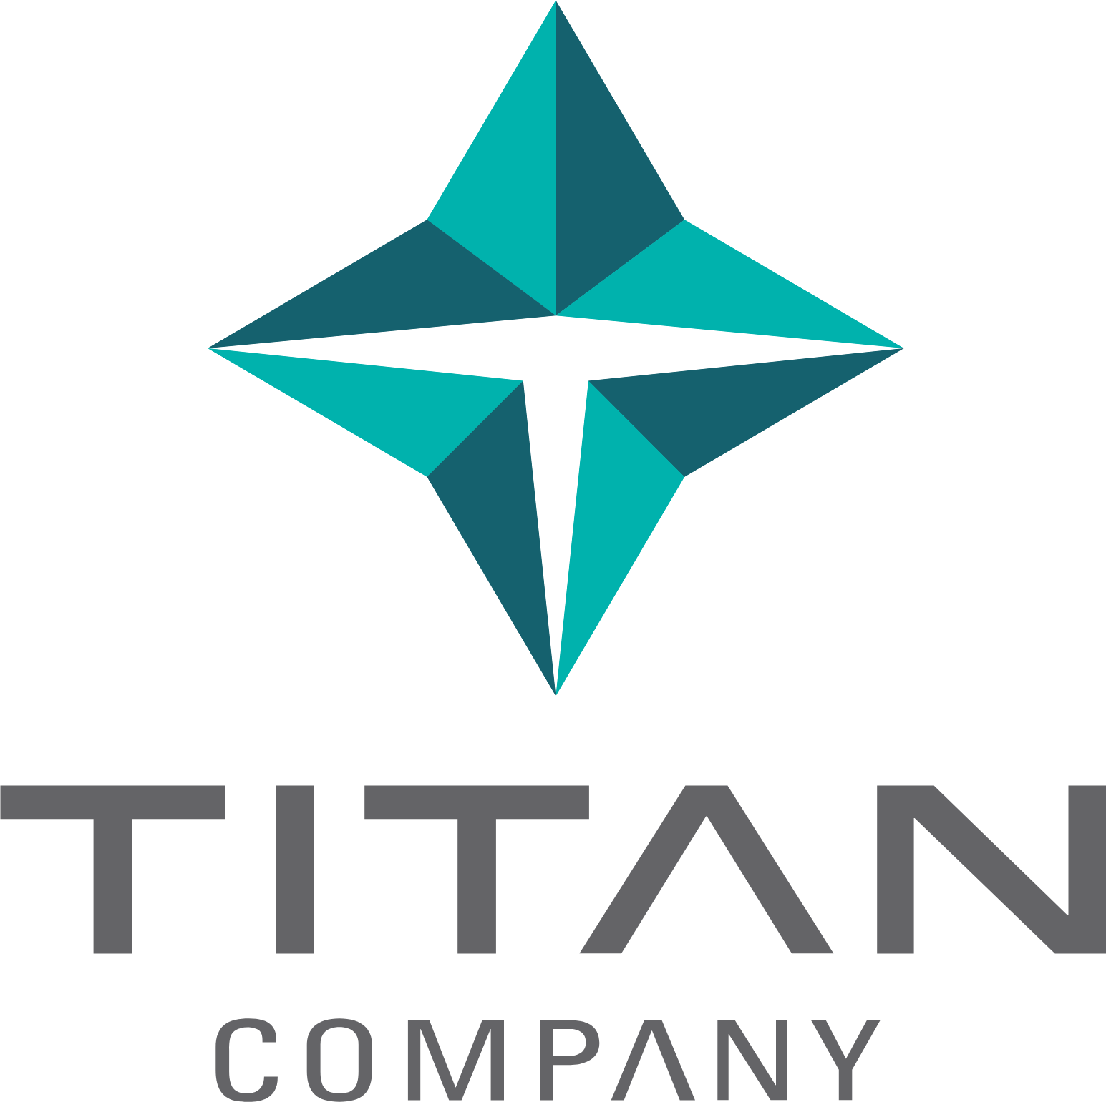
TITAN COMPANY LIMITED
TPRM AI
Assessment Platform
Smarter Third-Party Risk Management,
Powered by Artificial Intelligence
7-Step
Real-Time
Auto
AI Pipeline
Progress Tracking
Report Generation
01
CONFIDENTIAL | Titan Company Limited | 2025

Slide 2
CORE CAPABILITIES
AI-Powered Risk Intelligence Engine
End-to-end automation from vendor documents to actionable risk insights
1
📋 Vendor Assessment Engine
2
🔍 Document Intelligence
3
⚡ Gap Analysis (RAG + LLM)
▸ PBA scoring — 10-question sensitivity check
▸ Processes PDFs, DOCX, XLSX, PPTX, images
▸ Retrieves top-5 evidence chunks per question
▸ SIG Lite: 21 control sections parsed automatically
▸ OCR-powered text extraction from scanned files
▸ Identifies: missing controls, policy violations,
▸ Auto-extracts vendor responses & justifications
▸ 1536-dim embeddings via OpenAI (pgvector DB)
▸ evidence gaps, process gaps & future risks
4
🛠 Remediation Planning
5
📜 Contract Intelligence
6
✅ LLM Quality Judge
▸ AI-generated action plan per identified gap
▸ Maps gaps to existing contract clauses
▸ Multi-pass review — up to 3 auto-iterations
▸ Prioritised: Immediate / Short / Medium / Long
▸ Suggests new clauses: Must-have / Should-have
▸ Removes duplicates, vague wording, weak evidence
▸ Includes owner, timeline & acceptance criteria
▸ Covers AI governance, data sovereignty & more
▸ Validates severity alignment & summary accuracy
02
CONFIDENTIAL | Titan Company Limited | 2025

Slide 3
PLATFORM & GOVERNANCE
Enterprise-Grade Security, Analytics & Control
Built for Titan's compliance standards — secure, auditable and scalable
📊 Dashboard & Analytics
7-STEP AUTOMATED PIPELINE
Real-time home dashboard with gap charts, monthly assessment trends, vendor comparisons and division filters.
01
Parse SIG Lite & PBA Scoring
02
Embed Policies & Contract Clauses
📧 Vendor Email Notifications
One-click gap notification emails sent directly to the vendor SPOC via Microsoft Graph API — fully formatted HTML reports.
03
Analyse Questionnaire Responses
04
Chunk & Embed Vendor Artifacts
🔐 Enterprise Security & SSO
05
AI Gap Analysis (RAG + GPT)
Azure AD SSO, bcrypt auth, RBAC (Analyst / Admin), CSRF protection, rate limiting, account lockout & full audit logs.
06
Generate Remedial Plan & Contract Recs
🏗 Admin & Pipeline Control
07
LLM Judge Quality Review & Finalise
Toggle LLM Judge, manage default policy/contract documents, control caching, view platform info & manage users.
📄 PDF Report Export
📝 Word / DOCX Export
03
CONFIDENTIAL | Titan Company Limited | 2025

