Slide 1
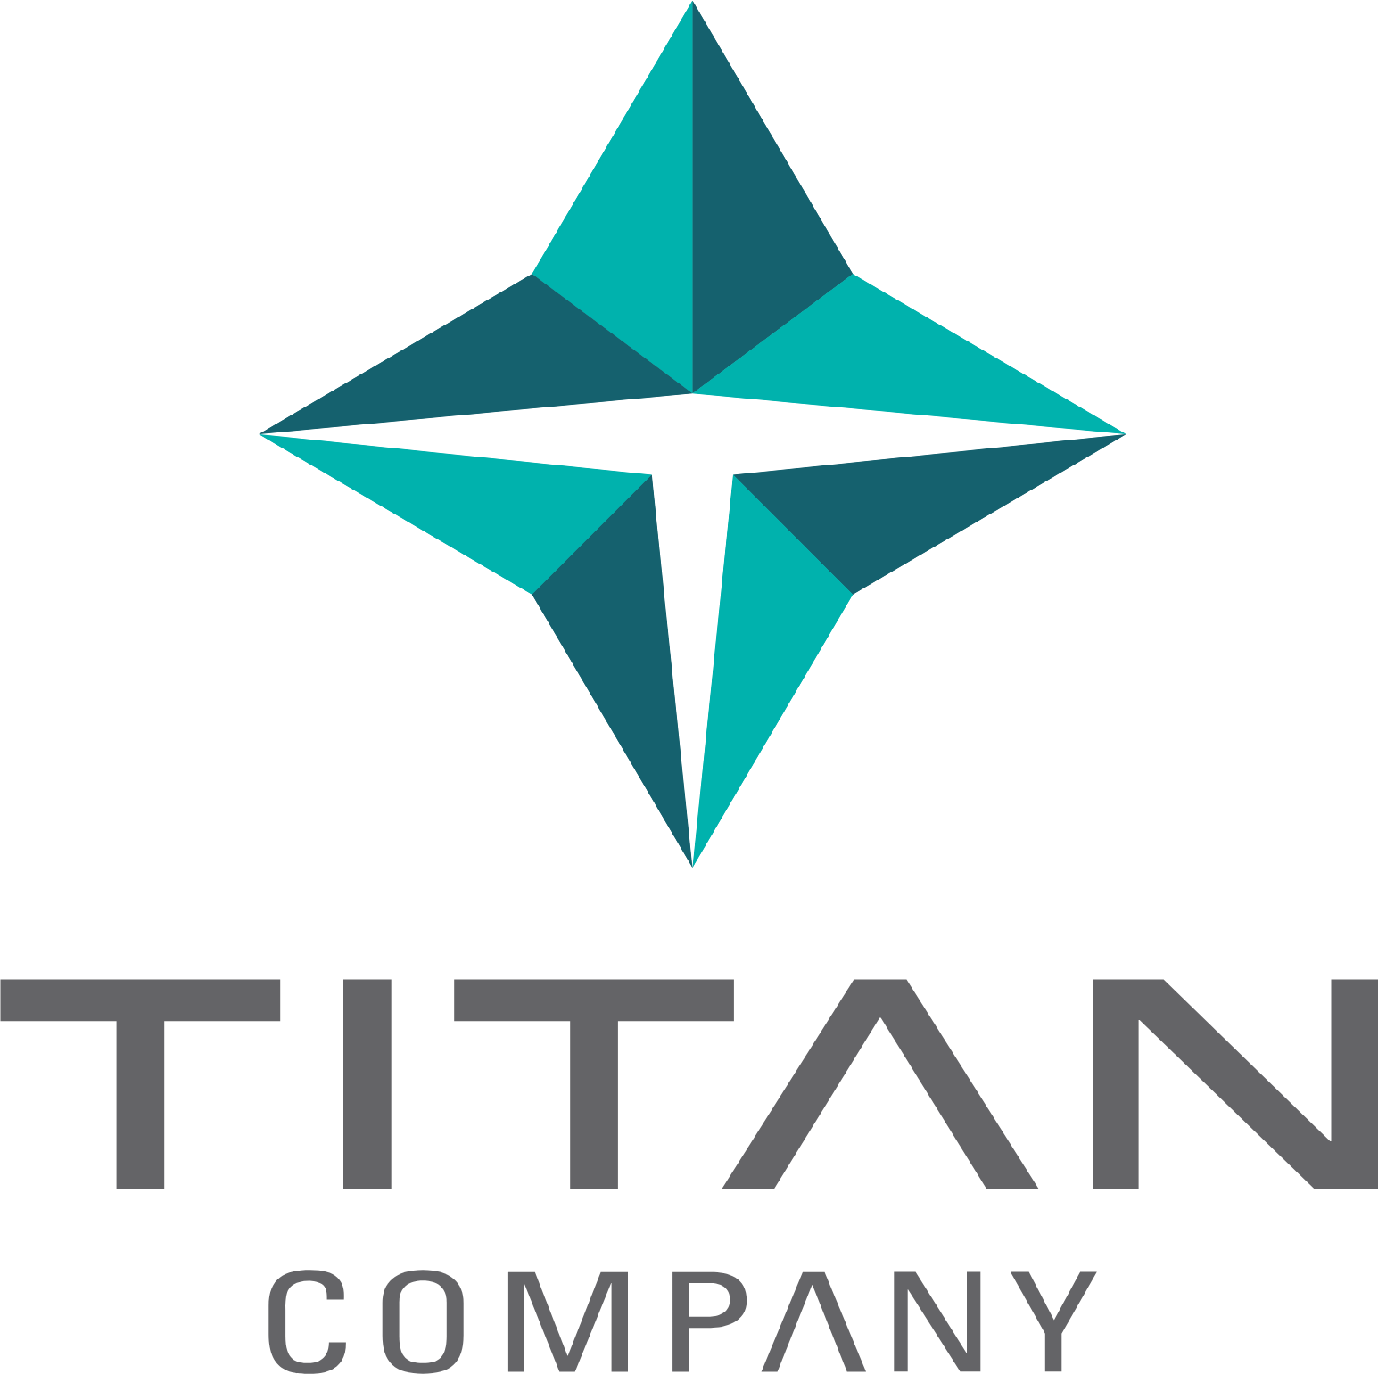
TITAN COMPANY LIMITED
TPRM AI | Assessment Platform
A TITAN INITIATIVE
Smarter Vendor Risk.
Powered by AI.
TPRM AI automates every step of vendor risk assessment —
from document review to gap detection to audit-ready reports.
What once took weeks now takes minutes.
80%
Minutes
Auto
Less Manual Effort
Not Weeks
Reports & Plans
A TITAN COMPANY INITIATIVE
TPRM AI Platform — Live Dashboard View
01
CONFIDENTIAL | Titan Company Limited | 2025

Slide 2
HOW IT HELPS
From Weeks of Manual Work to Minutes of Smart Automation
TPRM AI removes the bottlenecks of manual vendor assessments — giving your team more time to act, not analyse.
📋
Smart Vendor Screening
🔍
Automatic Document Review
Instant risk scoring before onboarding
AI reads vendor documents so your team doesn't have to
Automatically evaluates each vendor's sensitivity — data access, cloud usage, financial exposure — before any engagement begins.
Upload vendor questionnaires and evidence files. The platform reads, analyses and scores them instantly — no manual page-by-page review.
⚡
Compliance Gap Detection
🛠
Actionable Remediation Plans
Pinpoints exactly where risks and gaps exist
Clear steps to fix every risk found
Compares vendor claims against Titan's policies and contracts. Flags missing controls, policy conflicts and unsupported claims automatically.
For every gap identified, a prioritised action plan is generated — with owners, deadlines and success criteria ready to share with vendors.
📜
Contract Protection
📊
Reports & Live Dashboard
Safeguard Titan with the right contract clauses
Audit-ready reports generated in one click
Recommends contract clauses tailored to the gaps found — covering data protection, incident response and compliance obligations.
Executive summaries, gap tables and action plans exported as PDF or Word. Live dashboard tracks all vendors and open risks at a glance.
02
CONFIDENTIAL | Titan Company Limited | 2025

Slide 3
IMPACT & PLATFORM
Built for Enterprise — Secure, Scalable & Easy to Use
Designed to fit seamlessly within Titan's existing processes and compliance standards.
BUSINESS IMPACT AT A GLANCE
Secure Access & Single Sign-On
🔐
Integrates with Titan's Azure AD. Role-based access ensures the right people see the right data — with complete audit trails.
80%
Reduction in manual assessment effort
~10×
📧
Instant Vendor Alerts
Faster vendor assessment turnaround
Send risk findings directly to vendor contacts in one click. Fully formatted notifications — no manual emails required.
100%
Consistent, unbiased risk scoring every time
⚙️
Admin Controls
Zero
Manage users, upload Titan's internal policies as reference standards, and control all platform settings from one admin panel.
Missed gaps — AI reviews every document
1 Platform
For all vendor risk activities end-to-end
Live Risk Dashboard
📈
Track all active assessments, vendor risk trends and open gaps — giving leadership a clear, real-time picture of third-party exposure.
03
CONFIDENTIAL | Titan Company Limited | 2025

