Slide 1
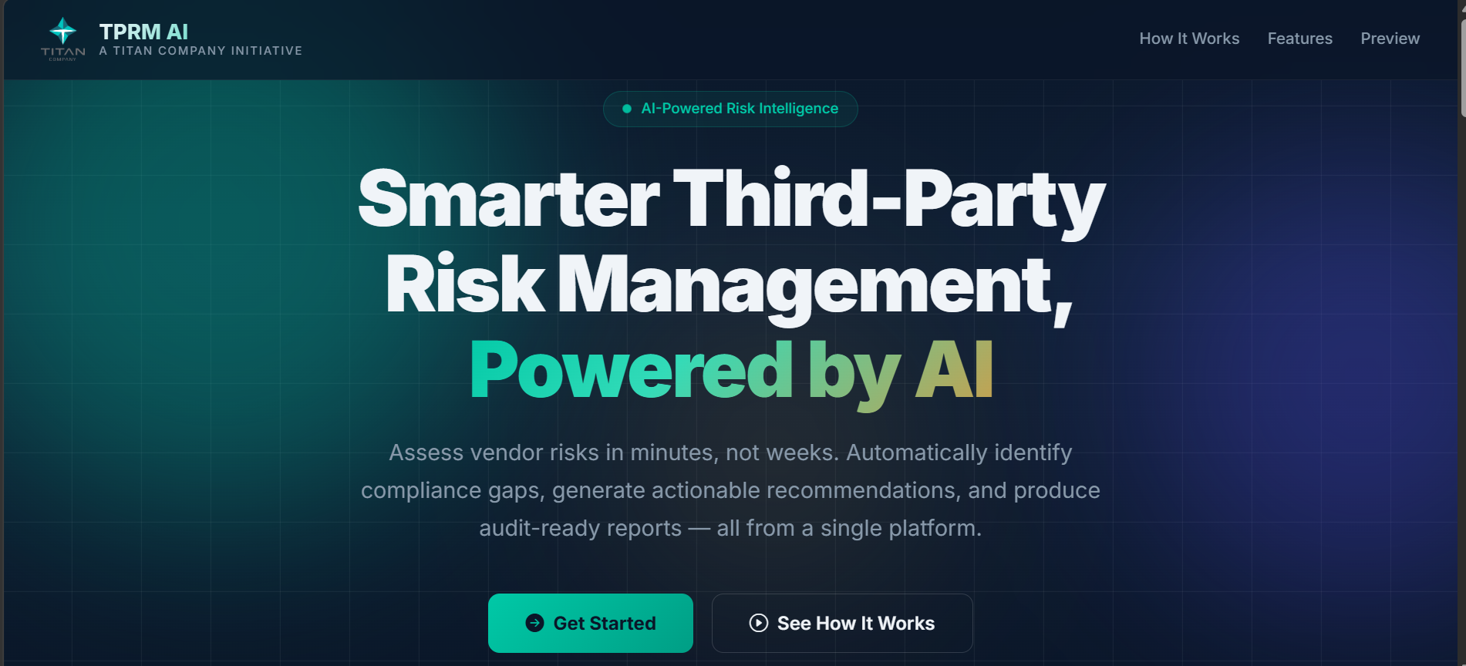
TITAN COMPANY LIMITED
TPRM AI
Assessment Platform
Assess vendor risks in minutes, not weeks.
Automatically identify gaps, generate action plans
and produce audit-ready reports — all in one place.
80%
Minutes
Auto
Less Manual
Effort
vs Weeks
To Assess
Reports &
Action Plans
A TITAN COMPANY INITIATIVE
TPRM AI Platform — Live Dashboard View
01
CONFIDENTIAL | Titan Company Limited | 2026

Slide 2
HOW IT HELPS
From Weeks of Manual Work to Minutes of Smart Automation
TPRM AI removes the bottlenecks of manual vendor assessments — giving your team more time to act, not analyse.
📋
Smart Vendor Screening
🔍
Automatic Document Review
Instant risk scoring before onboarding
AI reads vendor documents so your team doesn't have to
Automatically evaluates each vendor's sensitivity level — data access, cloud usage, financial exposure — before any engagement begins.
Uploads vendor questionnaires and evidence files. The platform reads, analyses and scores them instantly — no manual page-by-page review needed.
⚡
Compliance Gap Detection
🛠
Actionable Remediation Plans
Pinpoints exactly where risks and gaps exist
Clear steps to fix every risk found
Compares vendor claims against Titan's policies and contract standards. Flags missing controls, policy conflicts and unsupported claims automatically.
For every gap identified, the platform generates a prioritised action plan with owners, deadlines and success criteria — ready to share with vendors.
📜
Contract Protection Recommendations
📊
Reports & Live Dashboard
Safeguard Titan with the right contract clauses
Audit-ready reports generated in one click
Recommends contract clauses tailored to the gaps found — covering data protection, incident response and compliance obligations.
Executive summaries, gap tables and remediation plans exported as PDF or Word. Live dashboard tracks all vendors, trends and open risks at a glance.
02
CONFIDENTIAL | Titan Company Limited | 2026

Slide 3
IMPACT & PLATFORM
Built for Enterprise — Secure, Scalable & Easy to Use
Designed to fit seamlessly within Titan's existing processes and compliance standards.
BUSINESS IMPACT AT A GLANCE
Secure Access & SSO
🔐
Single Sign-On with Titan's Azure AD. Role-based access ensures the right people see the right data — with full audit trails.
80%
Reduction in manual assessment effort
~10×
Faster vendor assessment turnaround
📧
Instant Vendor Alerts
Send risk findings directly to vendor contacts in one click. No manual emails — the platform handles formatted notifications automatically.
100%
Consistent, unbiased risk scoring every time
⚙️
Admin Controls
Zero
Missed gaps — AI reviews every document line
Manage users, upload Titan's internal policies and contracts as reference standards, and control platform settings — all from one admin panel.
One
Unified platform for all vendor risk activities
📈
Live Risk Dashboard
Track all active assessments, vendor risk trends, open gaps and monthly progress — giving leadership a clear, real-time picture of third-party risk.
03
CONFIDENTIAL | Titan Company Limited | 2026

