Slide 1
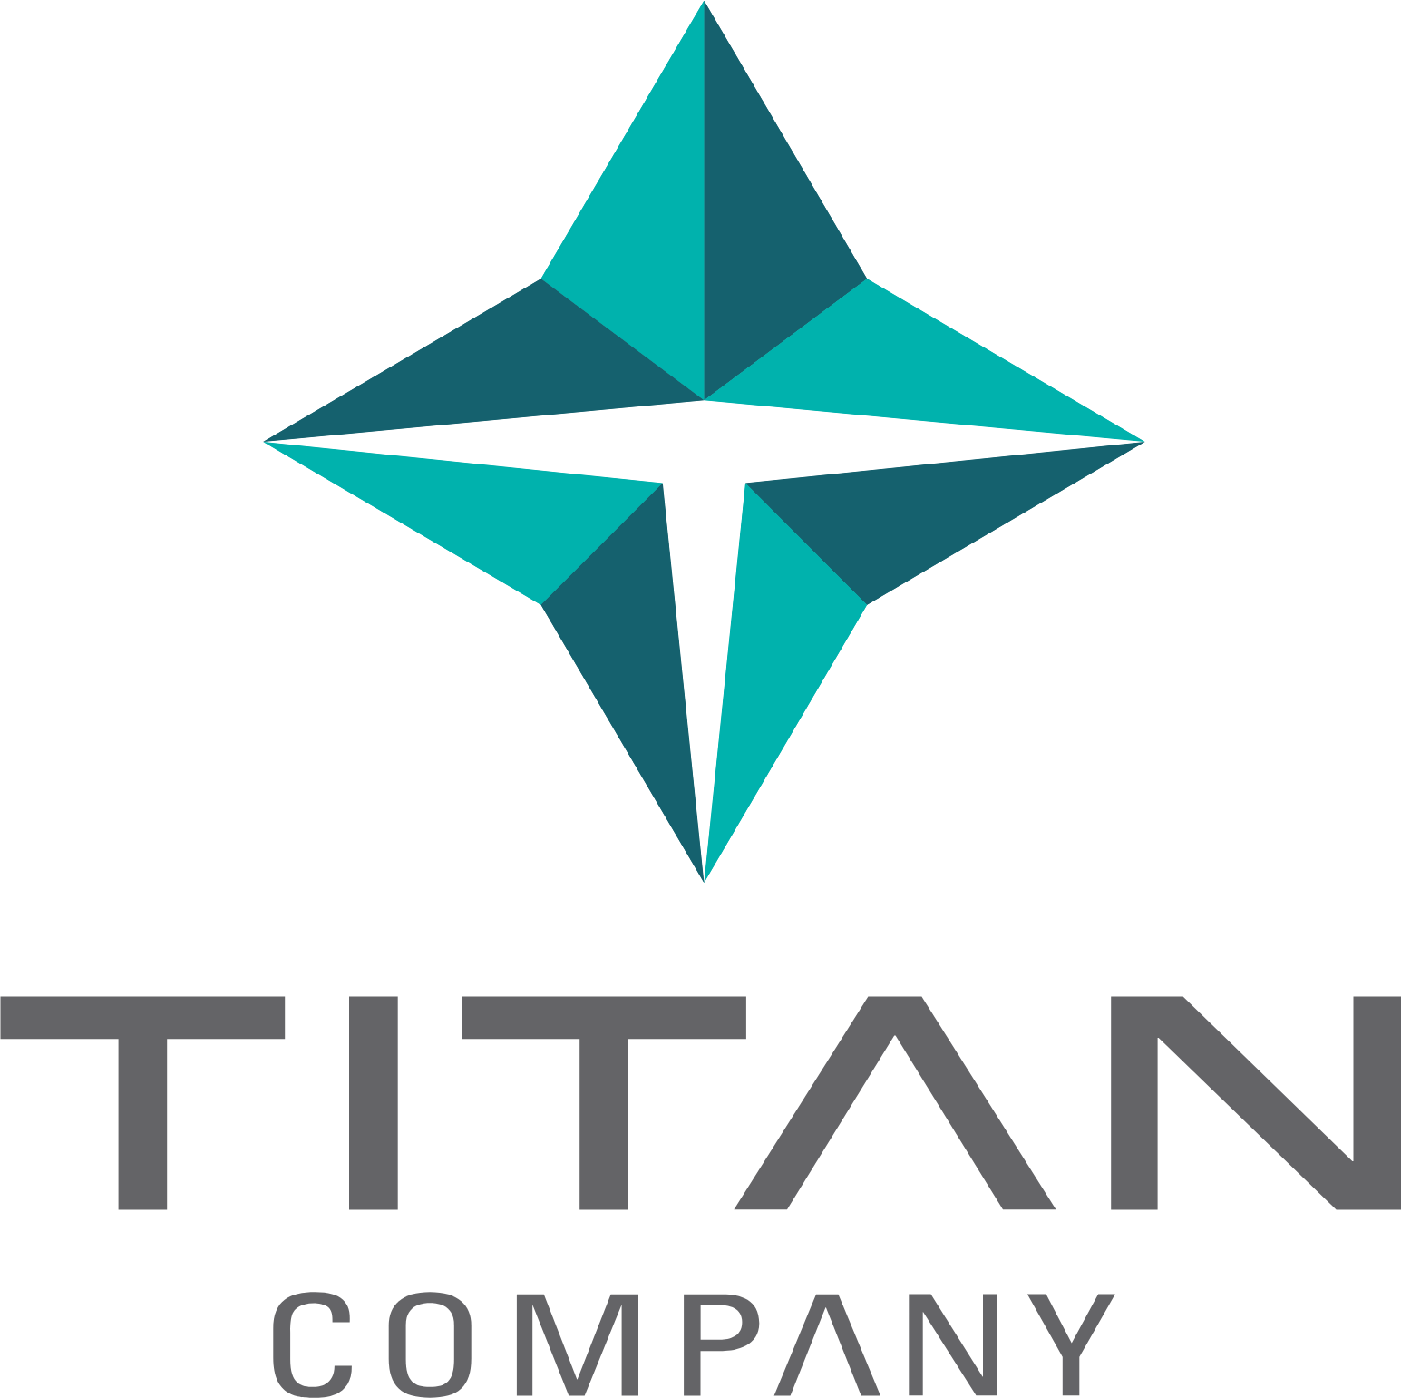
TITAN COMPANY LIMITED
A TITAN COMPANY INITIATIVE
TPRM AI
Assessment Platform
Assess vendor risks in minutes, not weeks.
Automatically identify gaps, generate action plans
and produce audit-ready reports — all in one place.
80%
Minutes
Auto
Less Manual
Effort
Not Weeks
Reports
& Action Plans
AI-POWERED RISK INTELLIGENCE
TPRM AI Platform — Live Dashboard View
01
CONFIDENTIAL | Titan Company Limited | 2025

Slide 2
HOW IT HELPS
From Weeks of Manual Work to Minutes of Smart Automation
TPRM AI removes bottlenecks of manual vendor assessments — giving your team more time to act, not analyse.
📋
Smart Vendor Screening
1
🔍
Automatic Document Review
2
Instant risk scoring before onboarding
AI reads vendor documents so your team doesn't have to
Automatically evaluates each vendor's sensitivity — data access, cloud usage, financial exposure — before any engagement begins.
Upload questionnaires and evidence files. The platform reads, analyses and scores them instantly — no manual review needed.
⚡
Compliance Gap Detection
3
🛠
Actionable Remediation Plans
4
Pinpoints exactly where risks and gaps exist
Clear steps to fix every risk found
Compares vendor claims against Titan's policies and contracts. Flags missing controls, policy conflicts and unsupported claims automatically.
For every gap identified, a prioritised action plan is generated — with owners, deadlines and success criteria ready to share.
📜
Contract Protection
5
📊
Reports & Live Dashboard
6
Safeguard Titan with the right contract clauses
Audit-ready reports generated in one click
Recommends contract clauses tailored to gaps found — covering data protection, incident response and compliance obligations.
Executive summaries and gap tables exported as PDF or Word. Live dashboard tracks all vendors and open risks at a glance.
02
CONFIDENTIAL | Titan Company Limited | 2025

Slide 3
IMPACT & PLATFORM
Built for Enterprise — Secure, Scalable & Always Ready
Designed to fit seamlessly within Titan's existing processes, governance and compliance standards.
BUSINESS IMPACT AT A GLANCE
Secure Access & Single Sign-On
1
🔐
80%
~10×
100%
Integrates with Titan's Azure AD. Role-based access ensures the right people see the right data — with complete audit trails.
Less Manual
Effort
Faster
Assessments
Consistent
Risk Scoring
📧
Instant Vendor Alerts
2
Zero
1 Hub
Send risk findings directly to vendor contacts in one click. Fully formatted notifications — no manual emails required.
Missed
Gaps
All Vendor Risk
Activities
⚙️
Admin & Pipeline Controls
3
Manage users, upload Titan's internal policies as reference standards, toggle AI features and control all platform settings.
📈
Live Risk Dashboard
4
Track all active assessments, vendor risk trends and open gaps — giving leadership a real-time picture of third-party exposure.
03
CONFIDENTIAL | Titan Company Limited | 2025

