Slide 1

Smart Traffic Signal Control System Using Machine Learning
Revolutionizing urban mobility with intelligent traffic management.
Leveraging ML for adaptive, real-time traffic optimization.
Improving efficiency, reducing congestion, and enhancing safety.

Slide 2
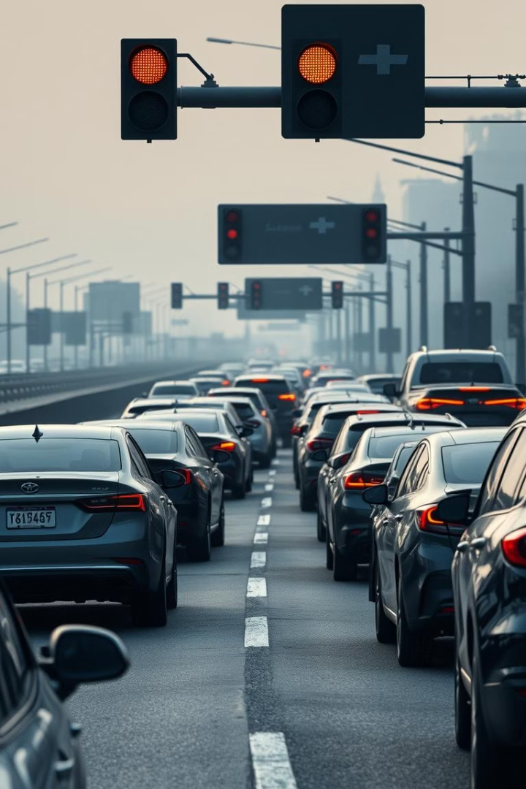





The Problem: Inefficient Traffic Management
Static Signals
Fixed timing plans don’t adapt to real traffic.
Urbanization Surge
Increasing vehicles cause severe congestion issues.
Environmental Cost
Idling vehicles raise emissions and pollution levels.
Economic Losses
Traffic jams cost the U.S. $190 billion annually.

Slide 3




Introducing Smart Traffic Signal Control
Real-time Data
Adaptive Timing
Machine Learning
Better Flow
Sensors, cameras, and connected cars feed live info.
Signals adjust dynamically based on traffic flow.
Predictive models optimize traffic continuously.
Traffic congestion and delays are dramatically cut.

Slide 4

System Architecture and Components
Sensor Network
Central Processing
ML Models
Collects data on traffic volume and speed.
Aggregates data and makes control decisions.
Predict traffic flow and optimize signal timing.
Signal Controllers
Communication
Execute optimized timing plans at intersections.
Ensures reliable data flow between all parts.

Slide 5


Machine Learning Algorithms
Reinforcement Learning
Deep Learning
Support Vector Machines
Continuous Learning
Predicts traffic patterns and flow accurately.
Optimizes signal timing adaptively in real time.
Detects and classifies traffic incidents efficiently.
System improves with ongoing data and feedback.
Example: RL reduced wait times by 25% in Pittsburgh trials.

Slide 6
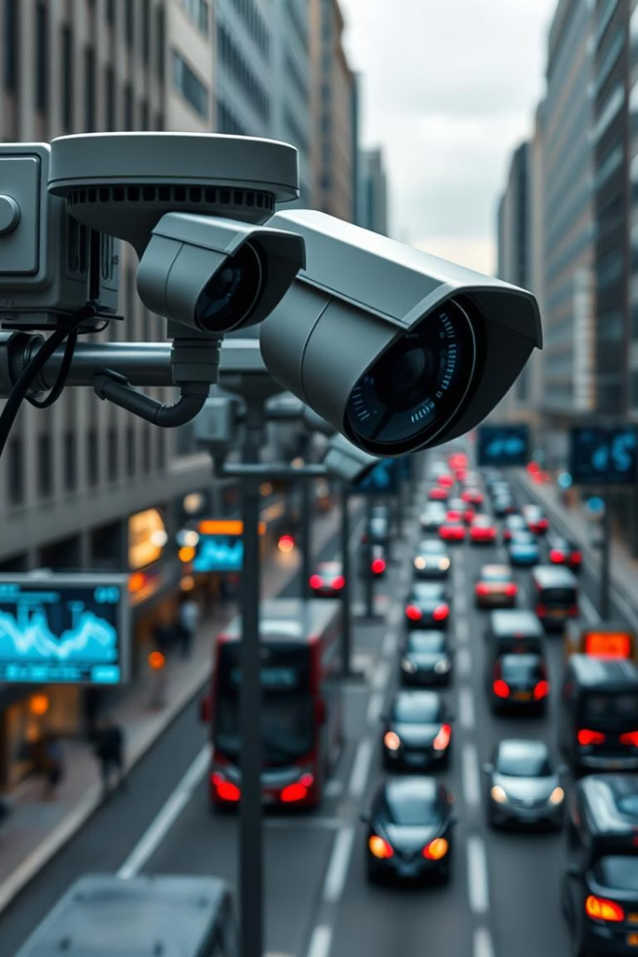
Data Acquisition and Preprocessing
Data Sources
Sensors, cameras, and GPS from connected vehicles.
Data Types
Includes traffic volume, speed, density, and weather.
Preprocessing
Cleaning, normalization, and feature extraction ensure quality.
Security
Data confidentiality and integrity are strictly maintained.

Slide 7




Implementation and Evaluation
Simulation
Field Deployment
Performance Metrics
Case Study
ML algorithms validated in controlled virtual settings.
Pilot installations test real-world performance.
Denver pilot cut delays by 40%, showing strong results.
Evaluated on congestion, travel time, and emissions.

Slide 8

Benefits and Impact
Reduced Congestion
Lower Travel Times
Fewer Emissions
Traffic moves efficiently with less idling.
Commuters and businesses save valuable time daily.
Environmental impact significantly reduced.
Improved Safety
Economic Gains
Incidents detected and managed proactively.
Productivity rises, fuel consumption drops.

Slide 9



Challenges and Future Directions
Data Privacy
Ensuring security and citizen trust remains critical.
Scalability
Adapting to different cities and varied traffic patterns.
Integration
Incorporating autonomous vehicles and smart city tech.
Public Adoption
Educating and gaining trust from communities.
AI-Powered Future
Towards fully automated, sustainable urban traffic control.

Slide 10

Conclusion
Transformative Solution
Smart control systems revolutionize urban mobility.
Machine Learning Power
Enables adaptive, intelligent traffic management.
Real-world Impact
Improves safety, efficiency, and sustainability.
Call to Action
Support smart transportation for future cities.

Slide 11

THANKYOU
TEAM MEMBERS:
2210040011- AASHRITHA 2210040022- SUMA HARSHITA 2210040139- PRANATHI 2210040148- AKSHITHA 2210040150- BHAGYA 2210040152- HARSHITHA

