Slide 1



Slide 2
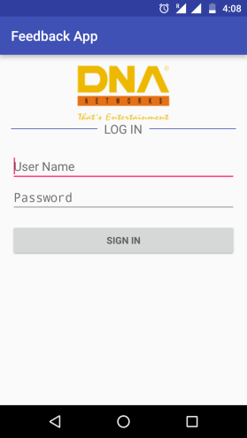
The login credentials are pre-defined for the following users:
keyur@dnanetworks.com. Password: Dna@123
ritesh@dnanetworks.com. Password: Dna@123
ranjit@dnanetworks.com. Password: Dna@123
rohit@dnanetworks.com. Password: Dna@123
Password for all above users is the same Dna@123(case sensitive).
If the user will give a wrong user name the app will ask to enter a valid user name, or if the password is incorrect ,the app will ask for a valid password
Login Screen

Slide 3
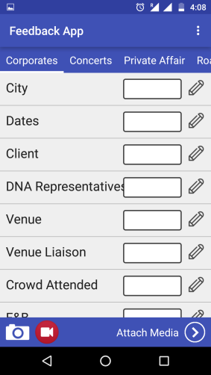
The feedback page for all category is same as, all category have same set of subjects.
The user can put any text data over the text boxes, on clicking the textbox or the edit button, there will be a popup to write the feedback as shown in the next slide.
There are 18 fields associated with each category, and at least one field should be filled to attach the media file with the feedback.
Feedback Page

Slide 4
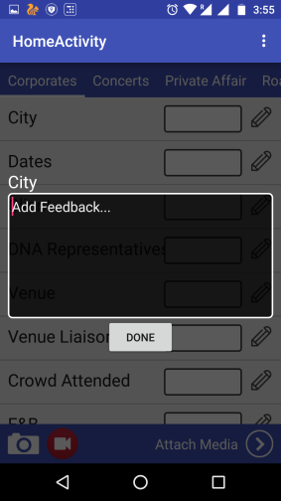
The editable popup field is opened when user click the edit button or the text box.
Above the editable box the user can see the current subject about which he wants to write.
In the editable popup box the user can also update the previous feedback that he want to edit.
By pressing the Done button the feedback for the current subject will be saved.
Editable popup field

Slide 5
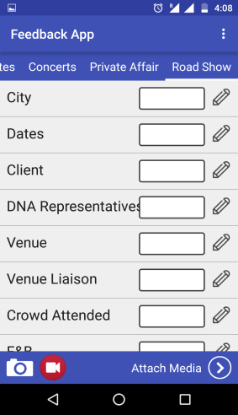
The camera and video recording screen are same, as both are using the default device camera.
The user can open the camera by clicking on the camera icon present at the bottom of the screen left side.
Once the user will click an image or video the image or video will be saved inside the gallery.
Camera and video recording screen

Slide 6
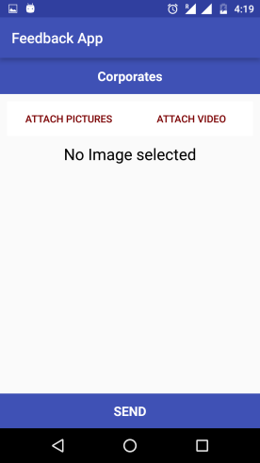
The attachment screen contains two options attach pictures and attach video.
User can send the feedback without attachments, if user is sending the feedback without video or images attachment a dialog popup will came as shown in next slide.
Attachment Screen

Slide 7
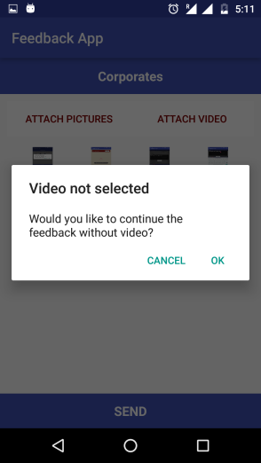
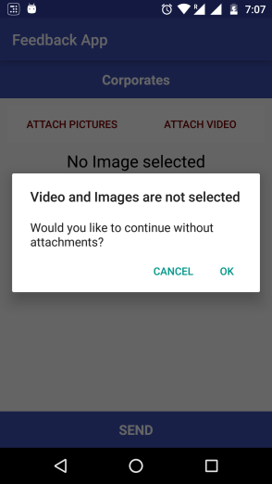
Sending feedback without attachment Screen

Slide 8
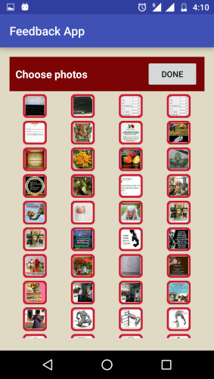
The user can select multiple images to attach with the feedback. There is no limit to select the images.
After selecting all images from the gallery, the user can click on done button(top of the screen right side)
For selecting the video, the user will be directed to gallery where he can see only the videos, for making the selection easy to him images will be invisible to him.
Attaching images and video from gallery

Slide 9
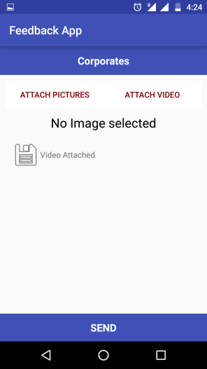
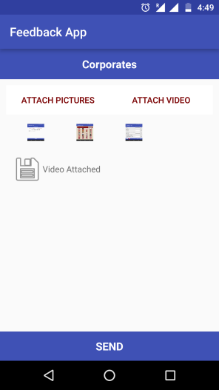
After attaching video and Images

Slide 10
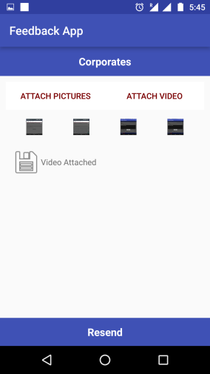
If a feedback is not send successfully and some of file still remains to send then user can send the remaining file by clicking on resend button as shown.
The resend button will only come if the sending of feedback is terminated cause of internet or some other reason.
Feedback send Exception

Slide 11
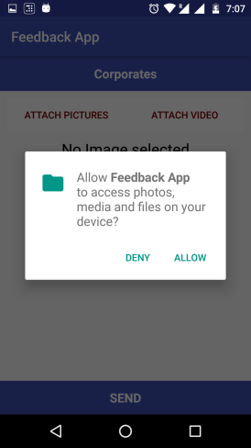
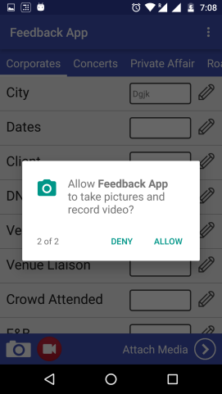
Device and media permission
For marshmallow version the app will ask fore some Runtime permission as shown bellow:

Slide 12
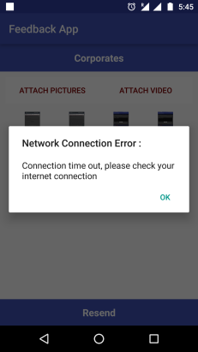
If internet connection breaks user will get an popup dialog:

