Slide 1
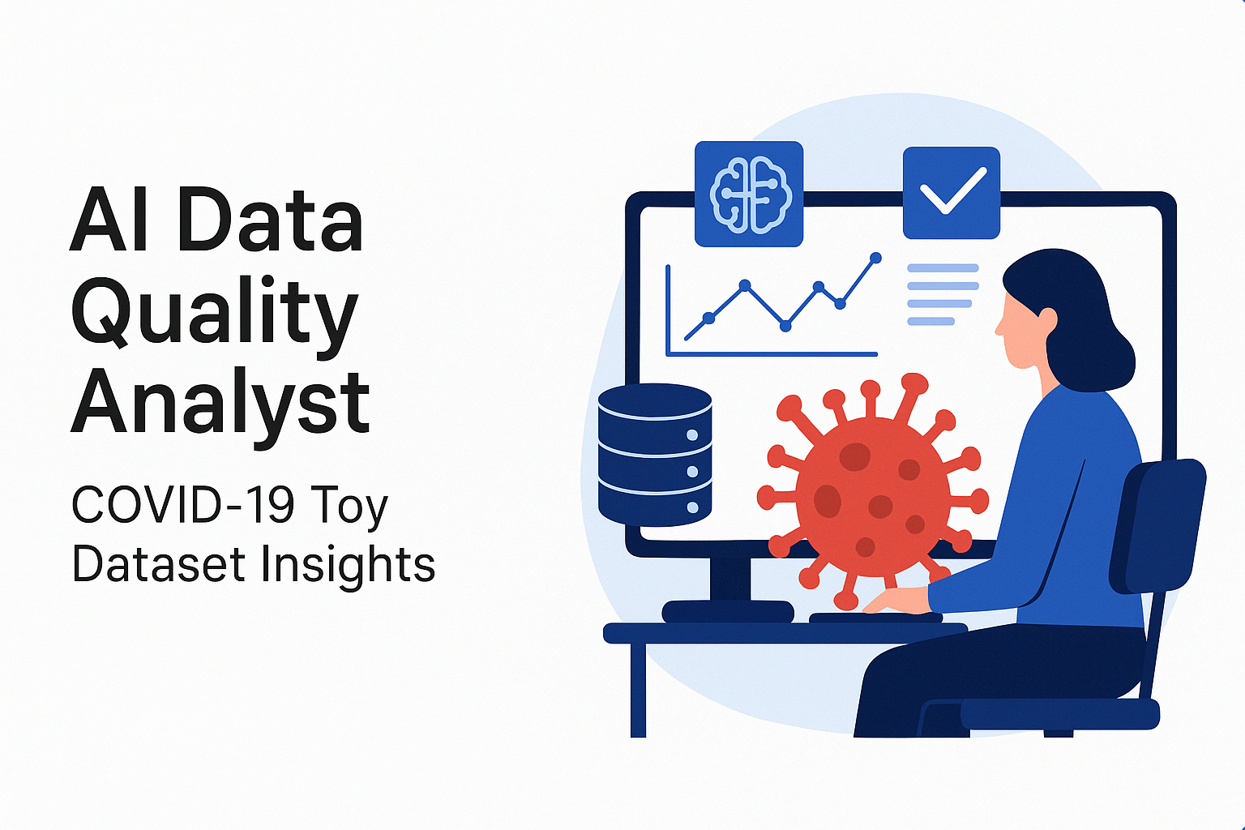
AI Data Quality Analyst: COVID-19 Toy Dataset Insights
This report explores the AI Data Quality Analyst project, focusing on a sample COVID-19 dataset. We'll delve into analyzing, cleaning, and visualizing crucial health-related features to uncover hidden patterns and ensure data integrity.

Slide 2
Project Overview: Enhancing Data Trustworthiness
The AI Data Quality Analyst project aims to provide a comprehensive framework for understanding and improving data quality using a synthetic COVID-19 dataset. This report highlights the methodologies applied for data cleaning, preprocessing, and insightful visualization, crucial steps for reliable data-driven decisions in public health.
Purpose
Dataset Focus
Analyze, clean, and visualize health-related features like age, fever, cough type, city, and COVID test results.
Utilizes a sample COVID-19 dataset to demonstrate data quality processes and visualization techniques effectively.

Slide 3
Dataset at a Glance: ‘covid_toy.csv’
The analysis is based on a small, synthetic dataset named `covid_toy.csv`, designed to simulate real-world health data. This dataset, with its limited scope, allows for a focused exploration of data quality issues and the application of various analytical and visualization techniques.
Filename:
covid_toy.csv
Rows:
100
Columns:
6
age: Age of the person
gender: Male or Female
fever: Body temperature (°F)
cough: Cough severity (e.g., Mild, Severe)
city: City of residence
has_covid: COVID test result (`Yes` or `No`)

Slide 4




Core Objectives: Ensuring Data Integrity
The project is guided by clear objectives aimed at transforming raw data into reliable, actionable insights. By systematically addressing data quality issues and employing robust analytical methods, the project enhances the trustworthiness of the dataset for further research or decision-making.
Data Quality Detection
Data Cleaning & Preprocessing
Identify and flag anomalies such as missing values, duplicate entries, and inconsistent data formats or values across all features.
Implement effective strategies for handling detected issues, including imputation for missing data and standardization of inconsistent entries.
Pattern Analysis & Relationships
Data Visualization
Explore the dataset to uncover significant patterns and correlations between different health-related features and the COVID-19 test results.
Generate compelling visual representations of the processed data to communicate complex insights clearly and efficiently.

Slide 5





Technical Stack: Tools for Analysis
This project leverages powerful open-source Python libraries, renowned for their capabilities in data manipulation, statistical analysis, and visualization. These tools collectively form a robust environment for data science workflows.
Python 🐍
Pandas 🐼
Seaborn 🎨
The primary programming language, offering a vast ecosystem for data science.
Essential for data manipulation and analysis, providing powerful data structures like DataFrames.
A high-level data visualization library based on Matplotlib, excellent for statistical graphics.
Matplotlib 📊
Google Colab
A foundational plotting library for creating static, animated, and interactive visualizations.
A cloud-based Jupyter notebook environment, facilitating collaborative and interactive analysis.

Slide 6
Diverse Visualizations for Deeper Understanding
A wide array of visualization techniques has been employed to present the dataset's characteristics and findings effectively. Each chart type is chosen to highlight specific aspects of the data, from distributions to relationships between variables.
Categorical Data
Numerical Data
Relationships & Correlations
Bar Charts (Grouped, Horizontal, Stacked)
Histograms and KDE Curves
Line and Scatter Plots
Box Plots
Heatmaps
Pie Chart

Slide 7
Getting Started: Running the Analysis
To replicate the analysis and explore the visualizations interactively, follow these straightforward steps. The project is designed for ease of use within a Google Colab or Jupyter Notebook environment.
Clone the Repository: Download the project code from its source or clone the GitHub repository.
Open the Notebook : Launch the `AI_Data_Quality_Analyst.ipynb` notebook in Google Colab or your preferred
Jupyter Notebook environment.
Upload Dataset : Ensure the `covid_toy.csv` file is uploaded to your working environment. In Google Colab,
you can use the file upload feature.
Execute Cells : Run each cell sequentially to observe the data analysis, cleaning processes, and the generated
visualizations step by step.

Slide 8
Key Insights: Unveiling Data Patterns
The analysis of the `covid_toy.csv` dataset revealed several significant patterns and data quality challenges. These insights highlight the importance of preprocessing and careful examination before drawing conclusions from health data.
Data Cleaning Outcomes
COVID-19 Trend Observations
Fever Values: Missing fever entries were identified and successfully filled using mean imputation, ensuring data completeness for analysis.
Geographical Hotspots: COVID-19 cases showed higher frequency in specific cities, indicating potential localized outbreaks or testing concentrations.
Age and Fever Correlation: A weak correlation was observed between age and fever, suggesting that fever intensity doesn't significantly increase or decrease with age in this dataset.
Gender Distribution: Analysis revealed that COVID cases were more frequent among certain genders, prompting further investigation into contributing factors.
Symptom-Test Result Patterns: Visualizations clearly demonstrated discernible patterns between reported symptoms (like cough type) and COVID test results, aiding in symptom-based predictions.

Slide 9



Impact & Future Directions
This project provides a robust foundation for understanding and enhancing data quality, especially in sensitive domains like public health. The insights gained underscore the critical role of data cleaning and visualization in supporting epidemiological research and decision-making.
Validated Data
Clear Communication
Informed Decisions
Ensures that insights derived from the dataset are based on clean and reliable information.
Visualizations effectively convey complex patterns, making them accessible to a wider audience.
Supports public health officials in making data-driven decisions related to disease monitoring and intervention strategies.

Slide 10
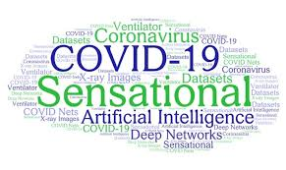
Key Takeaways & Next Steps
The AI Data Quality Analyst project demonstrates a
complete workflow for data preparation and insightful
visualization, vital for any data-driven initiative.
Data Quality is Paramount: Emphasizes the need for rigorous
data cleaning before analysis.
Visualizations Drive Understanding: Effective charts transform raw
data into clear, actionable insights.
Reusable Framework: The methodology can be applied to diverse
datasets beyond this COVID-19 sample.
Next Steps:
Explore advanced imputation techniques for missing data.
Integrate machine learning models for predictive analysis.
Scale the analysis to larger, real-world datasets.

Slide 11


