Slide 1
Stock Market Analysis using S3, CloudWatch, Lambda ,Glue Crawler, Glue WorkFlow and Athena.

Slide 2
Project Overview
In this Project, we will demonstrate how to perform data engineering activities using AWS tech stack. This stock exchange data generated by stock market. AWS S3 as Data Lake and Spark-SQL for performing the analytics. we will store all the historical data into S3 and perform ETL and Data warehouse query using Spark-SQL.
Introduction
NYSE dataset Daily stock data of each company is available live on yahoo finance for each stock exchange worldwide. We have taken the NYSE stock exchange data for this study.
The data set is composed of: stock exchange, company symbol, date, open price of the day, high of the day, low of the day, close of the day , volume and adjusted close price.
Goal:
Design a Business Intelligence system that provide suggestions to customers based on historical stock data and enable customers to build dashboard and perform a search for specific stock data.

Slide 3

Objective:
Based on data analytics, customers will be able to view popular stocks based on specific date.
Glue Workflow
Bronze Bucket
Trigger 1
Gold Bucket
Trigger 2
Upload the raw data into S3 bucket
AWS Glue (ETL Job)
AWS Crawler
Filtered Data
Raw Data
Aggregated Data
Clean and processed Data
AWS Data Catalogue
AWS Cloud Watch
Sliver Bucket
Use copy command to load aggregated data to Redshift
AWS Lambda Function
Redshift
AWS Quick Sight
AWS Athena

Slide 4
Procedure
We have collected last 25 years (1981-2010) of NYSE stock exchange data from yahoo finance.
Imported the Raw data into s3 bucket (Bronze zone bucket).
Created Event Rule to monitor the resources of S3 if any data imported to S3 then cloud watch event will trigger the lambda function.
Lambda function triggers the glue workflow.
First trigger to run the spark glue job to read the raw data from Bronze zone bucket.
Applied few transformation operation on these raw data listed below
Data Cleaning : This involves dropping null values, fixing data formats, and removing duplicate records. these cleaned and processed data stored in silver zone bucket
Data filtering and aggregation
Filtered the data based on “open price of the day” and “high of the day” and “close of the day” is greater than 0 and stored the filtered data in Gold zone bucket
Aggregated the data to find out highest average return and highest loss based on company symbol and stored aggregated data in Gold zone bucket

Slide 5
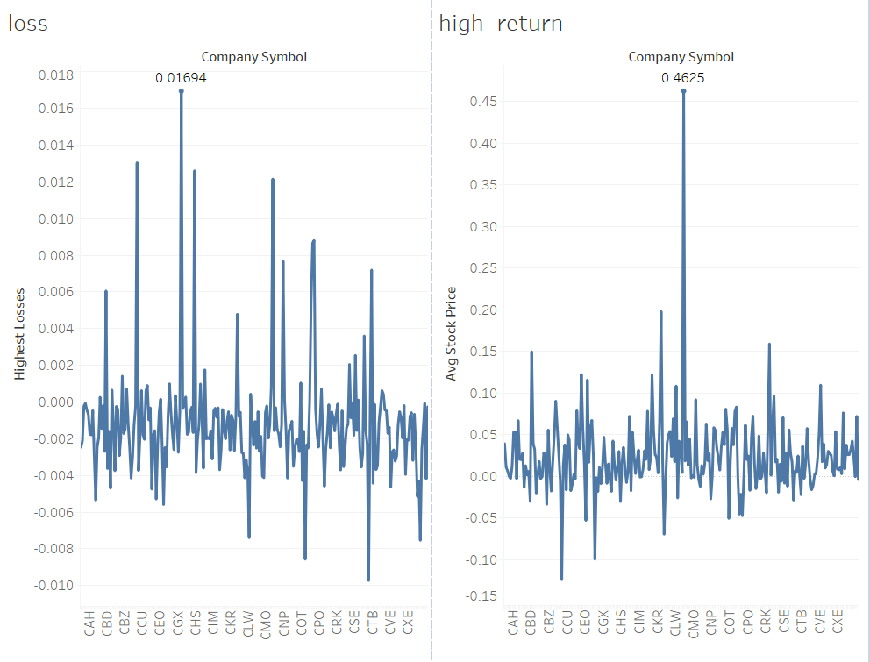
Second trigger to run AWS Glue crawler on filtered data to create table structure in AWS Glue data catalogue ( Table name : “NYSE_Partition” )
Run Athena query on this table “NYSE_Partition” to find out which stock’s open price of the day is greater than 68 and high close price is less than 70.
Build Dashboard visualization using AWS Quick Sight by aggregating data on company’s name to see which company has given highest return and highest loss.
Highest Loss : CHB company symbol Highest return : CME company symbol

