Slide 1

Exploratory Data Analysis of 1000 Movies Dataset
Rekha Thakur

Slide 2
CO DATASET DAIGRAM
Revenue
Director
Genre
Description
Runtime
Year
Rating
Title
Votes
Actors

Slide 3
Problem Statement
What are the Director role play in the industry's growth with total number of movies made and Revenue earned in overall market ?
Analyze Trend between Average Revenue and Average Rating (Popularity) of movies over the years ?
Genre combinations which earn high Revenues and Rating and Critics Scores ?
Future planning to add new services and enhance the quality of existing services.
We need to help in publish Movie Success Mantra to Magazine , news Articles / blog and Digital mode services like YouTube / Netflix / Amazon.

Slide 4

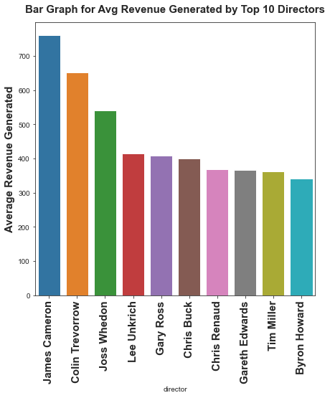
Top 10 Success Directors with best Revenue, Rating and Metascore
James Cameron : Revenue
Christopher Nolan : Rating
Barry Jenkins : Metascore

Slide 5
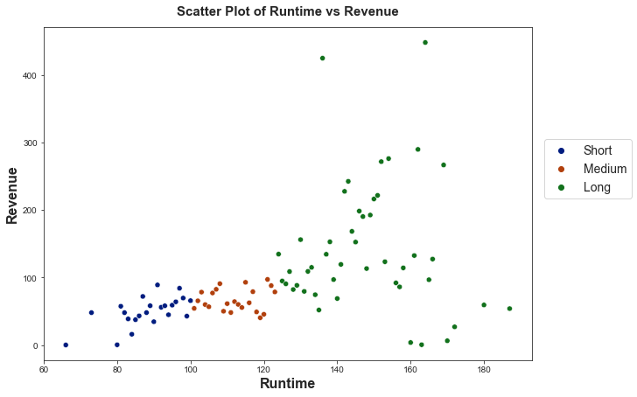
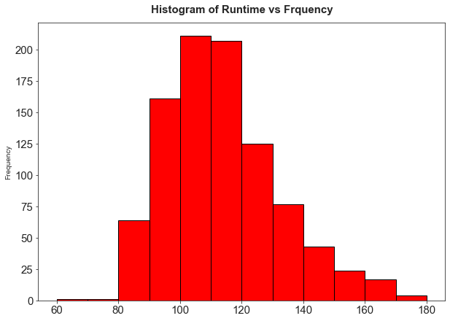
How does Runtime impact the success of a movie?
100 - 120 mins (25th and 75th percentile)
Interesting observation with Revenue with Runtime changes from mild to low as Runtime increase.
Co-relation :
Short Mild
Medium Mild
Long Low

Slide 6
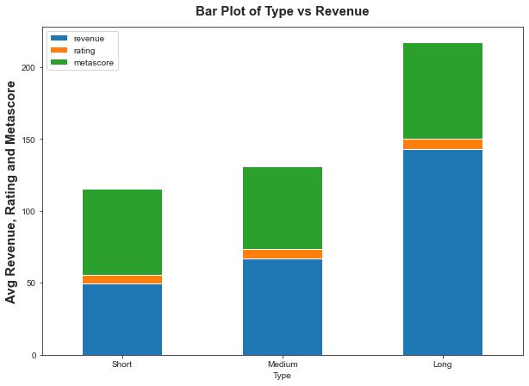
Which Runtime Interval earns higher revenue, ratings ,Critic ratings ?
Revenue
Long High
Short Low
Ratings
Long High
Critic ratings
Long High
Long duration (>123 mins)

Slide 7
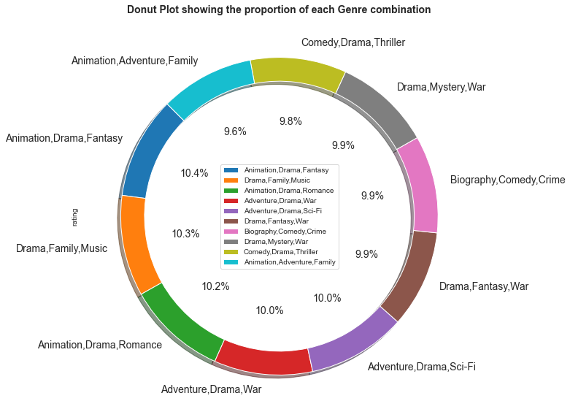
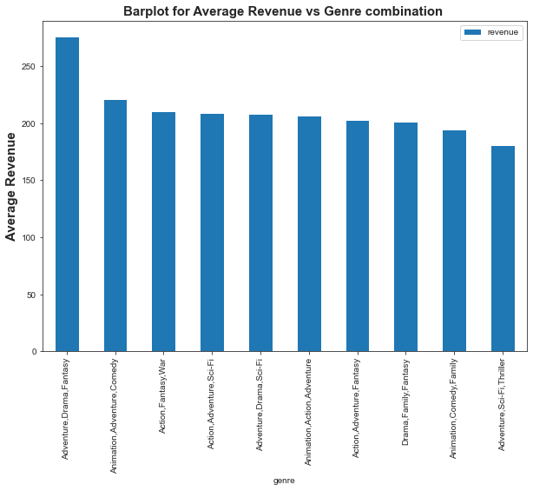
How does Genre impact the success of a movie?
Adventure, Drama, Fantasy extremely well in terms of Revenue Generation
Tough competition in terms of Ratings but Animation, Drama, Fantasy still leads.
Drama, Fantasy, War seems to do very well with the critics.

Slide 8
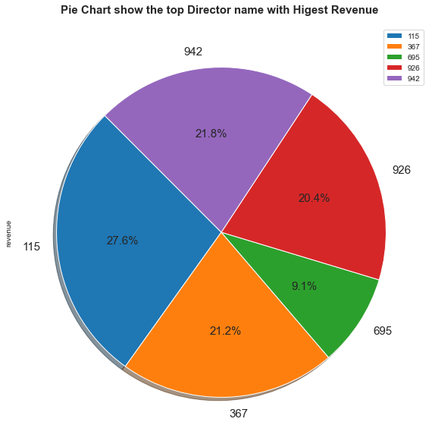
Which directors make movies of popular genres?
Best Revenue gainer David Yates(Rank 115)
Best Rating generator Makoto Shinkai
Best Metascore Guillermo del Toro

Slide 9
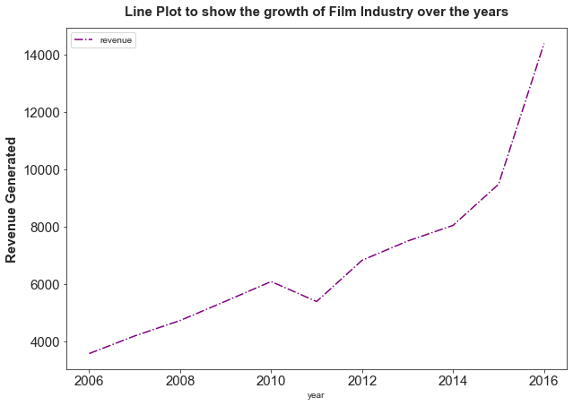
What has changed over the years?
Movie release growth in last 10 Years increased by 15.3 %.
The overall Revenue increased over the years.
More production , more new market of opportunities with year.
Positive Industry growth attracts more investors in the market.

Slide 10
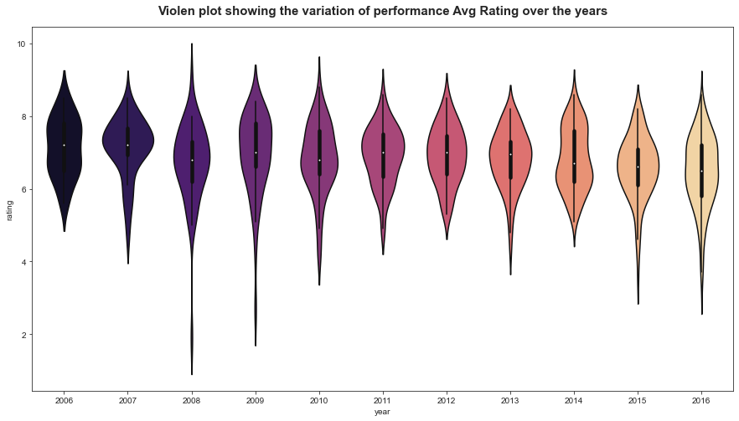
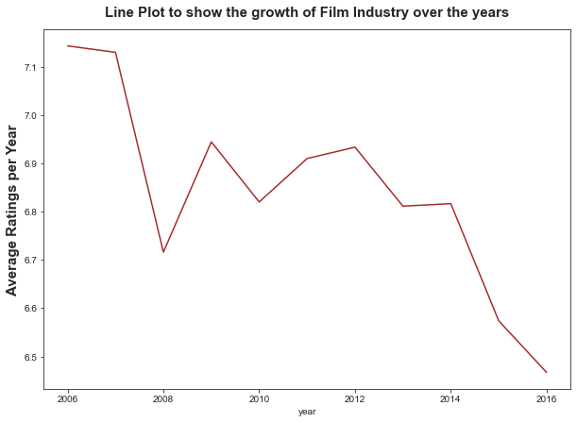
Average Revenue and Rating pattern changed over the years ?
Avg. Revenue & Avg. Rating (Popularity) of movies have shown a Negative Trend.
Avg. revenue generated per movie fallen down after 2013.
More movies & healthy competition in strong choices , hard to impress people expectations.
Film makers fails in likes of audience and critics in a particular period of time.

Slide 11
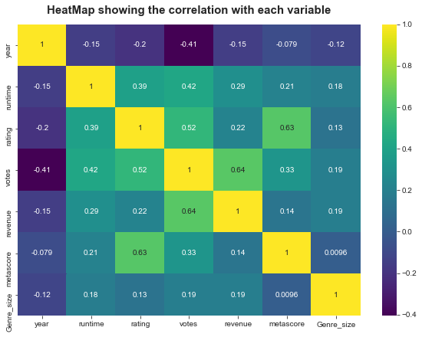
Why are movies not got success?
Problem :
Increase in Revenue , the avg. Ratings and Revenues are falling down.
Solution : Co-relation
Rating and Metascore have a high correlation.
Audience and critics have very similar opinions and think alike that make sense.

Slide 12
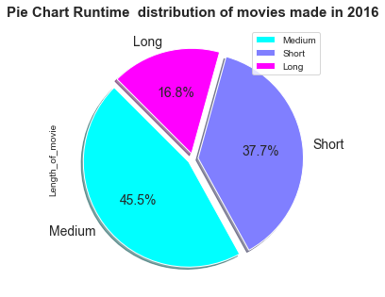
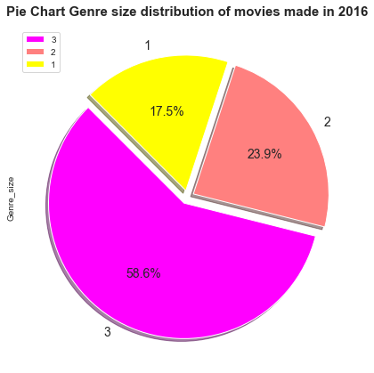
Analysing the genre_size of movies of 2016?
Analysing the Runtime
Long : Revenue generation, Rating and Metascore
2016 = 16.8% Long
Rest = Medium
Here Opportunity was missed out
By Director and fall down trend.
Analysing the Directors
Christopher Nolan : Top
Avg Ratings : Low
MetaScore : 58
Analysing the genre
Adventure,Drama,Fantasy : Highest Revenue
Animation,Drama,Fantasy : Highest Rating
Drama,Fantasy,War : Highest Score

Slide 13


👍 Super Hit Movies Word Cloud

Slide 14

Thank You !

