Slide 1
Version changes
New board design.
Categorised resources into “trinkets” and treasure. Trinkets are given as generic rewards.
Treasures can only be exchanged during your turn or when paying for a ritual/power.
Added day/night mechanic. Resources are only generated during Daytime.
Meeple is removed from player board when hexed.
Whisper moves to next suspicion number.

Slide 2
Spaces generate resource
Players move in clockwise order from first player token
Bribes and “rescued” civilians
Players resolve powers in turn order
Players resolve gather/rituals in turn order with priority. After each gather/ritual, adjust Suspicion meter before next player resolves action

Slide 3











9
8
7
6
5
4
9
8
7
6
5
4
3
2
1
0 (4)
0 (5)
2
6
6
2 (4)
1 (4)
9
8
7
6
4
9
8
7
6
5
4
3
2
1
0 (10)
2
1
12
10

Slide 4
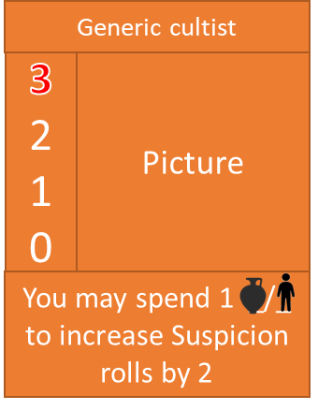

Slide 5



6
5
9
8
7
65
4
3
2
1
4
4
33
2

Slide 6
6
5
6
5
5
6
5
2
6
5
5
2
2
4
4
33
2
5
4
4
33
2
44
3
3
6
5
6
44
3
3
Increase/reduce
any Suspicion by 1
Move up to 2 _ from one space to an adjacent space
6
5
2
6
5
5
6
5
5
6
5
6
2
4
4
33
2
4
4
33
2
5
44
3
3
6
3
44
3
3
8
+1 blessing
Gather +2
Pull extra gold from mine
Guard moves to ritual sites
6
6
5
4
32
2
8
2 players

Slide 7











5
6
6
5
6
5
4
5
4
4
4
4
3
4
3
3
3
3
2
3
3
2
6
6
6
5
6
5
5
5
5
4
4
4
4
3
4
3
2
3
3
2
3
±1
+1
6
6
5
6
5
5
4
5
4
4
4
4
3
4
3
3
3
3
2
3
2
2

Slide 8

Name | Symbol | Type | Res | Start | /turn | Cap | Special rule | 1 | 2 | 3 | 4 | 5 | 6 | 7
Slaughterhouse |  | Basic |  | 2 | 2 | 5 | N/A | 2 | 3 | 3 | 4 | 4 | 5 | 6
Graveyard |  | Basic |  | 2 | 2 | 5 | N/A | 2 | 3 | 3 | 4 | 4 | 5 | 6
Hamlet |  | Basic |  | 2 | 1 | 5 | N/A | 2 | 3 | 3 | 4 | 4 | 5 | 6
Mine |  | Basic |  | 2 | 1 | 3 | Move generated _ to castle when at cap | 2 | 3 | 3 | 4 | 4 | 5 | 6
Farm |  | Advanced |  | 0 | 2 | 6 | Move 2 _ | 3 | 3 | 4 | 4 | 5 | 5 | 6
Church |  | Advanced |  | 0 | 1 | 6 | +1 on next suspicion roll | 3 | 3 | 4 | 4 | 5 | 5 | 6
Tavern |  | Advanced |  | 0 | 1 | 6 | ±1 suspicion | 3 | 3 | 4 | 4 | 5 | 5 | 6
Castle |  | Advanced |  | 6 | 0 | 8 | Starts with 3 guards. Can gather +2 _ | 2 | 3 | 3 | 4 | 4 | 5 | 6
Town square |  | Town square | N/A | 0 | 0 | 8 | N/A | 2 | 2 | 3 | 4 | 5 | 6 | 6

Slide 9



Symbology
Name | Symbol | Description
Animals |  | Basic resource.
Idols |  | Basic resource.
People |  | Basic resource.
Treasure |  | Basic resource.
Dark Favour |  | Can be spent to use special action.
Hex |  | Resource placed on opposing players to increase their action cost.
Resource |  | A symbol to represent any resource on cards.
Suspicion |  | Determines the difficulty of performing an action on a given space.
Animosity |  | When animosity reaches maximum, you lose 4 resources.
Blessing |  | Can be used before suspicion roll to add +2 to roll.

Slide 10
Symbology
Name | Symbol | Description
Guard |  | Raises base suspicion by 2 and prevents resources being moved out of space.
Add resource |  | Add the indicated resource to a space.
Move |  | Move the indicated object the indicated number of spaces.
Raise/lower meter |  | Raise/lower indicated meter.
Gather cap |  | The maximum resources collected by a gather action. Either an adjusted value (+/-X) or an absolute value (X).
You |  | Indicates the actions affects you.
Other player |  | Indicates the action affects a player of your choice.
Transfer |  | Transfer the indicated object between the indicated places.
Hex |  | Add/remove a hex from another player.
2
+2
3
2

Slide 11
Symbology
Name | Symbol | Description
Collect |  | Take the indicated resources from a space without a suspicion roll. Overlapping circles indicate the resources can be taken from any number of spaces.

Slide 12
Characters
Sheep cultist
Generic cultist
Holy
Dragon cultist
3
2
1
0
Picture
3
2
1
0
Picture
3
2
1
0
Picture
3
2
1
0
Picture
Name
3
2
1
0
Picture
When gathering, may exchange 1 _ for 1 _
Can hex for 1 _, once per turn.
Reduces susp by 1 in space. -1 priority.
After gathering, destroy 1 _ in target space. +1 susp rolls and gather cap when space is full.
Special power
Plant
Jellies
Death wagon
Skellies
3
2
1
0
Picture
3
2
1
0
Picture
3
2
1
0
Picture
3
2
1
0
Picture
OSSIFY
After movement, you may place 1 flower on your space. A flower decreases the Suspicion by 1. When gathering, you may destroy a flower to gather 1 _ from that space, even if you are not in the space with the flower.
Bigger stock gives more power?
When moving, you may destroy 1 _ in each space passed. Each _ destroyed counts as 1 _ for rituals or powers on this turn.
Can summon skeletons with a power card. When moving, move each skeleton 1 space in any direction.

Slide 13

Power board
Herd
Move 2 _
Whisper
±1 suspicion
Sneak
Stop anim dice
Hex
Apply _ to player
Seize
Gather 4 _ from any spaces
AND
AND
OR
OR
Generic
Cull
X
Gather +2X
Bribe
X
Move X guards
“Rescue”
X
-X animosity
Syphon
Steal 2 _ from _ ed player
OR
Reap
Steal 3 _ from one _ ed player
Shepherd
Move 3 _
Add 2 _
Whisper
±1 suspicion
Sneak
Stop anim dice
Hex
Apply _ to player
Butcher
Gather cap +2
Susp roll +1
Sheep
X
AND
X
AND
X
OR
OR
Cull
Gather +2X
Bribe
Move X guards
Donate
-X animosity
Syphon
Steal 2 _ from _ ed player
OR
Transform
Convert 5 _ of other player into
Herd
Move 2 _
Channel
+1 suspicion
-1 suspicion
Sneak
Stop anim dice
Hex
Apply _ to player.
Manipulate
±1 suspicion in all spaces
Witch
X
AND
AND
X
OR
X
OR
Cull
Gather +2X
X
Drain
Steal X+1 _ from _ ed player
Bribe
Move X guards
“Rescue”
-X animosity
OR
Curse
Steal 3 _ from each player per _. Remove _s

Slide 14
Power board
Herd
Move 2 _
Charity
-1 suspicion
Sneak
Stop anim dice
Hex
Apply _ to player
Pray
Gain 3 _
X
AND
X
AND
X
OR
OR
Holy
Cull
Gather +2X
Bribe
Move X guards
Preach
-X anim
+1 anim on other
Syphon
Steal 2 _ from _ ed player
OR
Deceive
Flip susp in two spaces.
Herd
Move 2 _
Whisper
±1 suspicion
Sneak
Stop anim dice
Hex
Apply _ to player.
Transmute
Convert 4_ into
Dragon
AND
AND
X
OR
OR
Hoard
+2 resources on space
X
Calcify
Destroy 2_ from _ed player. +1
Bribe
Move X guards
“Rescue”
-X animosity
OR
Conflagrate
Destroy 8 _

Slide 15
Power board
Herd
Whisper
Serve
Hex
Seize
2
Skip Gather/
Ritual phase
4
X
X
X
Generic
Cull
Bribe
“Rescue”
Syphon
X
X
Reap
+2X
2
2
3
Shepherd
Whisper
Serve
Hex
Seize
3
Skip Gather/
Ritual phase
4
Sheep
X
X
X
Cull
Bribe
Donate
Syphon
X
X
Reap
+2X
2
2
3
Witch

Slide 16
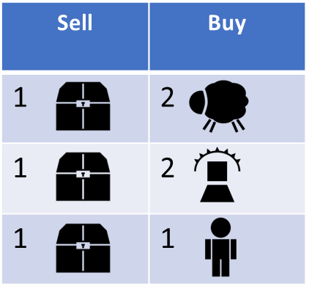
Shop
Sell | Buy
1 | 2
1 | 2
1 | 1

Slide 17
Action | Description | After
Generate resources | Increase resources in indicated space
Roll susp dice | +1 susp in indicated space
Move | Move 2 spaces
Power | Pay resources and resolve | All - Resolve space power
Action | Pray – +1 Gather – Susp roll, +3 Ritual – Susp roll | All susp roll – Animosity die roll, adjust susp meter Successful ritual - +1 animosity, move 1 guard
Adjust susp meter | +1 if succeeded -1 if failed

Slide 18
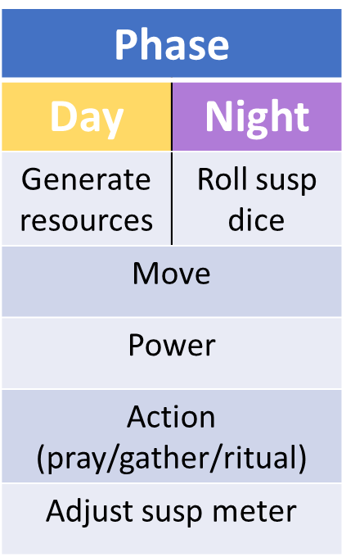
Phase
Day | Night
Generate resources | Roll susp dice
Move
Power
Action (pray/gather/ritual)
Adjust susp meter

Slide 19
+1 suspicion roll.
Gather +2 _
Move 2 _
X
X
X
2
2 _ 1 _
-1 animosity
(X is current animosity)
±2X suspicion
Apply X _ to player(s). Increase cost by 2
Decrease suspicion by 2 and increase by 1 in two adj spaces
Convert applied _
to 1 _ each
+2 adj _
Move +4 _
+1 animosity on other
Shift all suspicion by 1
+2 _
+1 suspicion roll
Move 2 _
Add 2 _
X
X
X
3 _ 1 _ 1 _
-1 animosity
(X is current animosity)
±2X suspicion
Apply _ to player. Increase cost by 2
Generate 2X _
No gather limit. +2 suspicion roll
+2 adj _
Move +4 _
+1 animosity on other
Shift all suspicion by 1
+2 _

Slide 20
+1 suspicion roll
Move 2 _
X
X
-1 animosity
(X is current animosity)
±2X suspicion
Add 1 _
Apply _ to player. Destroy 1 of their _
+2 adj _
Move +4 _
+1 animosity on other
Shift all suspicion by 1
+2 _
-Gather +1 _
-+1 susp roll, gather + 1 _
- +2/+2
-Move 1 _
-Move 3 _
-Move 2 _,
gather 2 _
X
X
1 _ 1 _
4 _ from belly
-1 animosity
(X is current animosity)
±2X suspicion
Apply _ to player. Increase cost by 2
Move up to 4 _ from anywhere before gathering
+2 adj _
Move +4 _
+1 animosity on other
Shift all suspicion by 1
+2 _

Slide 21
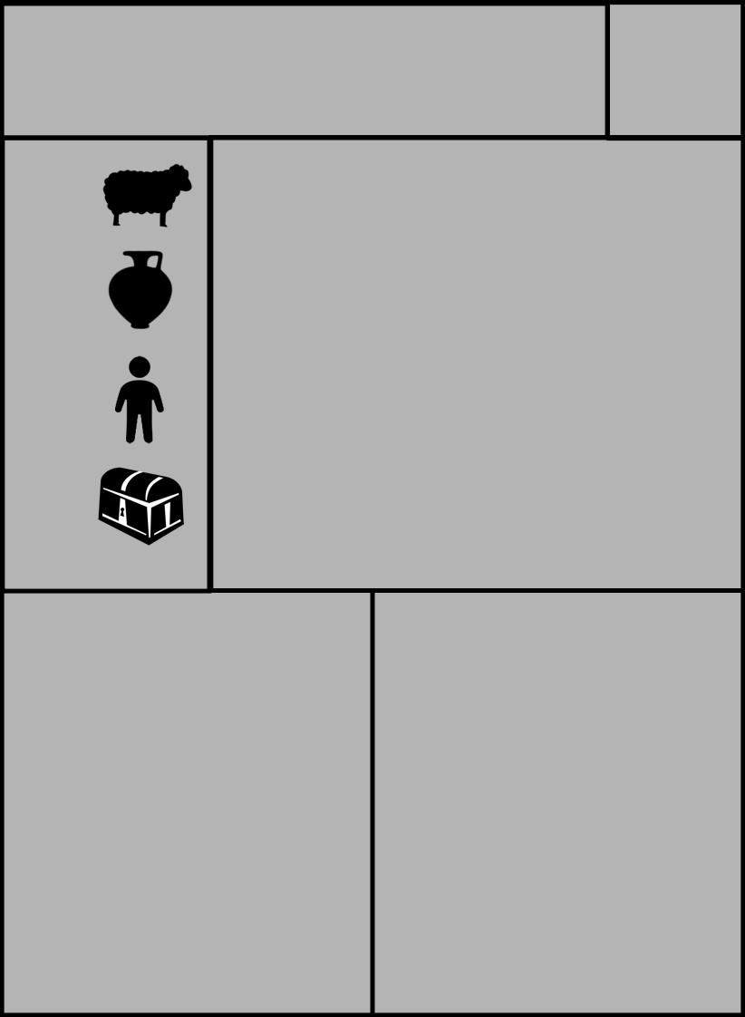
Rituals
Blood for the blood god!
Basic
4
4
-
-
Picture
4
4
-
-
Location
Requirements
Name
Type
Picture
Skulls for the skull throne!
Advanced
Location
Requirements
8
8
-
-
Picture
Requirements

Slide 22




Basic rituals
1
2
-
-
4
-
-
-
-
-
-
2
-
4
-
-
-
-
-
-
+2
2
1
1
-
2
-
2
-
-
3
2
-
-
-
-
4
-
5
3
-
2

Slide 23
7
-
-
-
-
3
2
-
-
-
-
3
-
6
-
-
-
3
3
-
3
+1
1
±1
2
Advanced rituals
2
4
4
-
4
-
3
-
-
3
3
1
-
4
3
-
-
2
2
2
2
-1
5
3
2
2
4
2
2
2

Slide 25

Types:
Simple
Complex
Final
Sheep cultist
Regular cultist
The Ram
Final
The Deep One
Final
Pale Rider
Final
King of Dragons
Final
8
-
2
1
Picture
3
3
5
-
Picture
-
-
-
-
Picture
-
-
-
-
Picture
Must be 7 _ in target space
The Suspicion must be 6 in at least 2 other locations
Must have at least 1 skelly in each space
Plant thing
Final
Radiant One
Final
Consumption
Final
The Great Jelly
Final
-
-
-
-
Picture
-
-
-
-
Picture
-
-
-
-
Picture
-
-
-
-
Picture

