Slide 1
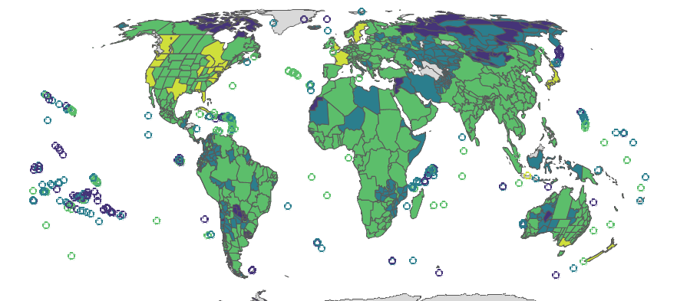

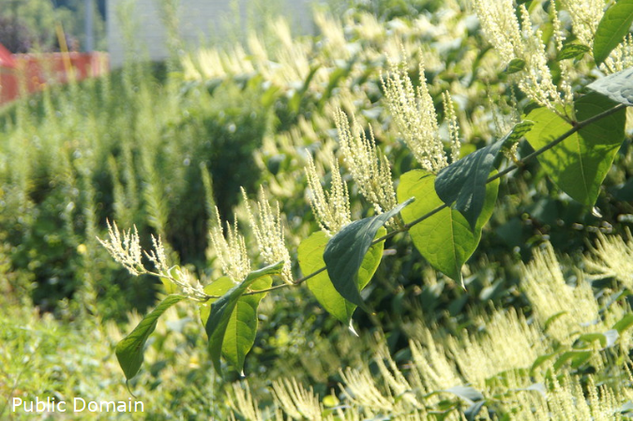


A barrier to global plant invasion ecology: gaps in trait availability for alien species
Matthias Grenié, Helge Bruelheide, Wayne Dawson, Franz Essl, Mark van Kleunen, Holger Kreft, Ingolf Kühn, Petr Pyšek, Patrick Weigelt, Marten Winter
Sdiv Lab meeting – Thursday 29th September 2022
matthias.grenie@idiv.de
@LeNematode
https://rekyt.github.io/

Slide 2
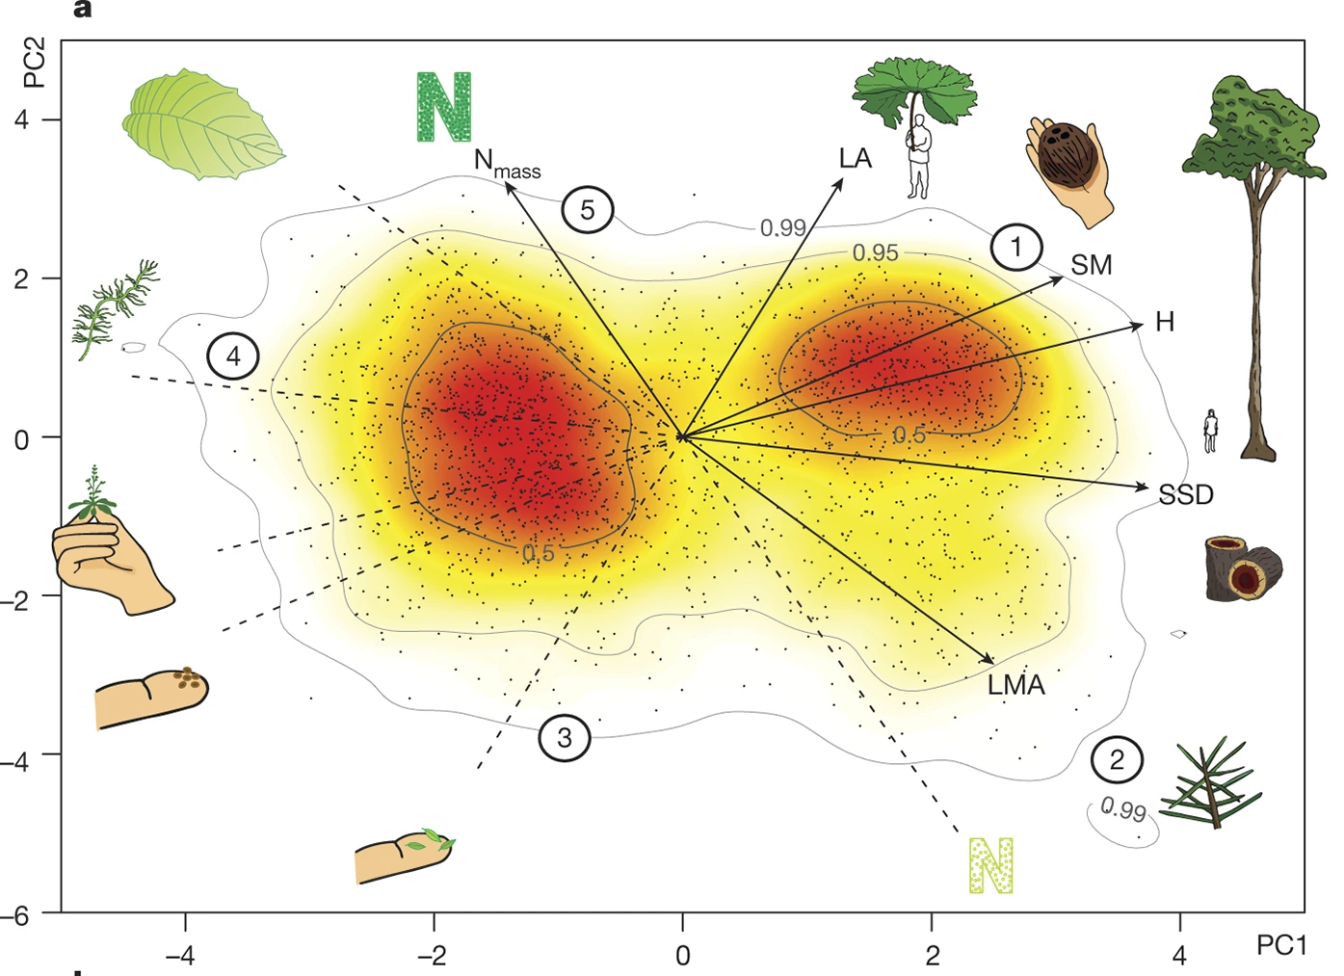
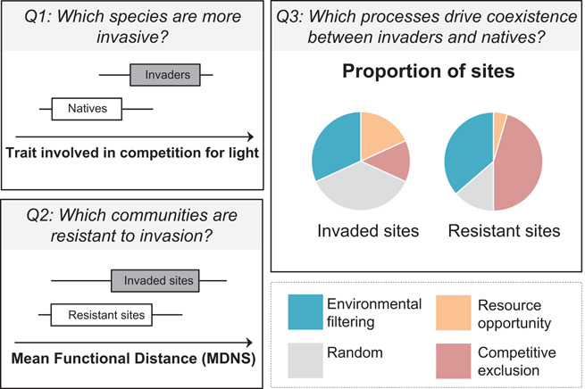
Functional Invasion Community Ecology?
Community Ecology focuses
on multiple species together
Functional traits let us gain insight
Díaz et al. 2016
Gallien & Carboni 2016
→ Study community assembly processes of alien species using functional traits
<numéro>

Slide 3
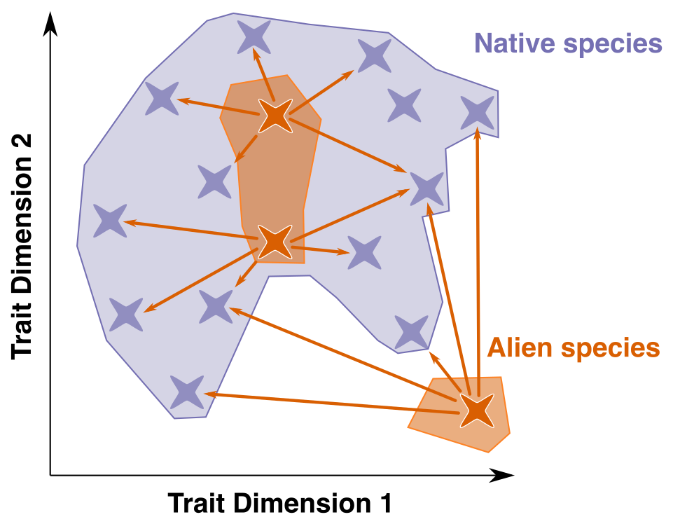
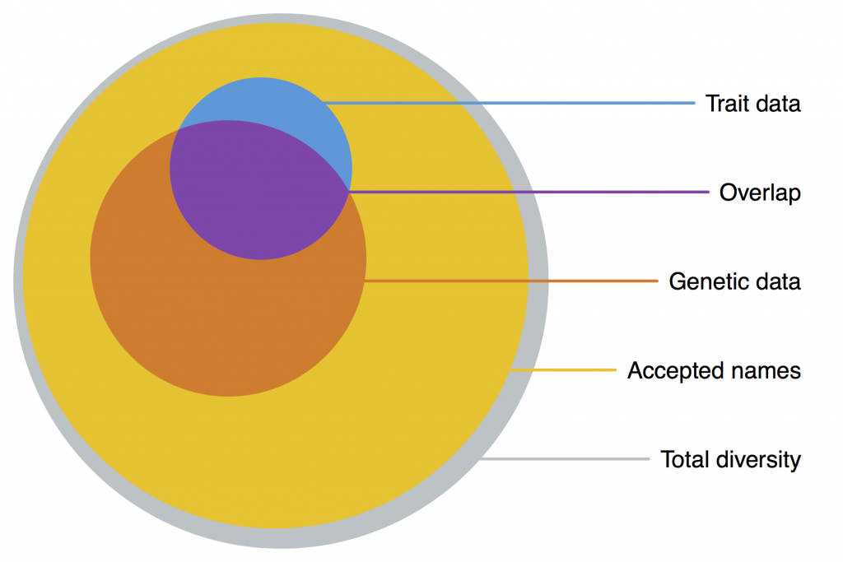
The problem...
Functional Position of Aliens
Wanted to study the “Biotic Resistance Hypothesis” globally in the Tropics with a functional lens
Huge gaps in trait data for alien species
Cornwell et al. 2019
What do we know of functional traits of alien (plant) species at global scale?
<numéro>

Slide 4




Merging Alien Plant Species Lists and Global Traits
(Open) Trait Data
Alien status
and distribution
Taxonomic Harmonization (Grenié et al. 2022)
+ Trait Harmonization + Trait Categorization
16,538 species from GloNAF
→ 15,490 species with at least one trait (consolidated data)
<numéro>

Slide 5

“Aligning” trait databases in practice
Heavily inspired by the work of Elizabeth Wenk on AusTraits (Thanks again!)
Manually build correspondence table between each pair of databases
(apart from AusTraits ↔ TRY)
Records:
Two database Trait IDs/Trait Names
If trait are identical (exactly same meaning)
If traits are similar
Additional comments
~1 person in 1-2 days
424 traits in AusTraits
54 traits in BIEN
133 traits in GIFT
2091 traits in TRY
<numéro>
Notes:
To do so I used 4 trait databases (AusTraits, BIEN, GIFT, and TRY).
However I needed to combine them to get a complete overview so I had to merge all datasets.
Fortunatelt Lizzy Wenk had done the tedious job between AusTraits and TRY (with many information regarding similarity of traits/units/organs, etc.).
I did the same for all pairs of databases.
AusTraits has XX traits, BIEN YY, GIFT ZZ, and TRY AA
In total I matched traits if they were identical (same meaning, same unit) or similar.
I’ve built a network of trait names across databases. One connected component is a group of “similar” traits.

Slide 6
“Aligning” trait databases in practice: Example table
bien_trait_name | try_trait_id | try_trait_name | identical | similar | comments
diameter at breast height (1.3 m) | 21 | Stem diameter | yes | yes | NA
fruit type | 99 | Fruit type | yes | yes | NA
leaf area | 3108 | Leaf area (in case of compound leaves: leaf, petiole excluded) | no | yes | Leaf area in BIEN doesn’t specify if it is measured on leaflet or with/without petiole
leaf area | 3109 | Leaf area (in case of compound leaves: leaflet, petiole excluded) | no | yes | Leaf area in BIEN doesn’t specify if it is measured on leaflet or with/without petiole
<numéro>
Notes:
To do so I used 4 trait databases (AusTraits, BIEN, GIFT, and TRY).
However I needed to combine them to get a complete overview so I had to merge all datasets.
Fortunatelt Lizzy Wenk had done the tedious job between AusTraits and TRY (with many information regarding similarity of traits/units/organs, etc.).
I did the same for all pairs of databases.
AusTraits has XX traits, BIEN YY, GIFT ZZ, and TRY AA
In total I matched traits if they were identical (same meaning, same unit) or similar.
I’ve built a network of trait names across databases. One connected component is a group of “similar” traits.

Slide 7
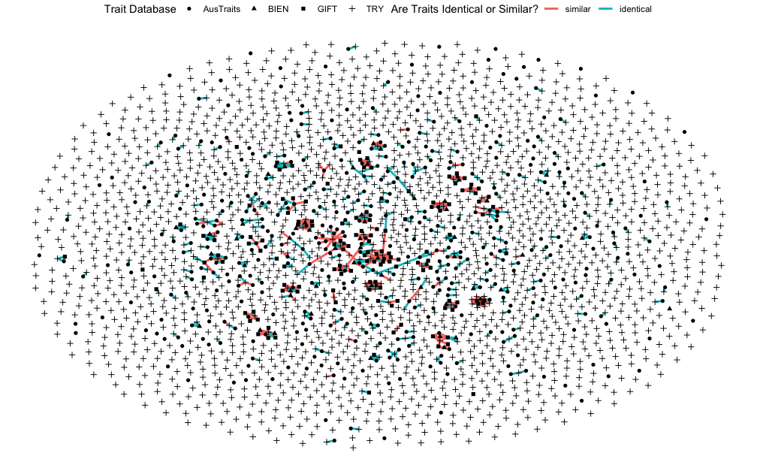
Step aside regarding trait harmonization
Trait Harmonization is no easy task
Had to manually build correspondence tables between databases
→ Results in a trait network
1 node = 1 trait name
1 edge = identical or similar traits
One connected component = one “group of traits” across databases
→ Will present this idea to
DB managers to see if publishable
<numéro>

Slide 8
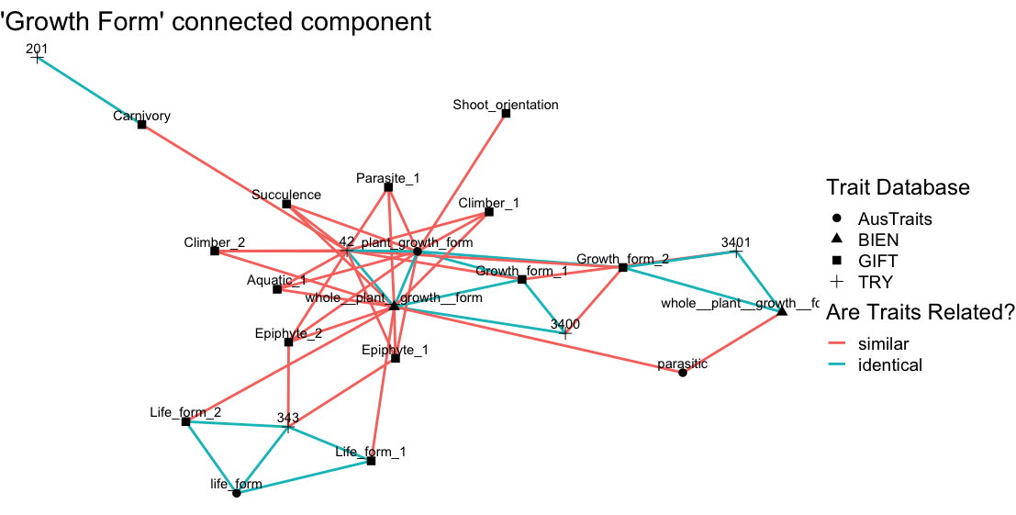
Zooming in the trait network
Plant nutrition mode (heterotrophy)
Detailed growth form
Life form traits
<numéro>
Notes:
To do so I used 4 trait databases (AusTraits, BIEN, GIFT, and TRY).
However I needed to combine them to get a complete overview so I had to merge all datasets.
Fortunatelt Lizzy Wenk had done the tedious job between AusTraits and TRY (with many information regarding similarity of traits/units/organs, etc.).
I did the same for all pairs of databases.
AusTraits has XX traits, BIEN YY, GIFT ZZ, and TRY AA
In total I matched traits if they were identical (same meaning, same unit) or similar.
I’ve built a network of trait names across databases. One connected component is a group of “similar” traits.

Slide 9
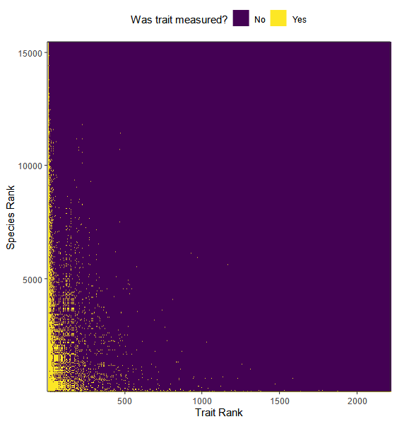
Global Trait Matrix
1 pixel = 1 trait x 1 species
98% of trait matrix is empty
We are lacking much of alien plant species traits
<numéro>

Slide 10
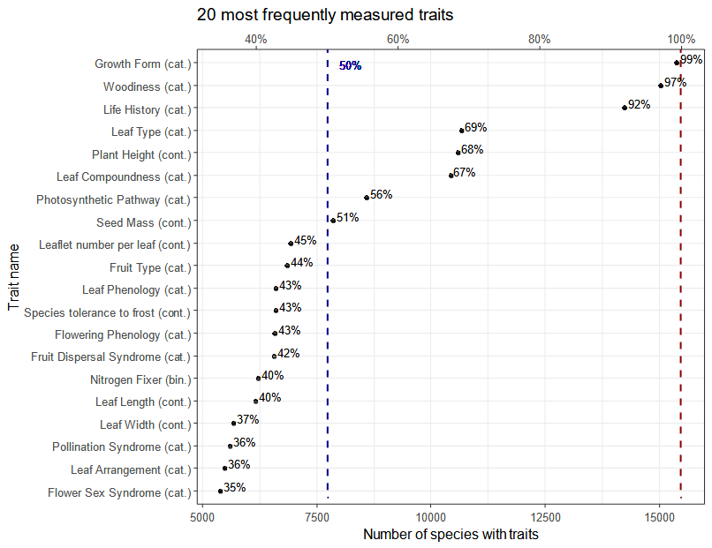
20 most measured traits are mostly categorical
Most traits measured
for <50% of species
Plant height is the
first continuous trait
Available for ~70% of species
Seed mass is the
second continuous trait
Available for ~50% of species
<numéro>

Slide 11
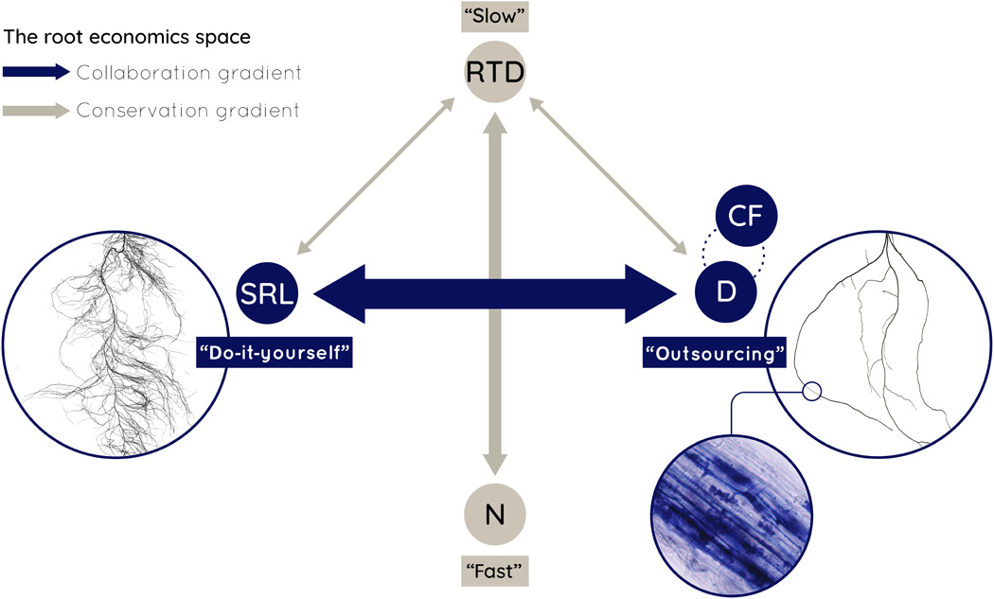
Trait Combinations
Species (16,538) x Traits (2,215) matrix is big
Reduce complexity → trait combinations
Leaf-Height-Seed Mass
Westoby et al. 1999
3 traits
Aboveground Traits
Díaz et al. 2016
6 traits
Root Traits
Bergmann et al. 2020
4 traits
Specific
Leaf Area
Height
Seed Mass
<numéro>

Slide 12
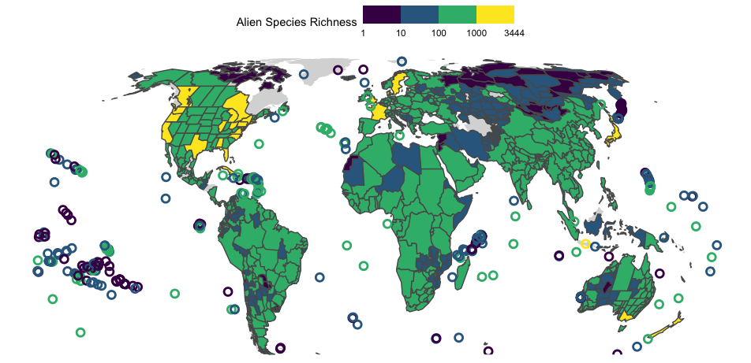
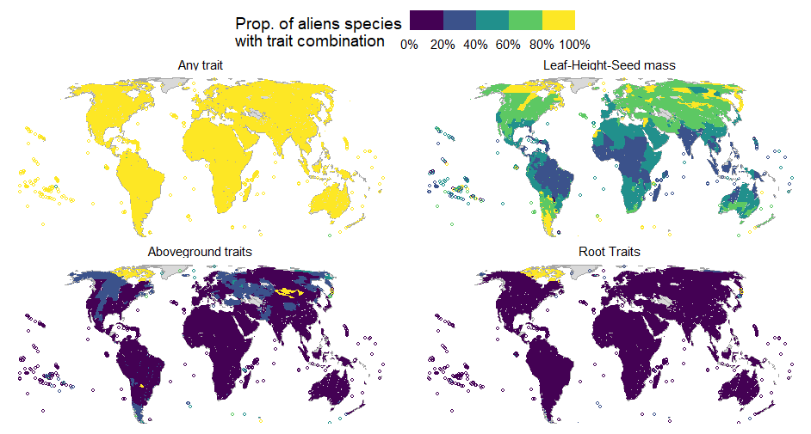
We have global gaps in trait combinations
<numéro>

Slide 13
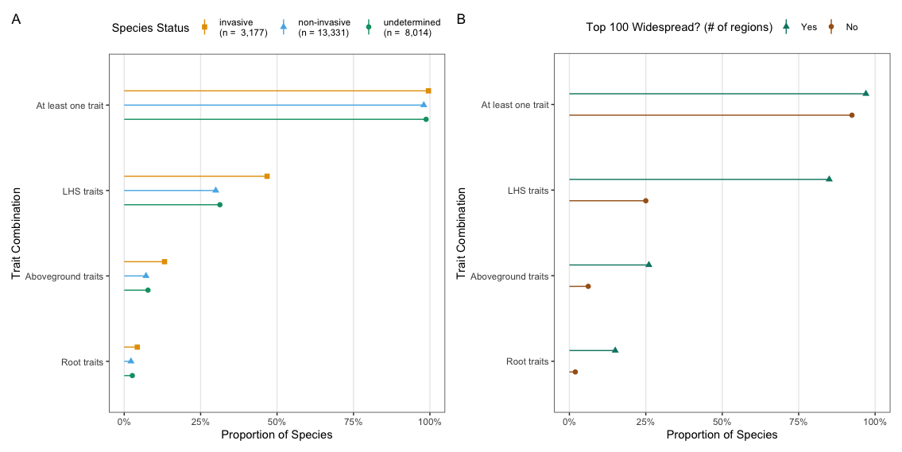
Widespread and Invasive Species are better known
<numéro>

Slide 14
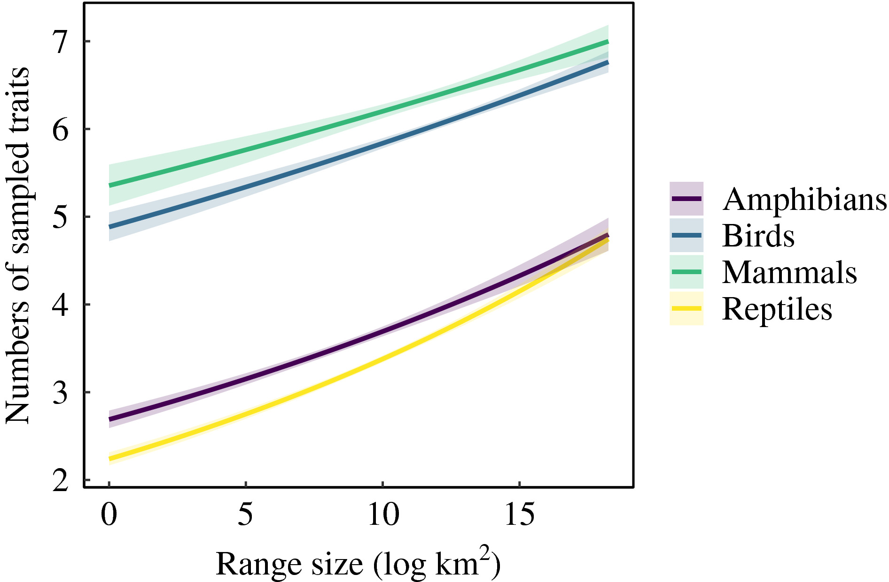
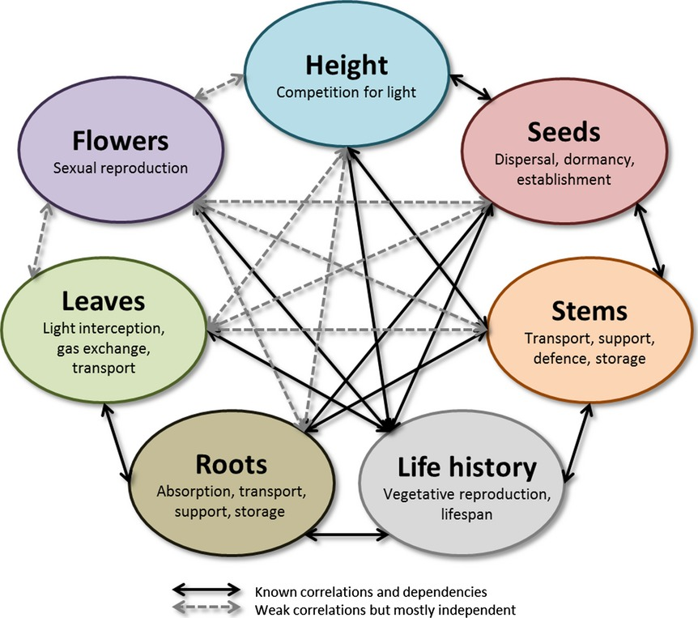
Perspectives
Identify the drivers of trait knowledge in alien species
(range size, country of origin, growth form, invasiveness, etc.)
Analyze amount of geolocated information (trait provenance)
Prioritize species/regions/traits on which to close the gaps
→ costs, heavily invaded region, easy to “close” region
Etard et al. 2020
Laughlin 2014
<numéro>

Slide 15

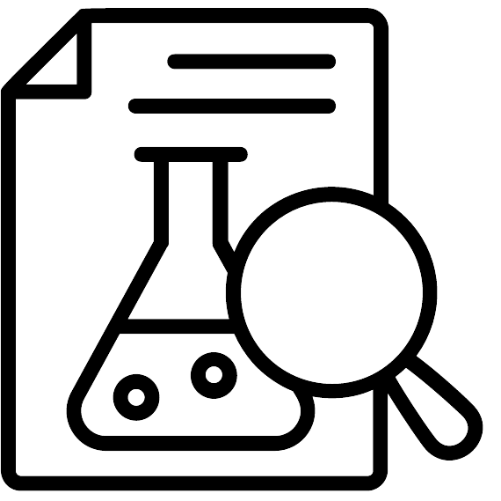

Closing the trait gaps?
Scientific Literature (+Floras?)
Distributed Field Campaign
Call for data contributions
Recent Examples
LT-Brazil (Mariano et al. 2021) FunAndes (Baez et al. 2022)
We need a coordinated global effort to close the trait gaps
<numéro>

Slide 16
<numéro>

