Slide 1


A barrier to global plant invasion ecology
gaps in trait availability for alien species
Matthias Grenié, GloNAF consortium, and Marten Winter MacroFest 2022 ‑ July 5th 2022

Slide 2
Alien species have dramatic consequences

Slide 3
Using functional biogeography to advance invasion ecology

Slide 4

Methods

Slide 5
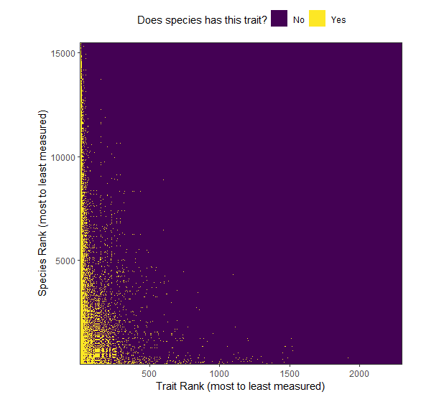
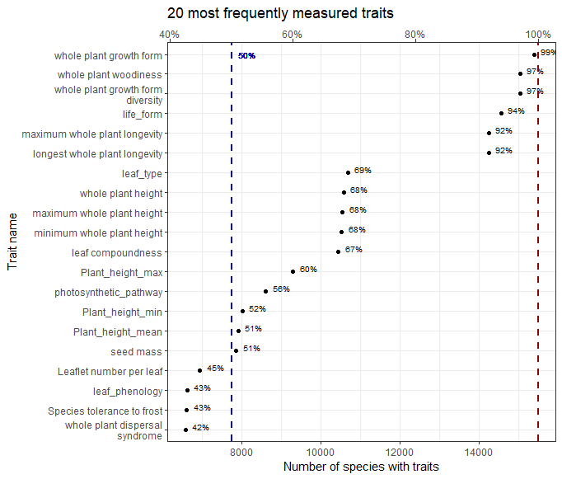
Few Consistently Measured Traits Top Measured Traits are not that Relevant

Slide 6
Trait combinations are not that often measured

Slide 7
Closing the gaps: a needed community effort
Does not mean that traits are not measured -> Traits NOT in databases
Need to better data integration
Bias in measured species
Geographical bias -> known in ecology should work with

Slide 8

@LeNematode
https://rekyt.github.io/
Thank you!

