Slide 1
Alien Trait Gaps:
Results Summary
21st June 2022

Slide 2
Scientific Questions
What traits are best known for alien species?
How many species are covered by usually used combinations of traits?
(LHS, Diaz et al., etc.)
What places are best covered by these traits? (geographic bias)
Where can we improve trait coverage easily?

Slide 3





Brief Methodological Summary
(Open) Trait Data
Alien status
and distribution
Taxonomic Harmonization + Trait Harmonization + Trait Categorization
16 538 species from GloNAF
→ 15 490 species with at least one trait (consolidated data)

Slide 4
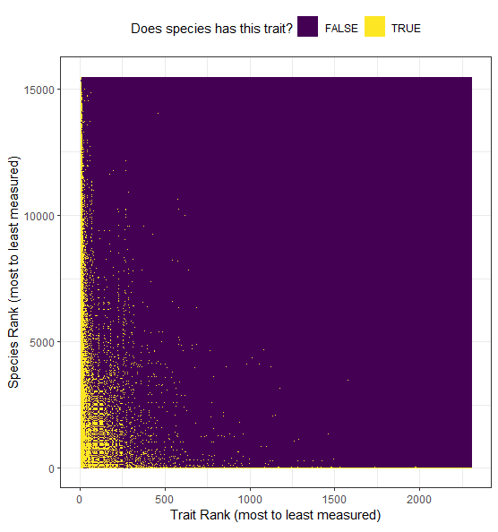
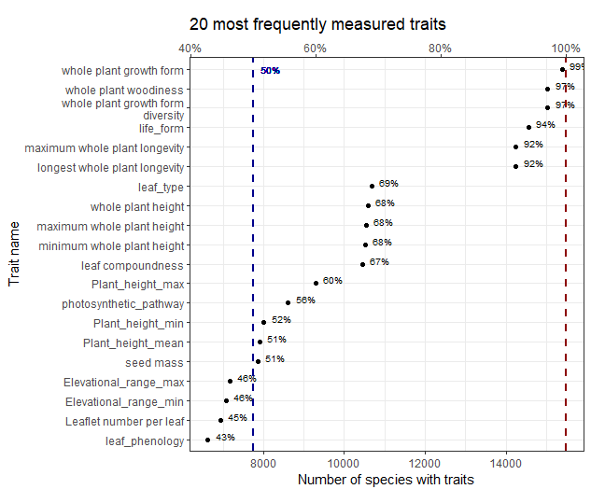
Some Results
Most measured traits “soft”
cover <50% species
As expected trait matrix mostly empty

Slide 5
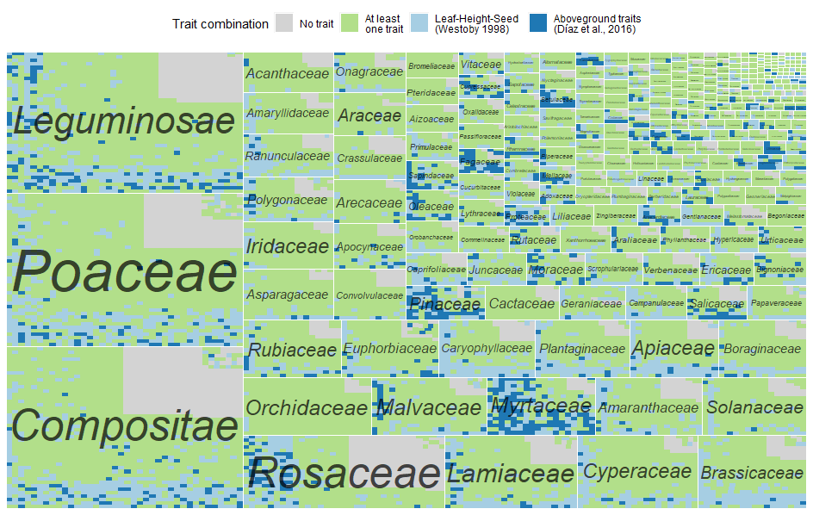
Some Results
Apart from Myrtaceae few families with exhaustive knowledge
Having one trait says nothing about having
the same trait measured

Slide 6
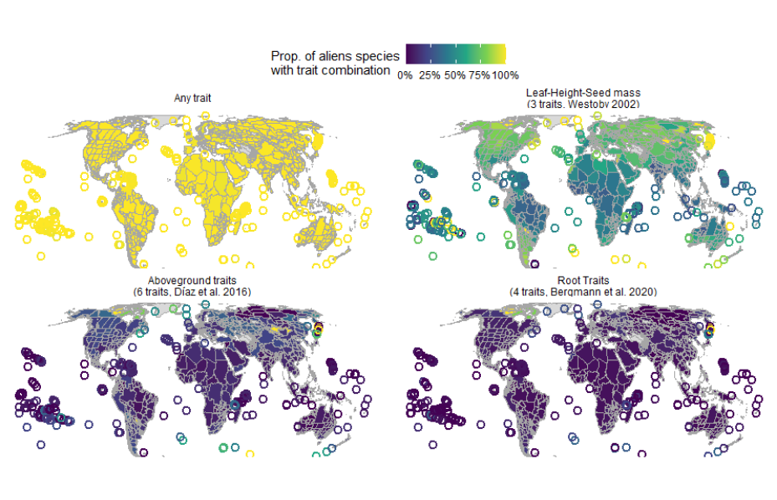
Some Results

Slide 7
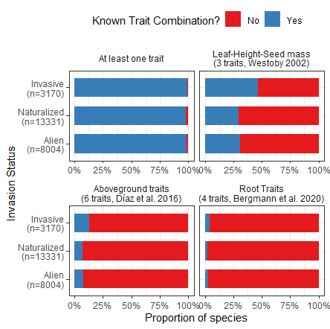
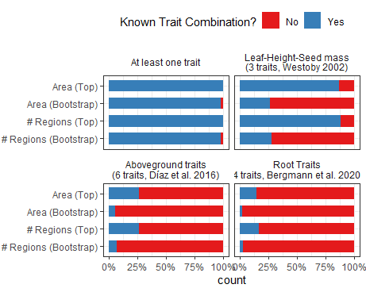
Some Results
Invasive and wide-ranged species are better known
than non-invasive and smaller-ranged species

Slide 8
Important traits for alien species?
What other trait combinations to add in my plots?
Need an alien-specific trait combination
But combinations in literature are rather justified by data availability
than by ecological reasoning
Difficulty to find single combination covering alien species (contingency?)
→ Link specific invasion processes to specific traits?
If there are no universal “invasion syndrome” maybe
there are “barriers syndromes”?

Slide 9
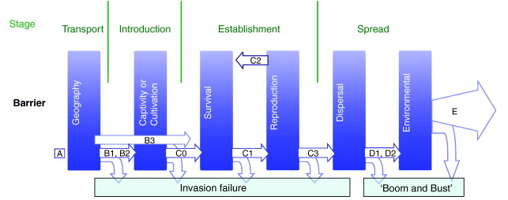
Linking Invasion Processes to Specific Traits
Traits linked to human use
(nutritional or horticultural interest)
No dependence on pollination
nor mycorrhizae
Selfing rate?
Clonal reproduction?
Number of seeds?
Traits linked to seed dispersal (seed mass, wind/animal dispersal, seed longevity?)
If resource-rich habitat acquisitive traits
If resource-poor conservative traits?
(no dependence on mycorrhizae)

Slide 10
Linking Invasion Processes to Specific Traits
Maybe could use an “acquisitive syndrome” combination of traits?
(SLA, LA, Wood Density for woody species, LDMC, Leaf nutrient content? + acquisitive root traits)

