Slide 1
A barrier to global plant invasion ecology: gaps in trait availability for alien species
Matthias Grenié, Helge Bruelheide, Wayne Dawson, Franz Essl, Holger Kreft, Ingolf Kühn, Jan Pergl, Petr Pyšek, Mark van Kleunen, Patrick Weigelt, Marten Winter
iDiv Conference 2022
Patterns and Drivers in the Anthropocene
Notes:
Matthias Grenié
iDiv Conference 2022 – R game

Slide 2
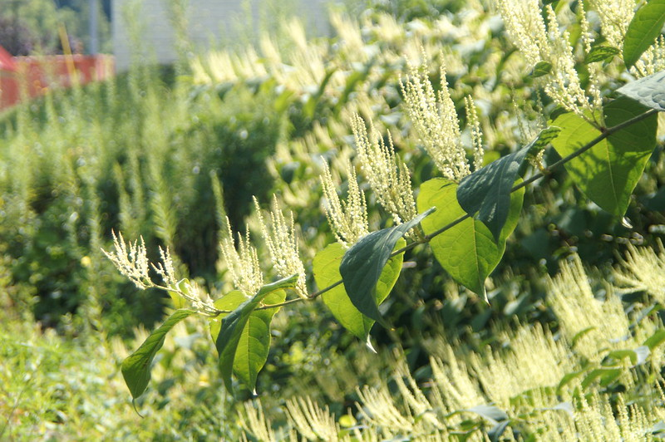
Alien plant species?
Asian knotweed
Fallopia japonica (Houtt.)
Replaces native species
Cost to remove
(GER alone!)
annually ~€32.3 million (Reinhardt et al. 2003)
Public Domain
→ Importance of understanding ecology of alien species
Notes:
Alien plants are everywhere and causing massive disruption in ecosystems.
Also great model to study how communities react to disturbances.

Slide 3
Functional traits?
Notes:
Functional trait have been proven for a couple of decades to be very useful to study ecological systems and understand the ecological processes.
They represent characteristics of organisms linked to fitness components.
Of course, alien species have been studied through the functional lens as well, identifying the generality of invasions through similar functional traits.

Slide 4
Promises of functional biogeography
Notes:
A recent trend in functional ecology is to try to put trait on the map at very large scale to uncover bigger generalities. At national, continental, or global scales.

Slide 5
Global open plant trait databases
Notes:
This trend has been fueled by the increasing availability of open access big trait databases.
For example TRY, BIEN, AusTraits. All give access to traits acquired across the world.

Slide 6
Research questions
Notes:
To what extent are alien species well described in trait databases?
What are most commonly measured traits and trait combinations?
Is there a taxonomic bias in trait availability?
And a geographical bias?
→ How can we use the answers to these questions

Slide 7
Methods: Databases

Slide 8
Methods: Trait combinations

Slide 9
Methods: Trait combinations

Slide 10
Results: trait frequency

Slide 11
Global Trait Matrix

Slide 12
Most frequently measured traits

Slide 13
Trait combinations

Slide 14
Traits per family

Slide 15
Trait availability across the world

Slide 16
Trait availability across the world

Slide 17
Okay, what do we do now?

Slide 18
Priority species, traits, and areas

Slide 19
Low hanging fruits

Slide 20
For a truly large scale functional invasion ecology

Slide 21
Thank you!

