Slide 1
Alien Trait Gaps Results Summary
(January 26th 2022)

Slide 2
Data sources
GloNAF + TRY + BIEN + AusTraits

Slide 3
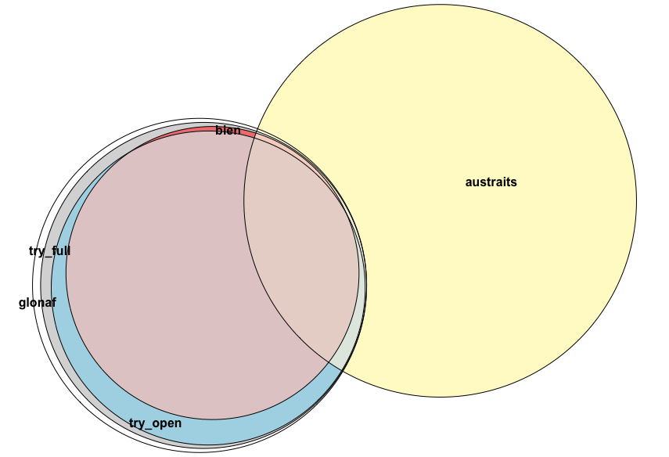
Number of species
16538 alien species referenced in GloNAF
Harmonization against TNRS
(because BIEN is standardized on the same database)

Slide 4
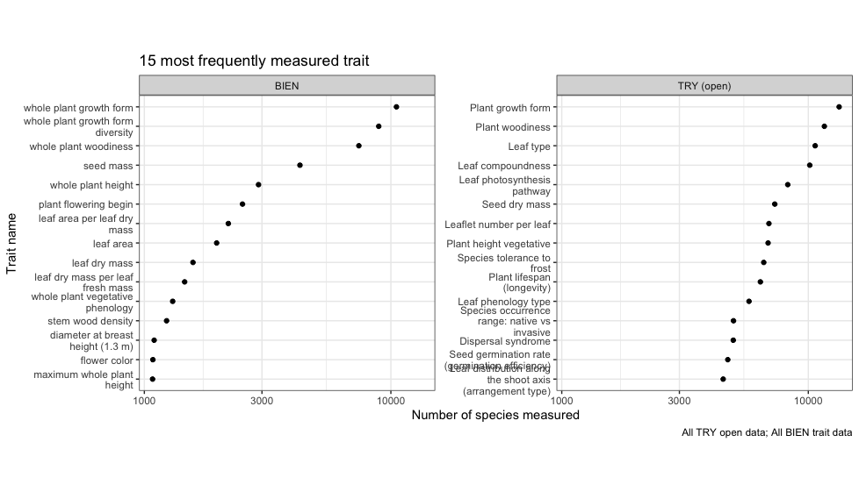
Most measured traits

Slide 5
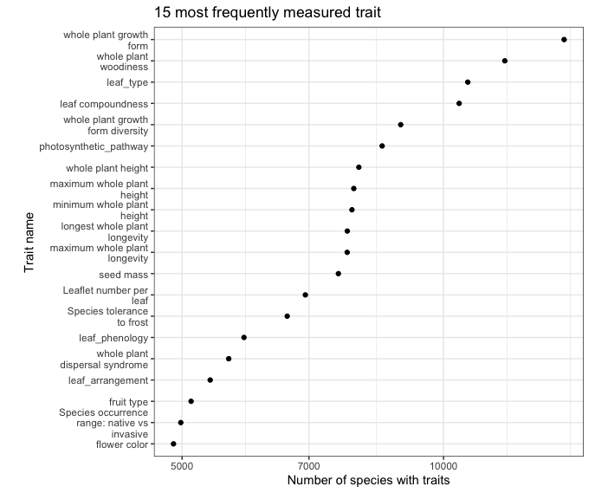
Most measured traits
Combined trait from TRY, BIEN, and AusTraits

Slide 6
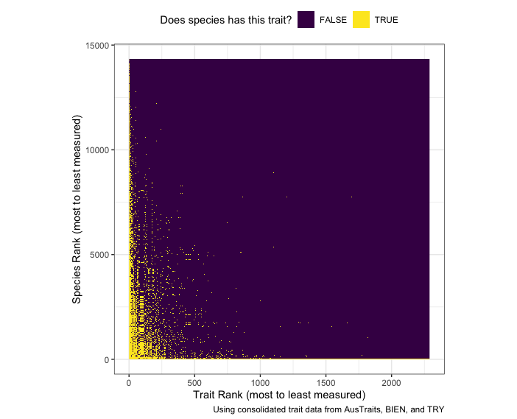
Most measured trait combinations

Slide 7
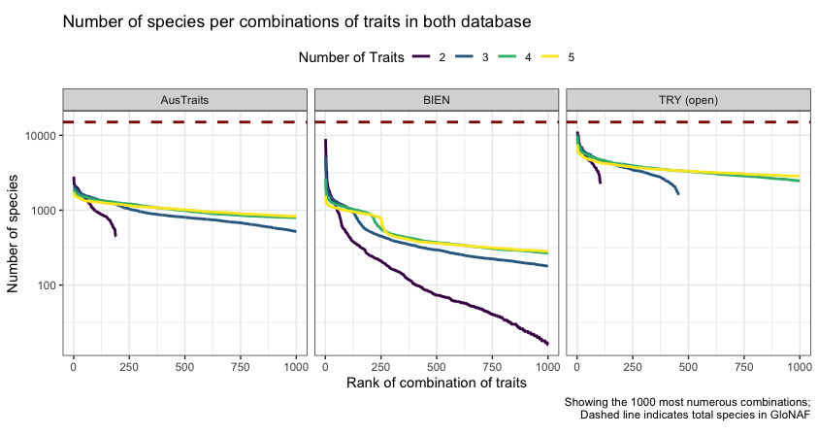
Most measured trait combinations

Slide 8
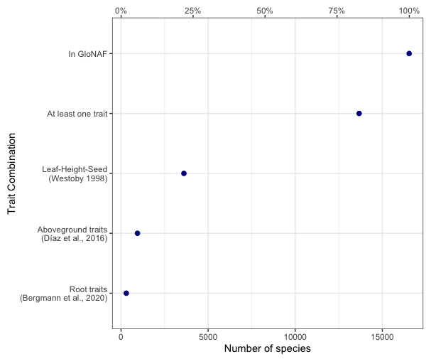
“Classical” trait combinations

Slide 9
Phylogeny of trait gaps for alien species

Slide 10
Map of trait gaps for alien species

