Slide 1
“Biodiversity facets in macro-space”
Tutorial 01
Matthias Grenié & Marten Winter
July 5th 2021

Slide 2
Goals for this practical lecture
Understand and define what are functional traits
Understand the functional approach
Know how to mesure functional diversity on different organisms
Know some of the effect of global changes functional diversity

Slide 3
Schedule of the day

Slide 4
Refresher on functional diversity

Slide 5

Did you say functional diversity?
Biodiversity facets
Taxonomic Diversity
Phylogenetic Diversity
Functional Diversity
Different facets assesses different “dimensions” of biodiversity

Slide 6
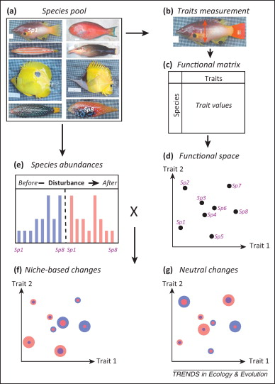
Putting species in trait space
1. List of species at local level
2. Measure traits for each species
3. Different traits for each species
4. Position species along functional space
according to their trait
Mouillot et al. 2014 TREE

Slide 7
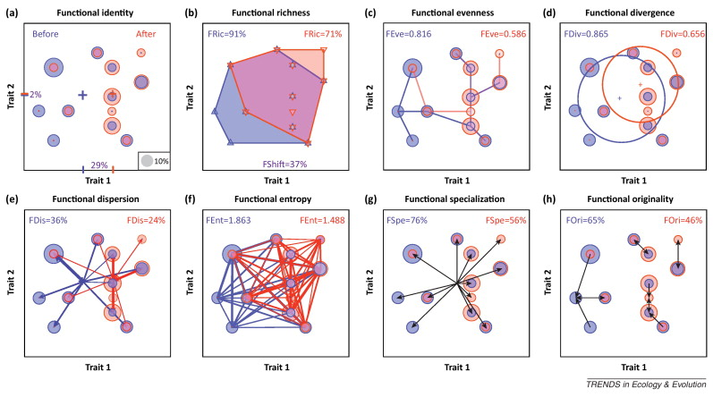
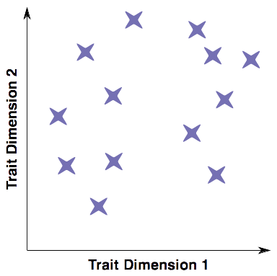
Measuring Functional Diversity
Mouillot et al. 2014 TREE
Many Different Functional Diversity Indices

Slide 8
The Dimensions of Functional Diversity
Functional diversity has three dimensions
Richness
Divergence
Regularity
Total functional space covered
Average functional differences among
set of species
Variance in functional differences among set of species

Slide 9
Introduction to
Phylogenetic diversity

Slide 10
Phylogenetic tree
Uses functional traits to approximate the “function” of an individual
Allow direct understanding of ecosystem processes in terms of trait distribution
Allow the computation of functional diversity across its three dimensions
Depends on the traits used

Slide 11
Phylogenetic Diversity

Slide 12
Dimensions of phylogenetic diversity

Slide 13
Practical session

Slide 14
Ecological Context

Slide 15
Schedule of the day

