Slide 1








Harmonisation des noms de taxons pour les données de biodiversité
généralités et zoom sur les plantes
Matthias Grenié, Emilio Berti, Juan Carvajal-Quintero,
Alban Sagouis, Gala Mona Louise Dädlow,
and Marten Winter
24 Mai 2022 – Atelier D2KB
@LeNematode
https://rekyt.github.io/
Notes:
I will present our work with a group of people working at iDiv in Leipzig Germany. This is ongoing work to synthesize information about taxonomic harmonization for the practitioner.
This work is supported by iDiv and sDiv synthesis centre.
Please don’t hesitate to contact me through the following links if you want to discuss about it.

Slide 2
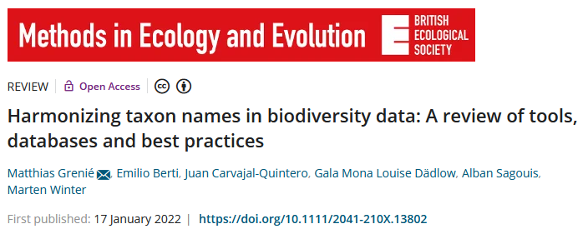
Presentation based on a published article
https://link.infini.fr/harmo
Notes:
What is taxonomic harmonization?
As macro-ecologists we want to study phenomena at large scales (but what is macroecology?).
For this purpose we generally need to merge datasets.
Let’s say I’m interested in the phylogenetic diversity of palms at global scale?
I need a phylogeny of palms, as well as an occurrence dataset. They come from independent sources. However both use species names to index their data.
I could merge them directly by matching exact species names directly. But there is no guarantee that both datasets used a similar taxonomy. It’s safer to actually harmonize taxonomy through matching a central database.
Taxonomic harmonization is thus this step where list of species names are standardized against a central reference.

Slide 3
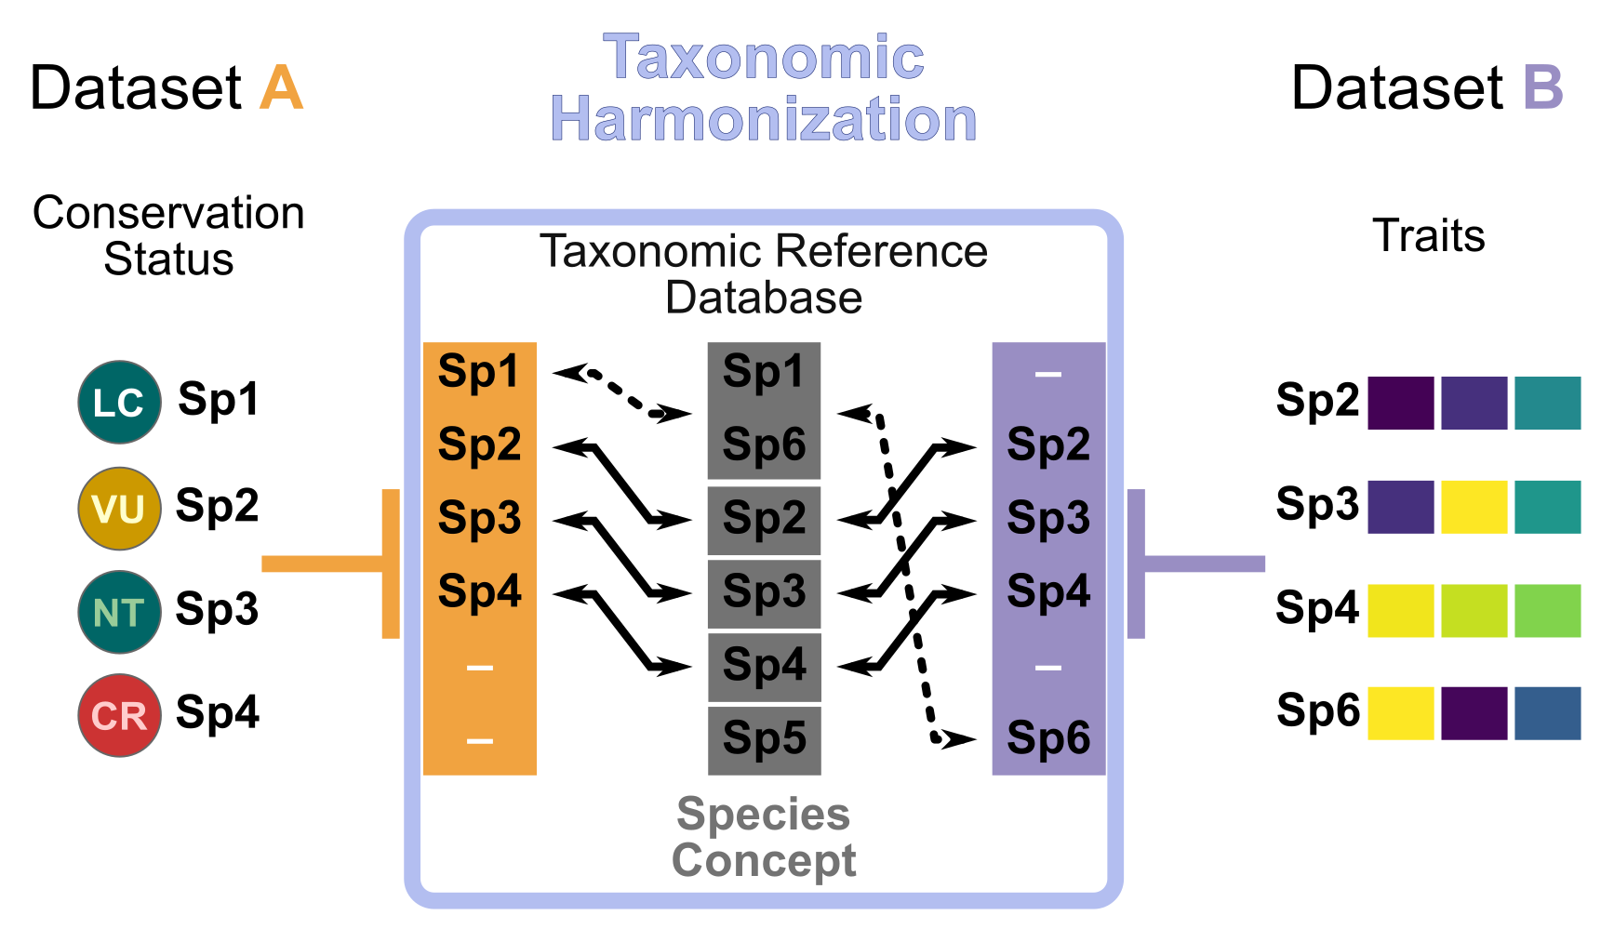
Did you say taxonomic harmonization?
Macro-ecology merge datasets to answer questions
Taxonomic harmonization standardize species names list with a reference
Notes:
What is taxonomic harmonization?
As macro-ecologists we want to study phenomena at large scales (but what is macroecology?).
For this purpose we generally need to merge datasets.
Let’s say I’m interested in the phylogenetic diversity of palms at global scale?
I need a phylogeny of palms, as well as an occurrence dataset. They come from independent sources. However both use species names to index their data.
I could merge them directly by matching exact species names directly. But there is no guarantee that both datasets used a similar taxonomy. It’s safer to actually harmonize taxonomy through matching a central database.
Taxonomic harmonization is thus this step where list of species names are standardized against a central reference.

Slide 4
Why is taxonomic harmonization important?
Example: Bird extinction risk in function of biomass (Norman et al. 2020)
Conservation Status
(IUCN)
Traits
(EltonTraits)
With 9 ≠ sp. (6 in both)
Pipile pipile
Pipile cumanensis
Pipile cujubi
Pipile jacutinga
Megapodius decollatus
Margaroperdix madagarensis
Falcipennis falcipennis
Aburria pipile
Aburria cumanensis
Aburria cujubi
Aburria jacutinga
Megapodius reinwardt
Margaroperdix madagascariensis
Catreus wallichii
Falcipennis falcipennis
Without 13 ≠ sp. (2 in both)
Taxonomic harmonization make datasets comparable
Notes:
Alright I told you that it’s not a good idea to match exact species names. But why?
Cite examples.
Outdated datasets different species concepts
Species synonymy.
May lose many species in the process.
It becomes even more important.

Slide 5
Taxonomic harmonization: a foggy landscape
No general outlook on sources
No overview of available tools
No guide on how to proceed
(Macro-)ecologists need a guide!
→ our motivation: write an overview paper
Notes:
Okay okay, taxonomic harmonization is important but how do I do it?
What should I use?
Need database, tools, and ways to deal with this information.
Right now there is no central place to find all this info.
That’s were we come to the rescue!
We’re working on a review for the users of taxonomic information. Plan to submit in this MEE BES special issue. Follow this special issue in the hope that we go through it ;)

Slide 6

Describing the landscape
ako_law - CC BY-SA 2.0

Slide 7

Taxonomy sources: databases
Taxonomic Reference Database
(also taxonomic backbone, taxonomic checklist, taxonomic authority, etc.)
“Centralized repository of nomenclatural information”
+Spelling Correction
+Synonymy Resolution
Notes:
So the first element we need are databases. Why databases? Centralized repository of nomenclatural information. Also called “taxonomic backbone, taxonomic checklists, taxonomic reference lists”…
They provide organized taxonomic information, as well as synonymy resolution (tell you which name is accepted and which one is not), and eventually correct spelling mistakes.
It takes massive amount of effort for taxonomist to organize this information.
One of the best known is probably the GBIF backbone. Contains XX millions names and XX accepted ones. It cover all possible kingdoms.
Another one is the Leipzig Catalog of Vascular Plants, a recent effort to build a global taxonomy for vascular plant. Global also but more focused taxonomically.
Based on this we propose a typology of databases based on their spatial scale and taxonomic breadth.

Slide 8

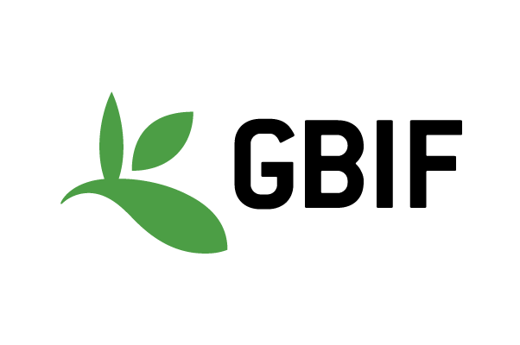


Taxonomy sources: database examples
June 2021
6.6M names
3.7M accepted
2.6M synonyms
Backbone
GBIF (2021)
No taxonomic restriction
Global
Leipzig Catalogue
of Vascular Plants
LCVP
(Freiberg et al. 2020)
Nov. 2020
1.3M names
350k accepted
850k synonyms
Global
Vascular Plants
Notes:
So the first element we need are databases. Why databases? Centralized repository of nomenclatural information. Also called “taxonomic backbone, taxonomic checklists, taxonomic reference lists”…
They provide organized taxonomic information, as well as synonymy resolution (tell you which name is accepted and which one is not), and eventually correct spelling mistakes.
It takes massive amount of effort for taxonomist to organize this information.
One of the best known is probably the GBIF backbone. Contains XX millions names and XX accepted ones. It cover all possible kingdoms.
Another one is the Leipzig Catalog of Vascular Plants, a recent effort to build a global taxonomy for vascular plant. Global also but more focused taxonomically.
Based on this we propose a typology of databases based on their spatial scale and taxonomic breadth.

Slide 9
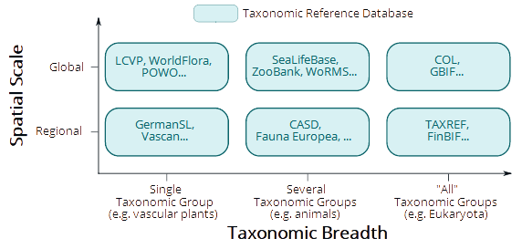
Taxonomy sources: database typology
Notes:
So the first element we need are databases. Why databases? Centralized repository of nomenclatural information. Also called “taxonomic backbone, taxonomic checklists, taxonomic reference lists”…
They provide organized taxonomic information, as well as synonymy resolution (tell you which name is accepted and which one is not), and eventually correct spelling mistakes.
It takes massive amount of effort for taxonomist to organize this information.
One of the best known is probably the GBIF backbone. Contains XX millions names and XX accepted ones. It cover all possible kingdoms.
Another one is the Leipzig Catalog of Vascular Plants, a recent effort to build a global taxonomy for vascular plant. Global also but more focused taxonomically.
Based on this we propose a typology of databases based on their spatial scale and taxonomic breadth.

Slide 10
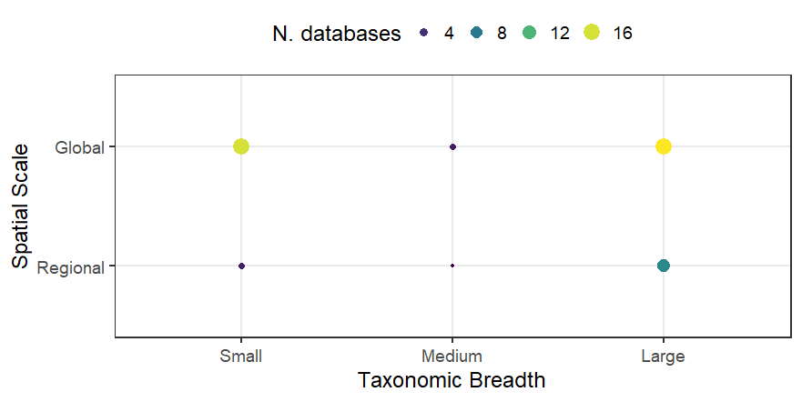
Taxonomy sources: list of databases
Identified 50 accessible databases (not exhaustive)
Many Global ones of either Small or Large Taxonomic Breadth
Notes:
So the first element we need are databases. Why databases? Centralized repository of nomenclatural information. Also called “taxonomic backbone, taxonomic checklists, taxonomic reference lists”…
They provide organized taxonomic information, as well as synonymy resolution (tell you which name is accepted and which one is not), and eventually correct spelling mistakes.
It takes massive amount of effort for taxonomist to organize this information.
One of the best known is probably the GBIF backbone. Contains XX millions names and XX accepted ones. It cover all possible kingdoms.
Another one is the Leipzig Catalog of Vascular Plants, a recent effort to build a global taxonomy for vascular plant. Global also but more focused taxonomically.
Based on this we propose a typology of databases based on their spatial scale and taxonomic breadth.

Slide 11
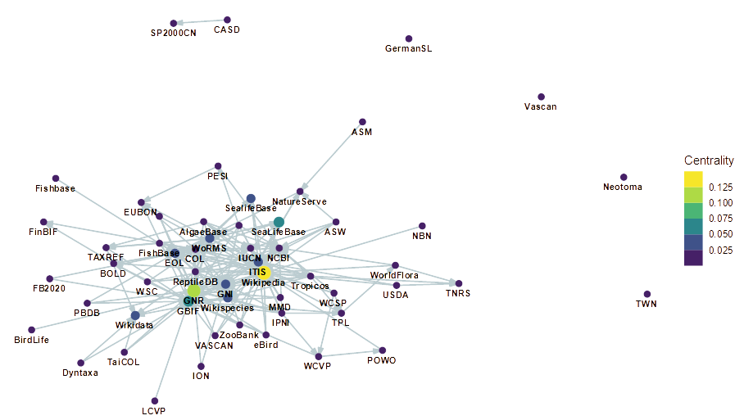
Taxonomy sources: relationships between databases
Relationships
Source → Target
Specific databases widely reused
Some “mega-”
aggregator databases
N.B.: This information is very difficult to gather
(not even talking quantitatively)
<numéro>

Slide 12

From Databases to Tools
Ferjflores- CC BY-SA 2.0

Slide 13






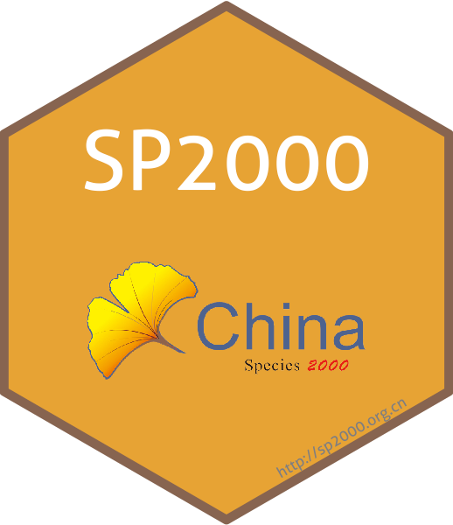
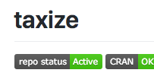
Taxonomic tools: R packages
Review of packages on CRAN + GitHub + Bioconductor
Manual curated from standard queries (GitHub code search + r-pkg.org)
Criteria
Real R package (not collection of scripts)
Not a wrapper (not only reusing other tools)
Not about genomics (different field)
Identified 68 packages of which 59 were included
Notes:
Now that we have the datasources we need tools to manipulate the information.
Indeed we could manually extract the data ourself with tables of data, however it starts to be impractical and error-prone when working with hundreds of species and many different datasets.
Thus the need for automatic tools. Focus here on R packages because R is the most popular language in ecology.
We identified >50 packages that deal with taxonomic information split in 4 different categories.
Show package table?
Main fact we got:
Packages not connected enough → no common infrastructure
Several packages do same things → access same data. Probably a better idea to contribute to single tool

Slide 14
Taxonomic tools: Different categories
Identified 64 packages belonging to four categories
Database Access
Data Wrangling
Infrastructure
Visualization
3 pkgs
52 pkgs
15 pkgs
4 pkgs
taxize accesses many databases
taxa provides standard classes
rgnparser parses names into components
metacoder displays taxonomy
taxadb offers offline access
Notes:
So the first element we need are databases. Why databases? Centralized repository of nomenclatural information. Also called “taxonomic backbone, taxonomic checklists, taxonomic reference lists”…
They provide organized taxonomic information, as well as synonymy resolution (tell you which name is accepted and which one is not), and eventually correct spelling mistakes.
It takes massive amount of effort for taxonomist to organize this information.
One of the best known is probably the GBIF backbone. Contains XX millions names and XX accepted ones. It cover all possible kingdoms.
Another one is the Leipzig Catalog of Vascular Plants, a recent effort to build a global taxonomy for vascular plant. Global also but more focused taxonomically.
Based on this we propose a typology of databases based on their spatial scale and taxonomic breadth.

Slide 15
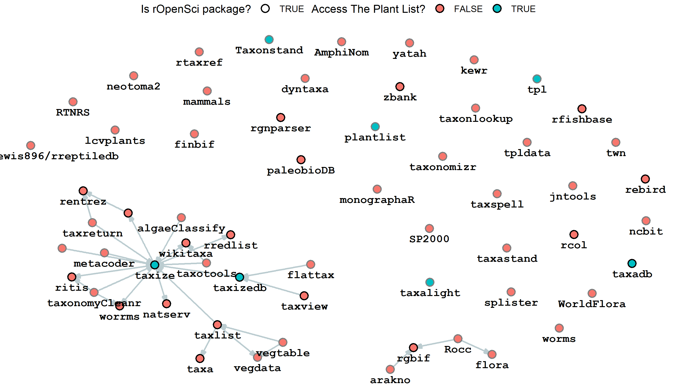
Packages Dependency Network
Disconnected network
Apart from
rOpenSci packages
Many pkgs
provide same source
(TPL)
→ No standards to interact with taxonomic data
<numéro>

Slide 16



Taxonomic tools: Lessons Learned
→
GitHub is not a perennial archive
…
Contribute
rather than rebuild
Taxonomic software is HARD
→ Uncommon expertise
(and limited incentives)
Notes:
So the first element we need are databases. Why databases? Centralized repository of nomenclatural information. Also called “taxonomic backbone, taxonomic checklists, taxonomic reference lists”…
They provide organized taxonomic information, as well as synonymy resolution (tell you which name is accepted and which one is not), and eventually correct spelling mistakes.
It takes massive amount of effort for taxonomist to organize this information.
One of the best known is probably the GBIF backbone. Contains XX millions names and XX accepted ones. It cover all possible kingdoms.
Another one is the Leipzig Catalog of Vascular Plants, a recent effort to build a global taxonomy for vascular plant. Global also but more focused taxonomically.
Based on this we propose a typology of databases based on their spatial scale and taxonomic breadth.

Slide 17
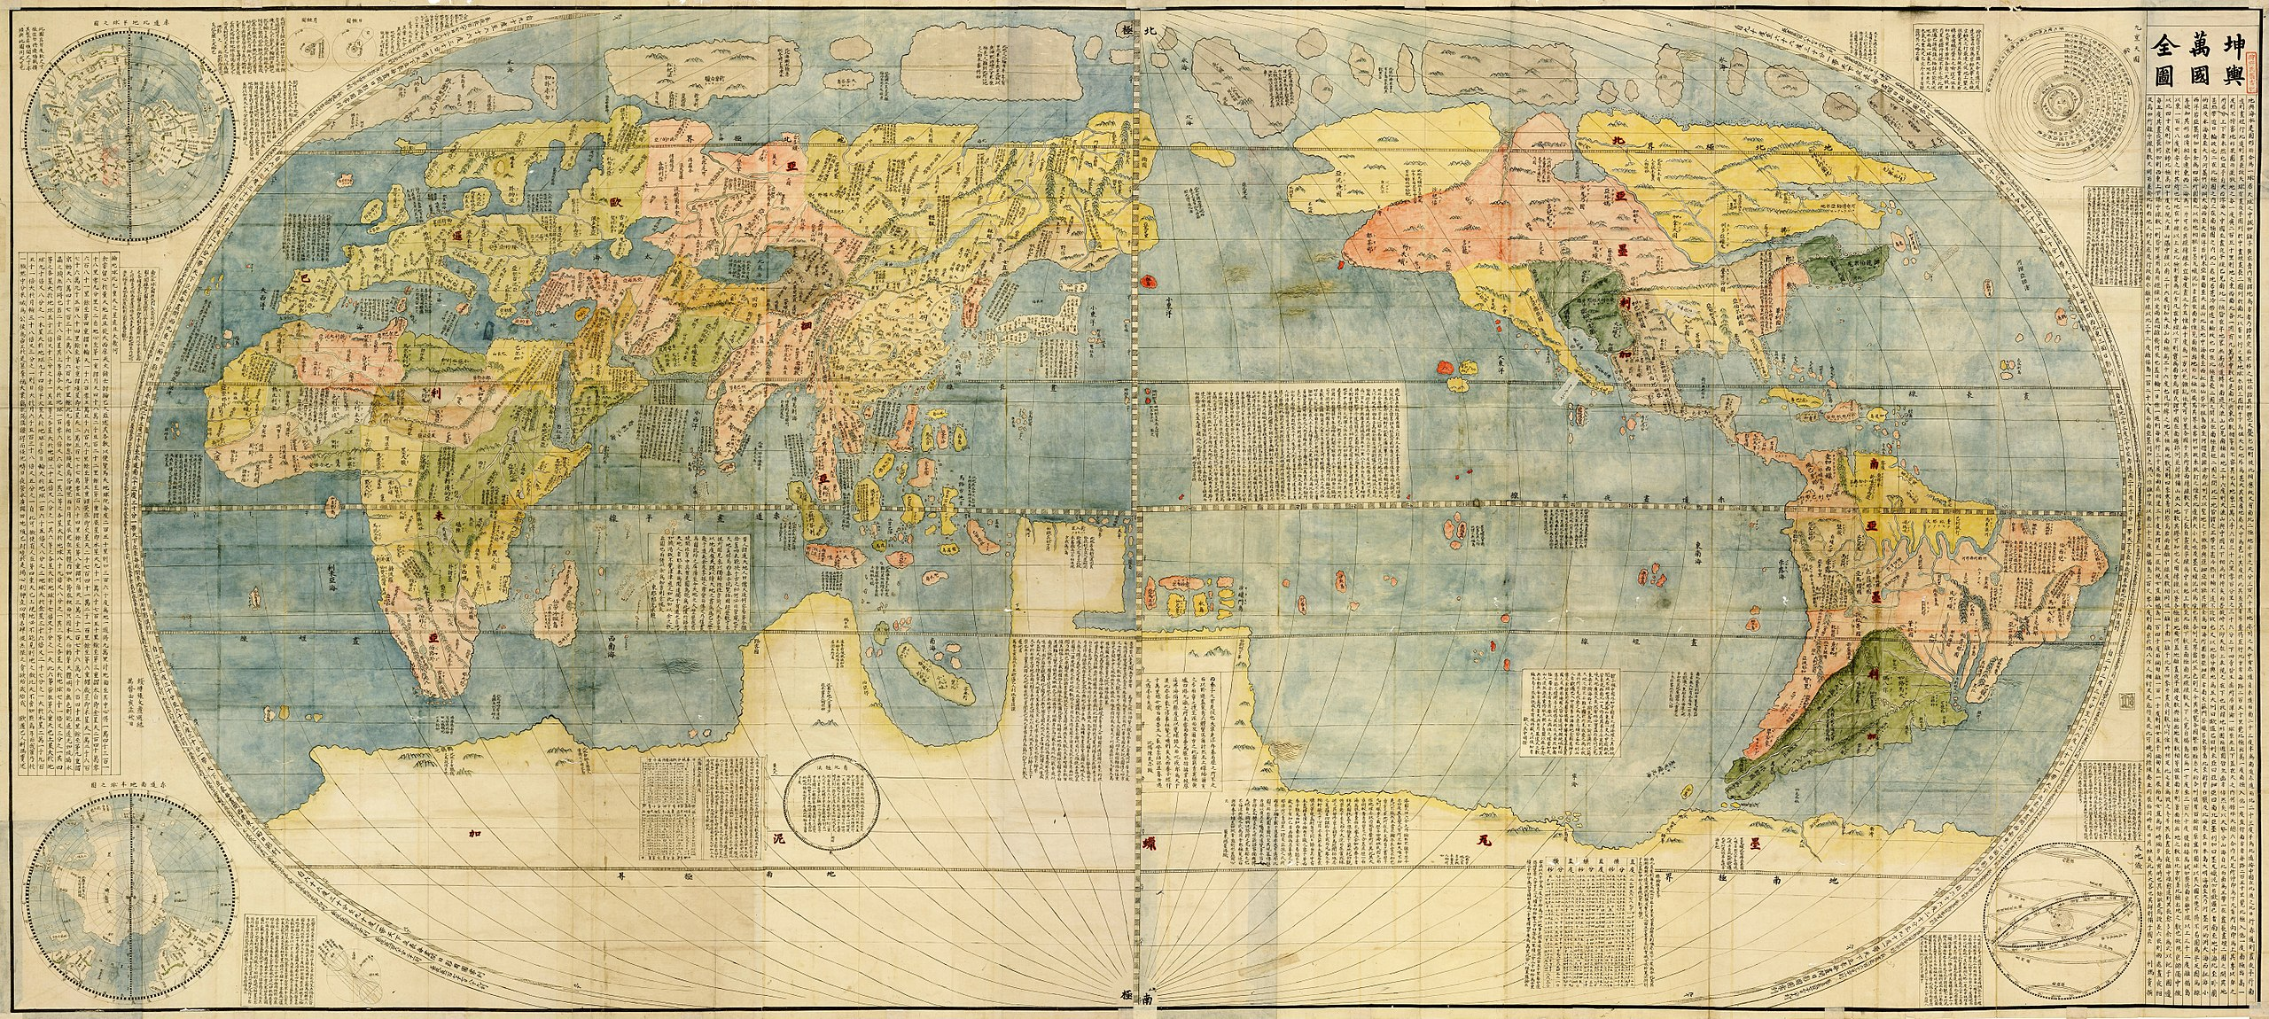
Mapping the landscape
of taxonomic tools
Kunyu Wanguo Quantu (坤輿萬國全圖) 1604 - Public Domain

Slide 18
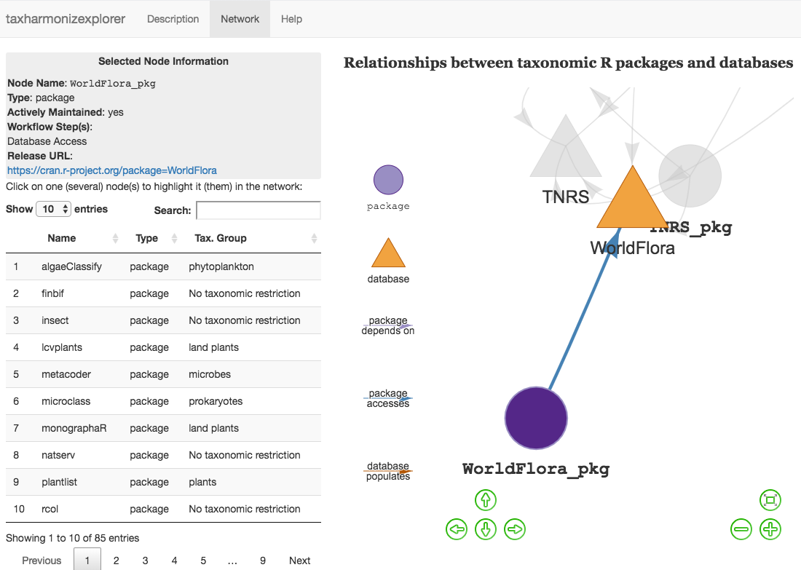

taxharmonizexplorer
Show directed relationships between databases and packages
Show basic information
on package/database
Living database
(continuously updated)
Access it on:
https://tiny.cc/taxharmonizexplorer
Notes:
To wrap-up this information and understand better the links between packages, between databases, and between packages and databases we built an interactive shiny app, accessible through the link below. This can help the users see how different databases are connected and which package access which databases?
Display information about databases and packages
BUT links between databases are difficult to get
Packages can also be difficult to get
→ community source it (miss a database miss a package, contact me!)
→ we’ll be also have a student helper working on digging the links out and make this available

Slide 19
DEMO TIME!
Notes:
So the first element we need are databases. Why databases? Centralized repository of nomenclatural information. Also called “taxonomic backbone, taxonomic checklists, taxonomic reference lists”…
They provide organized taxonomic information, as well as synonymy resolution (tell you which name is accepted and which one is not), and eventually correct spelling mistakes.
It takes massive amount of effort for taxonomist to organize this information.
One of the best known is probably the GBIF backbone. Contains XX millions names and XX accepted ones. It cover all possible kingdoms.
Another one is the Leipzig Catalog of Vascular Plants, a recent effort to build a global taxonomy for vascular plant. Global also but more focused taxonomically.
Based on this we propose a typology of databases based on their spatial scale and taxonomic breadth.

Slide 20

Focus on Plant
Taxonomic Databases
Twin Lantana camara 'Patty Wankler' – CC-BY 2.5 – Joaquim Alves Gaspar

Slide 21
Available Plant-Specific Databases and Tools
Identified 13 databases and 19 packages
→ 9 Global level databases
→ 4 Regional ones (FB 2020, GermanSL, USDA, VASCAN)
→ Several packages access the same database
Notes:
What is taxonomic harmonization?
As macro-ecologists we want to study phenomena at large scales (but what is macroecology?).
For this purpose we generally need to merge datasets.
Let’s say I’m interested in the phylogenetic diversity of palms at global scale?
I need a phylogeny of palms, as well as an occurrence dataset. They come from independent sources. However both use species names to index their data.
I could merge them directly by matching exact species names directly. But there is no guarantee that both datasets used a similar taxonomy. It’s safer to actually harmonize taxonomy through matching a central database.
Taxonomic harmonization is thus this step where list of species names are standardized against a central reference.

Slide 22
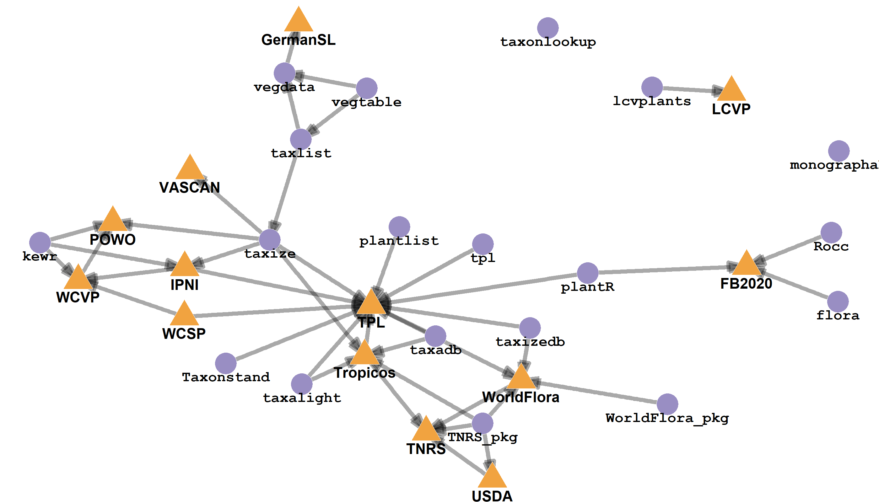
Relationship between them
Centrality of The Plant List
Tangled relationships
between databases
WCSP – WCVP – POWO?
Regional databases
are not connected
Notes:
What is taxonomic harmonization?
As macro-ecologists we want to study phenomena at large scales (but what is macroecology?).
For this purpose we generally need to merge datasets.
Let’s say I’m interested in the phylogenetic diversity of palms at global scale?
I need a phylogeny of palms, as well as an occurrence dataset. They come from independent sources. However both use species names to index their data.
I could merge them directly by matching exact species names directly. But there is no guarantee that both datasets used a similar taxonomy. It’s safer to actually harmonize taxonomy through matching a central database.
Taxonomic harmonization is thus this step where list of species names are standardized against a central reference.

Slide 23
Perspectives on Plant Databases
The Plant List (outdated since 9 years!)
→ Ease of access (API, scrappable webpages, still online!)
≥4 updated global plant taxonomies
Leipzig Catalogue of Vascular Plants, POWO, World Flora Online, WorldPlants.de (CoL)
No current effort to harmonize all of them (≠ birds)
Make the links between databases explicit
Links between regional and global taxonomies unclear → less synonyms in regional
Paper in prep. comparing global plant taxonomies and TPL
(Led by David Schellenberger-Costa)
Notes:
What is taxonomic harmonization?
As macro-ecologists we want to study phenomena at large scales (but what is macroecology?).
For this purpose we generally need to merge datasets.
Let’s say I’m interested in the phylogenetic diversity of palms at global scale?
I need a phylogeny of palms, as well as an occurrence dataset. They come from independent sources. However both use species names to index their data.
I could merge them directly by matching exact species names directly. But there is no guarantee that both datasets used a similar taxonomy. It’s safer to actually harmonize taxonomy through matching a central database.
Taxonomic harmonization is thus this step where list of species names are standardized against a central reference.

Slide 24
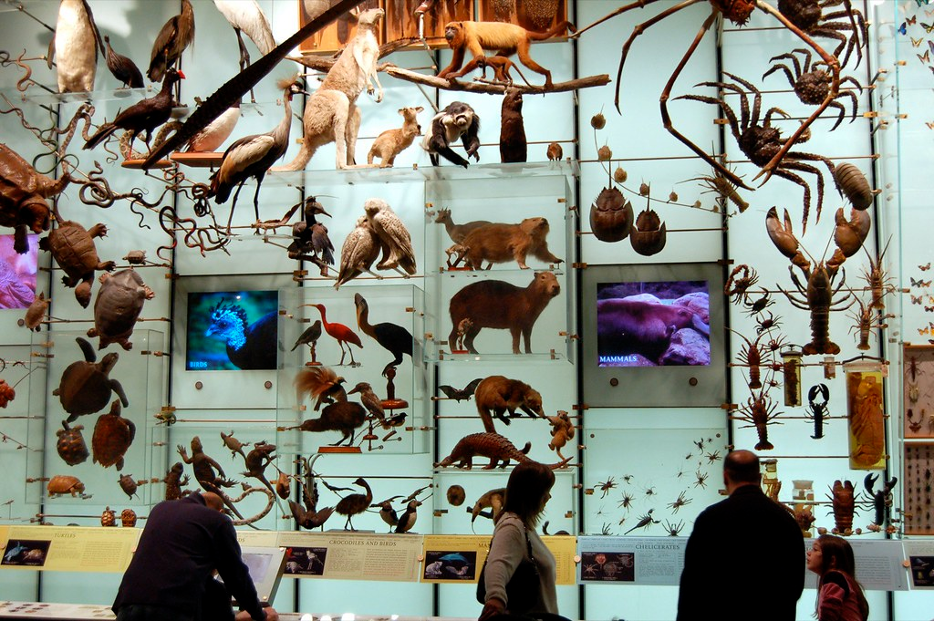
Taxonomic harmonization
in practice
Dano CC BY 2.0

Slide 25
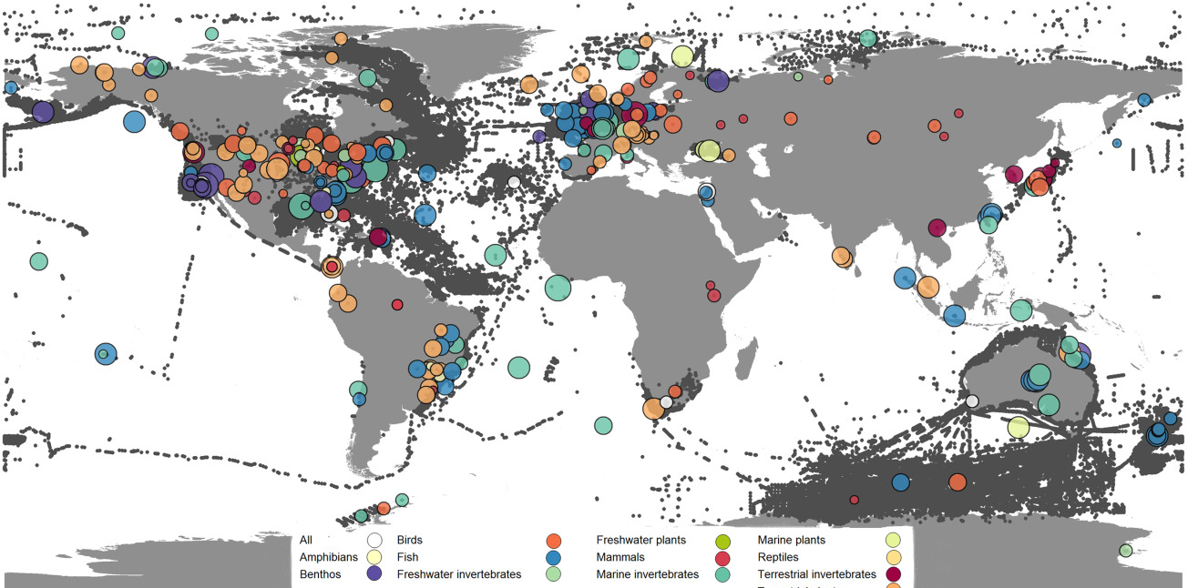

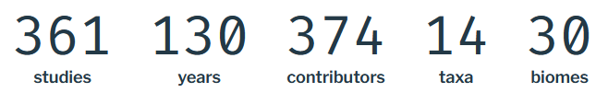
Use case
How should we perform taxonomic harmonization?
Example Data
Dornelas et al. 2018
Notes:
So the first element we need are databases. Why databases? Centralized repository of nomenclatural information. Also called “taxonomic backbone, taxonomic checklists, taxonomic reference lists”…
They provide organized taxonomic information, as well as synonymy resolution (tell you which name is accepted and which one is not), and eventually correct spelling mistakes.
It takes massive amount of effort for taxonomist to organize this information.
One of the best known is probably the GBIF backbone. Contains XX millions names and XX accepted ones. It cover all possible kingdoms.
Another one is the Leipzig Catalog of Vascular Plants, a recent effort to build a global taxonomy for vascular plant. Global also but more focused taxonomically.
Based on this we propose a typology of databases based on their spatial scale and taxonomic breadth.

Slide 26
Interest of using BioTIME
Actually used at iDiv and by many people
(over 2000 downloads, >100 citations)
Multi-taxa → more difficult harmonization
Not well harmonized
“Additionally, species names were checked for typographic errors and misspellings […]. Most records were included as provided and may not always conform to the latest nomenclature.” Dornelas et al. 2018
Notes:
So the first element we need are databases. Why databases? Centralized repository of nomenclatural information. Also called “taxonomic backbone, taxonomic checklists, taxonomic reference lists”…
They provide organized taxonomic information, as well as synonymy resolution (tell you which name is accepted and which one is not), and eventually correct spelling mistakes.
It takes massive amount of effort for taxonomist to organize this information.
One of the best known is probably the GBIF backbone. Contains XX millions names and XX accepted ones. It cover all possible kingdoms.
Another one is the Leipzig Catalog of Vascular Plants, a recent effort to build a global taxonomy for vascular plant. Global also but more focused taxonomically.
Based on this we propose a typology of databases based on their spatial scale and taxonomic breadth.

Slide 27
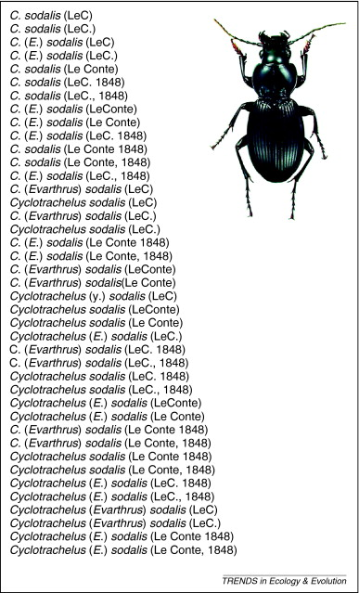
Importance of pre-processing
Goal: Unify writing style (+correct mistakes)
(identify components)
Cyclotrachelus sodalis (Le Conte, 1848)
44 326 unique taxa in BioTIME
32 900 after pre-processing
rgnparser::gn_parse()
rgbif::parsenames()
Patterson et al. 2010
Notes:
Workflow results Bogota vs. Torino.
Very similar results? What are different

Slide 28
Conclusion about workflows
Taxon-specific workflows achieved better matching
Global workflows worked well but less synonymy resolution
however faster than taxon-specific workflows
→ Choice of workflow depends on your question and accuracy
<numéro>

Slide 29

Conclusion
96dpi CC BY-NC 2.0

Slide 30
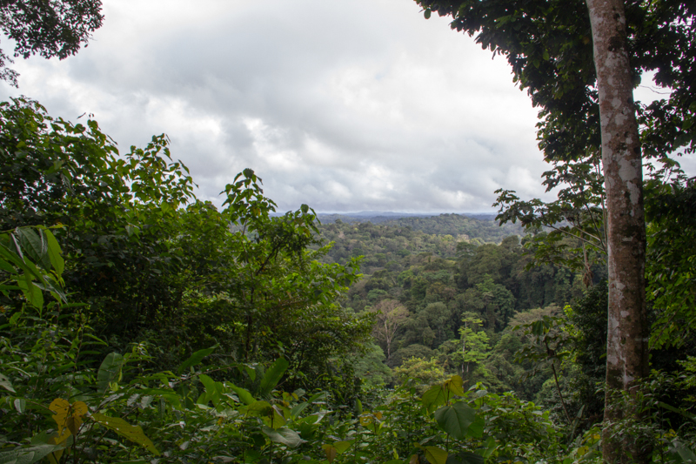
Emerging from the fog: take home messages
Think about taxonomic harmonization
→ needed to maximize data reuse
Know the taxonomic landscape
→ use taxharmonizexplorer 😎
Detail your workflow
→ record versions and functions used
Notes:
Take Home Messages:
For database managers → make the links with other databases discoverable, provide an easily accessible API
For package developers → don’t reinvent the wheel, contribute to other projects instead of creating a new one
For users → think about taxonomic harmonization, actually use the tools available, they’re pretty good and it is worth it :)

Slide 31

Perspectives
Need to better characterize impact of different workflows
(with author names, fuzzy matching, etc.)
Need cross-talk between taxonomists, database managers,
and end-users (ecologists and others)
Continue completing
the network of resources
TAXONOMISTS
Notes:
Take Home Messages:
For database managers → make the links with other databases discoverable, provide an easily accessible API
For package developers → don’t reinvent the wheel, contribute to other projects instead of creating a new one
For users → think about taxonomic harmonization, actually use the tools available, they’re pretty good and it is worth it :)

Slide 32
@LeNematode
https://rekyt.github.io/
Thank you
taxharmonizexplorer
https://tiny.cc/taxharmonizexplorer

