Slide 1
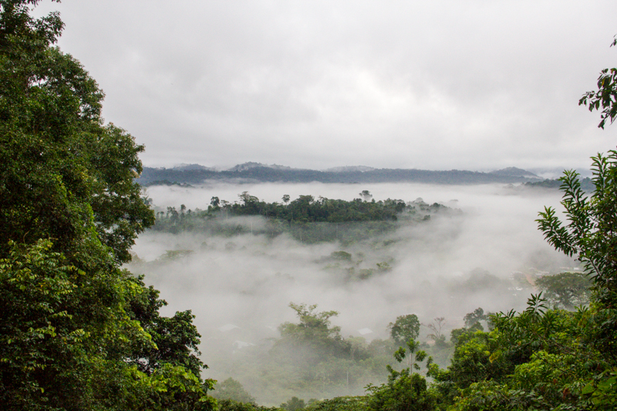







Harmonisation des noms de taxons pour les données de biodiversité
généralités et zoom sur les plantes
Matthias Grenié, Emilio Berti, Juan Carvajal-Quintero,
Alban Sagouis, Gala Mona Louise Dädlow,
et Marten Winter
24 Mai 2022 – Atelier D2KB
@LeNematode
https://rekyt.github.io/
Notes:
I will present our work with a group of people working at iDiv in Leipzig Germany. This is ongoing work to synthesize information about taxonomic harmonization for the practitioner.
This work is supported by iDiv and sDiv synthesis centre.
Please don’t hesitate to contact me through the following links if you want to discuss about it.

Slide 2
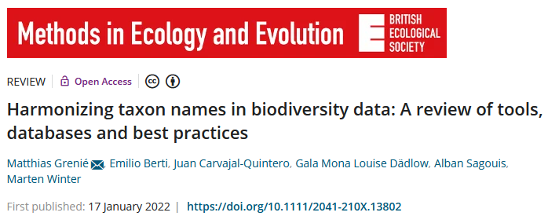
Présentation basée sur un article publié
https://link.infini.fr/harmo
Notes:
What is taxonomic harmonization?
As macro-ecologists we want to study phenomena at large scales (but what is macroecology?).
For this purpose we generally need to merge datasets.
Let’s say I’m interested in the phylogenetic diversity of palms at global scale?
I need a phylogeny of palms, as well as an occurrence dataset. They come from independent sources. However both use species names to index their data.
I could merge them directly by matching exact species names directly. But there is no guarantee that both datasets used a similar taxonomy. It’s safer to actually harmonize taxonomy through matching a central database.
Taxonomic harmonization is thus this step where list of species names are standardized against a central reference.

Slide 3
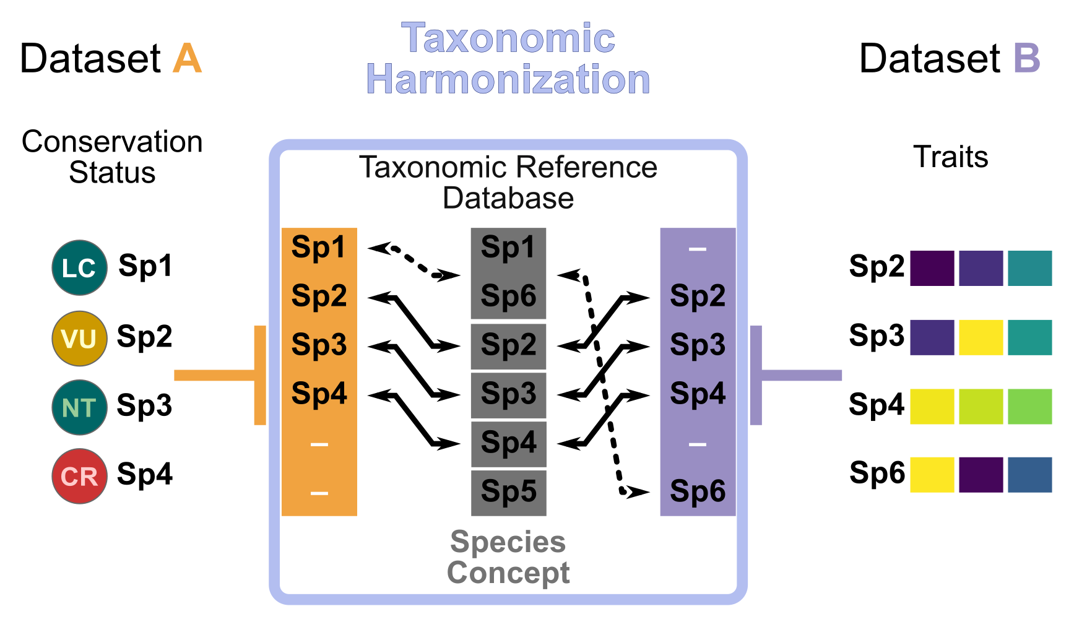
Vous avez parlé d’ « harmonisation taxinomique » ?
Macroécologie = correspondance de jeux de données pour répondre à des questions
L’harmonisation taxinomique homogénéise des noms de taxon
grâce à une liste de référence
Notes:
What is taxonomic harmonization?
As macro-ecologists we want to study phenomena at large scales (but what is macroecology?).
For this purpose we generally need to merge datasets.
Let’s say I’m interested in the phylogenetic diversity of palms at global scale?
I need a phylogeny of palms, as well as an occurrence dataset. They come from independent sources. However both use species names to index their data.
I could merge them directly by matching exact species names directly. But there is no guarantee that both datasets used a similar taxonomy. It’s safer to actually harmonize taxonomy through matching a central database.
Taxonomic harmonization is thus this step where list of species names are standardized against a central reference.

Slide 4
Pourquoi harmoniser des noms de taxons ?
Exemple : Risque d’extinction d’oiseaux en fonction de leur biomasse
Statuts de Conservation
(UICN)
Traits
(EltonTraits)
Avec 9 ≠ sp. (6)
Pipile pipile
Pipile cumanensis
Pipile cujubi
Pipile jacutinga
Megapodius decollatus
Margaroperdix madagarensis
Falcipennis falcipennis
Aburria pipile
Aburria cumanensis
Aburria cujubi
Aburria jacutinga
Megapodius reinwardt
Margaroperdix madagascariensis
Catreus wallichii
Falcipennis falcipennis
Sans 13 ≠ sp. (2)
L’harmonisation taxinomique permet la comparaison
Notes:
Alright I told you that it’s not a good idea to match exact species names. But why?
Cite examples.
Outdated datasets different species concepts
Species synonymy.
May lose many species in the process.
It becomes even more important.

Slide 5
L’harmonisation taxinomique : un paysage brumeux
Pas de perspectives générales
sur les sources
Pas de vue d’ensemble des outils disponibles
Pas de guide sur comment procéder
Les (Macro-)écologues ont besoin d’un guide !
→ notre motivation: écrire un article de synthèse
Notes:
Okay okay, taxonomic harmonization is important but how do I do it?
What should I use?
Need database, tools, and ways to deal with this information.
Right now there is no central place to find all this info.
That’s were we come to the rescue!
We’re working on a review for the users of taxonomic information. Plan to submit in this MEE BES special issue. Follow this special issue in the hope that we go through it ;)

Slide 6

Décrire le paysage
ako_law - CC BY-SA 2.0

Slide 7

Sources de taxinomie : les bases de données
Taxonomic Reference Database
(= Base de données de Référence Taxinomique)
(aussi taxonomic backbone,
taxonomic checklist, taxonomic authority, etc.)
« Base de données centralisées d’information nomenclaturelle »
+Correction d’erreur
+ Résolution synonymique
Notes:
So the first element we need are databases. Why databases? Centralized repository of nomenclatural information. Also called “taxonomic backbone, taxonomic checklists, taxonomic reference lists”…
They provide organized taxonomic information, as well as synonymy resolution (tell you which name is accepted and which one is not), and eventually correct spelling mistakes.
It takes massive amount of effort for taxonomist to organize this information.
One of the best known is probably the GBIF backbone. Contains XX millions names and XX accepted ones. It cover all possible kingdoms.
Another one is the Leipzig Catalog of Vascular Plants, a recent effort to build a global taxonomy for vascular plant. Global also but more focused taxonomically.
Based on this we propose a typology of databases based on their spatial scale and taxonomic breadth.

Slide 8




Sources de taxinomie : exemples de bases de données
Juin 2021
6.6M de noms
3.7M acceptés
2.6M synonymes
Backbone
GBIF (2021)
Sans restriction taxinomique
Mondial
Leipzig Catalogue
of Vascular Plants
LCVP
(Freiberg et al. 2020)
Nov. 2020
1.3M de noms
350k acceptés
850k synonymes
Mondial
Plantes Vasculaires
Notes:
So the first element we need are databases. Why databases? Centralized repository of nomenclatural information. Also called “taxonomic backbone, taxonomic checklists, taxonomic reference lists”…
They provide organized taxonomic information, as well as synonymy resolution (tell you which name is accepted and which one is not), and eventually correct spelling mistakes.
It takes massive amount of effort for taxonomist to organize this information.
One of the best known is probably the GBIF backbone. Contains XX millions names and XX accepted ones. It cover all possible kingdoms.
Another one is the Leipzig Catalog of Vascular Plants, a recent effort to build a global taxonomy for vascular plant. Global also but more focused taxonomically.
Based on this we propose a typology of databases based on their spatial scale and taxonomic breadth.

Slide 9
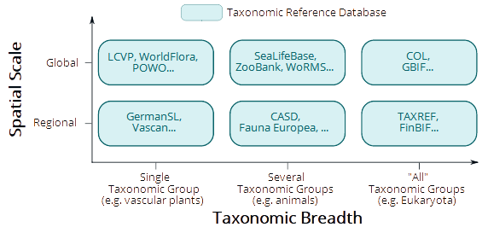
Sources de taxinomie : typologie des bases de données
Notes:
So the first element we need are databases. Why databases? Centralized repository of nomenclatural information. Also called “taxonomic backbone, taxonomic checklists, taxonomic reference lists”…
They provide organized taxonomic information, as well as synonymy resolution (tell you which name is accepted and which one is not), and eventually correct spelling mistakes.
It takes massive amount of effort for taxonomist to organize this information.
One of the best known is probably the GBIF backbone. Contains XX millions names and XX accepted ones. It cover all possible kingdoms.
Another one is the Leipzig Catalog of Vascular Plants, a recent effort to build a global taxonomy for vascular plant. Global also but more focused taxonomically.
Based on this we propose a typology of databases based on their spatial scale and taxonomic breadth.

Slide 10
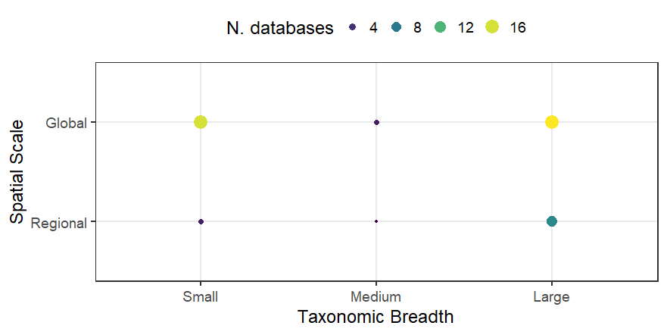
Sources de taxinomie : liste de base de données
Identification de 50 bases de données
(non exhaustif)
Nombreuses Mondiales de petite ou large étendue taxinomique
Notes:
So the first element we need are databases. Why databases? Centralized repository of nomenclatural information. Also called “taxonomic backbone, taxonomic checklists, taxonomic reference lists”…
They provide organized taxonomic information, as well as synonymy resolution (tell you which name is accepted and which one is not), and eventually correct spelling mistakes.
It takes massive amount of effort for taxonomist to organize this information.
One of the best known is probably the GBIF backbone. Contains XX millions names and XX accepted ones. It cover all possible kingdoms.
Another one is the Leipzig Catalog of Vascular Plants, a recent effort to build a global taxonomy for vascular plant. Global also but more focused taxonomically.
Based on this we propose a typology of databases based on their spatial scale and taxonomic breadth.

Slide 11
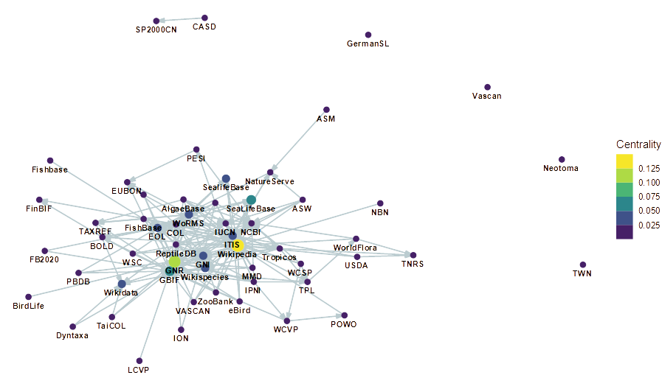
Sources de taxinomie : relation entre bases de données
Arête
Source → Cible
Quelques bases très réutilisées
Quelques bases « mega-aggrégatrices »
N.B. : Cette information est très difficile à obtenir
(sans parler de la dimension quantitative)
<numéro>

Slide 12
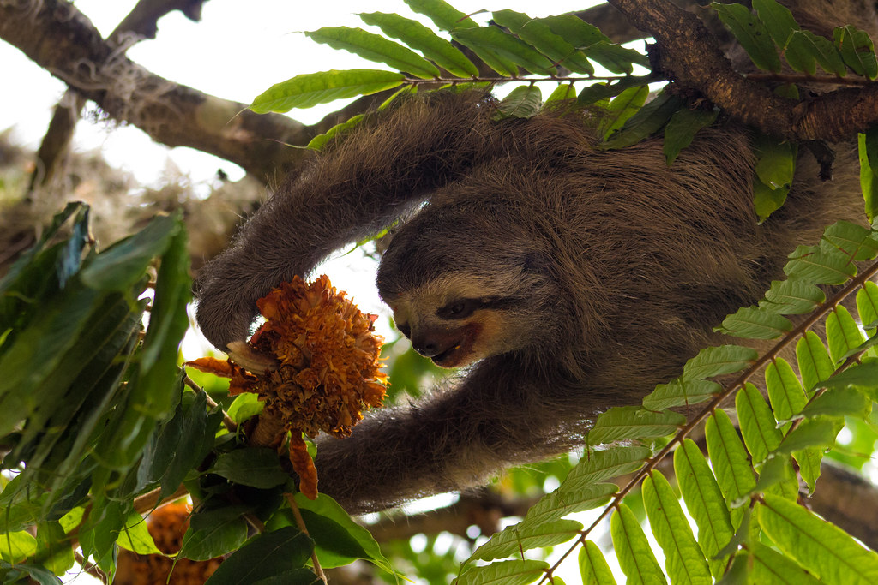
Des bases de données
aux outils
Ferjflores- CC BY-SA 2.0

Slide 13






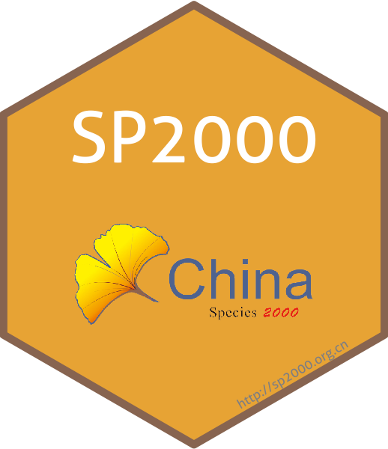
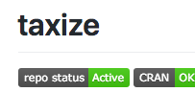
Outils taxinomiques : paquets R
Revue des paquets sur le CRAN + GitHub + Bioconductor
Tri manuel à partir de requêtes standard (recherche GitHub + r-pkg.org)
Critères
Vrai paquet R (pas de liste de scripts)
Pas un « wrapper » (outils originaux)
Ne traitant pas de génomique (champ différent)
Identification de 73 paquets dont 64 inclus
Notes:
Now that we have the datasources we need tools to manipulate the information.
Indeed we could manually extract the data ourself with tables of data, however it starts to be impractical and error-prone when working with hundreds of species and many different datasets.
Thus the need for automatic tools. Focus here on R packages because R is the most popular language in ecology.
We identified >50 packages that deal with taxonomic information split in 4 different categories.
Show package table?
Main fact we got:
Packages not connected enough → no common infrastructure
Several packages do same things → access same data. Probably a better idea to contribute to single tool

Slide 14
Outils taxinomiques : différentes catégories
64 paquets appartenant à 4 catégories
Accès à une base
Manipulation de données
Infrastructure
Visualisation
3 paq.
52 paq.
15 paq.
4 paq.
taxize accède
à de nombreuses bases
taxa propose des classes standards
rgnparser transforme
un nom en composants élémentaires
metacoder affiche
la taxinomie
taxadb propose un accès hors-ligne
Notes:
So the first element we need are databases. Why databases? Centralized repository of nomenclatural information. Also called “taxonomic backbone, taxonomic checklists, taxonomic reference lists”…
They provide organized taxonomic information, as well as synonymy resolution (tell you which name is accepted and which one is not), and eventually correct spelling mistakes.
It takes massive amount of effort for taxonomist to organize this information.
One of the best known is probably the GBIF backbone. Contains XX millions names and XX accepted ones. It cover all possible kingdoms.
Another one is the Leipzig Catalog of Vascular Plants, a recent effort to build a global taxonomy for vascular plant. Global also but more focused taxonomically.
Based on this we propose a typology of databases based on their spatial scale and taxonomic breadth.

Slide 15
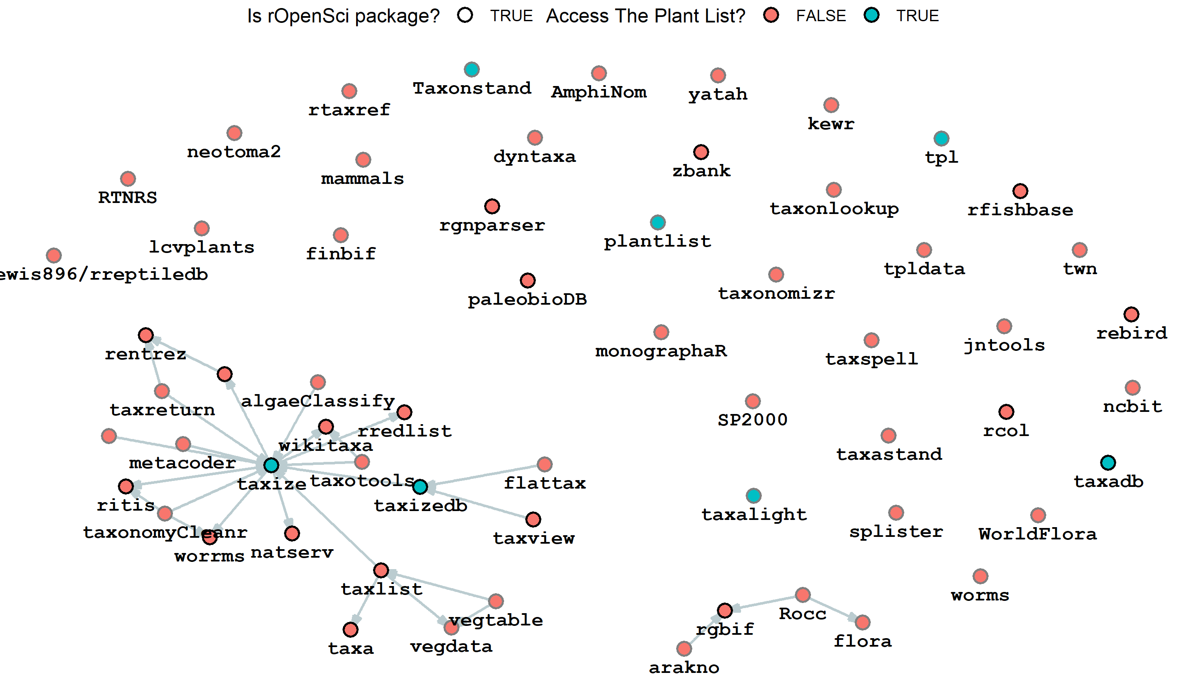
Réseau de dépendances entre paquets
Réseau très éclaté
Sauf les
paquets rOpenSci
Beaucoup de paquets
accède
à la même source
(TPL)
Pas de standard pour manipuler les données taxinomiques
<numéro>

Slide 16

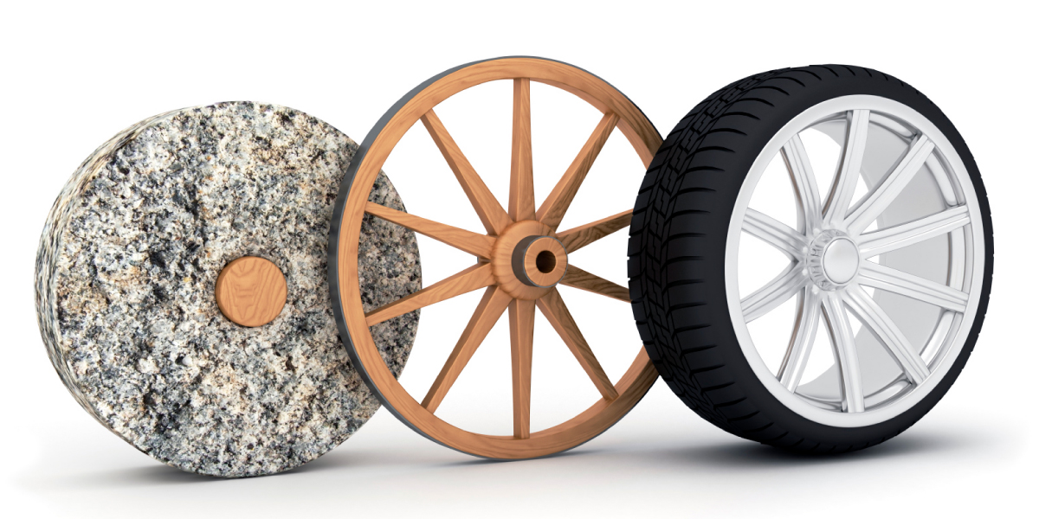

Outils taxinomiques : enseignements tirés
→
GitHub n’est pas
une archive pérenne
…
Contribuer
plutôt que recréer
Le dév. d’outils taxinomique est DIFFICILE
→ Expertise rare (& peu de motivation)
Notes:
So the first element we need are databases. Why databases? Centralized repository of nomenclatural information. Also called “taxonomic backbone, taxonomic checklists, taxonomic reference lists”…
They provide organized taxonomic information, as well as synonymy resolution (tell you which name is accepted and which one is not), and eventually correct spelling mistakes.
It takes massive amount of effort for taxonomist to organize this information.
One of the best known is probably the GBIF backbone. Contains XX millions names and XX accepted ones. It cover all possible kingdoms.
Another one is the Leipzig Catalog of Vascular Plants, a recent effort to build a global taxonomy for vascular plant. Global also but more focused taxonomically.
Based on this we propose a typology of databases based on their spatial scale and taxonomic breadth.

Slide 17
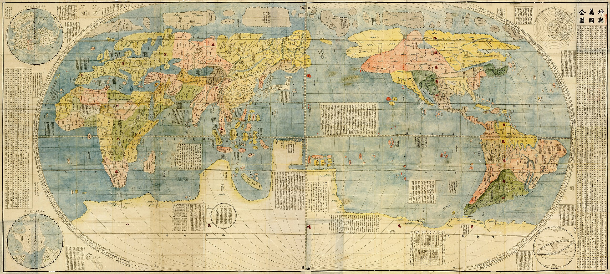
Cartographier le paysage des outils taxinomiques
Kunyu Wanguo Quantu (坤輿萬國全圖) 1604 - Public Domain

Slide 18
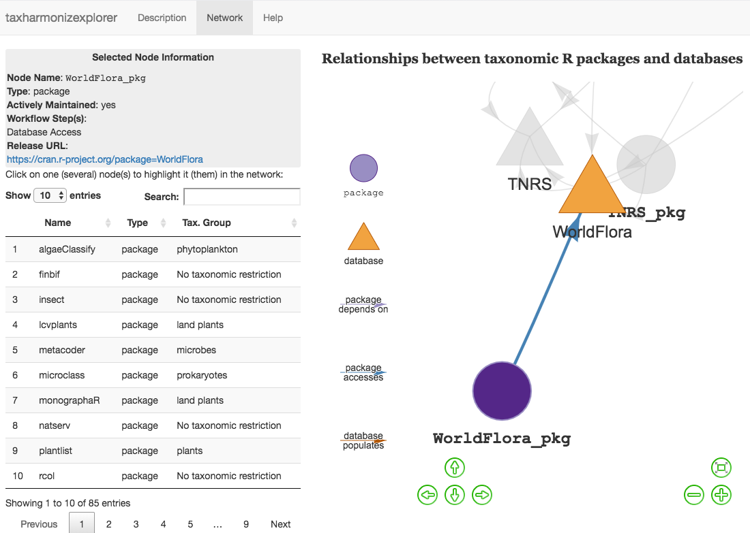

taxharmonizexplorer
Affiche les relations dirigées entre bases & paquets
Affiche information résumées sur les nœuds
Base évolutive
(mise-à-jour continuellement)
Accès via :
https://tiny.cc/taxharmonizexplorer
Notes:
To wrap-up this information and understand better the links between packages, between databases, and between packages and databases we built an interactive shiny app, accessible through the link below. This can help the users see how different databases are connected and which package access which databases?
Display information about databases and packages
BUT links between databases are difficult to get
Packages can also be difficult to get
→ community source it (miss a database miss a package, contact me!)
→ we’ll be also have a student helper working on digging the links out and make this available

Slide 19
DÉMONSTRATION
Notes:
So the first element we need are databases. Why databases? Centralized repository of nomenclatural information. Also called “taxonomic backbone, taxonomic checklists, taxonomic reference lists”…
They provide organized taxonomic information, as well as synonymy resolution (tell you which name is accepted and which one is not), and eventually correct spelling mistakes.
It takes massive amount of effort for taxonomist to organize this information.
One of the best known is probably the GBIF backbone. Contains XX millions names and XX accepted ones. It cover all possible kingdoms.
Another one is the Leipzig Catalog of Vascular Plants, a recent effort to build a global taxonomy for vascular plant. Global also but more focused taxonomically.
Based on this we propose a typology of databases based on their spatial scale and taxonomic breadth.

Slide 20

Focus
sur les bases de plantes
Twin Lantana camara 'Patty Wankler' – CC-BY 2.5 – Joaquim Alves Gaspar

Slide 21
Bases & outils spécifique pour les plantes
Identification de 13 bases & 19 paquets
→ 9 bases à l’échelle mondiale
→ 4 régionales (FB 2020, GermanSL, USDA, VASCAN)
→ Plusieurs paquets accèdent aux même bases
Notes:
What is taxonomic harmonization?
As macro-ecologists we want to study phenomena at large scales (but what is macroecology?).
For this purpose we generally need to merge datasets.
Let’s say I’m interested in the phylogenetic diversity of palms at global scale?
I need a phylogeny of palms, as well as an occurrence dataset. They come from independent sources. However both use species names to index their data.
I could merge them directly by matching exact species names directly. But there is no guarantee that both datasets used a similar taxonomy. It’s safer to actually harmonize taxonomy through matching a central database.
Taxonomic harmonization is thus this step where list of species names are standardized against a central reference.

Slide 22
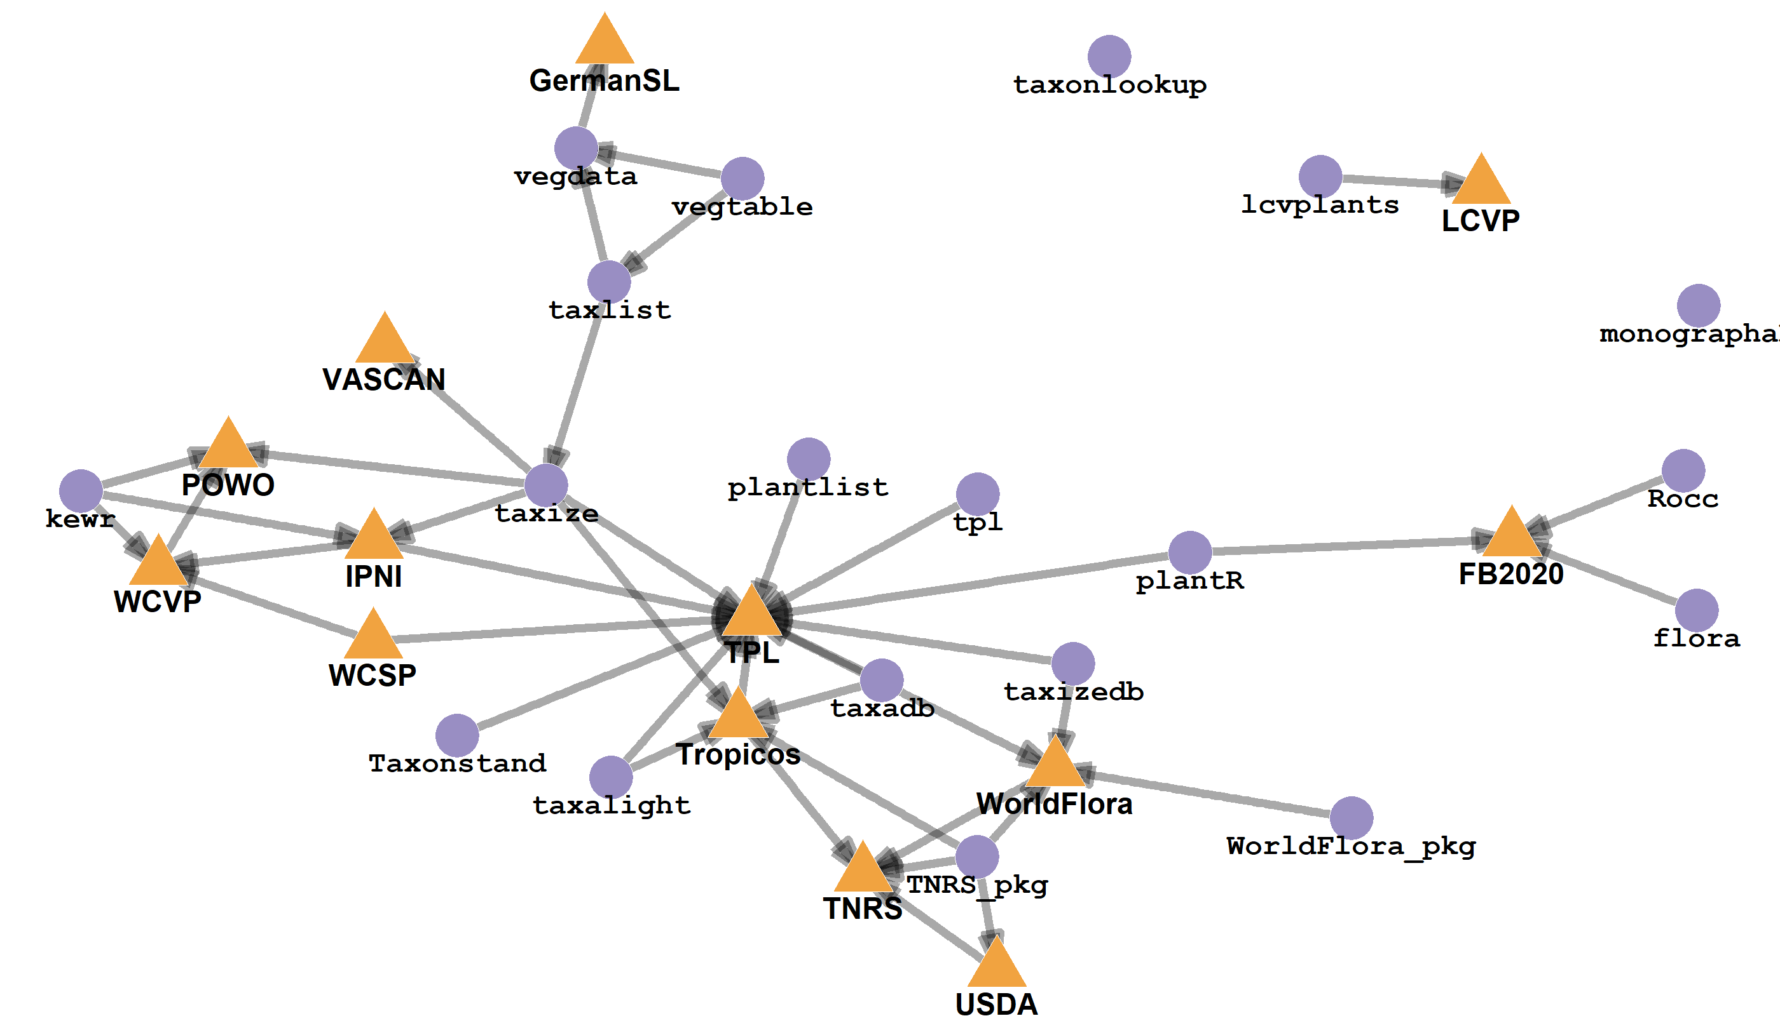
Relation entre bases ↔ paquets
Centralité de The Plant List
Relation compliquées entre bases
WCSP – WCVP – POWO ?
Les bases régionales
ne sont pas connectés au reste du réseau
Notes:
What is taxonomic harmonization?
As macro-ecologists we want to study phenomena at large scales (but what is macroecology?).
For this purpose we generally need to merge datasets.
Let’s say I’m interested in the phylogenetic diversity of palms at global scale?
I need a phylogeny of palms, as well as an occurrence dataset. They come from independent sources. However both use species names to index their data.
I could merge them directly by matching exact species names directly. But there is no guarantee that both datasets used a similar taxonomy. It’s safer to actually harmonize taxonomy through matching a central database.
Taxonomic harmonization is thus this step where list of species names are standardized against a central reference.

Slide 23
Perspectives sur les outils taxinomiques pour les plantes
The Plant List (obsolète depuis 9 ans!)
→ Facilité d’accès (API, pageweb scrappable, pérennité!)
≥4 taxonomies mondiale à jour
Leipzig Catalogue of Vascular Plants, POWO, World Flora Online, WorldPlants.de (CoL)
Pas d’effort d’harmonisation mondiale (contrairement aux oiseaux)
Article in prep. de comparaison des taxinomies globales avec TPL
(Mené by David Schellenberger-Costa)
Importance de rendre liens entre bases explicites
Liens entre bases mondiale & régionales peu clairs
Notes:
What is taxonomic harmonization?
As macro-ecologists we want to study phenomena at large scales (but what is macroecology?).
For this purpose we generally need to merge datasets.
Let’s say I’m interested in the phylogenetic diversity of palms at global scale?
I need a phylogeny of palms, as well as an occurrence dataset. They come from independent sources. However both use species names to index their data.
I could merge them directly by matching exact species names directly. But there is no guarantee that both datasets used a similar taxonomy. It’s safer to actually harmonize taxonomy through matching a central database.
Taxonomic harmonization is thus this step where list of species names are standardized against a central reference.

Slide 24
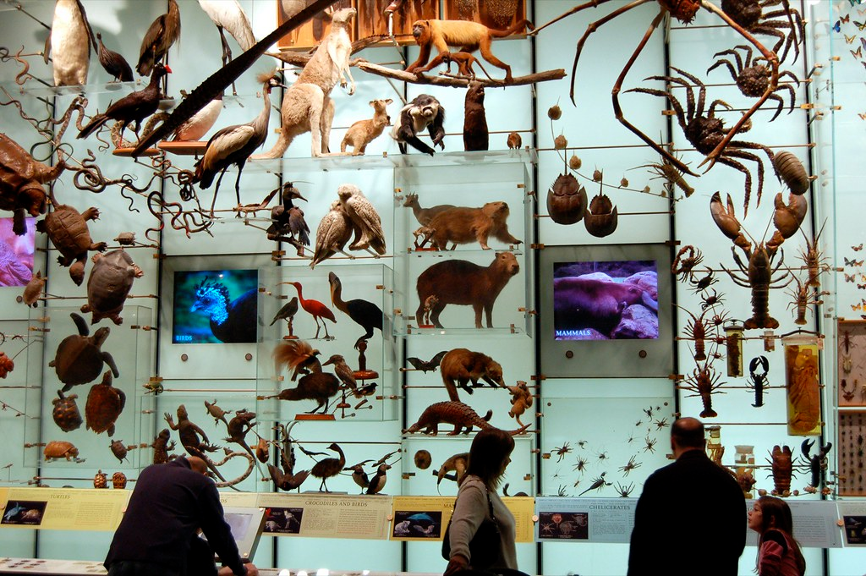
Harmonisation taxinomique en pratique
Dano CC BY 2.0

Slide 25
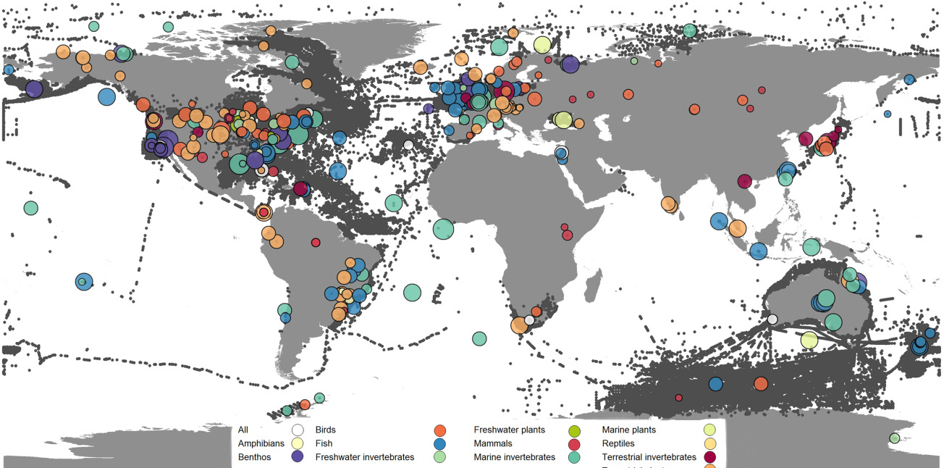

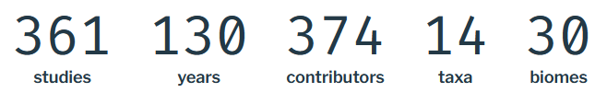
Cas d’utilisation
Comment harmoniser en pratique ?
Données d’exemple
Dornelas et al. 2018
Notes:
So the first element we need are databases. Why databases? Centralized repository of nomenclatural information. Also called “taxonomic backbone, taxonomic checklists, taxonomic reference lists”…
They provide organized taxonomic information, as well as synonymy resolution (tell you which name is accepted and which one is not), and eventually correct spelling mistakes.
It takes massive amount of effort for taxonomist to organize this information.
One of the best known is probably the GBIF backbone. Contains XX millions names and XX accepted ones. It cover all possible kingdoms.
Another one is the Leipzig Catalog of Vascular Plants, a recent effort to build a global taxonomy for vascular plant. Global also but more focused taxonomically.
Based on this we propose a typology of databases based on their spatial scale and taxonomic breadth.

Slide 26
Intérêt de BioTIME
Utilisée à iDiv by de nombreuses équipes (+2000 téléchargements, >100 citations)
Multi-taxa → harmonisation plus difficile
Pas vraiment harmonisée
“Additionally, species names were checked for typographic errors and misspellings […]. Most records were included as provided and may not always conform to the latest nomenclature.” Dornelas et al. 2018
Notes:
So the first element we need are databases. Why databases? Centralized repository of nomenclatural information. Also called “taxonomic backbone, taxonomic checklists, taxonomic reference lists”…
They provide organized taxonomic information, as well as synonymy resolution (tell you which name is accepted and which one is not), and eventually correct spelling mistakes.
It takes massive amount of effort for taxonomist to organize this information.
One of the best known is probably the GBIF backbone. Contains XX millions names and XX accepted ones. It cover all possible kingdoms.
Another one is the Leipzig Catalog of Vascular Plants, a recent effort to build a global taxonomy for vascular plant. Global also but more focused taxonomically.
Based on this we propose a typology of databases based on their spatial scale and taxonomic breadth.

Slide 27
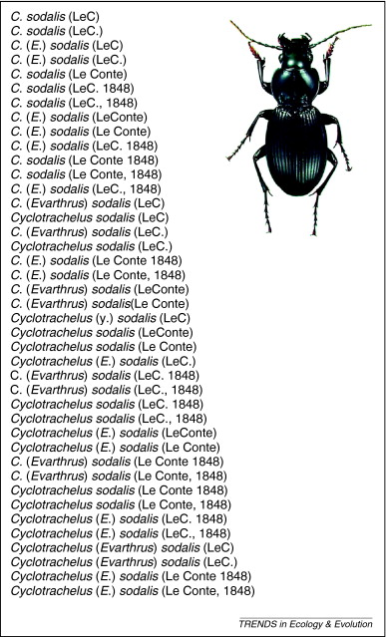
Importance du pré-traitement
Objectif : Unifier le style d’écriture
+ corriger des erreurs
(en identifiants les composants du noms)
Cyclotrachelus sodalis (Le Conte, 1848)
44 326 noms unique dans BioTIME
32 900 après pré-traitement
rgnparser::gn_parse()
rgbif::parsenames()
Patterson et al. 2010
Notes:
Workflow results Bogota vs. Torino.
Very similar results? What are different

Slide 28
Conclusion sur harmonisation en pratique
Analyse par groupe taxonomique réussissent meilleures correspondances
Analyse utilisant des bases mondiales sans restriction tax.
sont plus rapides mais résolvent moins de synonymes
→ Le choix dépend de la question et du besoin en précision
<numéro>

Slide 29

Conclusion
96dpi CC BY-NC 2.0

Slide 30
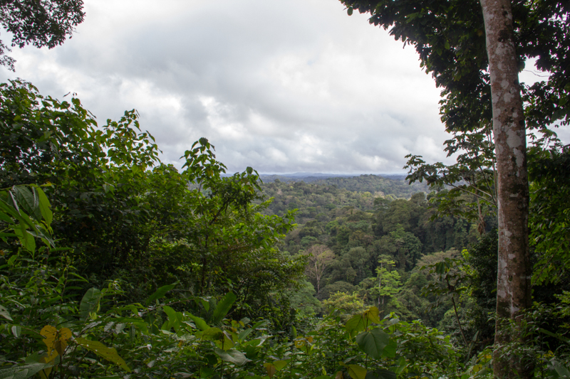
Sortir du brouillard taxinomique
Penser à l’harmonisation taxonomique
→ nécessaire pour maximiser la réutilisation de données
Connaître le « paysage taxinomique »
→ utiliser taxharmonizexplorer 😎
Détailler ses analyses
→ expliciter les paquets et fonctions utilisées
Notes:
Take Home Messages:
For database managers → make the links with other databases discoverable, provide an easily accessible API
For package developers → don’t reinvent the wheel, contribute to other projects instead of creating a new one
For users → think about taxonomic harmonization, actually use the tools available, they’re pretty good and it is worth it :)

Slide 31

Perspectives
Besoin de mieux mesurer l’impact d’analyses différentes sur les résultats
(noms d’auteur, correspondance floue, etc.)
Besoin de dialogue entre taxinomistes, gestionnaires de bases,
et utilisateur⋅rice⋅s (écologues ou autres)
Compléter le réseau de ressources taxinomiques
TAXONOMISTS
Notes:
Take Home Messages:
For database managers → make the links with other databases discoverable, provide an easily accessible API
For package developers → don’t reinvent the wheel, contribute to other projects instead of creating a new one
For users → think about taxonomic harmonization, actually use the tools available, they’re pretty good and it is worth it :)

Slide 32
@LeNematode
https://rekyt.github.io/
Merci !
taxharmonizexplorer
https://tiny.cc/taxharmonizexplorer

