Slide 1


funbiogeo
Summary and Perspectives
Matthias Grenié & Nicolas Casajus
FREE2 – May 24th 2023

Slide 2
Workflows in functional biogeography
Raw
Traits
Raw
Site-species
Raw
Site-environment
Select & Filter
Select & Filter
Cleaned
Traits
Traditional Functional Diversity Tools
Cleaned
Site-species
Cleaned
Site-environment
Functional Diversity Indices
FD-environment relationships
Formalized and covered by funbiogeo
Visualizations of indices and maps

Slide 3

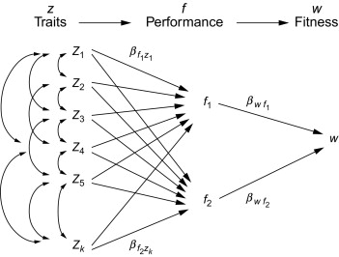
Target users for funbiogeo
Students and Researchers
learning about trait-based research
Experts in functional biogeography

Slide 4
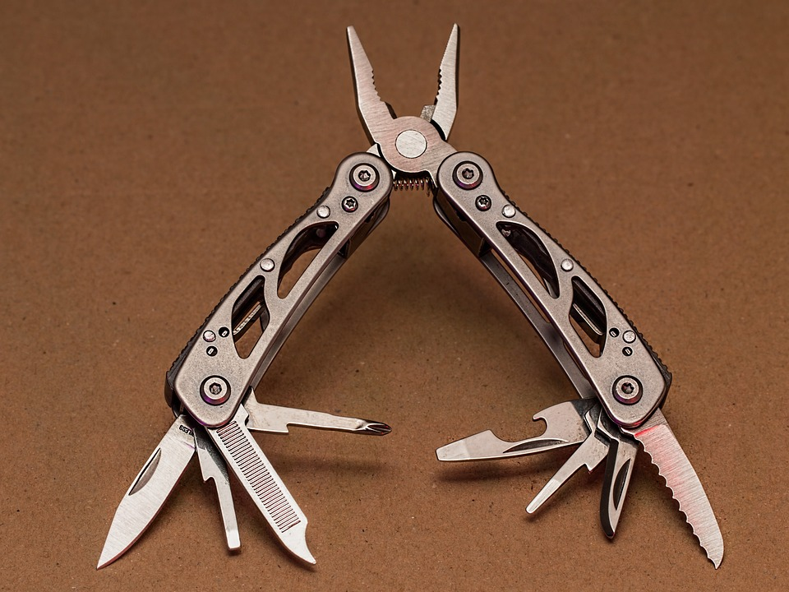
Goals of funbiogeo:
be the Swiss army knife of trait-based ecology
Provide standardized functions to help build a standard workflow for functional biogeography
Provide diagnostic plots to help functional ecologists navigate their analyses
Be agnostic about:
  Nature of “sites”
  Nature of functional traits used
  Spatial resolution of sites
Allow upscaling analyses to be ran

Slide 5
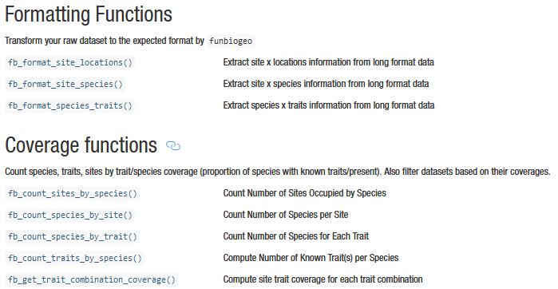
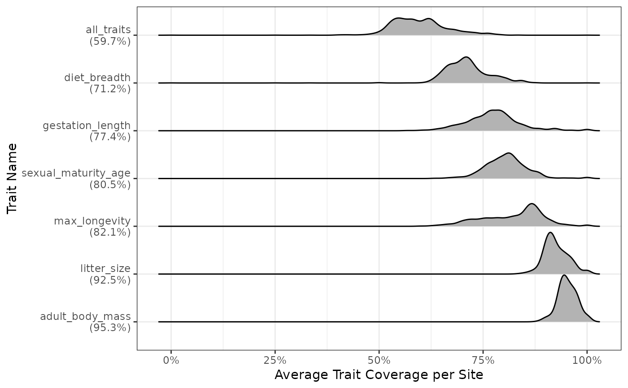
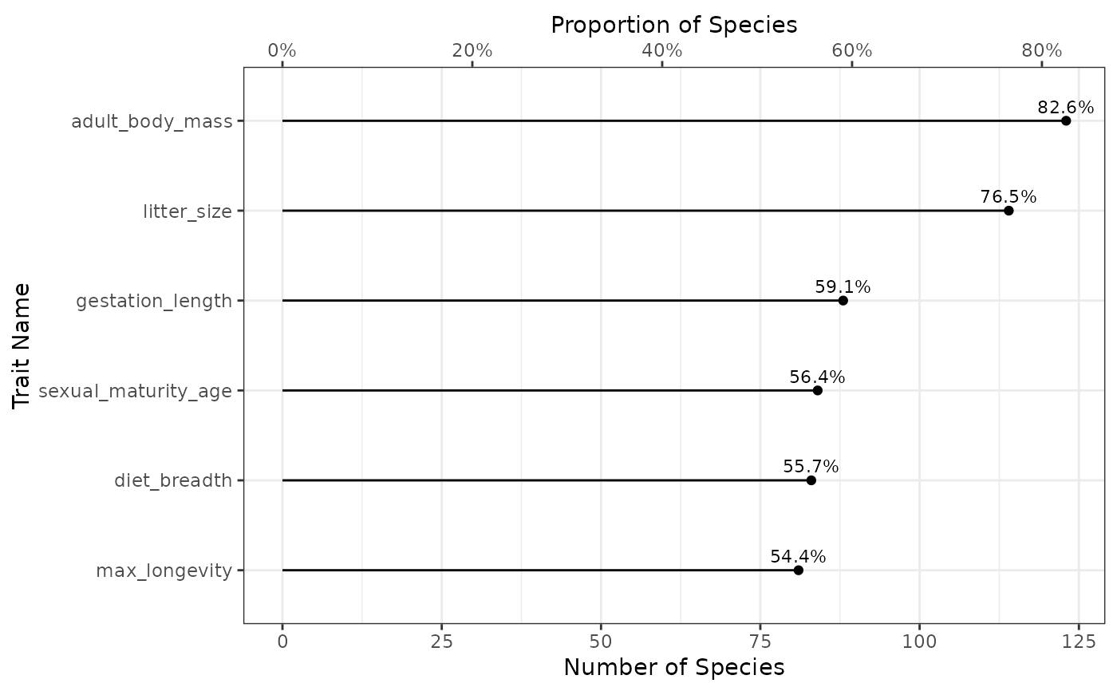
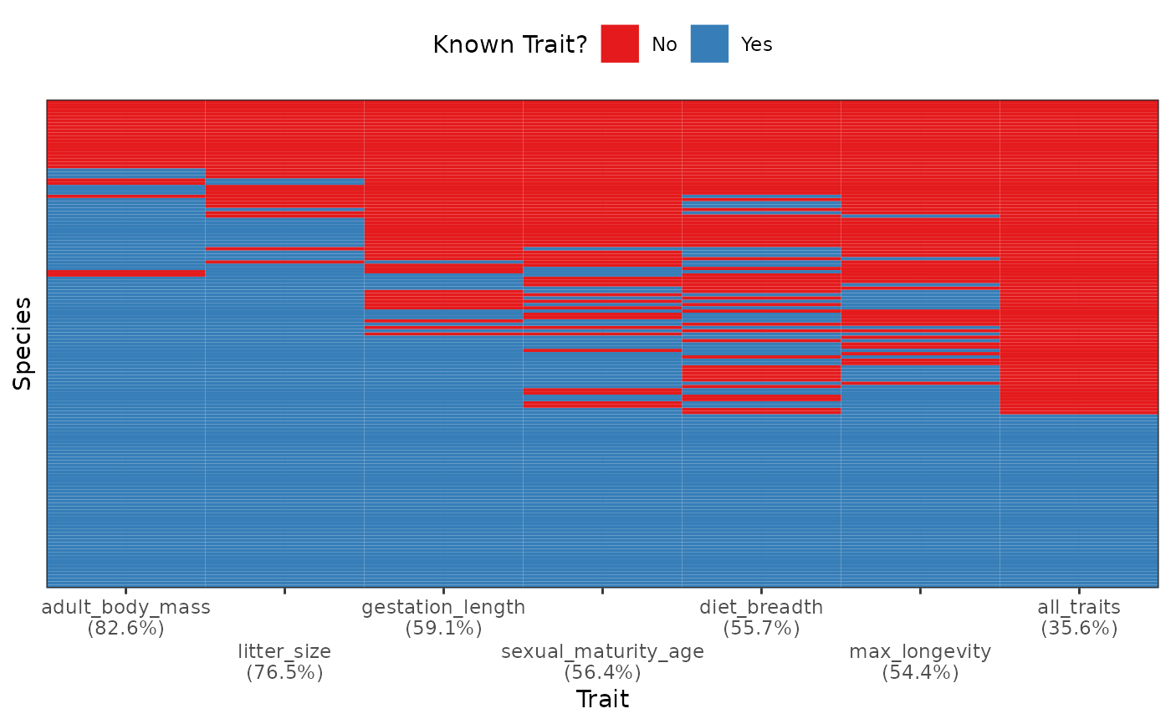
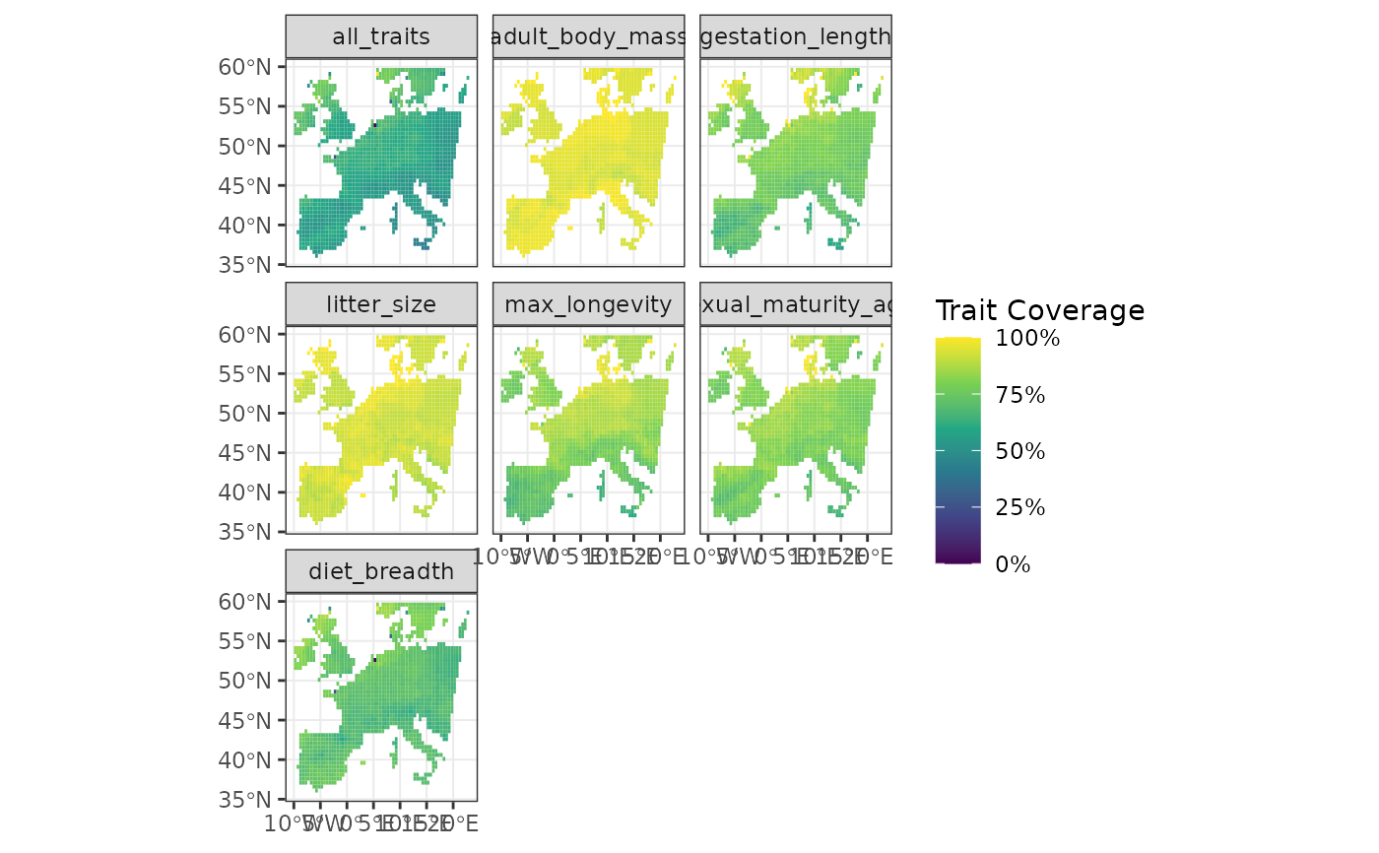
What has been achieved
Functions to filter and select data
Good default visualizations
Consistent function naming
Produces an automated report from the input datasets
(could be added easily as SI in papers)

Slide 6
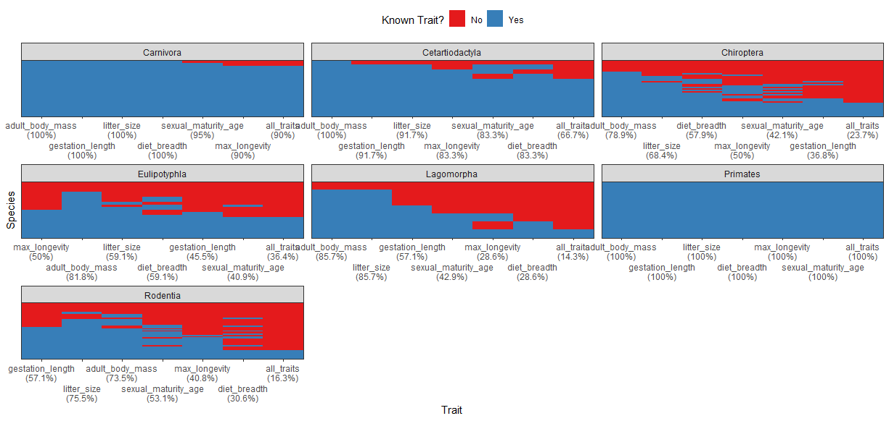
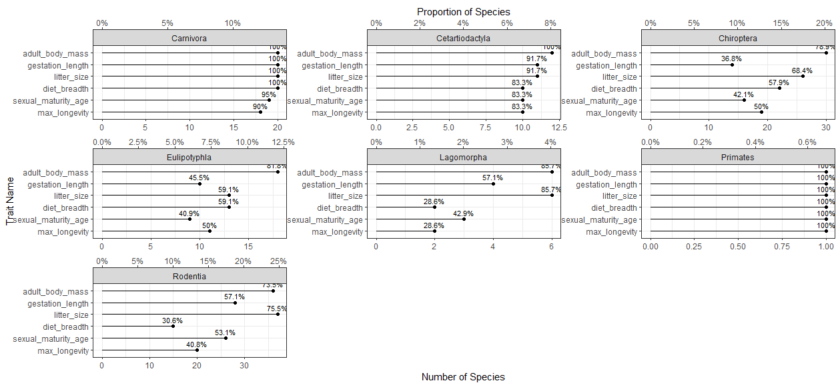
Nice feature: species categorization in diagnostic plots

Slide 7
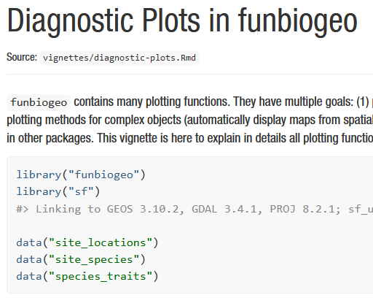
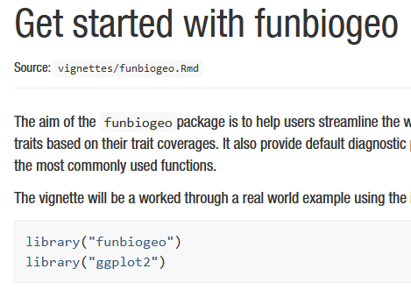
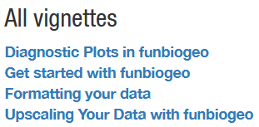
Extensive documentation

Slide 8
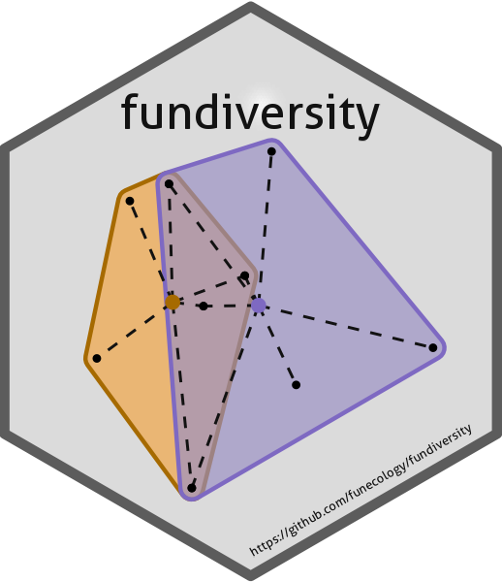


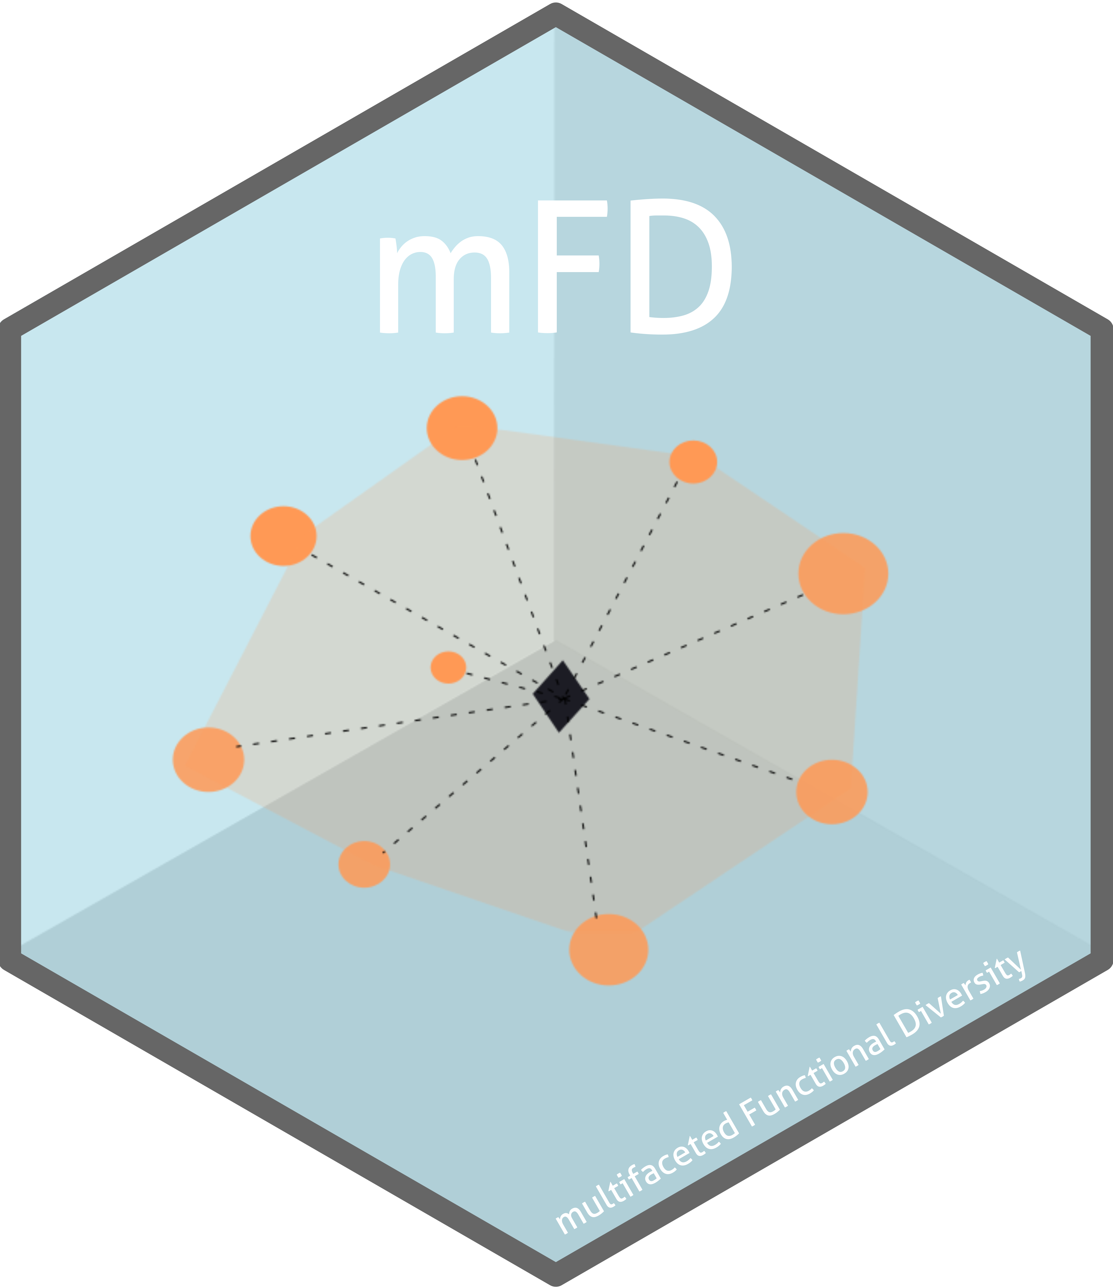
What still need to be done
Split sites per category
Run a test session with users (would you like to be part of this?
Maybe a 1h remote session?)
Write the paper!
(Journal: MEE/GEB/Ecography?)
Submit to CRAN
Any (reasonable) feature?
Working to build
the 21st Functional Ecologist Toolbox

