Slide 1
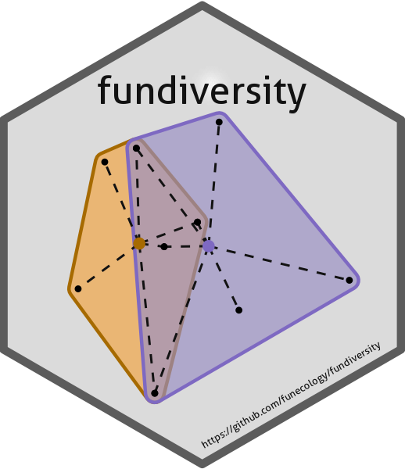
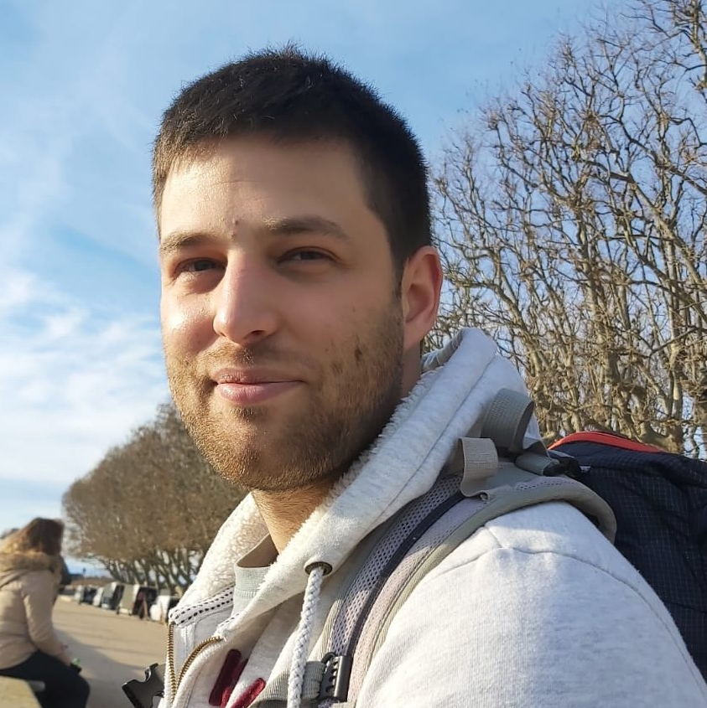


fundiversity
A modern alternative to compute functional diversity indices
Matthias Grenié & Hugo Gruson
sDiv lab meeting 19th January 2023
@LeNematode
https://rekyt.github.io/

Slide 2
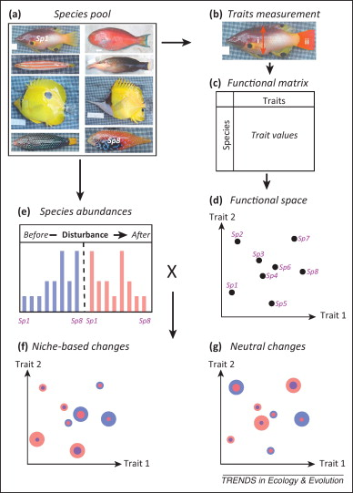
Functional diversity
Mouillot et al. 2014 TREE

Slide 3
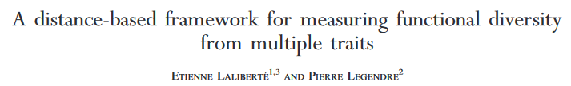
FD: the go-to R package
Laliberté & Legendre 2010 Ecology
>2,100 citations
Last significant update → 2014
One main function: dbFD() DEMO

Slide 4
Some difficulties...
Computes all indices even if you want only one
The documentation is not very clear
The code is difficult to read (and maintain)
Some optimization are possible
The code is not tested against known inputs
Not up-to-date with current practices

Slide 5
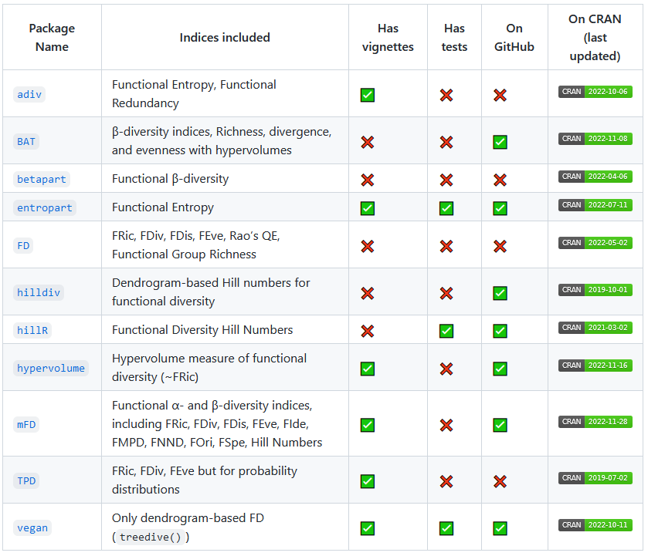
Alternative functional diversity packages
Not all packages
have vignettes
Very few packages have tests
No clear alternative to FD
Major optimization possible
Let’s build an alternative!

Slide 6
Features of fundiversity
Uses optimization to be faster
Better documented
Fully tested
Split-up code
(easy to understand & maintain)
Uses memoization
Uses easy parallelization
Designed for long-term availability

Slide 7
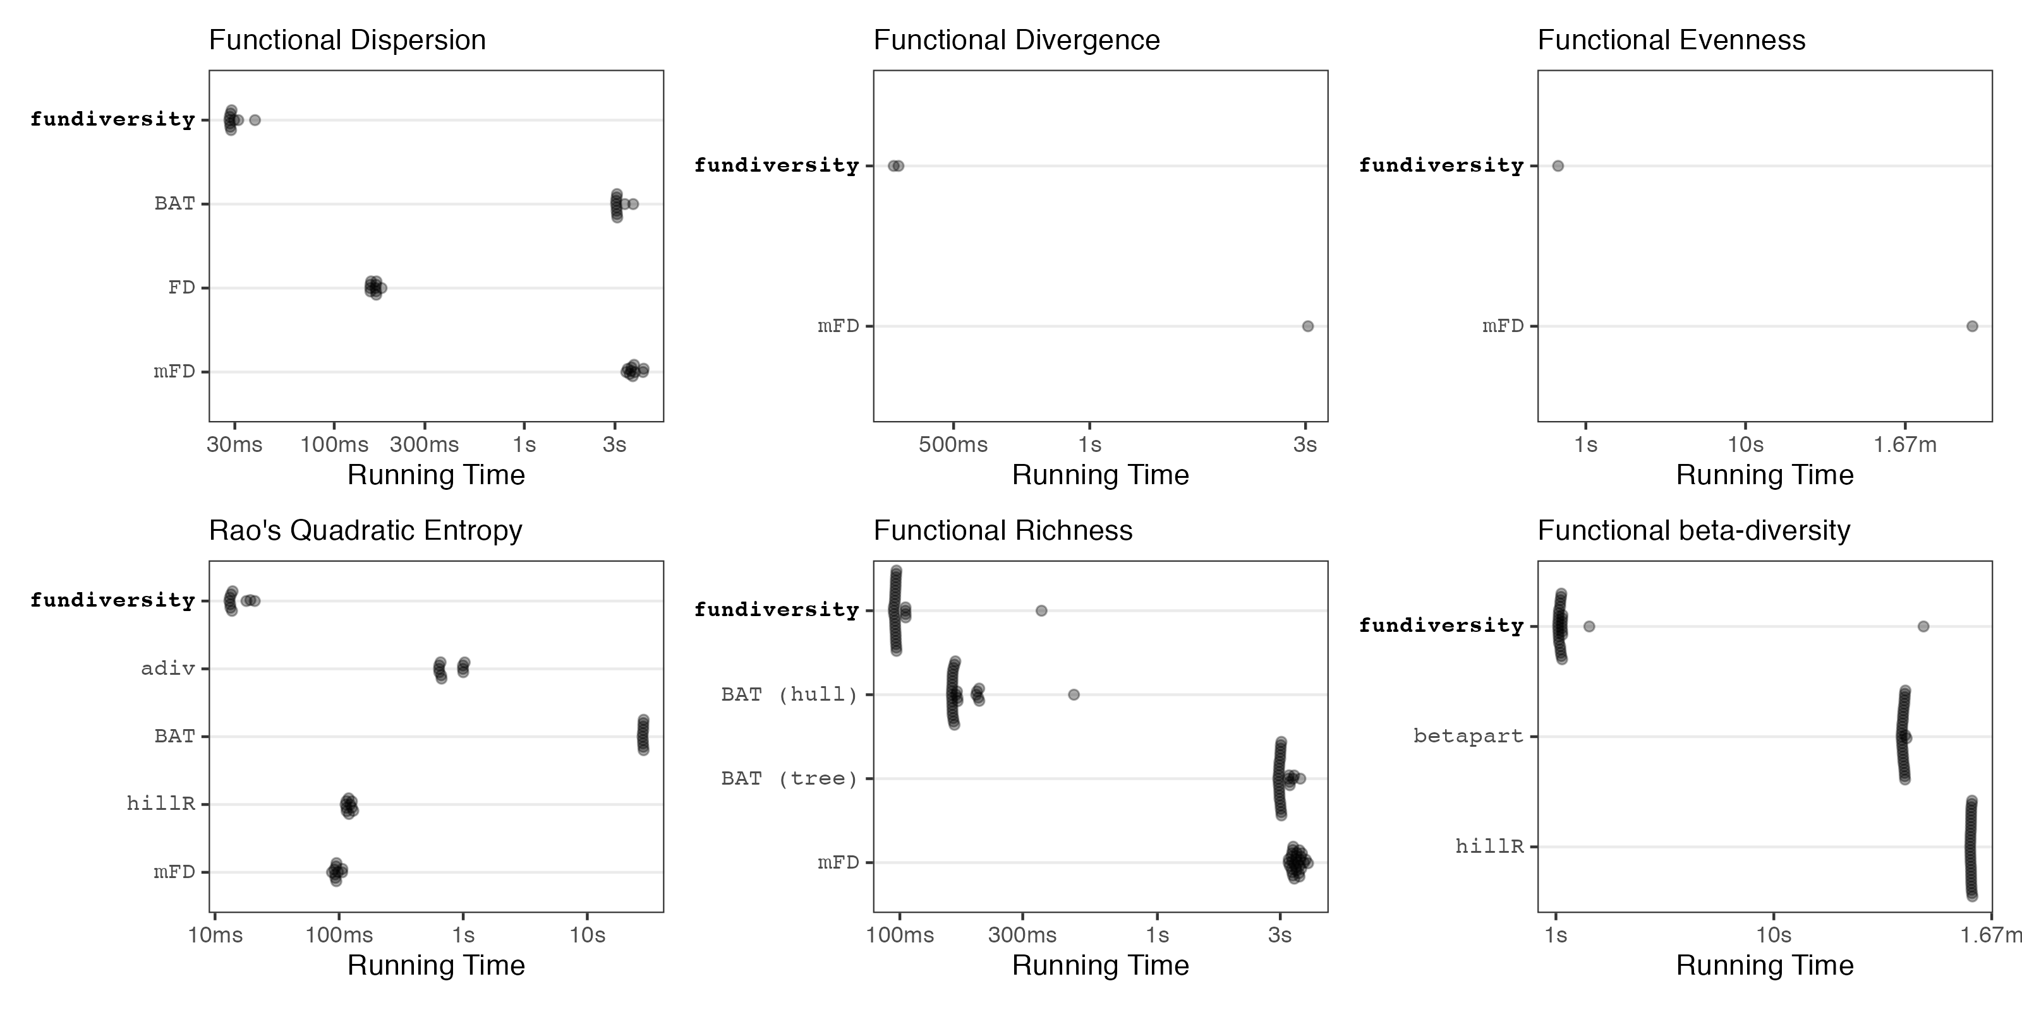
Time benchmark: fundiversity is 10x to 100x faster

Slide 8
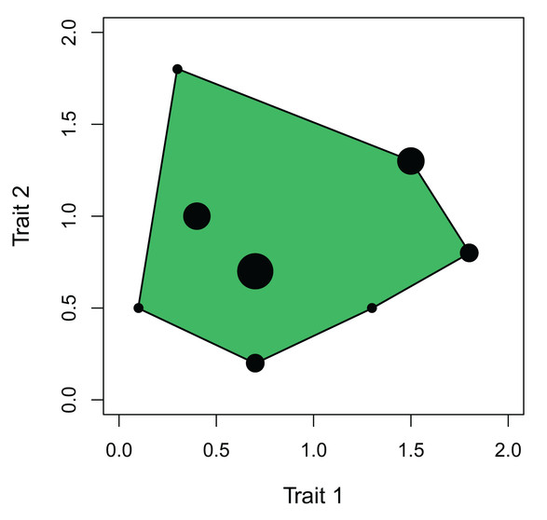
Memoization: storing complex results for later
Example: Computing Functional Richness
Memory
fd_fric()
my_traits
my_fric
my_fric
fd_fric()
my_traits
my_fric
Trades memory for speed
Transparent to the user
Best on complex operations (multidimensional convex hulls)

Slide 9
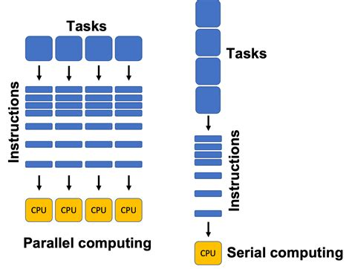

Parallelization: splitting computations across computer
Used to be a mess in R
Modern framework: future
One instruction:
future::plan(future::multissesion)
Same code across:
one computer/several/one HPC/etc.

Slide 10
Documentation
DEMO!

Slide 11
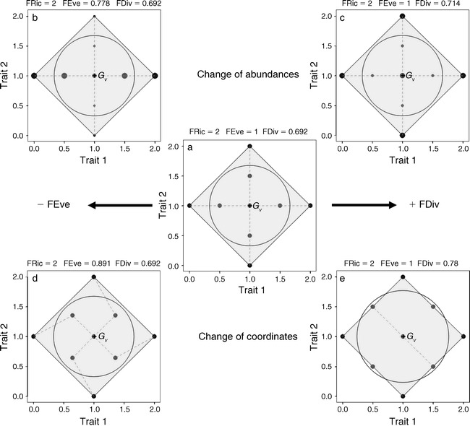
Software Practices: tests
Fully tested code (Errors + Working code) across several OSs and versions of R
Validated with reference dataset
by Villéger al. 2010

Slide 12
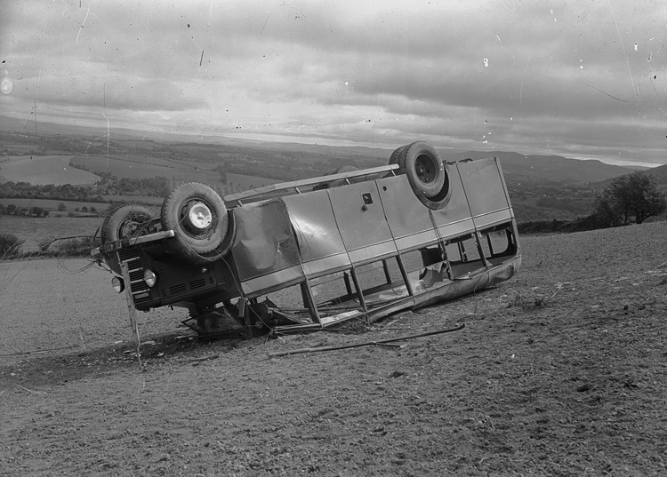
Software Practices: future & bus factor
Package is on CRAN
Package sits in an organization repository on GitHub (not personal)
One file = one function
→ small understandable chunks
Code follows clear rules
→ easy to extend
Public Domain

Slide 13
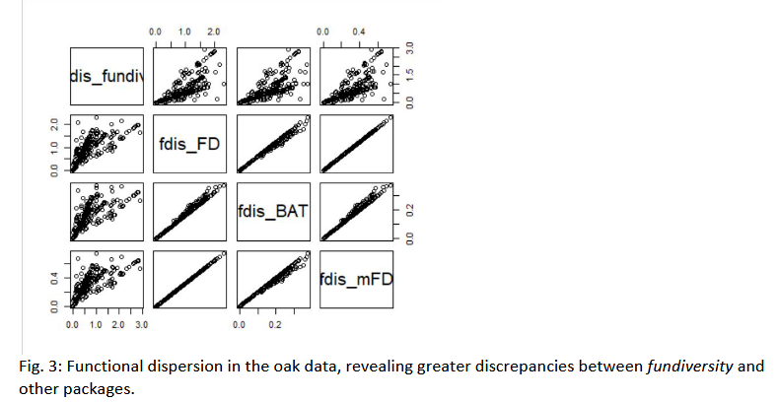


Side Story: amazing reviewers!
Incorrect implementation for FDis
Incorrect implementation for FDis
Correct one

Slide 14
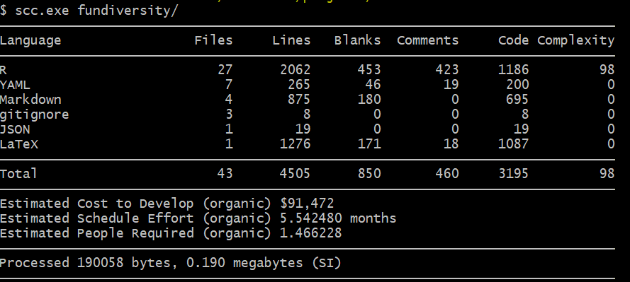
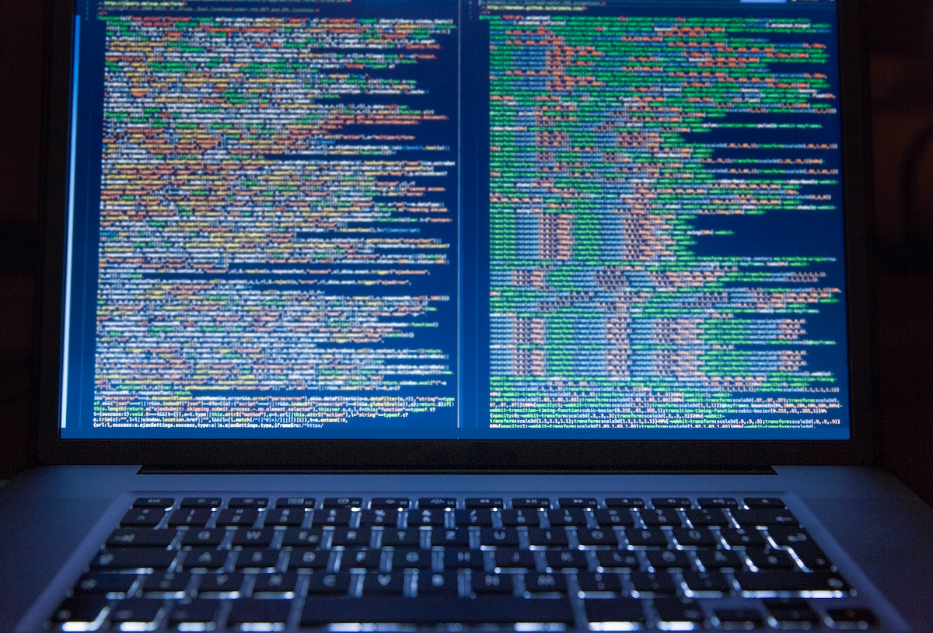
Conclusion
Writing robust software is HARD
Scientists are not trained for it
Need to keep up with practices
Career value?
Scientist’s or Engineer’s job?
Public Domain

Slide 15
Thank you
& the reviewers
& the original authors of FD!
install.packages(“fundiversity”)

