Slide 1
Finding Motifs in Paramecium:
A Long and Hard Quest
Lab Meeting - June 19th 2014
Matthias Grenié, Jean-François Goût, Michael Lynch

Slide 2


What have I been doing?
©bunnyrel 2014 (left) / © jeffreyww 2014 (right)

Slide 3
Gene Expression Regulation
Why study Gene Expression Regulation?
Major determinant of gene retention after WGD

Slide 4
Transcription Factor Binding Sites
One way is to study Transcription Factor Binding Sites

Slide 5
Model
Great Model → lots of closely related species = lots of orthologs + lots of paralogs thanks to WGDs
Genome compact → easier to follow

Slide 6

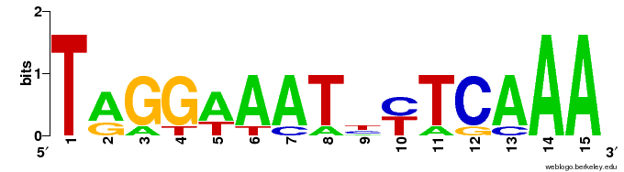
Classical Motif Finding
De novo motif finding
Several tools available
Statistical methods
Motif and Background sequences
TGGGTTATCCTCCAA
TAGGAAATTTTCAAA
TAGGAAATTTTCAAA
TAGGAAATCCAGAAA
TGATTAAAACTCAAA
Crooks et al. 2004 & Bailey et al. 2006

Slide 7
Phylogenetic Footprinting

Slide 8
Need a tree

Slide 9
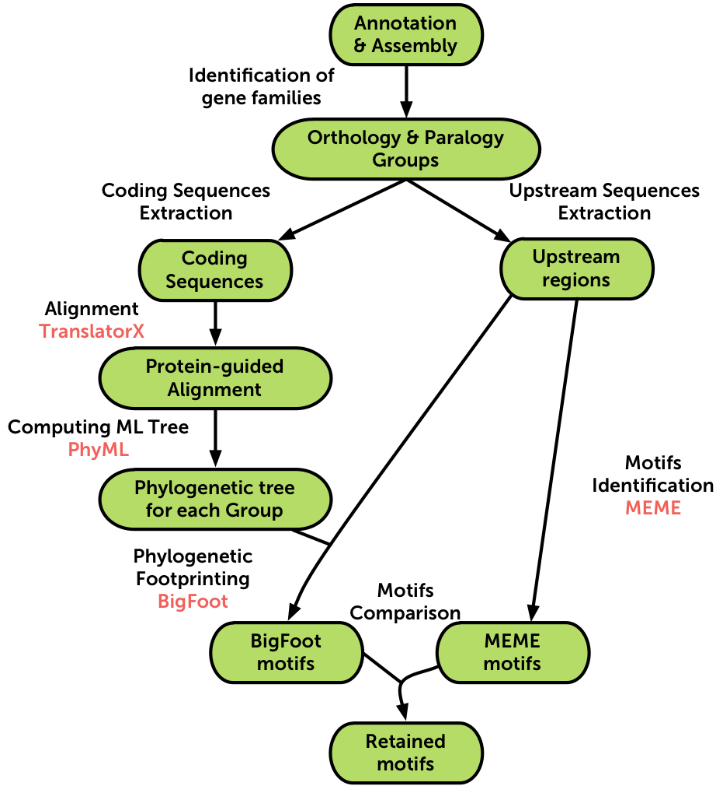
Pipeline Overview

Slide 10
First Results

Slide 11
More Results!

Slide 12
Perspectives/Caveats
Motif identification technique
Pipeline thresholds
Clustering
Motif extraction technique → reverse and normal sense motif

Slide 13
Learning?

Slide 14
Acknowledgements

Slide 15

Questions?
© captainkimo 2014

