Slide 1
Downloading and
Unzipping Exam Files
September 2025
Matthias Grenié & Laila Blömer

Slide 2
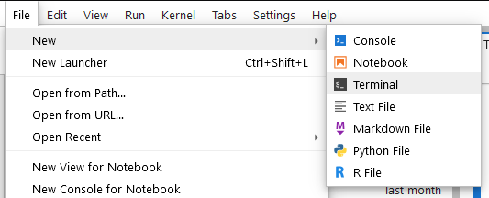
1st way: Directly download the file
1. Open DOORS on the class
2. Open a new Terminal
Go to the menu File > New > New Terminal

Slide 3
Download and unzip the file
3. Type the following commands in the Terminal
wget https://minifi.ca/exambhe
unzip exambhe
Alternative URL the above commands didn’t work: https://cloud.univ-grenoble-alpes.fr/s/NKRx4Kis4rx6mcy

Slide 4
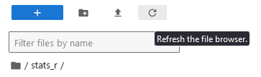
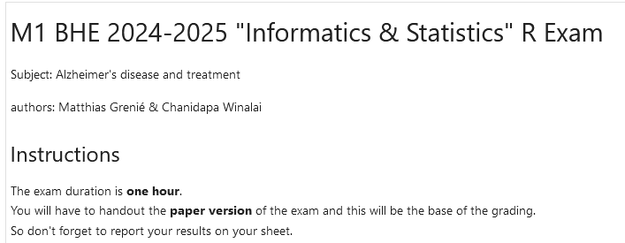
Refresh your file list and open the exam
Refresh the file browser
You should have an exam/ folder
Open it
Then double-click on the notebook and you’re ready to go

Slide 5
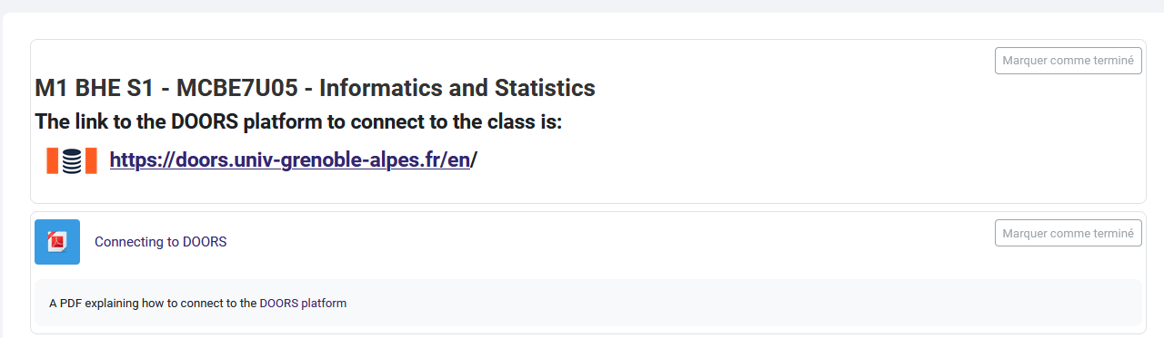
2nd way: Go to class page on UNESS
https://formation.uness.fr/formation/course/view.php?id=18390

Slide 6
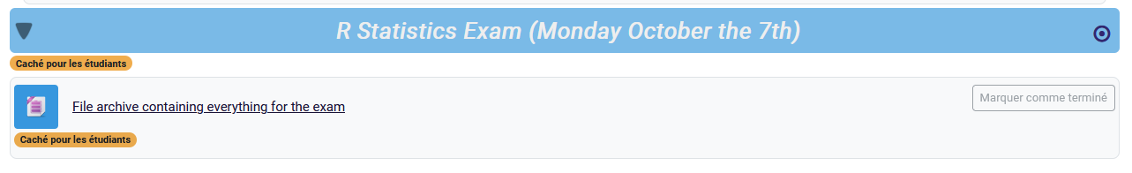
Scroll to the Exam and download .zip file

Slide 7
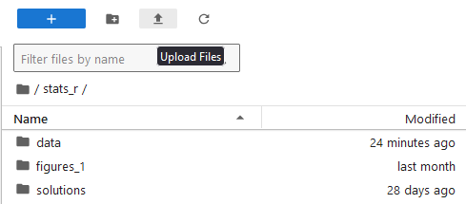
Open DOORS and upload it
Click on “Upload Files” and select the .zip file on your computer

Slide 8
Open a New Terminal and type the following command
Go to the menu File > New > New Terminal
Type the following commands
unzip bhe.zip

Slide 9
Refresh your file list and open the exam
Refresh the file browser
You should have an exam/ folder
Open it
Then double-click on the notebook and you’re ready to go

