Slide 1
targets the R workflow engine to help your analyses be reproducible
Matthias Grenié
iDiv Conference 2022 – R game

Slide 2

targets is a workflow engine
Pipeline tool (Make-file, snakemake)
Manage dependencies between targets
Store all intermediate outputs
All within R!
Notes:
What is a workflow engine? Maybe you already know Makefile or snakemake?
You define through a specific syntax a list of dependencies between steps, indicating which step depends on each other.
Example of a recipe (crêpes?)
Take XXXg flour
Take XXXg sugar
Take XXXg milk
Take YYY eggs
Mix in a bowl
Cook in a pan
Show workflow chart

Slide 3
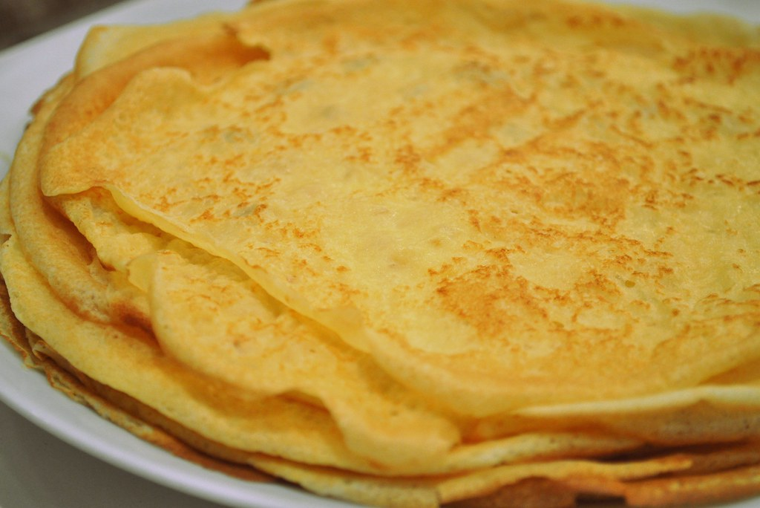
Example: let’s make some crêpes!
# Recipe for 6 foodies
bowl <- take_bowl()
# Mix dry ingredients
flour <- add_flour(bowl, 375) # g
dry_mix <- add_sugar(flour, 75) # g
# Add wet ones
egg_mix <- add_egg(bowl_flour, 6)
butter_mix <- add_butter(egg_mix, 90) # g
wet_mix <- add_milk(butter_mix, 1000) # mL
ready_mix <- whisk(wet_mix)
# Cook the crêpes
crepes <- cook_in_pan(ready_mix)
CC-BY fred_v

Slide 4
Example: let’s make some crêpes!
crepe_mix <- list(
tar_target(bowl, take_bowl()),
tar_target(flour, add_flour(bowl, 375)),
tar_target(dry_mix, add_sugar(flour, 75)),
tar_target(egg_mix, add_egg(dry_mix, 6)),
tar_target(
butter_mix, add_butter(egg_mix, 90)
),
tar_target(
wet_mix, add_milk(butter_mix, 1000)
),
tar_target(ready_mix, whisk(wet_mix)),
tar_target(crepes, cook_in_pan(ready_mix))
)
tar_make(crepes) # Run the pipeline!
CC-BY fred_v

Slide 5
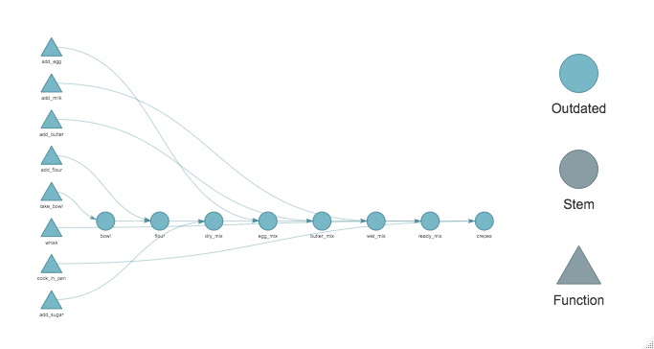
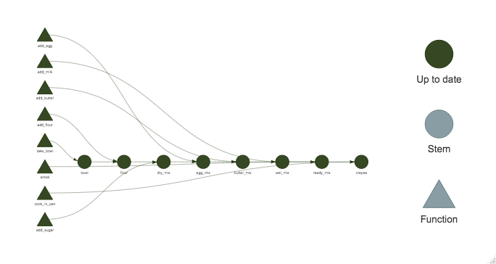
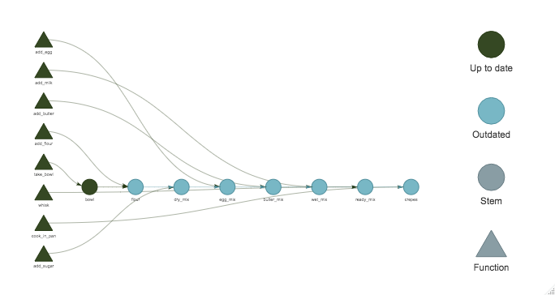
Nice features provided by targets
Dependency network of targets
Display progress
What happens if I want to add more flour?
→ Show targets that need to be updated

Slide 6
Nice features provided by targets
All in R tool
Transparent parallelization with future
(cores, sessions, cluster, HPC jobs)
Easy similar targets generations (parameters sets)
Several extensions (tarchetypes, stantargets, jagstargets)

Slide 7
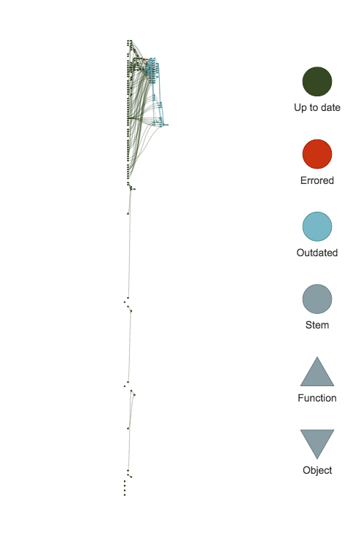
Real project workflow
Where to start?
Full manual on rOpenSci
(https://books.ropensci.org/targets/)
Many introductory presentations
and example projects available
Great community on GitHub, rOpenSci Slack,
and on StackOverflow

Slide 8


@LeNematode
https://rekyt.github.io/
Thank you!

