Slide 1
Taxonomic harmonization
Data, Tools & Best Practices
sMarten Winter | Scientific Head of sDiv | marten.winter@idiv.de Matthias Grenié, Emilio Berti, Juan Carvajal-Quintero, Alban Sagouis
Harmonizing species names is fundamental when e.g. combining different biodiversity data (species occurrences & traits) or when assessing biodiversity (species richness in a given place)
Example:
Bird extinction risk in function of biomass (Norman et al. 2020)
Conservation Status (IUCN)
Traits (EltonTraits)
Pipile pipile
Pipile cumanensis
Pipile cujubi
Pipile jacutinga
Megapodius decollatus
Scleroptila gutturalis
Margaroperdix madagarensis
Falcipennis falcipennis
Aburria pipile
Aburria cumanensis
Aburria cujubi
Aburria jacutinga
Megapodius reinwardt
Francolinus levalliantoides
Margaroperdix madagascariensis
Catreus wallichii
Falcipennis falcipennis
Falcipennis canadensis
No proper taxonomic harmonization: 2 species match
With taxonomic harmonnization: 6 species match

Slide 2
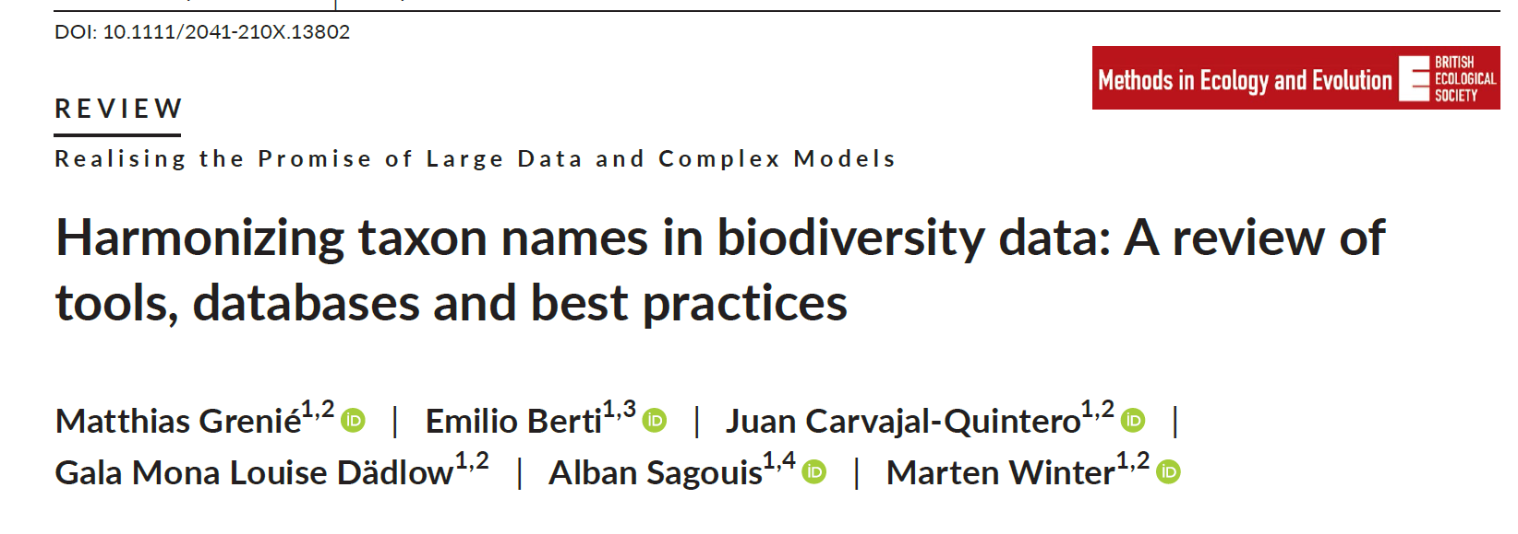
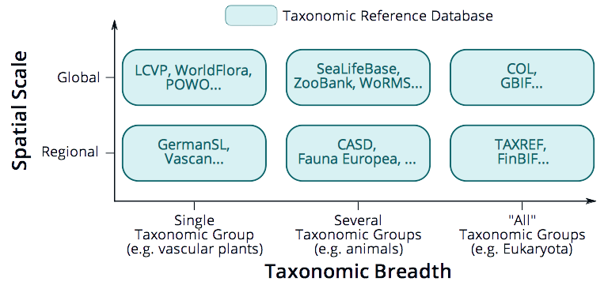
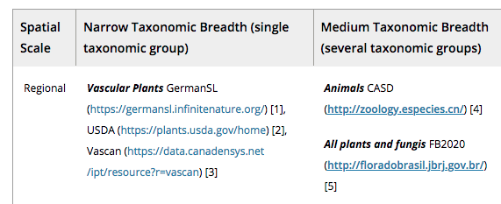


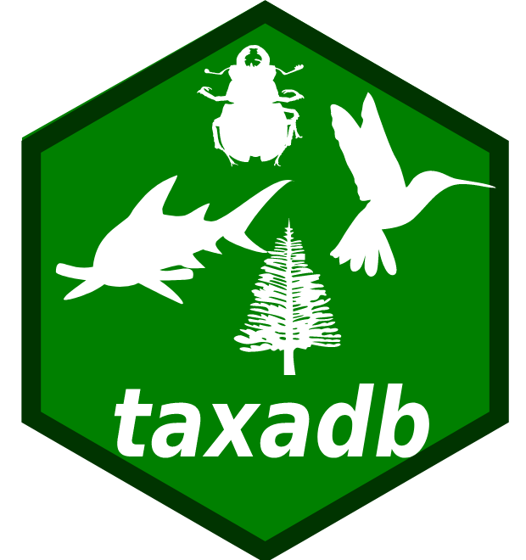
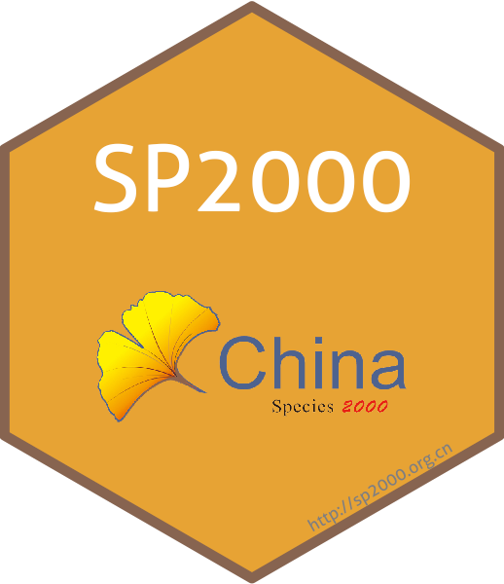
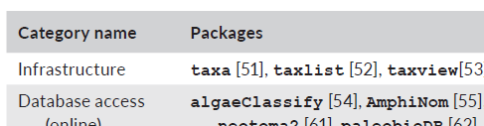
Taxonomic Databases contain taxonomic information
We reviewed a list of taxonomic databases
Needed Taxonomic Tools (R packages)
Identified 53 packages (GitHub, CRAN, Bioconductor)

Slide 3
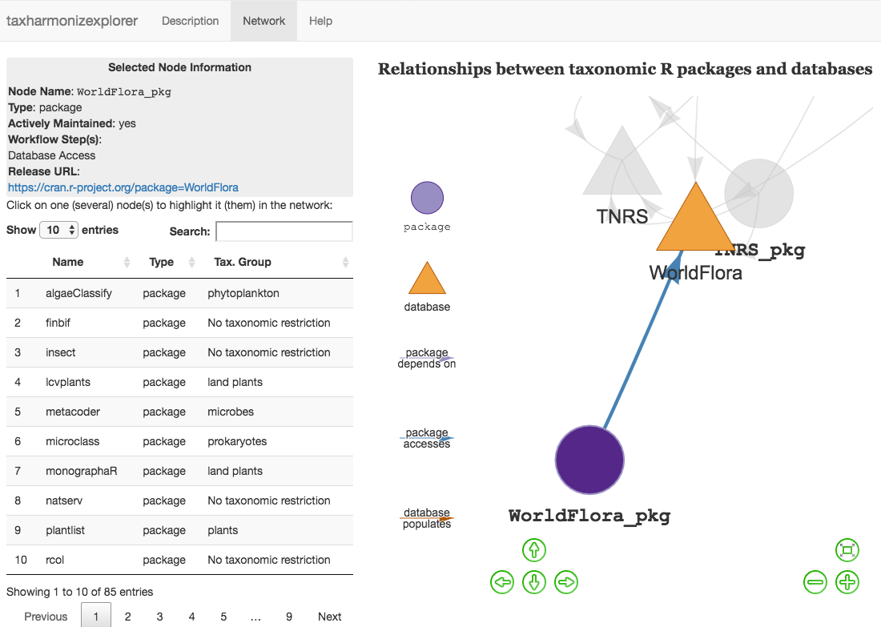
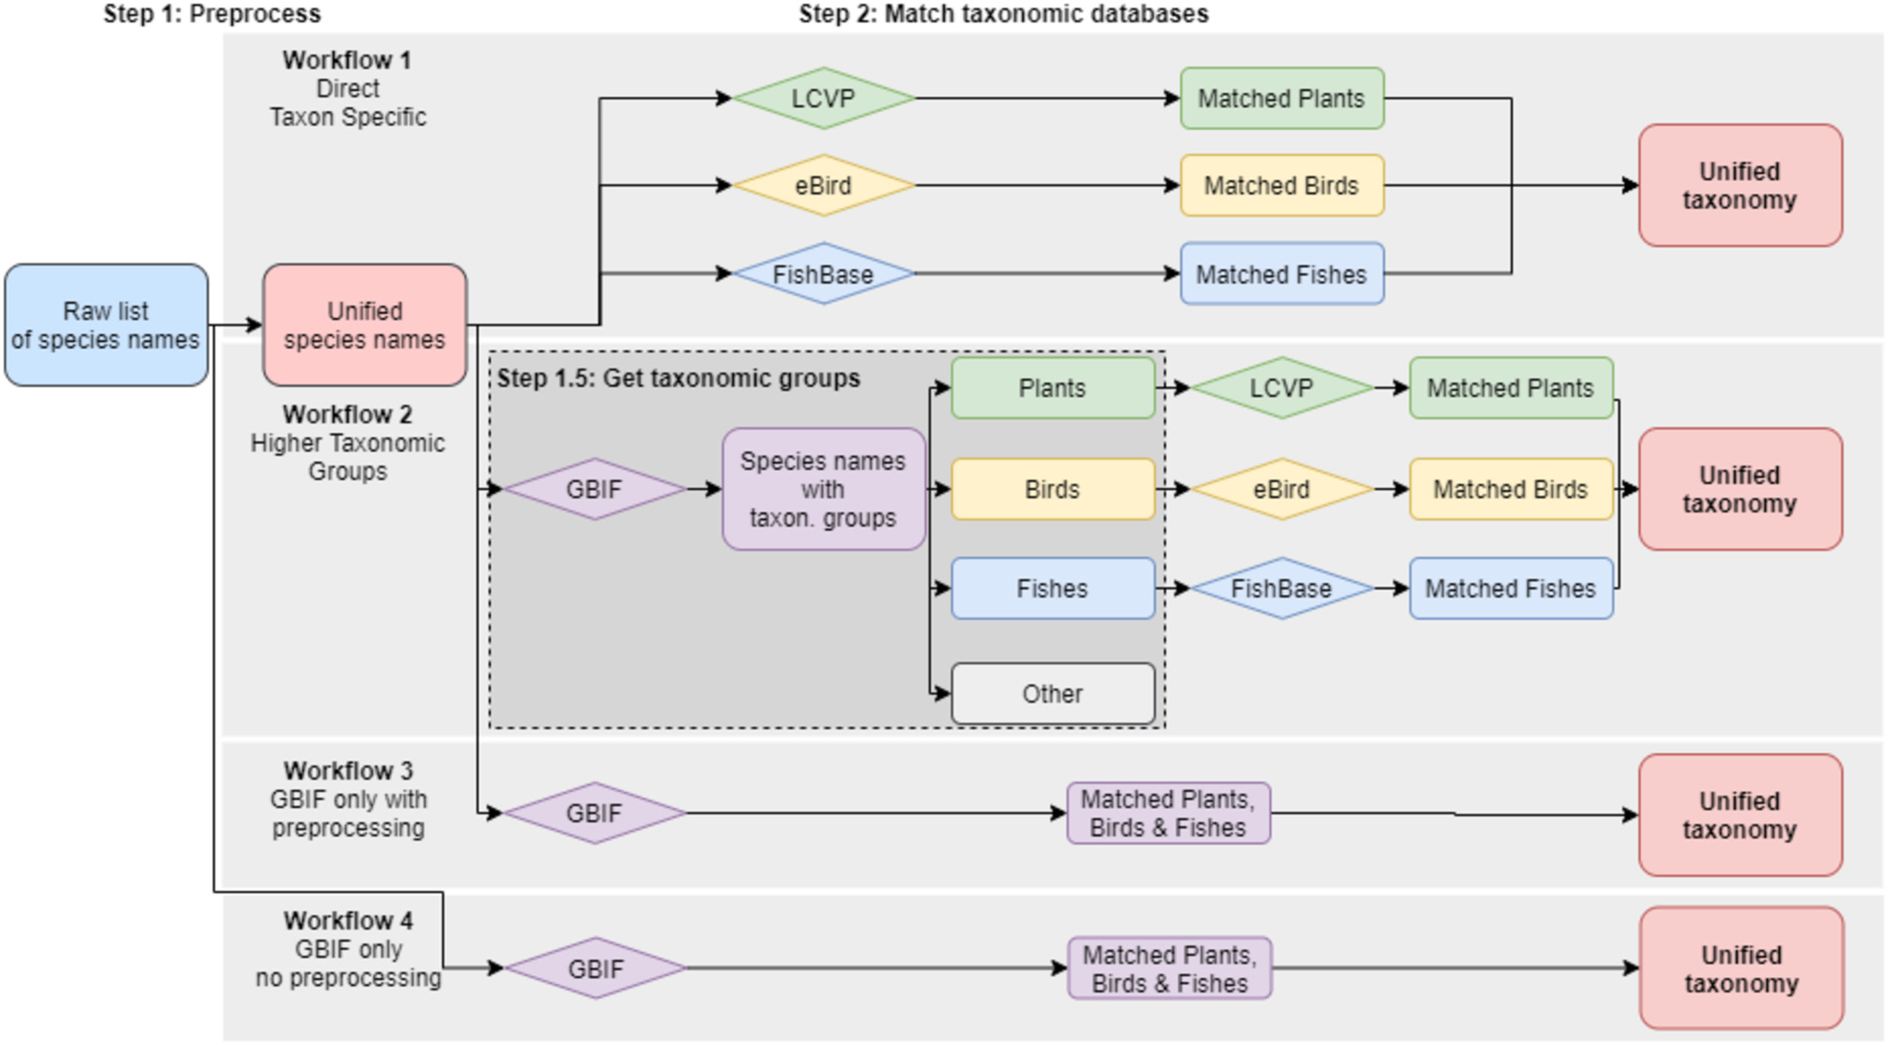
A review of tools & databases
Many tools and many databases → How to find your way?
→ We created a network of resources
→ Links between tools
→ Links between databases
→ Links between tools and databases
taxharmonizexplorer https://mgrenie.shinyapps.io/taxharmonizexplorer/
Or simpler: https://s.42l.fr/taxoharmo
Testing different harmonization workflows
→ Hard process to find one “best” workflow
→ Huge influence of pre-processing (correcting spelling errors etc.)
→ Rely on automated tools as possible
→ Calls for more study on the influence of harmonization workflows

