Slide 1




Taxonomic Harmonization
A problem you didn’t know you had!
Matthias Grenié (matthias.grenie@idiv.de) – GfÖ & NFDI4Biodiversity Winter School
Lecture 8 – Thursday December 8th 2022
"Museum of Natural History Cynthiacetus" by Shadowgate - CC BY 2.0

Slide 2
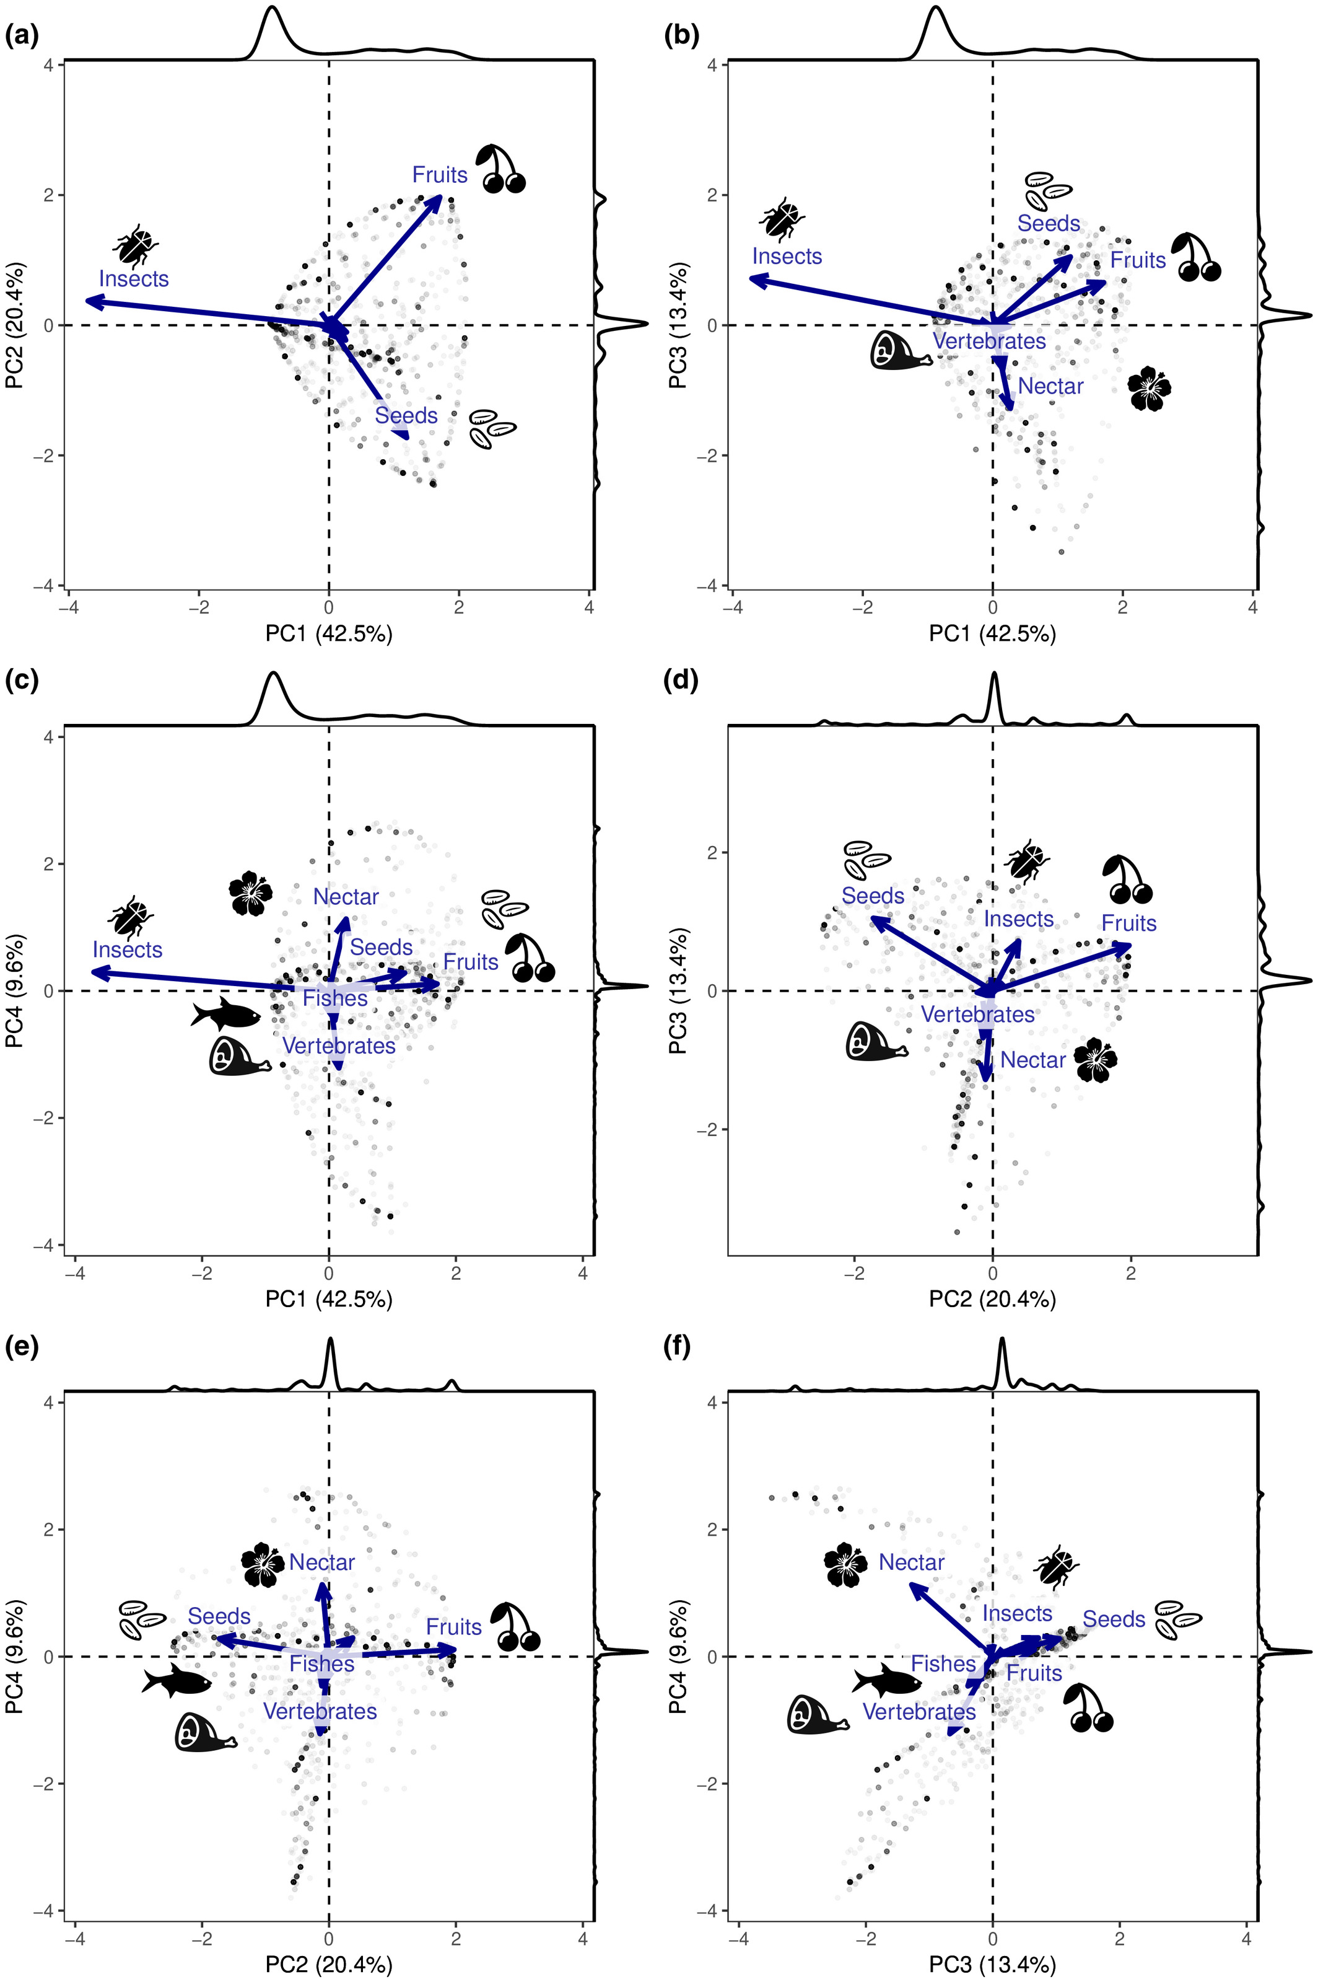
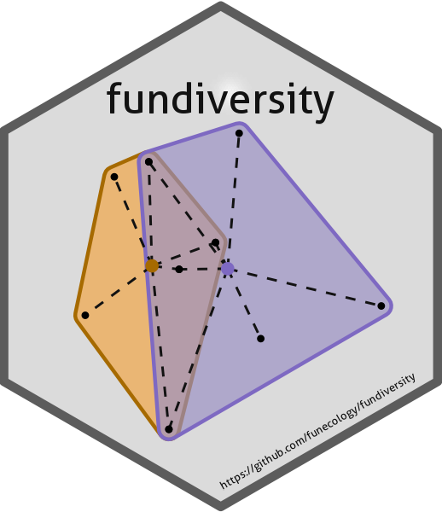
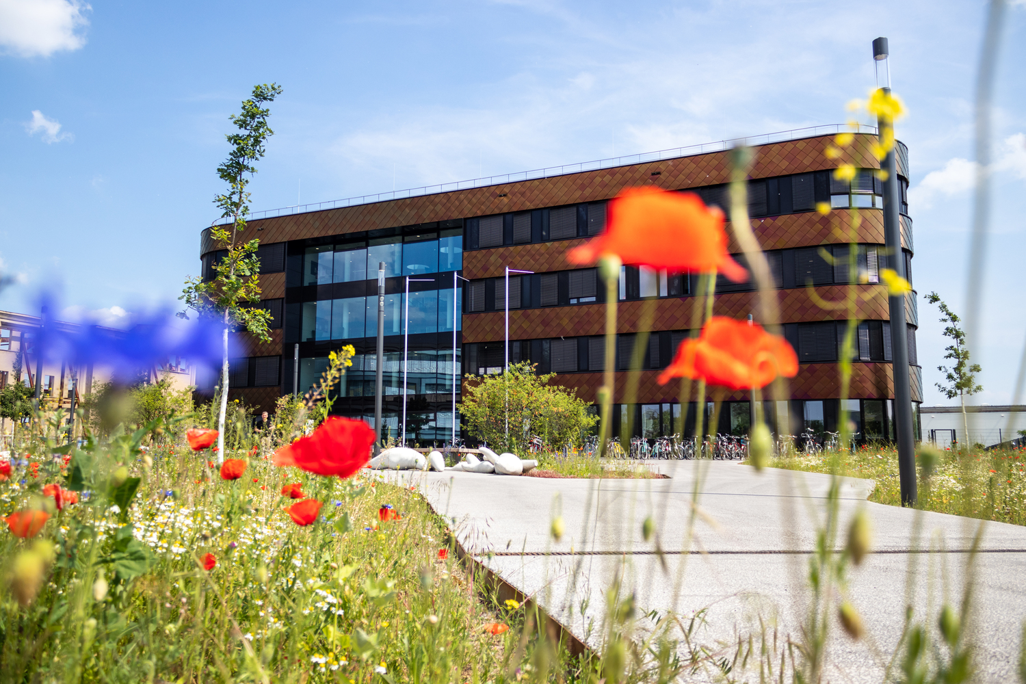

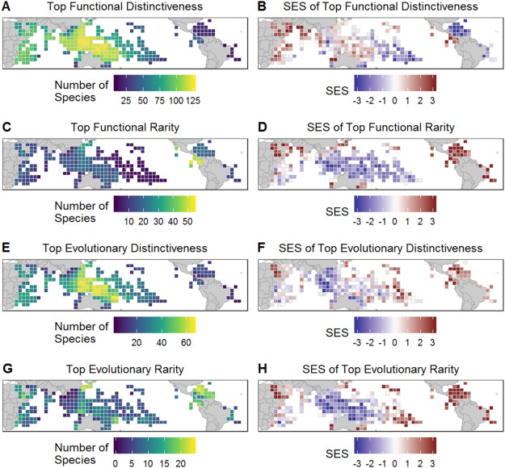
Who am I?
Trait-based
Invasion
Macro-ecologist
Postdoctoral Researcher at iDiv
Leipzig, Germany

Slide 3
Contact details
Email: matthias.grenie@idiv.de
Twitter: @LeNematode
Mastodon: @LeNematode@pouet.chapril.org
Website: https://rekyt.github.io

Slide 4
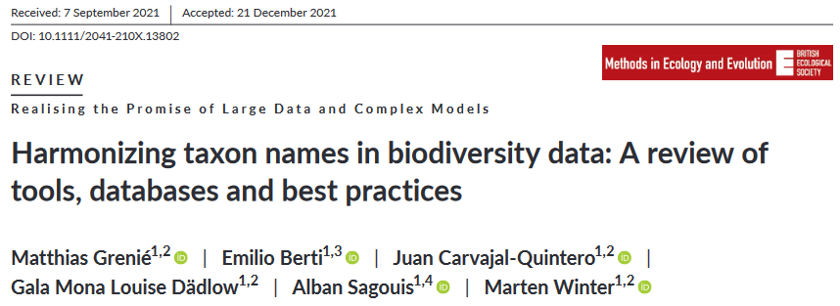
Why am I in front of you here?

Slide 5
Programme of this lecture
What is taxonomy? (Taxonomy 101)
What is “taxonomic harmonization”?
What is needed to perform taxonomic harmonization?
How to perform taxonomic harmonization in practice?

Slide 6
What is Taxonomy?

Slide 7
QUESTION
Who has a formal training
in taxonomy?
Notes:
Before starting, I want to know, who in the audience was formally trained in taxonomy or took taxonomy classes?
Well don’t worry, that’s the case of most of us.
I haven’t been train in taxonomy either.
And this is actually somewhat of a concern in the ecology community.
I’m going to develop a little why.

Slide 8
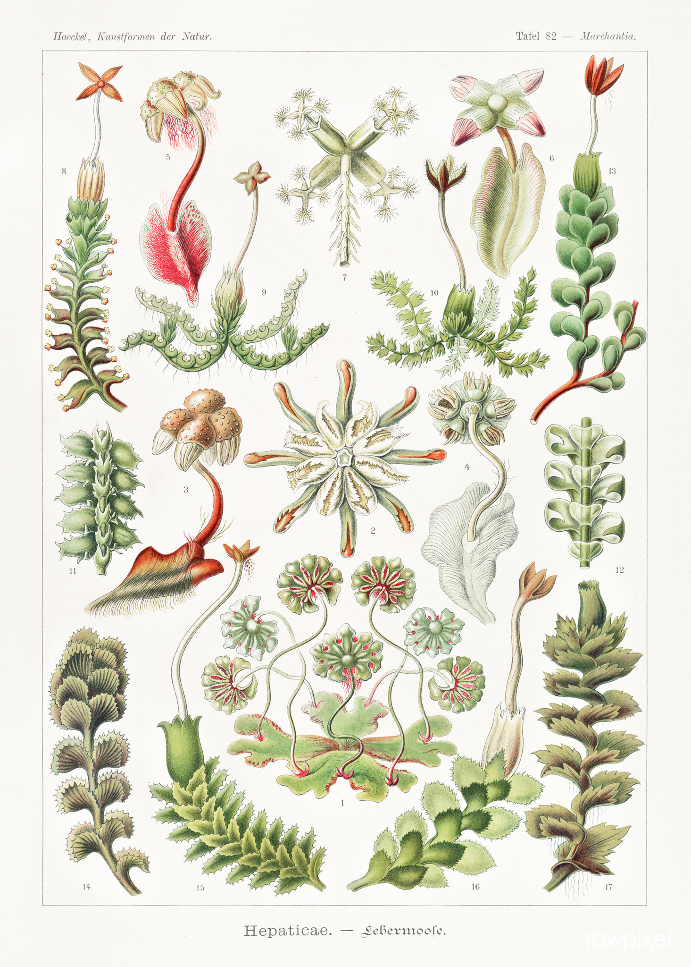
Taxonomy is the basis of all ecology
Need to name things
Need to define entities we’re working on
Need to uncover (evolutionary) relationships between organisms
Historically taxonomy came before
"Hepaticae–Lebermoose” (1904) by Ernst Haeckel. Original from Library of Congress. Digitally enhanced by rawpixel." CC-BY 2.0.

Slide 9
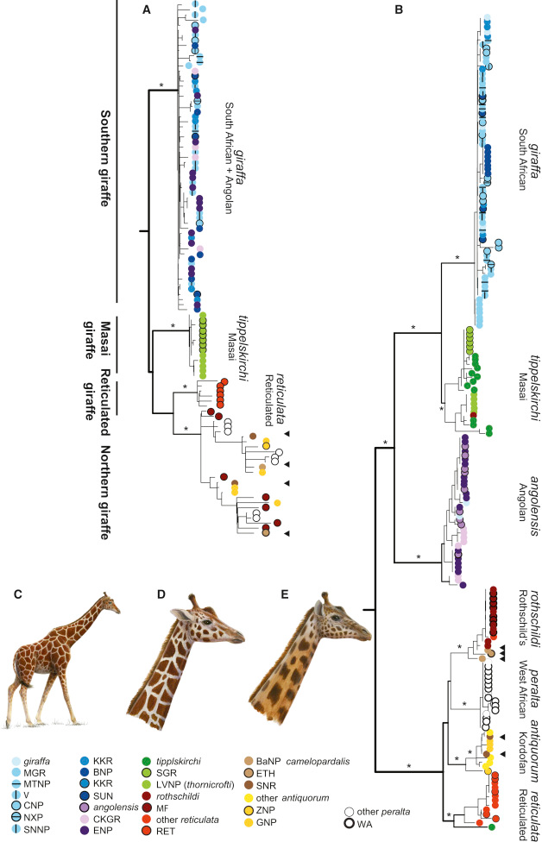
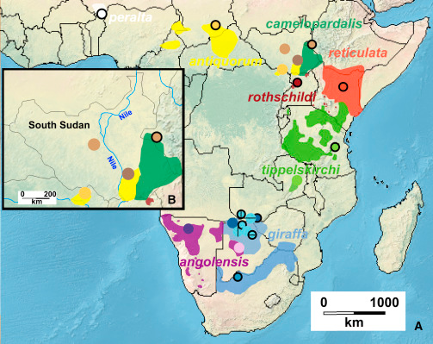
Why should I care about taxonomy?
How many species of giraffe are there?
Implications
for conservation programmes
Fennessy et al. 2016 Current Biology

Slide 10
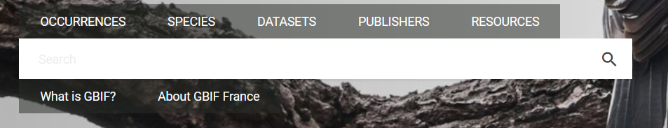
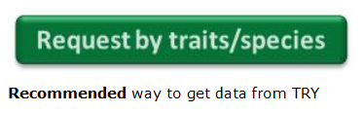

Everything is indexed by species names
Global Biodiversity Information Facility (GBIF) – Occurrence data
TRY Database – Plant Functional Trait
IUCN RedList – Threat Status

Slide 11
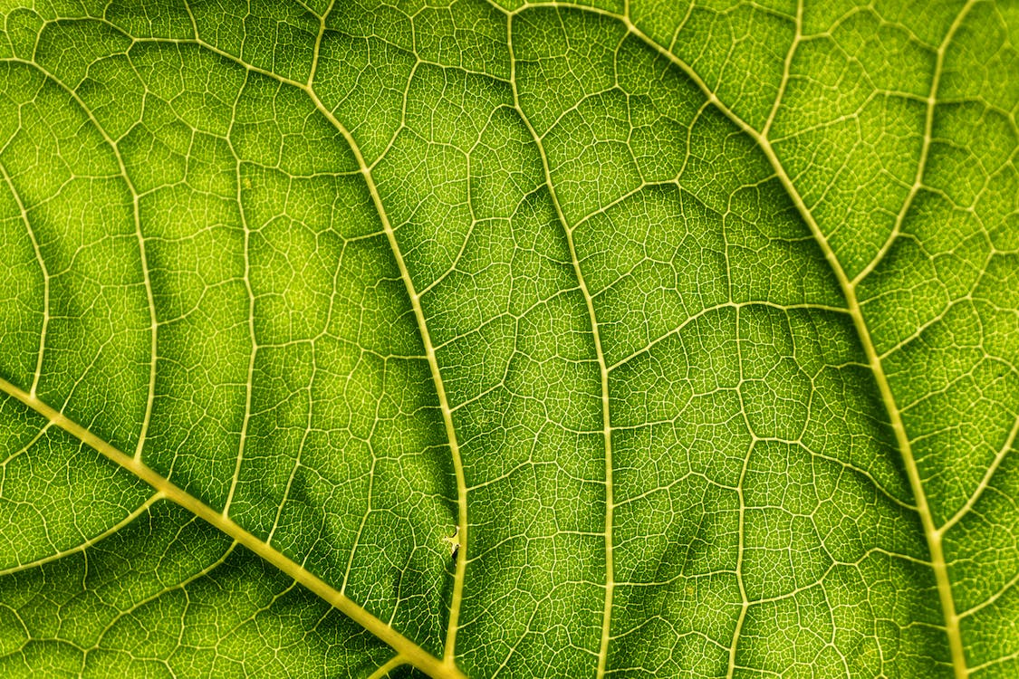
Taxonomy 101: how does it work?
Taxonomists use
Multiple Approaches
(DNA, Morphology, Behavior, etc.)
Establish
new species or relationships
Peer-reviewed into specialist journals
Discussion and Consensus Building

Slide 12
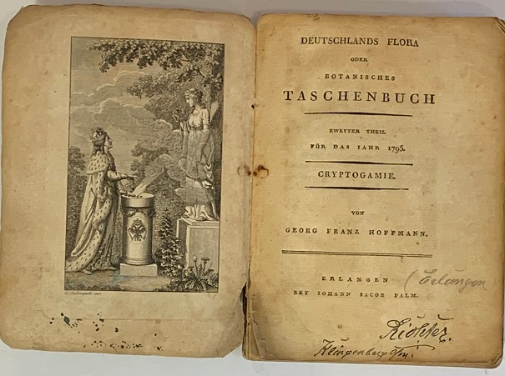




Aggregating taxonomic knowledge
Taxonomic Information is scattered
Need to assemble them
Taxonomic Databases
Provide Up-to-date taxonomy
Rely on individual or community curation

Slide 13
Summary of this part
Taxonomy is at the basis of ecology and biodiversity sciences
Its main goal is to discover and distinguish the different species
Taxonomic information (papers) is aggregated into databases
These databases are called Taxonomic Reference Databases
They provide updated taxonomic backbones for other data

Slide 14
What is Taxonomic Harmonization?

Slide 15
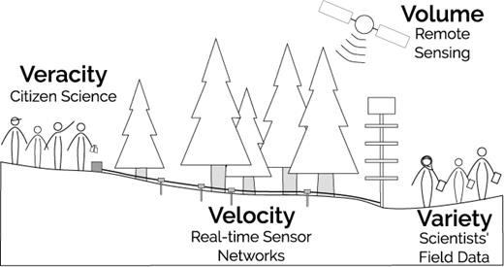
Increasing data size of Ecology
Data are getting larger
Some aspects of “big data”
Larger number of species measured
Farley et al. 2018 BioScience

Slide 16



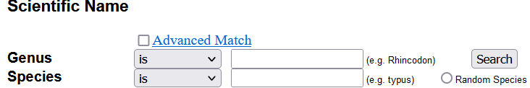
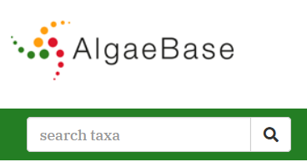
All data indexed by species name!
iNaturalist ‑ Occurrence & ID
FishBase ‑ Occurrence & Traits & Pictures & ...
AlgaeBase ‑ Distribution & Pictures & Taxonomy

Slide 17
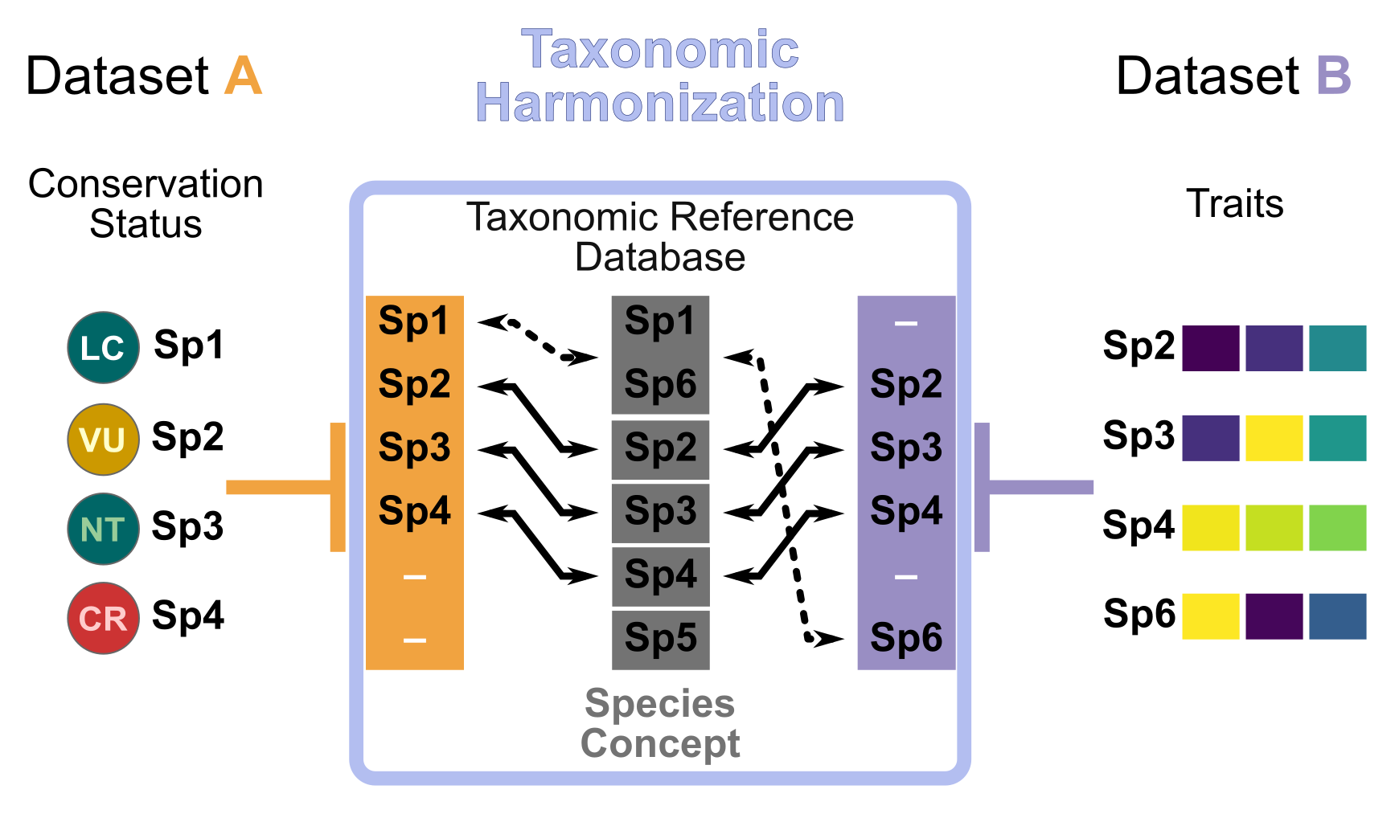
The process of taxonomic harmonization

Slide 18
A concrete example: Bird Extinction Risk vs. Biomass
From Norman et al. 2020
Conservation Status
(IUCN)
With Taxonomic Harmonization
6 species in common
Biomass
(EltonTraits)
Pipile pipile
Pipile cumanensis
Pipile cujubi
Pipile jacutinga
Megapodius decollatus
Margaroperdix madagarensis
Falcipennis falcipennis
Aburria pipile
Aburria cumanensis
Aburria cujubi
Aburria jacutinga
Megapodius reinwardt
Margaroperdix madagascariensis
Catreus wallichii
Falcipennis falcipennis
No taxonomic harmonization
Only 2 species in common
Taxonomic harmonization make datasets comparable

Slide 19
QUESTION
Were you already aware
of this issue?

Slide 20
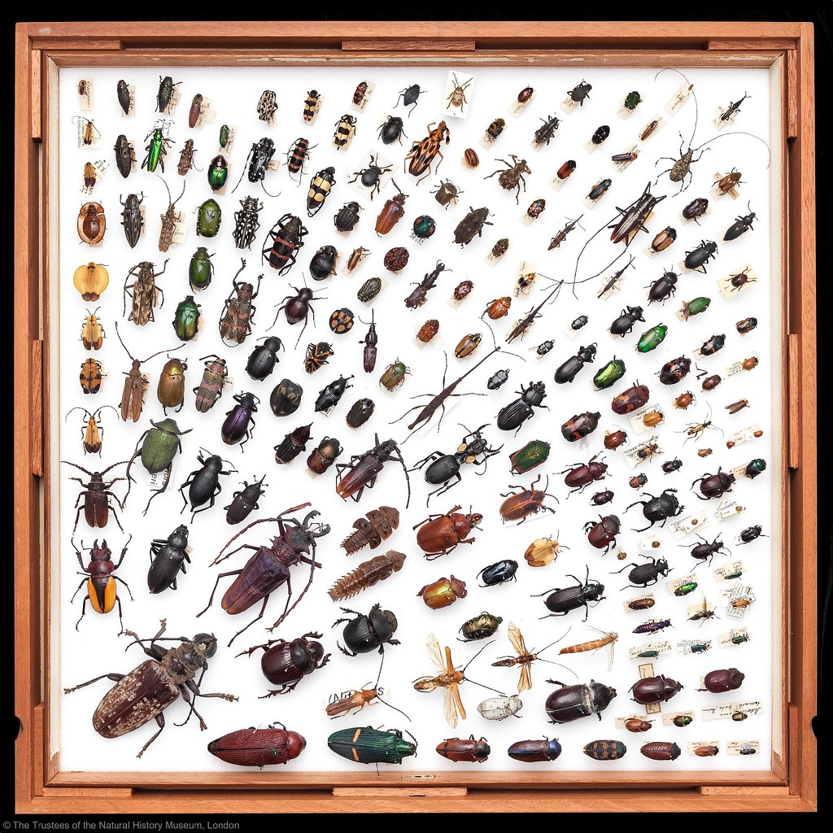
What should you care?
Taxonomic Harmonization
increases matched names
The taxonomy could have been updated between datasets
Use the last up-to-date taxonomy for your analyses
"Insect drawer Natural History Museum Rose Stainthorp 2010" by NHM Beetles and Bugs CC-BY 2.0.

Slide 21
Summary of this part
Taxonomic Harmonization is the matching of species names against species reference databases
Taxonomic Harmonization is necessary with the increasing size of datasets in ecology (manual harmonization is too hard)
With taxonomic harmonization we can resolve given species names into updated ones and take care of synonyms

Slide 22
What is needed to perform Taxonomic Harmonization?

Slide 23

The sources: Taxonomic Reference Databases
Taxonomic Reference Database
(also taxonomic backbone, taxonomic checklist, taxonomic authority, etc.)
“Centralized repository of nomenclatural information”
+Spelling Correction
+Synonymy Resolution

Slide 24

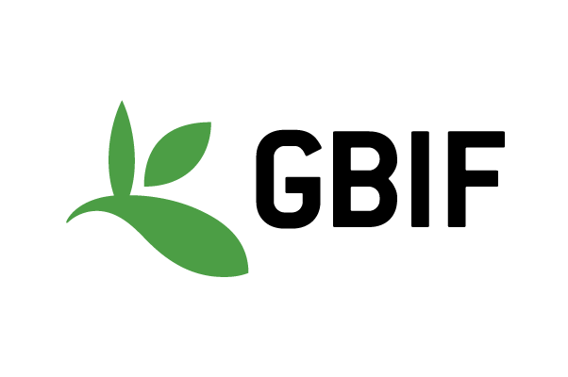


Examples of Taxonomic Reference Databases
June 2021
6.6M names
3.7M accepted
2.6M synonyms
Backbone
GBIF (2021)
No taxonomic restriction
Global
Leipzig Catalogue
of Vascular Plants
LCVP
(Freiberg et al. 2020)
Nov. 2020
1.3M names
350k accepted
850k synonyms
Global
Vascular Plants

Slide 25
QUESTION
What taxonomic reference database do you know for your group of interest?
(Microbes excepted)

Slide 26
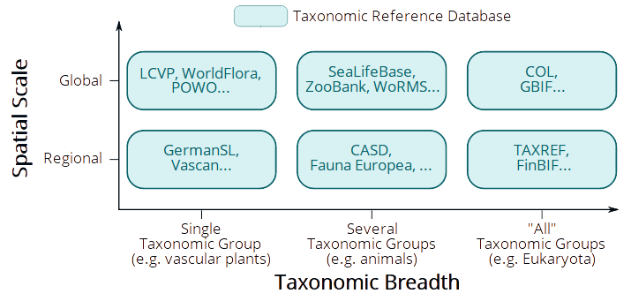
Database typology: Spatial Scale vs. Taxonomic Breadth

Slide 27
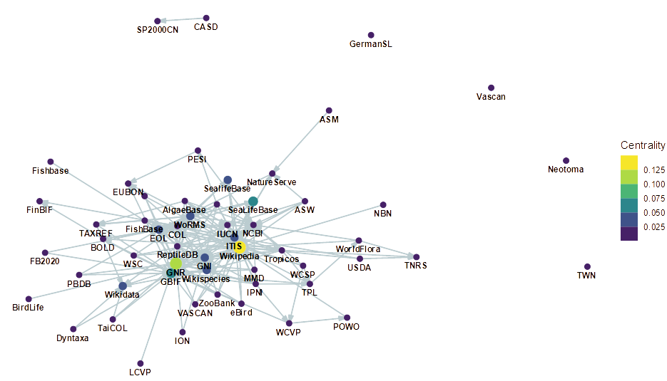
Beware of connections across databases
Relationships
Source → Target
Specific databases widely reused
Some “mega-”
aggregator databases
N.B.: This information is very difficult to gather
(not even talking quantitatively)

Slide 28





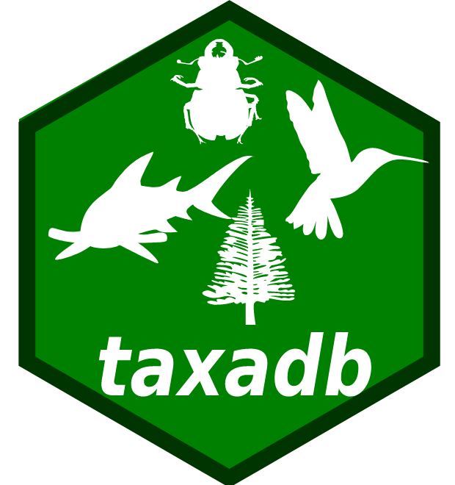
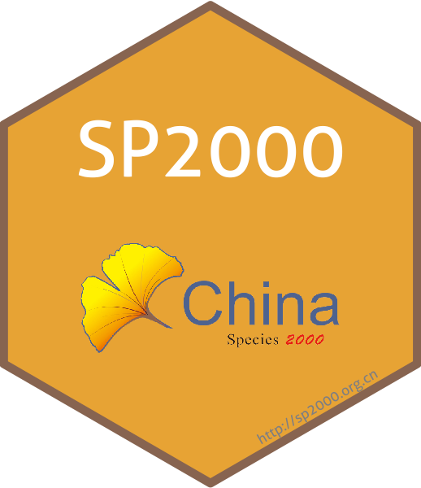
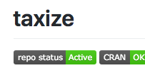
Then we need the tools: R packages
Review of packages on CRAN + GitHub + Bioconductor
Manually curated from standard queries (GitHub code search + r-pkg.org)
Criteria
Real R package (not collection of scripts)
Not a wrapper (not only reusing other tools)
Not about genomics (different field)
Identified 68 packages of which 59 were included

Slide 29
Packages for different purposes
Identified 59 packages belonging to four categories
Database Access
Data Wrangling
Infrastructure
Visualization
3 pkgs
46 pkgs
11 pkgs
2 pkgs
taxize accesses many databases
taxa provides standard classes
rgnparser parses names into components
metacoder displays taxonomy
taxadb offers offline access

Slide 30
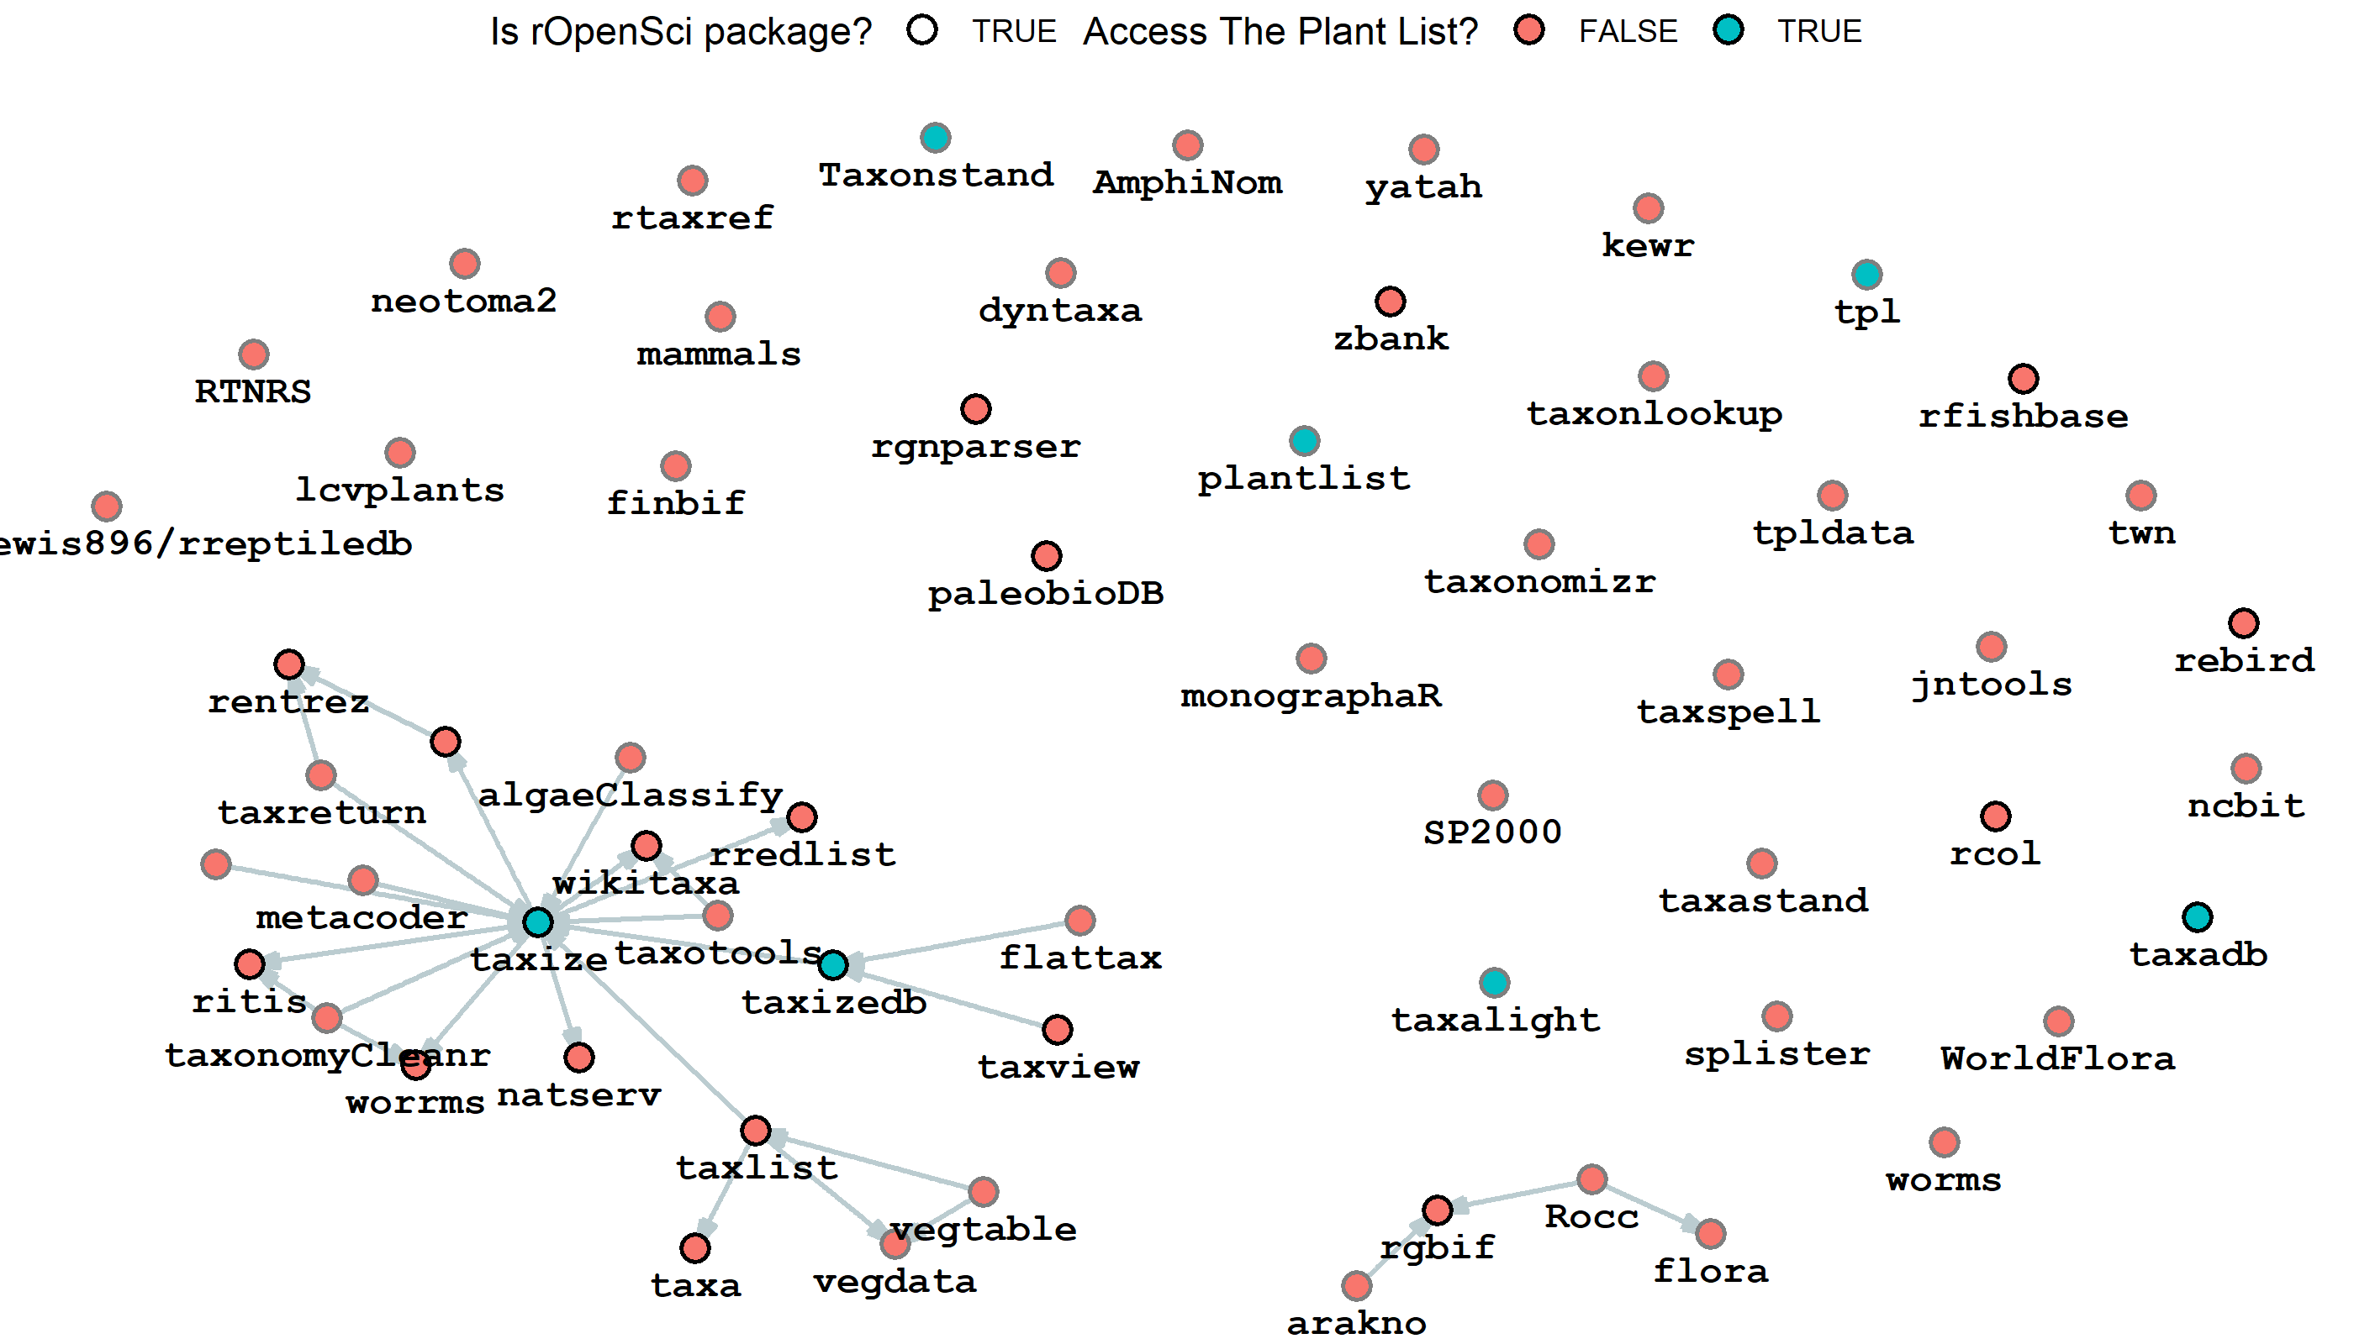
The Package Dependency Network
Disconnected network
Apart from
rOpenSci packages
Many pkgs
provide same source
(TPL)

Slide 31
Taxharmonizexplorer: Connectining Sources & Packages
DEMO TIME!
https://mgrenie.shinyapps.io/taxharmonizexplorer/

Slide 32
Summary of this part
Taxonomic Harmonization requires taxonomic reference databases
These databases cover various spatial scales and taxonomic breadth
Some larger databases aggregate smaller databases
Taxonomic harmonization also rely on tools which are diverse
Some R packages (e.g. taxize) access many databases

Slide 33
How to perform Taxonomic Harmonization?

Slide 34
QUESTION
Naively, how would you perform taxonomic harmonization?

Slide 35
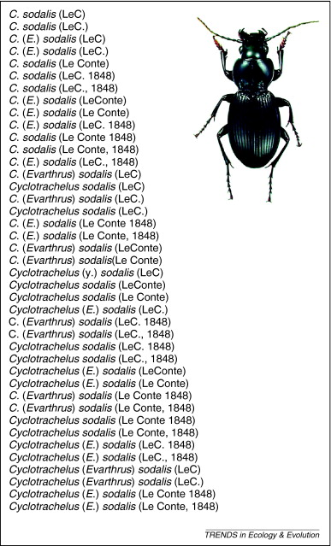
Okay, I have species names, how do I proceed?
Diversity of writing styles
Need to standardize it
Identify components of names
Standardize style
Patterson et al. 2010 TREE

Slide 36
Using Parsers to Identify Components of Names
Cyclotrachelus sodalis (Le Conte, 1848)
44 326 unique taxa in BioTIME
32 900 after pre-processing
rgnparser::gn_parse()
rgbif::parsenames()
Also online:
https://parser.globalnames.org/ https://www.gbif.org/tools/name-parser

Slide 37
No one-size-fit-all BUT tested four workflows
1: Pre-process
(unify spelling)
2: Match databases
3: Harmonize
Matched
on Plants
WF1
Matched
on Birds
Raw
List
Corrected
List
Harmonized
List
1.5: Get tax. group
Plants
Matched
Plants
WF2
Birds
Matched
Birds
WF3
GBIF
WF4
<numéro>
Notes:
Now that we identified the data sources and the tools to manipulate taxonomic information, how should we proceed for proper harmonization. We explored two different ways.

Slide 38
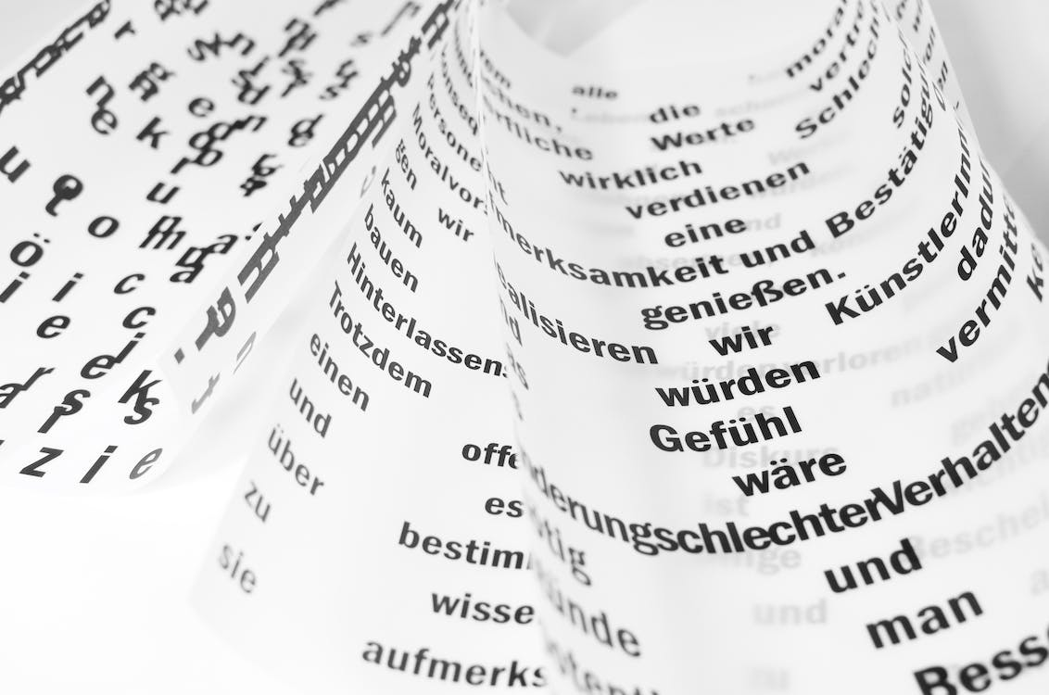
1. Check encoding and special characters

Slide 39

2. Parse name into components

Slide 40
3. Match names against well-selected databases
Select databases based on:
1. Taxonomic breadth (more specialized have more details)
2. Spatial Scale (smaller databases tend to be more up-to-date)
3. Date of update (more recent better reflect current knowledge)
4. Number of synonyms (more synonyms means better resolving)

Slide 41
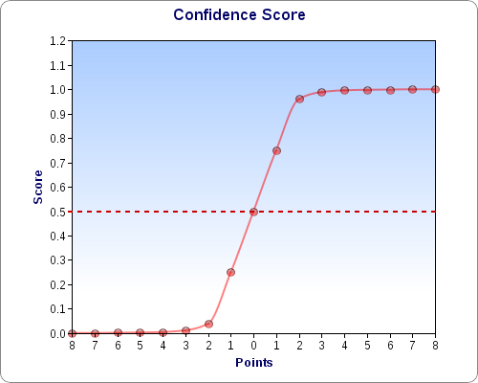

4. Resolve them
Use matching scores to resolve matching names automatically
Not perfect but difficult to achieve with many (>1,000) names

Slide 42
Summary of the workflow
Check encoding and special characters
Parse name into components
Match names against well-selected databases
Resolve names

Slide 43
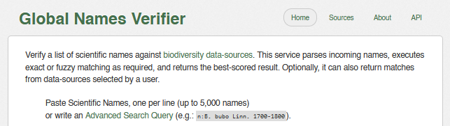
What to do with unmatched names?
Check spelling manually
Drop them?
Test against “aggregator databases” like Global Names Verifier
https://verifier.globalnames.org/

Slide 44
Other points of detail: author names
Cyclotrachelus sodalis (Le Conte, 1848)
Gives scientific information
Help distinguish different species concepts
→ Whenever possible (not all databases allow it) include author names

Slide 45
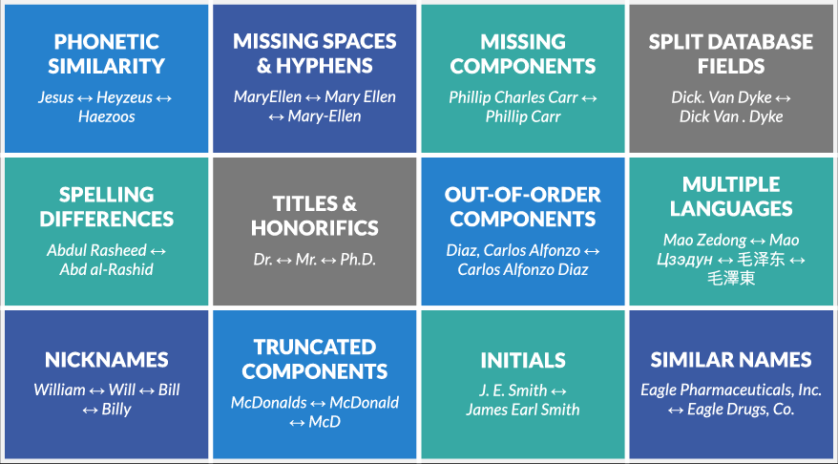
Other points of detail: fuzzy matching
Fuzzy matching means matching names that are not exactly written the same way
Variety of techniques implemented by databases
→ Can use it but with care (can match outside taxa or being too loose)

Slide 46
Summary of this part
Taxonomic Harmonization has no one-size-fit-all solution
Checking data encoding and parsing name components is important
Then match names on appropriate databases
Resolve them based on matching scores
Decide what to do about unmatched names

Slide 47
Take Home Messages and Grand Summary of Things

Slide 48
The Grand Summary of Things
Taxonomic harmonization is the process of matching taxonomic names onto reference databases
It’s paramount for the data matching process when combining data
It is supported by databases of different spatial scale and taxonomic breadth, as well as a diversity of tools
Pre-processing the names is important for harmonizing taxonomy
Think and decide about the matching process (scores, fuzzy matching, author names, etc.)

Slide 49

Remaining questions?

Slide 50
Email: matthias.grenie@idiv.de
Twitter: @LeNematode
Mastodon: @LeNematode@pouet.chapril.org
Website: https://rekyt.github.io
Thank you!

