Slide 1
A Predictive Analytics Approach to Customer Attrition in the Telecommunications Sector
Guidance
under
Prof. Dr. Chaojie (Jay) Wang
Presented by: Gowtham Krishna Sai Relangi

Slide 2
Why Customer Churn Matters..
Customer Churn (or attrition) is when customers cancel their service.
It's a major drain on revenue and market standing.
Acquiring a new customer is far more expensive than keeping an existing one.
The goal is to stop being reactive and become proactive.

Slide 3
Objectives
Build a predictive model to accurately forecast customer churn using historical data.
Identify key drivers of churn by analyzing which customer factors are the most important predictors.
Compare machine learning methods (Decision Tree, Random Forest, and XGBoost) to determine the most effective model for this problem.

Slide 4
Data Overview
Source: A historical Telco customer churn dataset with 7,043 customer records and 21 features.
Data Categories:
Demographics: (e.g., SeniorCitizen, Partner, Dependents)
Services: (e.g., InternetService, OnlineSecurity, TechSupport)
Account Info: (e.g., Contract, PaymentMethod, MonthlyCharges)
Target: Churn - a "Yes" or "No" label for attrition.
Key Challenge: The data is imbalanced. A large majority of customers did not churn, making it difficult for a model to learn to predict the rare "Yes" (churn) event.

Slide 5
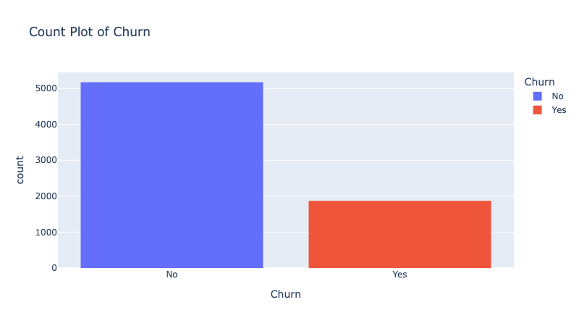
EDA
Make sure to keep the text in the notes column
Notes:
The target is imbalanced. A large majority of customers (5,174) did not churn, while 1,869 did. This imbalance is our main technical challenge, as it can bias a model. This is why we must use a technique like SMOTE to get a reliable result.

Slide 6
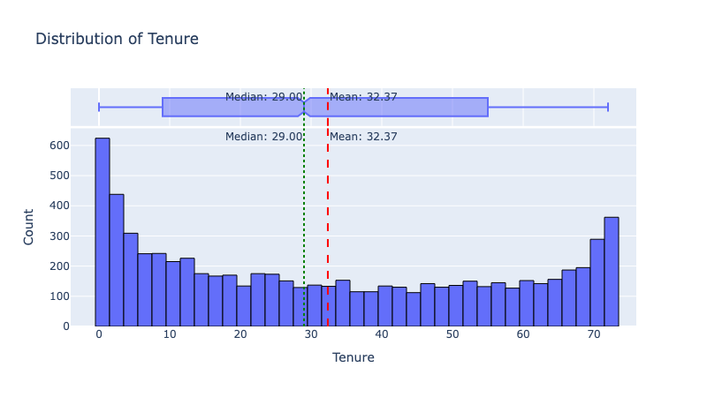
EDA Cont…
Notes:
The tenure (how long someone has been a customer) is split into two main groups: a large number of brand-new customers (left) and a large number of long-term, loyal customers (right). This suggests we are losing customers before they become loyal.

Slide 7
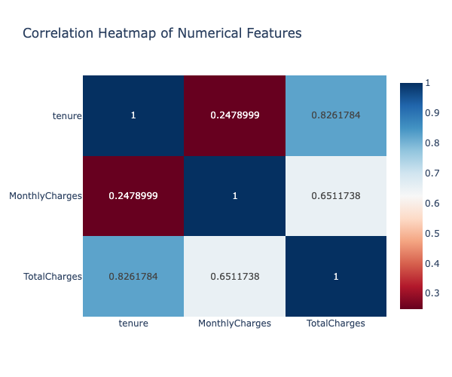
EDA Cont…
Notes:
This heatmap shows the relationship between key numerical features. As expected, tenure and TotalCharges are very strongly correlated (0.83)—the longer a customer stays, the more they pay in total.

Slide 8
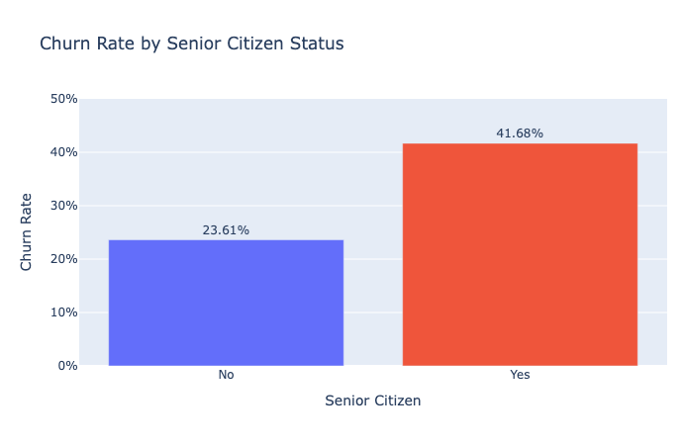
EDA Cont..
Notes:
Senior citizens churn at a rate of 41.7%, which is nearly double the rate of non-seniors (23.6%). This makes it a clear and important predictive signal for the model.

Slide 9
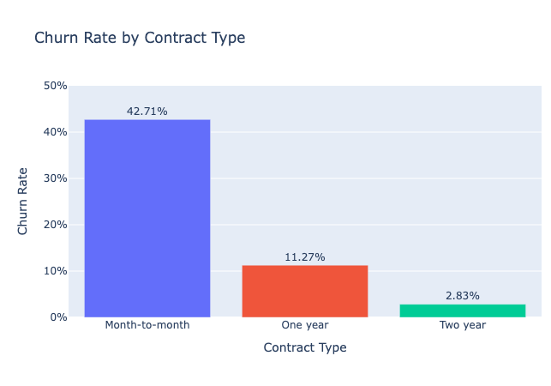
EDA Cont…
Notes:
Customers on a Month-to-Month contract churn at an alarming rate (42.7%). In contrast, customers on One-year (11.3%) or Two-year (2.8%) contracts are significantly more loyal.

Slide 10
Data Preparation
Encode Features: Converted all categorical data (like "Yes"/"No") into numbers so that the model can understand.
Balance Data (SMOTE): Used a technique called SMOTE on the training data only to create synthetic "Yes" examples. This stops the model from just guessing "No" all the time.
Split Data (80/20): Split the data into a training set (to build the model) and a test set (to check its real-world performance).

Slide 11
Model Design and Selection
Baseline Comparison
Trained Decision Tree (78%), Random Forest (84%), and XGBoost (83%).
Used 5-fold cross-validation on the balanced (SMOTE) training data.
Model Selection
Random Forest was selected as the champion model due to its high 84% baseline accuracy.
Hyperparameter Tuning
Performed RandomizedSearchCV on the Random Forest model.
This optimized its settings for our specific data.
Final Model
The result was our final, tuned Random Forest model with 85% accuracy.

Slide 12
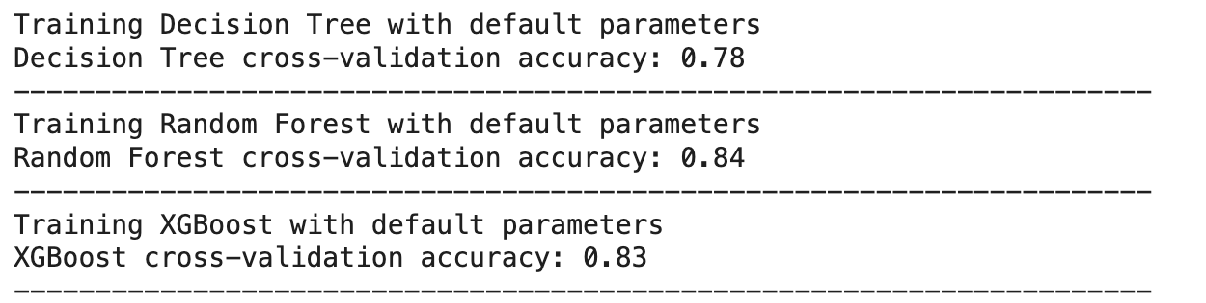
Model Accuracies

Slide 13
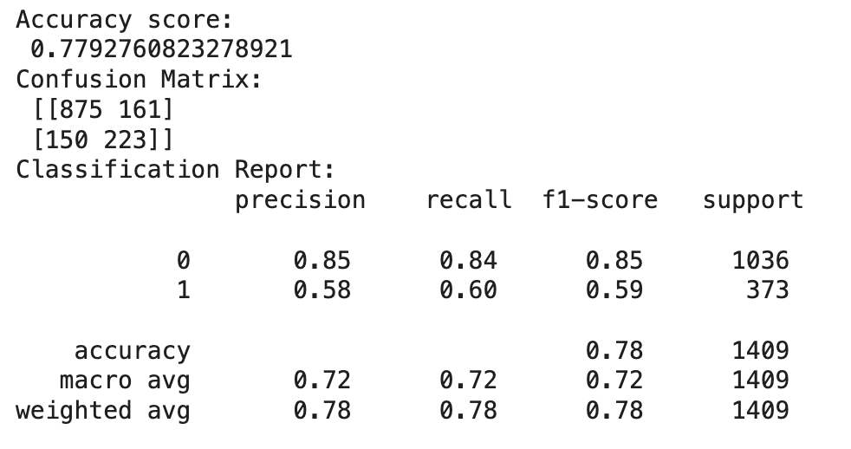
Classification Report
Overall Accuracy: 78%
This is the model's general performance.
Recall (for Churn): 60%
This is our most important metric.
It means we successfully find 6 out of 10 customers who are actually at risk of churning.
Precision (for Churn): 58%
When our model flags a customer as "at-risk," it is correct 58% of the time.
Business Takeaway: The model is a solid, proactive tool. It successfully identifies the majority (60%) of churners, allowing the company to intervene.

Slide 14
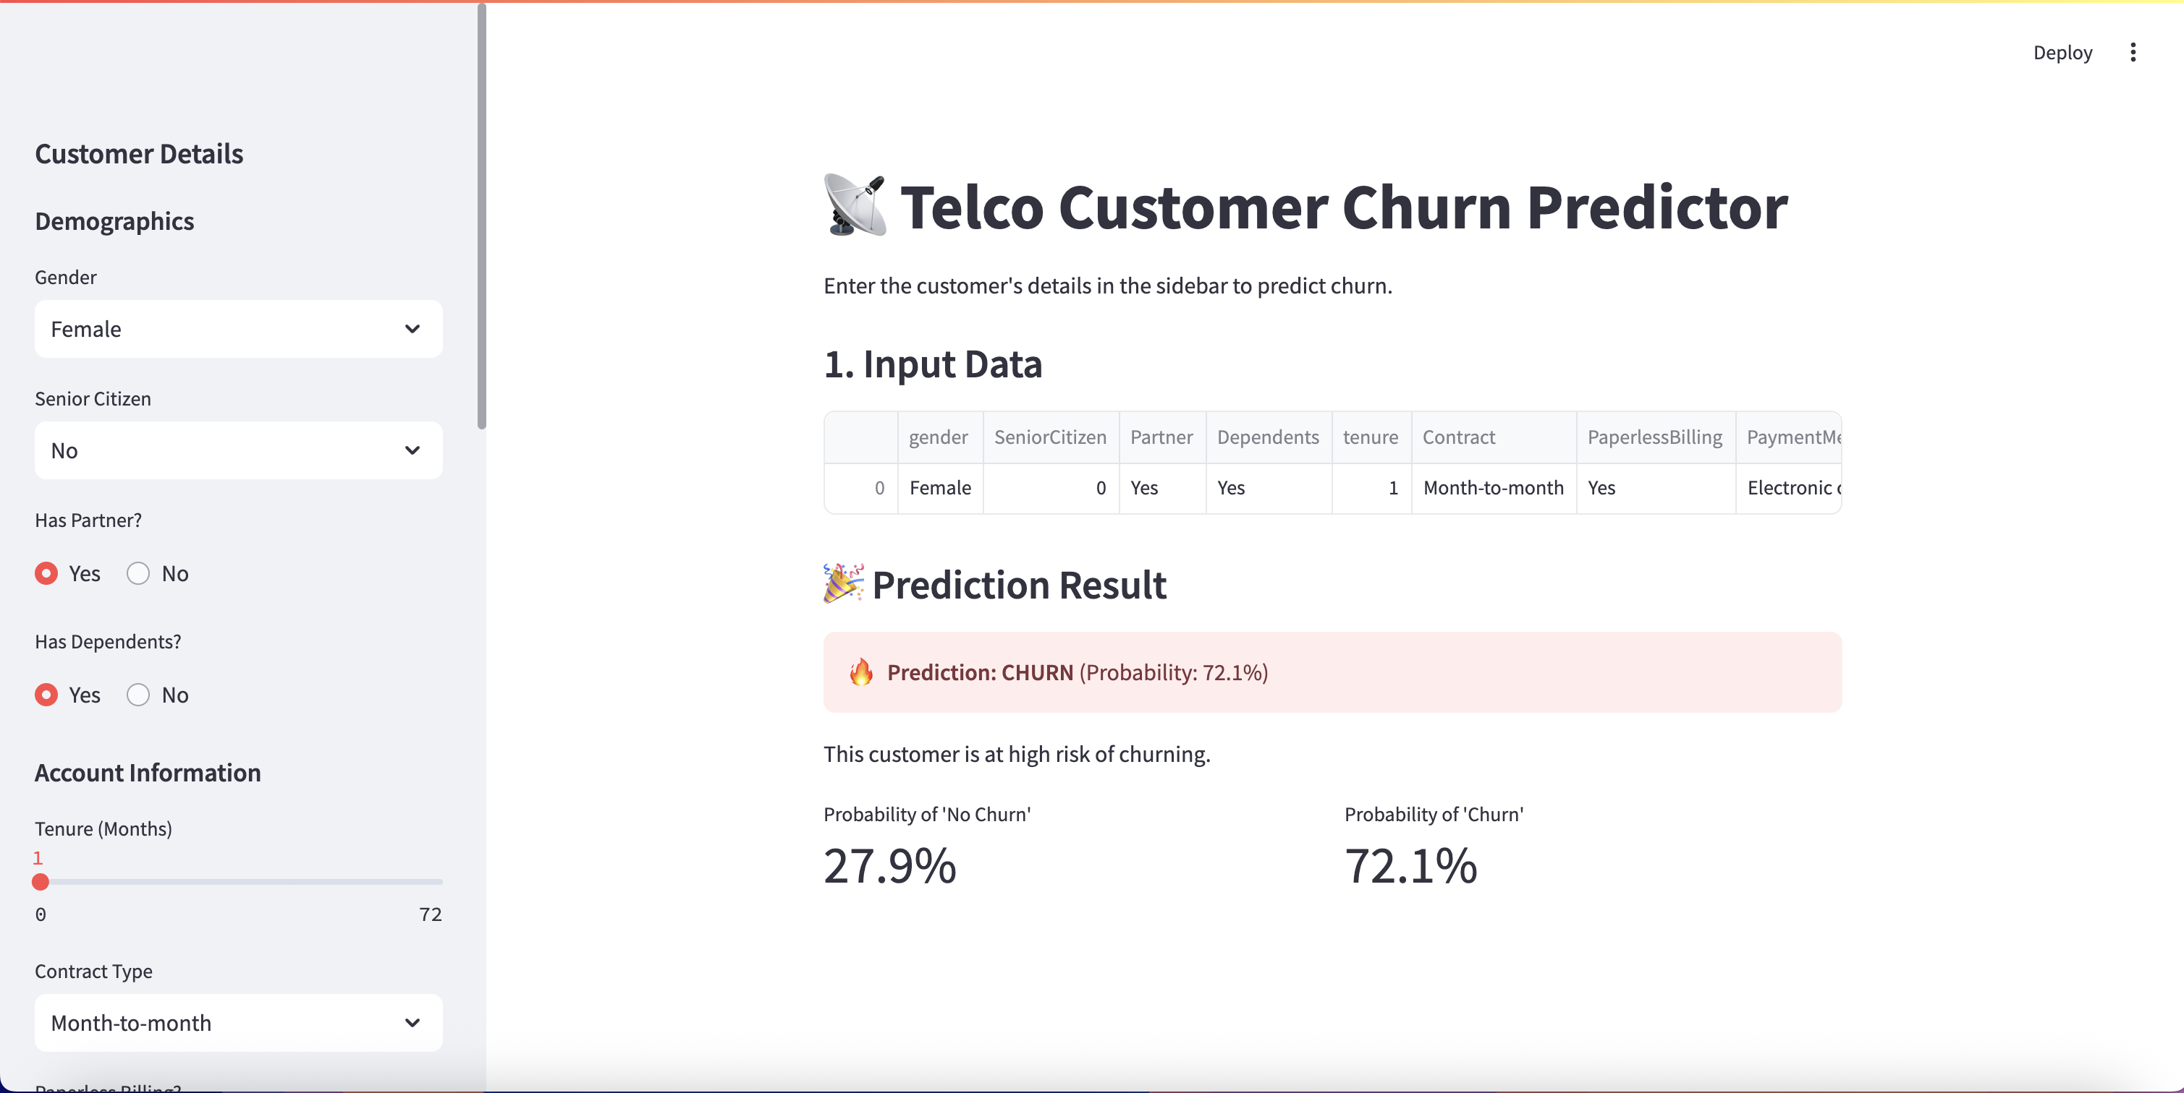
Application
Notes:
A Streamlit web application was built to deploy the model. The retention team can now input any customer's details and get an instant, actionable "Churn Risk" prediction.

Slide 15
Conclusion
Prediction: The model successfully identifies 60% of at-risk customers (60% Recall).
Key Drivers: Churn is driven by Contract type, tenure, and SeniorCitizen status.
Best Model: The Tuned Random Forest proved to be the most accurate model (78% overall).
Final Outcome: A Streamlit app is ready for use by the retention team.

Slide 16
THANK YOU

