Slide 1
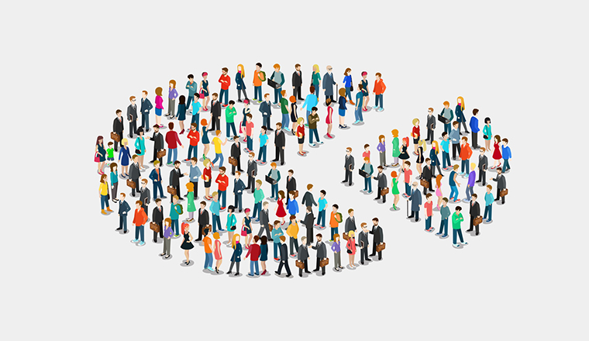
Group 1 P-361 (Customers Personality Analysis)
Mr. Relangi Hemanth Kumar
Ms. Pratiksha R. Jagtap
Ms. Pranjalee Sharma
Mr. Akash Yadav
Mr. Ujwal Jagdish Singh bais
Ms. Shubhangi A. Shipalkar
Ms. Kondavalasa Bhavitha

Slide 2
Business Objective
Customer personality analysis helps a business to modify its product based on its target customers from different types of customer segments.
Finding the potential customers by analysing the behaviour of them is useful to understand the targeted customers.
For example - instead of spending money to market a new product to every customer in the company’s database, a company can analyse which customer segment is most likely to buy the product and then market the product only on that particular segment.
Keywords: - Customer Personality Analysis, Customer Segments

Slide 3
Understanding Dataset
People
ID
Promotions
NumDealsPurchases
Products
Year_Birth
Education
Marital_Status
Income
Kidhome
Teenhome
Dt_Customer
Recency
Complain
MntWines
MntFruits
MntFistProducts
MntSweetProducts
MntGoldProds
AcceptedCmp1
AcceptedCmp2
AcceptedCmp3
AcceptedCmp4
AcceptedCmp5
Response
Place
NumWebPurchases
NumCatalogPurchases
NumStorePurchases
NumWebVisitsMonth

Slide 4
EDA(Exploratory Data Analysis)
Exploratory Data Analysis (EDA) is analysing the data using visual techniques. It is used to discover trends and patterns or to check assumptions with the help of Statistical Summaries and graphical representation.
Language Used
Python
Libraries Used
Pandas
Numpy
Matplotlib
Seaborn
Sklearn
Pickle
Streamlit

Slide 5
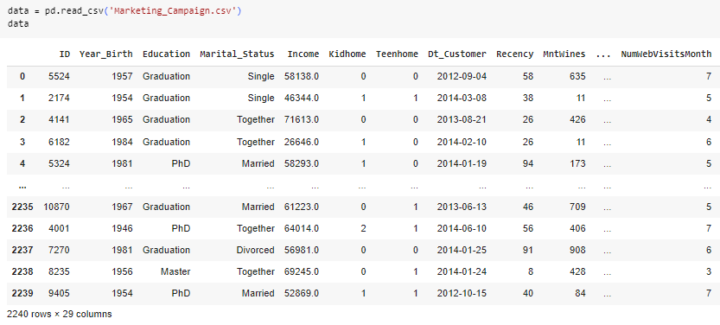
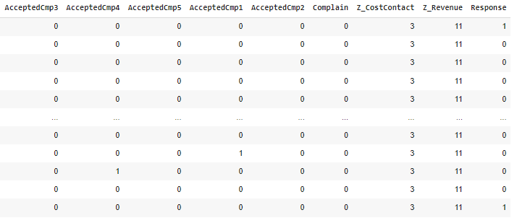
Dataset Details
Shape of the Dataset.
Rows
Columns
29
2240

Slide 6
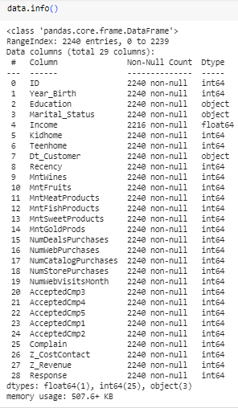
Dataset Information
Using data.info() we get the Information summary of the dataset.
It gives information of data frame as follows.
Class | Pandas.core.frame.DataFrame
RangeIndex | 2240 entries, 0 to 2239
Columns | 29 Columns
Non-Null | non-null
Dtype | Int64(25), object(3), float64(1)
Memory Usage | 507.6+ KB

Slide 7
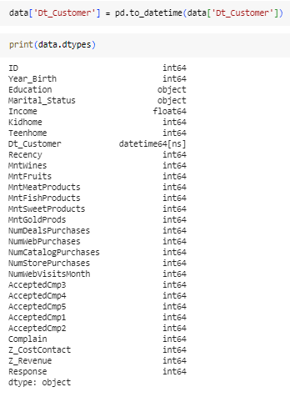
Convert DataType
here we are converted the data type of D_Customer from object to datetime64.

Slide 8
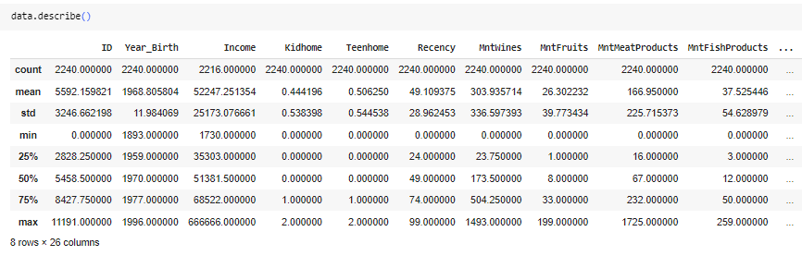
Dataset Description
Describe () method display the statistical summary as:
count, mean, std, min, 25%(Q1), 50%, 75%(Q3) and max
This summary is different for each column.

Slide 9

Checking for Duplicates
As you can see there is no duplicate record in the dataset.

Slide 10
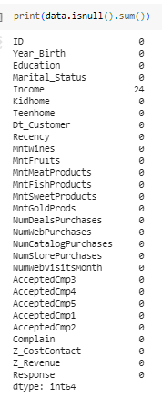
Checking for Null Values
Here we found out that Income column has 24 null values.
We filled this null values with the median.
As you can see we fill null values with the median value of the Income Column.
Now there is no any null values in the dataset.

Slide 11

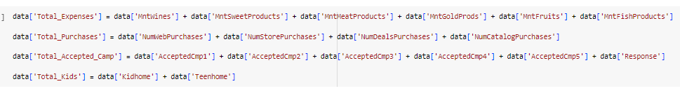
Creating New Columns
Creating ‘Age’ Column
Creating Total_Expenses, Total_Purchase, Toatl_Accepted_Camp and total_Kids Columns
We have created this columns for better understanding and visualization.

Slide 12
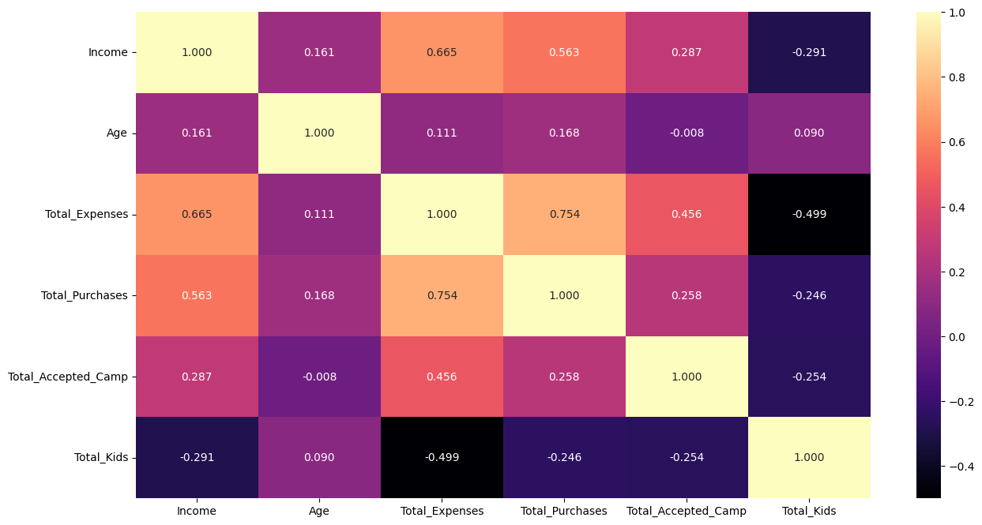
Visualization
Heatmap
Through heatmap we can see the correlation between the data points.
Total_Expenses and Total_Purchases has 0.754.
Income and Total_Expenses have 0.665.

Slide 13
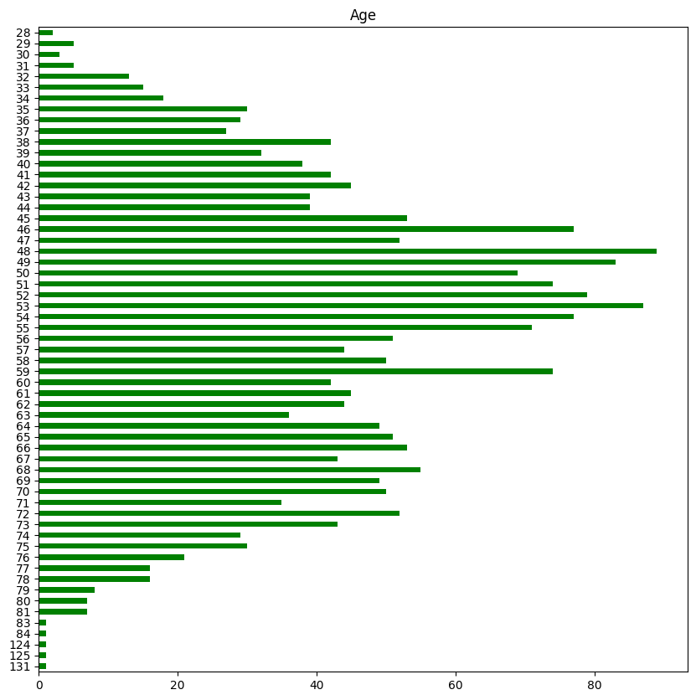

Bar Plot
Age Column
Here we are plotting the Bar Graph for checking the age group of active or regular Customers.
According to the graph, most of the customers are between the 45 to 59 age group.

Slide 14
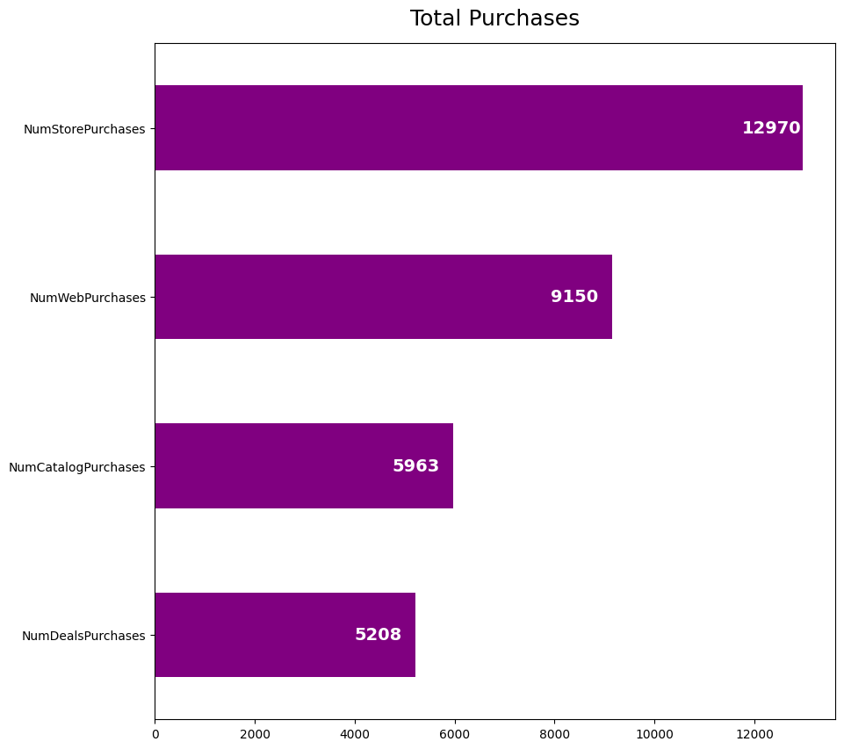
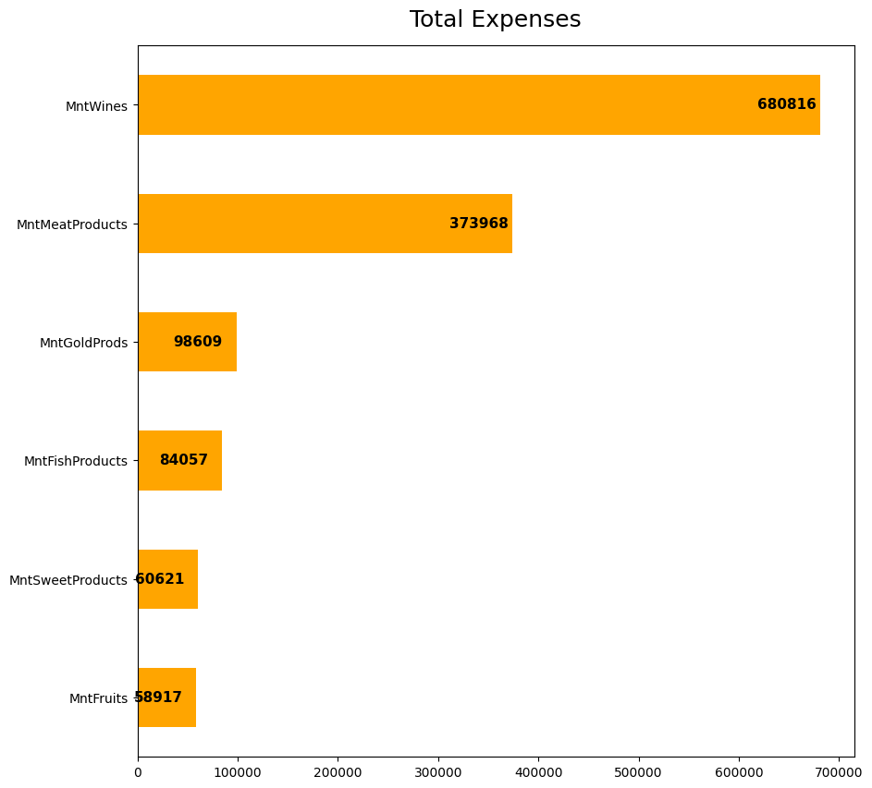
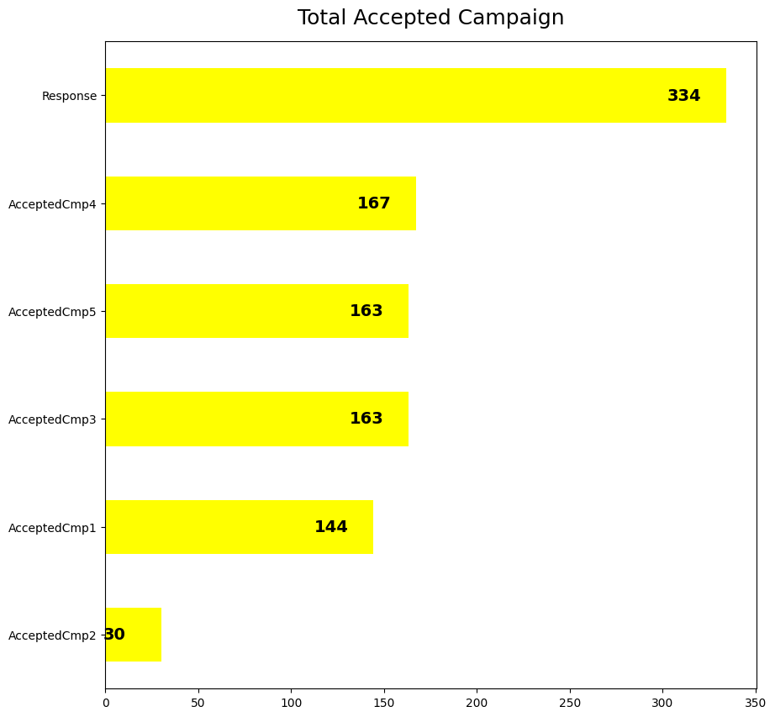
Total_Purchases, Total_Expenses, Total_Accepted_Camp
Total Purchase graph shows that the number of purchase made by the customers directly visiting the store.
And the least purchase is made by the discount.
Total Expenses graph shows the amount spend on products.
The graph also shows that the Wine is the best selling product and fruits are the least selling product.
In the graph we can see the most of the customers accept the offer in the last campaign.
and least of the customers accept the offer in the 2nd campaign.

Slide 15
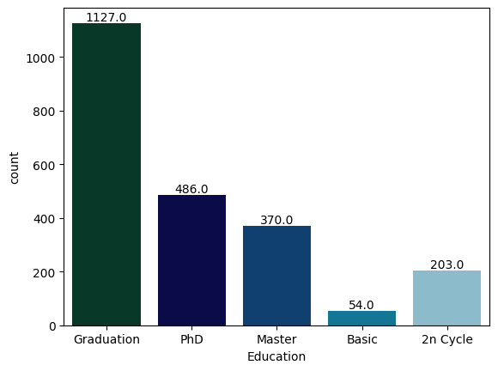
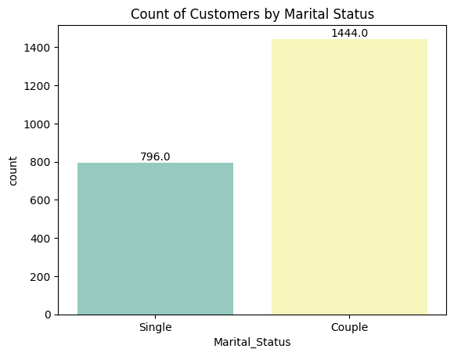
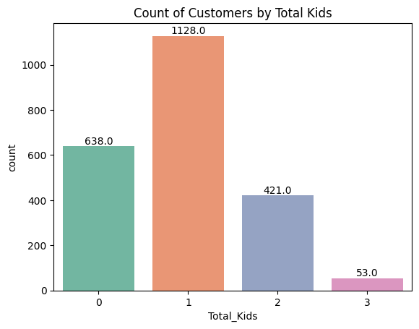
Count Plot
This plot shows the customers Education level.
The most of the customers are Graduated.
The plot shows the Marital Status of the customers
As per the plot 1444 customers are Married or Together and 796 Customers are single.
The plot shows the number of kids the customers have in their household.

Slide 16
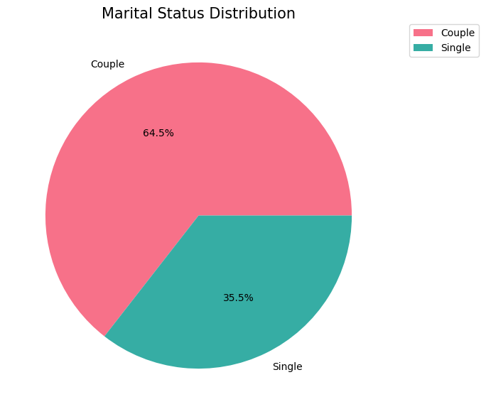
Pie Chart
A pie chart is circular statistical chart which divide into slices.
Each slice illustrate the numerical proportions in data.
As the pie chart represents the Marital Status of the customers, which shows that 64.5% of the customers are couple and 35.5% of customers are single.

Slide 17
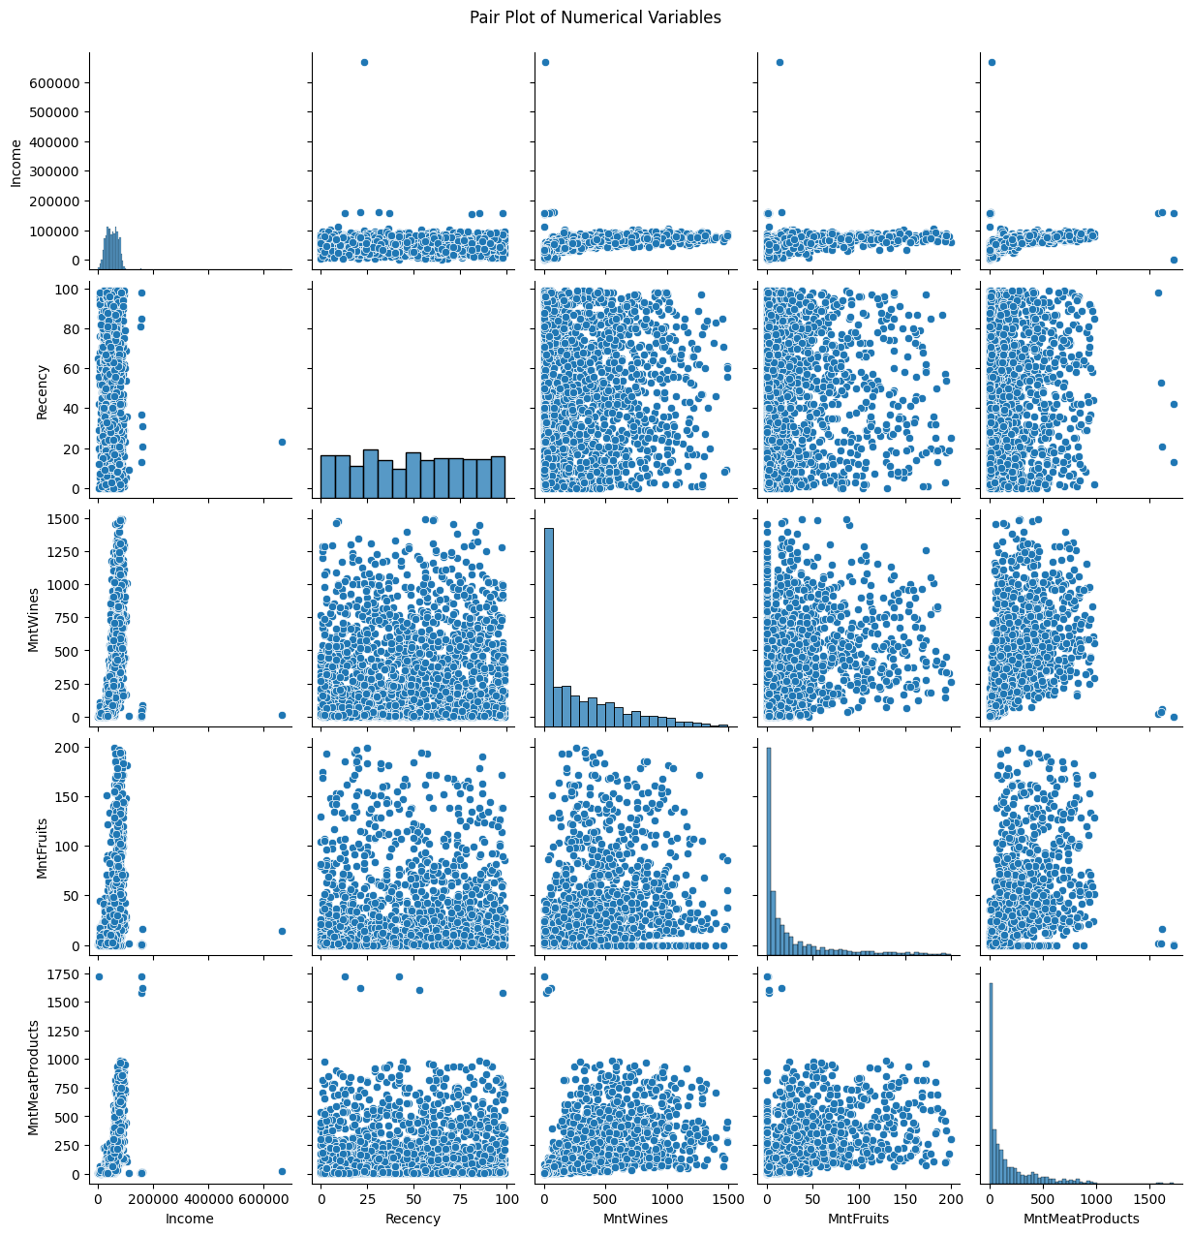
Pair Plot
Pair plot for Income', 'Recency', 'MntWines', 'MntFruits', 'MntMeatProducts.
Pair plot allow us to plot pairwise relationships between variables within a dataset.
Pair plot builds on two basic figures, the histogram and scatter plot.

Slide 18
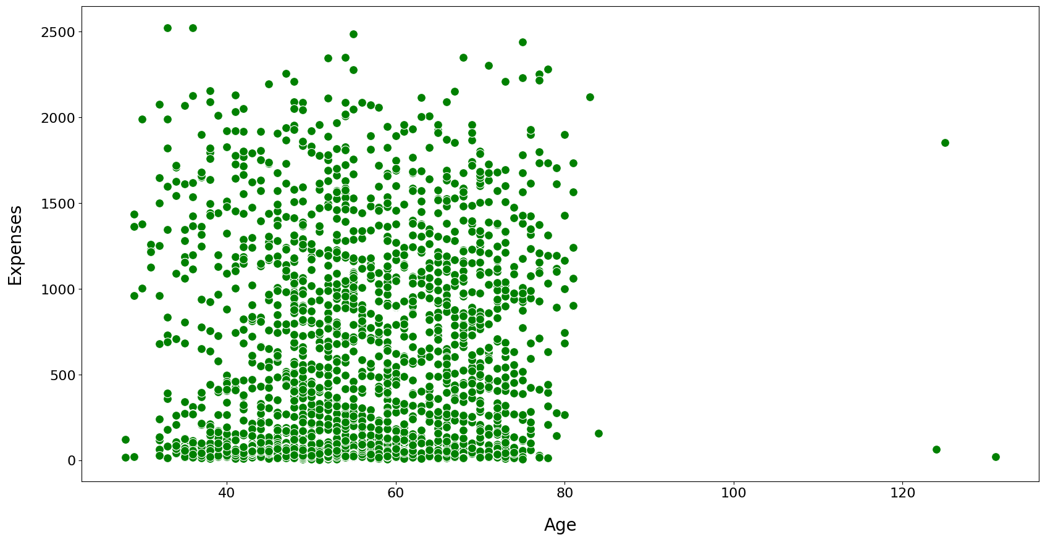
Scatter Plot
We plot this Scatter Plot to see how Age and Expenses relate to each other.
As we can see in the scatter plot the Age doesn’t make that much impact on the Expenses.
The scatter plot shows no relationship between the Age and Expenses.

Slide 19
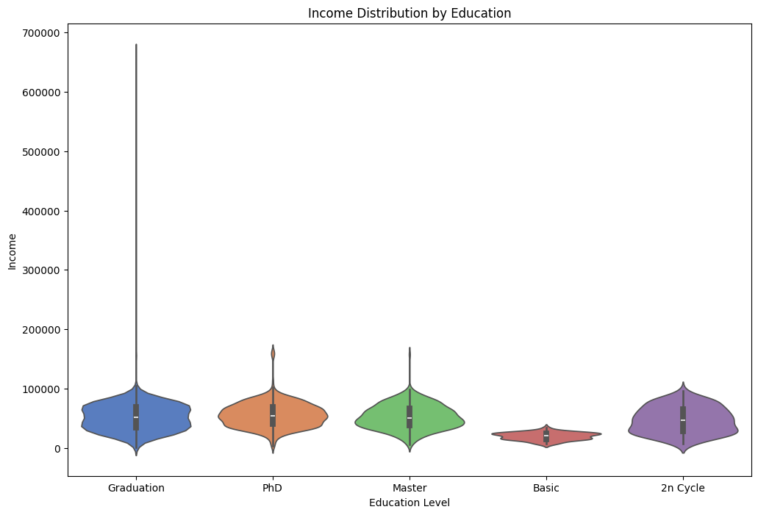

Violin Plot
1.5 Interquartile Range
Median
Kernal Density Estimation (KDE) Boundary

Slide 20
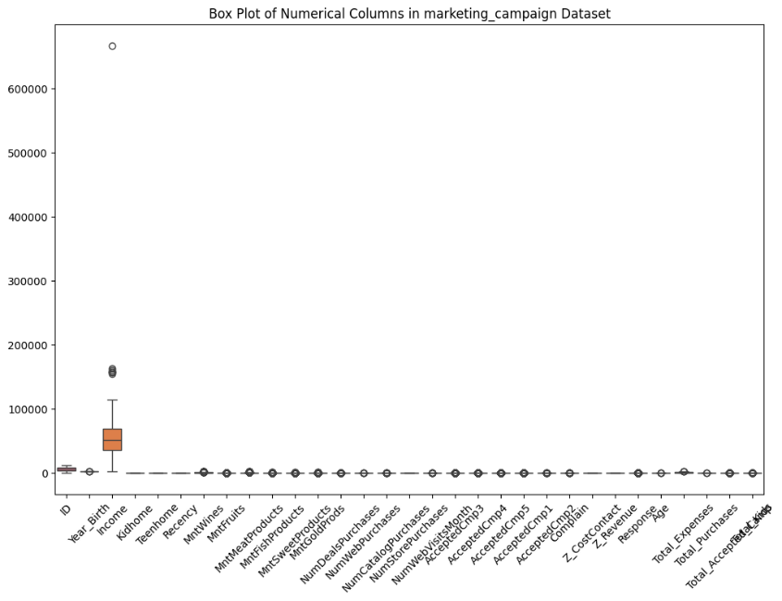
Outliers Detection
As we can see there is outliers present in the most of the columns.
But column “Income” has the most amount of outliers as compare to other columns.

Slide 21
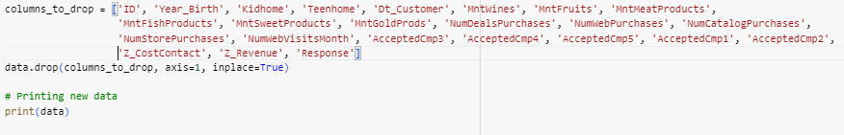
Clustering
As this project is about the Customer Segmentation where we need to analyse the personality of the customers for that we use clustering.
Clustering will help us to group similar customers together.
Drop unwanted Columns
We drop unwanted columns here and performed standardization and label encoding on that data.

Slide 22
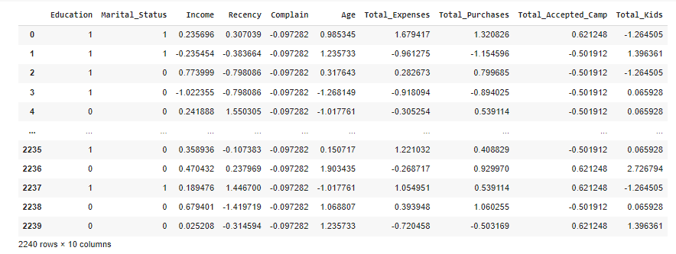
Final Transformed data
This is the final data after performing the Standardization and Label Encoding.

Slide 23
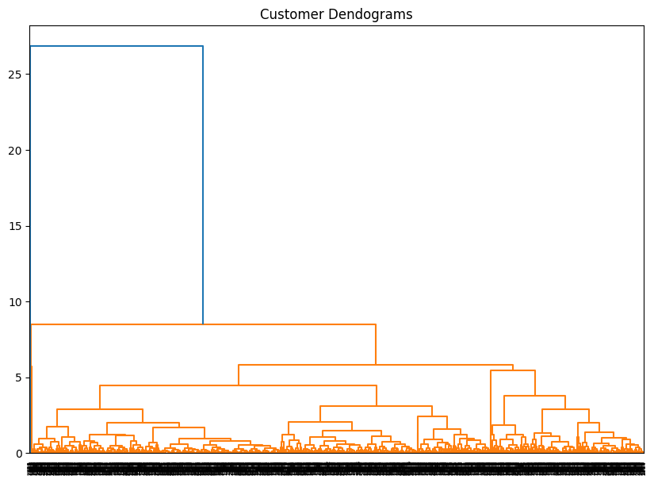
Dendrogram
The dendrogram shows the hierarchical clustering of customers based on their income and total purchases. The dendrogram visualizes the distance between individual customers, helping to identify potential clusters or groups within the data.

Slide 24
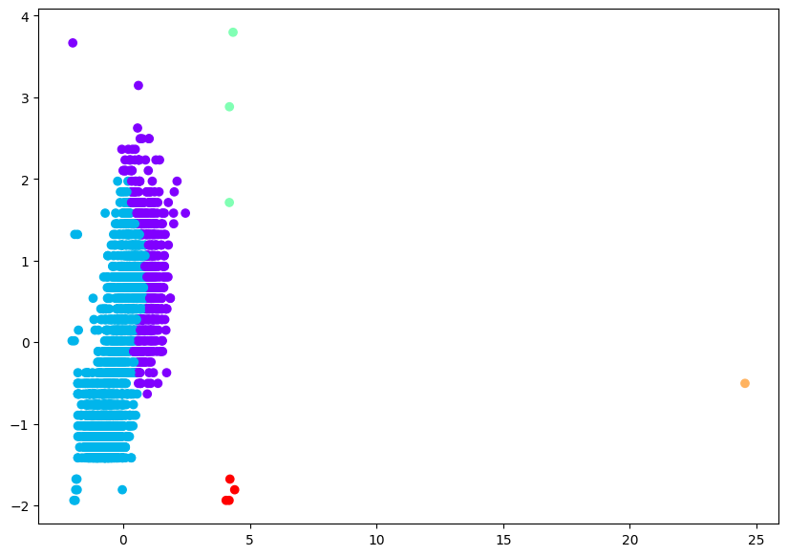

Agglomerative Clustering
Agglomerative Clustering is a method of clustering data points together based on their similarity.
The silhouette score measures how well each data point fits into its assigned cluster and ranges
The Agglomerative Silhouette Score is 0.308, it indicates that the clustering algorithm has produced clusters with moderate cohesion and separation, suggesting a reasonable clustering solution.
559
1673
3
1
4
Cluster 0
Cluster 1
Cluster 2
Cluster 3
Cluster 4

Slide 25
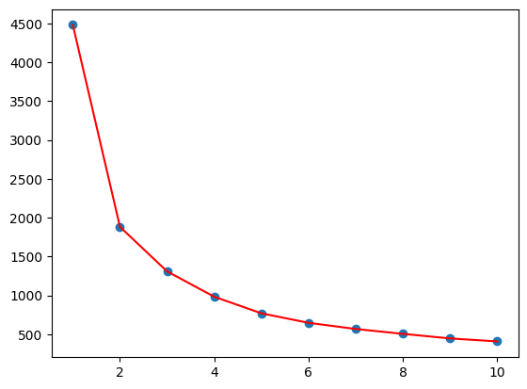
KMeans Clustering
The K Means Silhouette Score of 0.416, it indicates that the clustering algorithm has produced clusters with moderate cohesion and separation, suggesting a reasonable clustering solution.
The decreasing inertia values from 4428.40 to 399.26 indicate improved clustering as the number of clusters increases. This trend suggests that adding more clusters leads to better data separation
444
861
460
474
1
Cluster 0
Cluster 1
Cluster 2
Cluster 3
Cluster 4

Slide 26
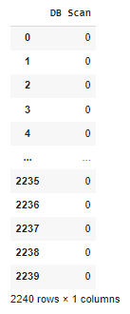
DBSCAN
DBSCAN clustered the data into two main groups, with 2229 data points in Cluster 0 and 4 points in Cluster 1. Additionally, 7 points were identified as outliers or noise clusters.
2229
4
7
Cluster 0
Cluster 1
Noise Clusters

Slide 27
Silhouette score of all models
Model | Silhouette Score
Agglomerative | 0.308382
K-Means | 0.416201
DBSCAN | 0.663214

Slide 28
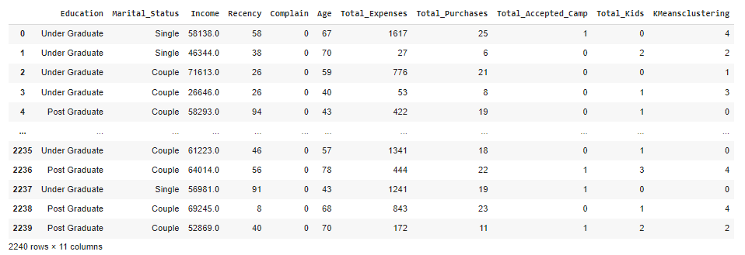
Classification
We are going to create the classification models on the above dataframe.
The data frame contains the “KMeansClustering” column that shows which data is belongs to which cluster.

Slide 29
Classification Models with the Accuracy
Model | Accuracy
Logistic Regression | 0.479911
KNN | 0.708929
Naïve Bayes | 0.883929
Linear_SVM | 0.944643
Poly_SVM | 0.662500

Slide 30
Deployment

Slide 31
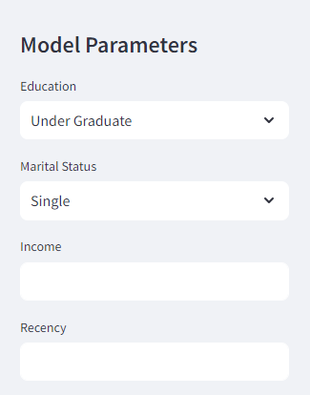
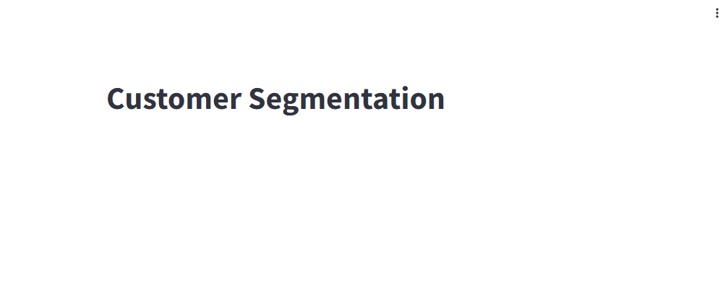
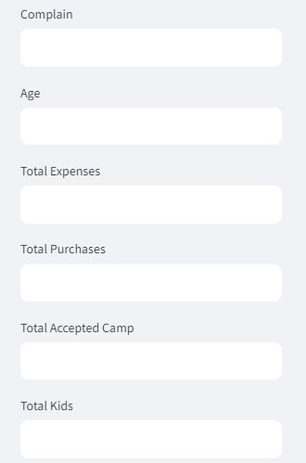

Deployment Window

Slide 32
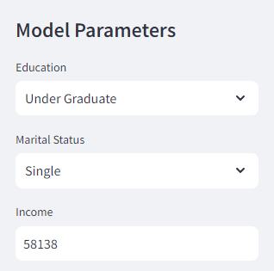
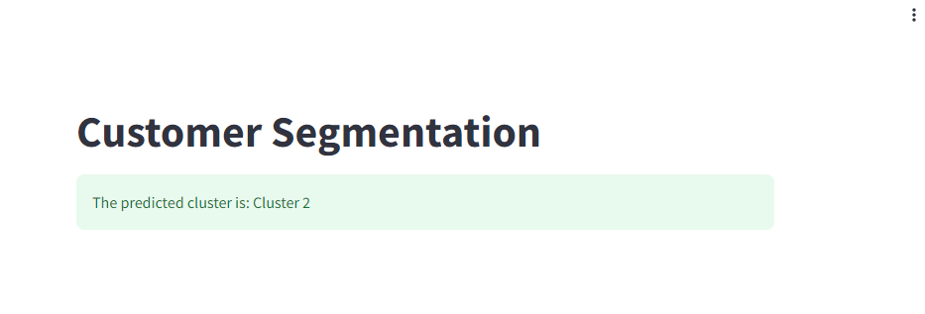
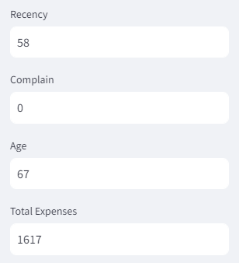
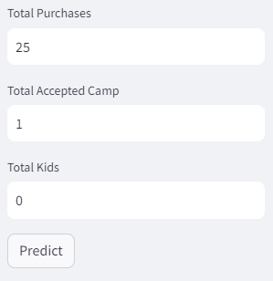
Predicted Result

Slide 33
THANK YOU!

