Slide 2
01
PROBLEM STATEMENT

Slide 3
PROBLEM STATEMENT DETAILS
…………………………………………………………………………………………………………………………
Domain | Public Safety Infrastructure
Problem Statement Title | HoleSols-Manhole detection and monitoring system
Problem Statement | Accidents on the road and deaths caused by manhole mishaps are often due to missing covers, improper coverage, partial coverage, and damaged manhole covers

Slide 4
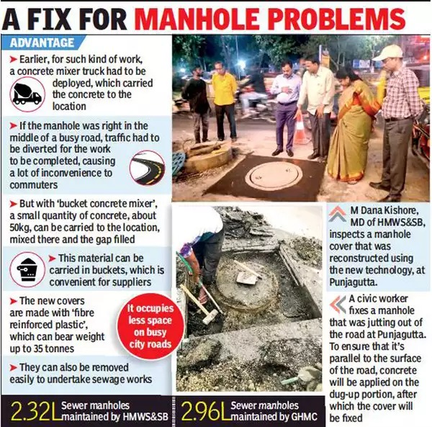
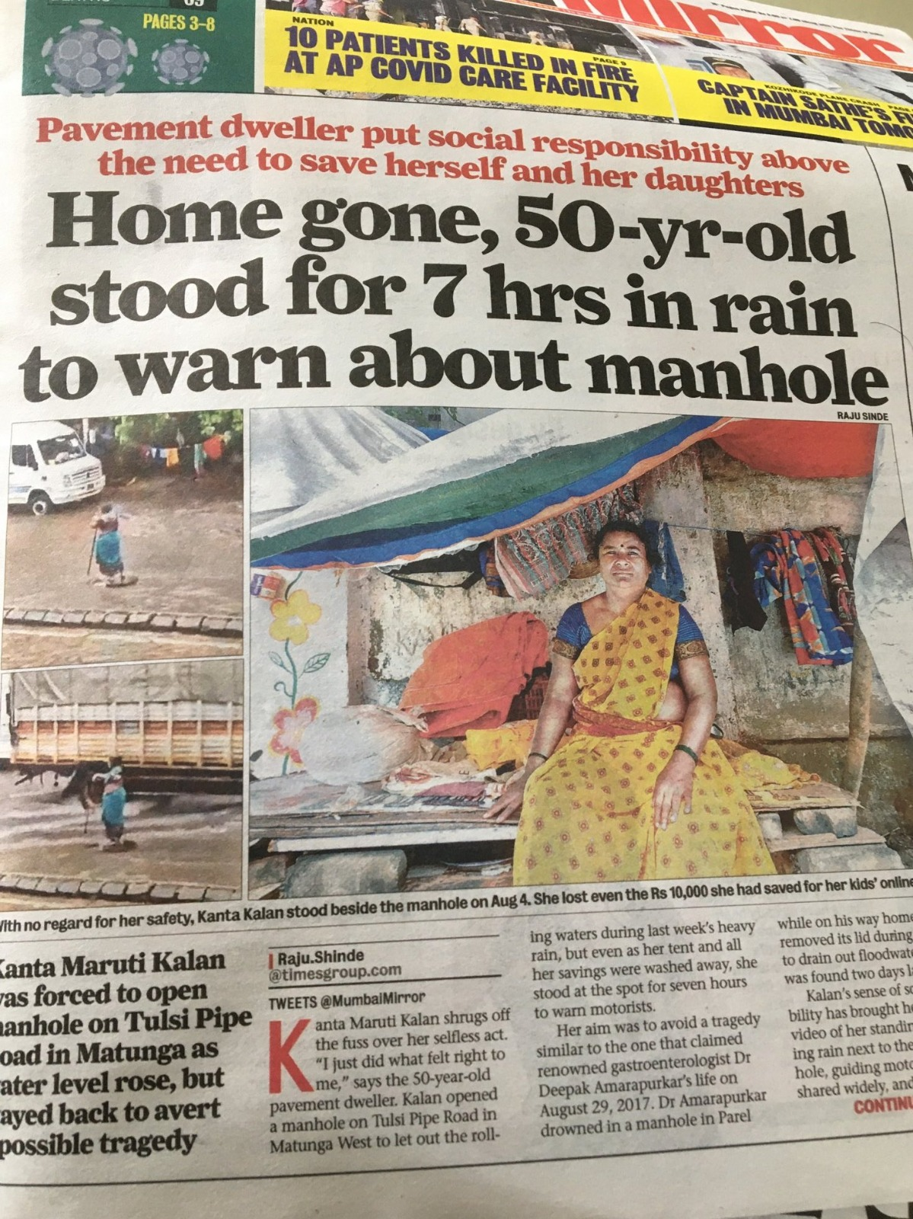
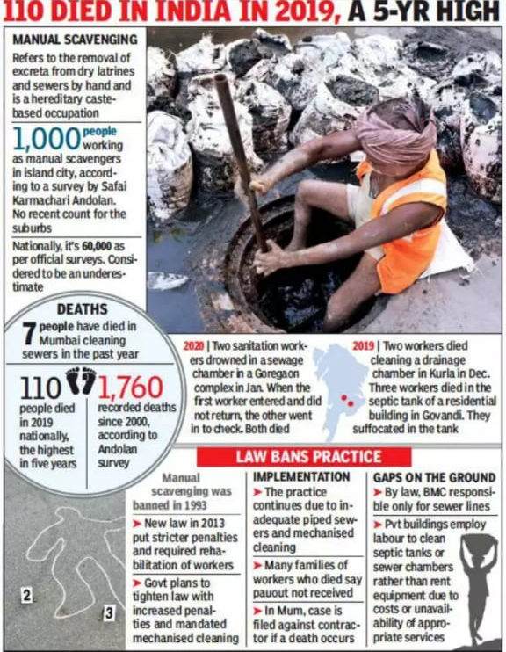
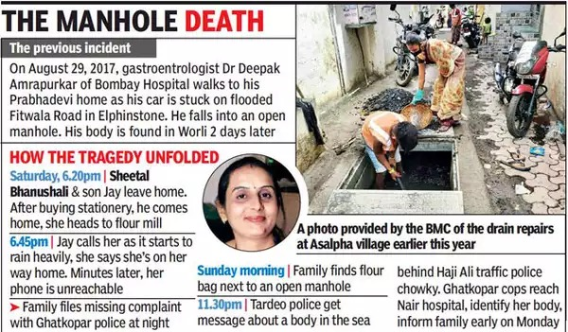
PROBLEM
STATEMENT
VALIDATION
https://timesofindia.indiatimes.com/city/hyderabad/no-more-uneven-manholes-tech-to-make-ride-smoother/articleshow/67937270.cms
https://twitter.com/manukumarjain/status/1293186306810327041
https://timesofindia.indiatimes.com/city/mumbai/woman-falls-into-open-manhole-in-ghatkopar-body-found-in-worli-sea/articleshow/78503791.cms
https://images.app.goo.gl/JNCxo9ejmuKQFDNZA
https://ncrb.gov.in/

Slide 5



SUSTAINABLE GOALS
SDG Goals applicable are as following:
SDG Target 11.5 seeks by 2030, to significantly reduce the number of deaths and the number of people affected caused by disasters, including infrastructure disasters, with a focus on protecting the poor and people in vulnerable situations.
SDG Target 6 seeks by 2030, to provide sustainable sanitation including wastewater management and sanitation infrastructure

Slide 6
02
HOLESOLS SOLUTION

Slide 7
features
PROPOSED SOLUTIONS
IoT-based detector
Alarm management system
Alert system through light signal/indication
Public notification through the app
Temporary manhole coverage
Geographical manhole indication
SDG GOALS
WE MEET

Slide 8

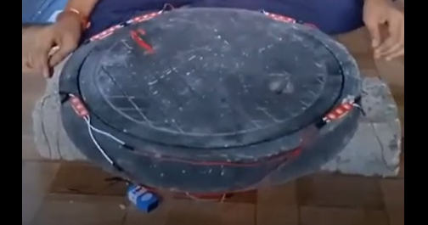
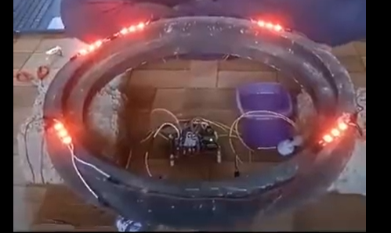


PROTOTYPE -----------------------
H S
https://drive.google.com/file/d/16Qnc4zYkeITsACo85ckpAtVay0XK7uRK/view?usp=sharing

Slide 9
TECHNICAL SPECIFICATION AND FEATURES OF THE PRODUCT
S.No. | Specification | Units | Range
1. | Missing manhole cover due to Broken (age old, heavy vehicles passing over it, Manual removal, Road extension or construction High pressure flow from inside
2. | Vibration-based detection of manhole covers | Hertz | 500
3. | Temporary manhole (for damaged manhole cover) cover while the permanent cover is getting installed | -
4. | Loud buzzer to give alarm when manhole cover is missing or manhole is open | dB | 100-120
5. | Visual Red Light when manhole is open | Lumens | ~ 500
Cont..

Slide 10
TECHNICAL SPECIFICATION AND FEATURES OF THE PRODUCT
S.No. | Specification | Units | Range
6. | Detects water level under the manhole (to prevent drainage overflow) | centimeters | Less than 10
7. | Live tracking of manhole conditions through an App and data collection
8. | A hardened plastic based material for electronics enclosure
9. | Enclosure Higher Ingress Protection rating (IP) |  | IP67 or higher
10 | Power source from street light
11 | Battery back (rechargeable) | mAh | 5000-10,000
 |  | V | 12
 |  | Type | Lithium

Slide 11
BLOCK DIAGRAM
Street Lights
Battery Controller
BATTERY
VIBRATION SENSOR
APP with Database
B-L475E-IOT01A
WATER LEVEL DETECTION SENSOR
Buzzer/Alarm
LED(Red)

Slide 12
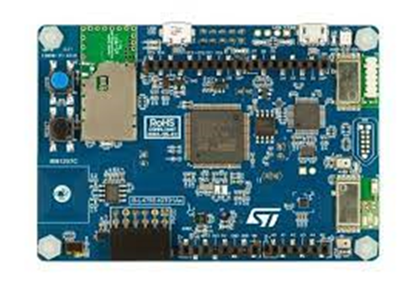
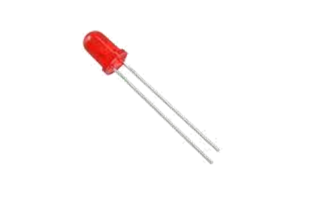
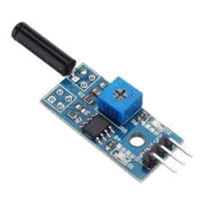
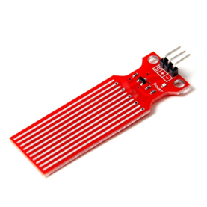
COMPONENT SPECIFICATIONS
Component | Specifications
Battery Controller (Relay) | Voltage : 12V
Battery | Type – Lithium ion Voltage – 5V Capacity – 2000MAH
Sensor | Type – Water level detection sensor(1-20cm) Vibration sensor(0-1500Hz)
Development Boards | Type: B-L475E-IOT01A
Buzzer | Voltage: 6V DC Sound Type: Continuous Beep Resonant Frequency: ~2300 Hz
LED Lights | Voltage: 12V

Slide 13
TESTING PLAN
…………………….............................
a. Technical Tests:
S.No | Test Name | Requirements
1. | Manhole covers missing test | i. Deliberate ii. Broken iii. By water force
2. | Weight test | i. Heavy vehicles standing or passing by a manhole ii. Normal vehicles
3. | Buzzer test | i. Audible to the people who drive vehicles like(bikes with helmets, cars, autos, etc..) ii. Audible during heavy rains, floods, and thunderstorms
4. | Light test | i. Visible during heavy rains, floods, and thunderstorms ii. Visible for the whole time when the manhole is open with the same intensity
Cont>>

Slide 14
TESTING PLAN
…………………….............................
S.No | Test Name | Requirements
5. | Tamper Proof test | i. Physical sturdiness under abnormal conditions such as predator attack
6. | Enclosure quality test | i. Strength, waterproof, stability, sensor protection and temperature resistance.
7. | Corrosion test
Cont>>

Slide 15
TESTING PLAN
…………………….............................
b. Software test:
S.No | Test Name | Requirements
1. | Cloud database integration test | i. Data feed ii. Data update iii. Update speed
2. | Application test | i. APIs and user interface ii. Sensor working and accuracy feed iii. Compatibility with various devices
3. | Backup and recovery test | i. Data restoration ii. Backup cloud

Slide 16
DESIGN METHODOLOGY (Concept to Product)
CONCEPT DEVELOPMENT
MOTIVATION TOWARDS PROBLEM STATEMENT
CUSTOMER SURVEY
(PROBLEM STATEMENT DEVELOPMENT)
MARKET RESEARCH
COMPETITIVE ANALYSIS
SOLUTION SURVEY
FAILURE MODES EFFECT ANALYSIS (FMEA)
VIRTUAL PROTOTYPE
TECHNICAL SPECIFICATIONS AND FEATURE DEVELOPMENTS
TECHNICAL CALCULATIONS
PROTOTYPE DESIGN UPDATES
PROTOTYPE BUILD
TESTING
POST TESTING UPDATES AND DESIGN FINALISATION

Slide 17
TECHNICAL CALCULATIONS
Sno. | Component | Power Consumption
1) | Lithium ion Battery | 10Wh
2) | Water level detection sensor | 5mW
3) | Vibration | 10mW
4) | LED | 240mW
5) | Buzzer/Alarm | 20W

Slide 18
COMPETITIVE ANALYSIS
Parameters | Detector India (CIPL) | MutelCor | COMARCH | WHIHEY | HOLESOLS (Our Solution)
TECHNOLOGY | MALÅ Easy Locator HDR | IoT/LoRa based sensor | Narrowband IoT (NB-IoT) – LTE Cat.M1 | WiilSW Monitoring senor | Real-time monitoring
LOCATION | Lajpat Nagar, New Delhi | Duisburg, Germany | Poland | Shanghai, China | Hyderabad, Telangana
PRICING | Medium | Medium | High | High | Low
FEATURES | Easy detection, One-hand operation, Easy storage | Alarms through text messages | Tampering monitoring | Easy to install, wireless communication and free maintenance | Light indication, temporary manhole coverage
www.comarch.com,www.detectorindia.com,mutelcor.com,www.whihey.com

