Slide 2


Team Members
Relangi Tarun Kumar
Baradwaj Arvapally
College: Geethanjali College of Engineering and Technology Stream: CSE-2nd year
Technical Support

Slide 3
Vision and Mission
Vision: Empowering Urban Infrastructure:
Revolutionise urban infrastructure management by creating a seamless, smart manhole detection and monitoring system that enhances safety, efficiency, and sustainability in cities worldwide.
Mission: Innovative Technology for Safer Cities:
Develop and deploy cutting-edge sensor technologies, data analytics, and real-time monitoring solutions to proactively detect and manage manhole issues, minimising risks, preventing accidents, and contributing to the creation of smarter and safer urban environments.

Slide 4
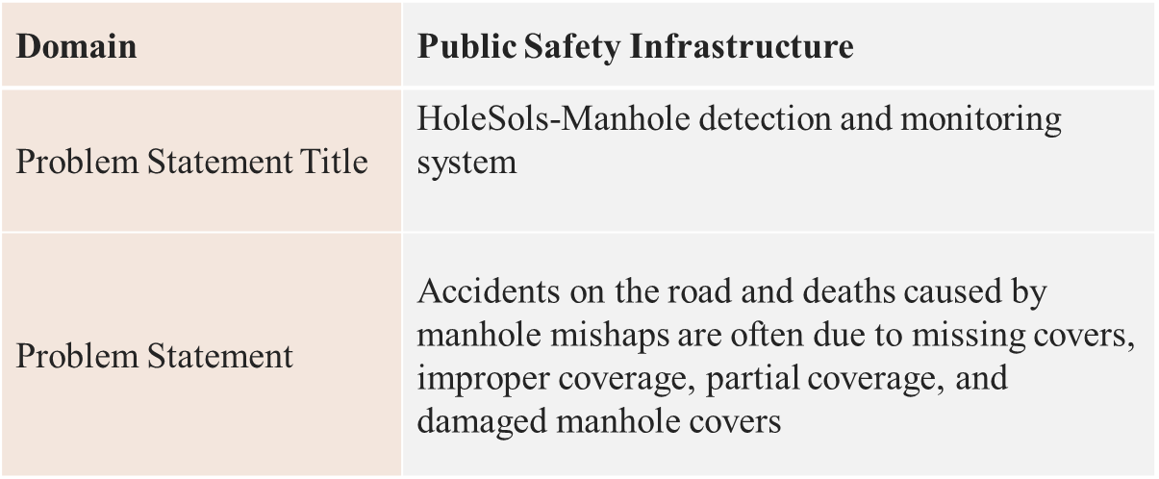
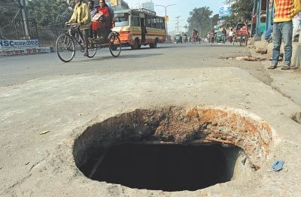
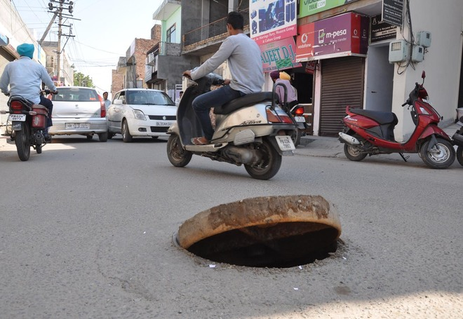
Problem Statement

Slide 5
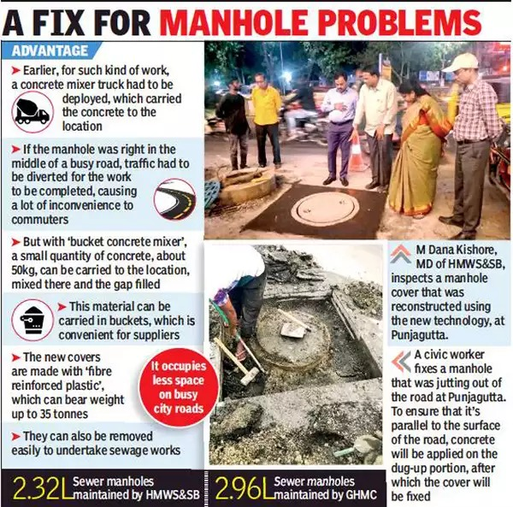
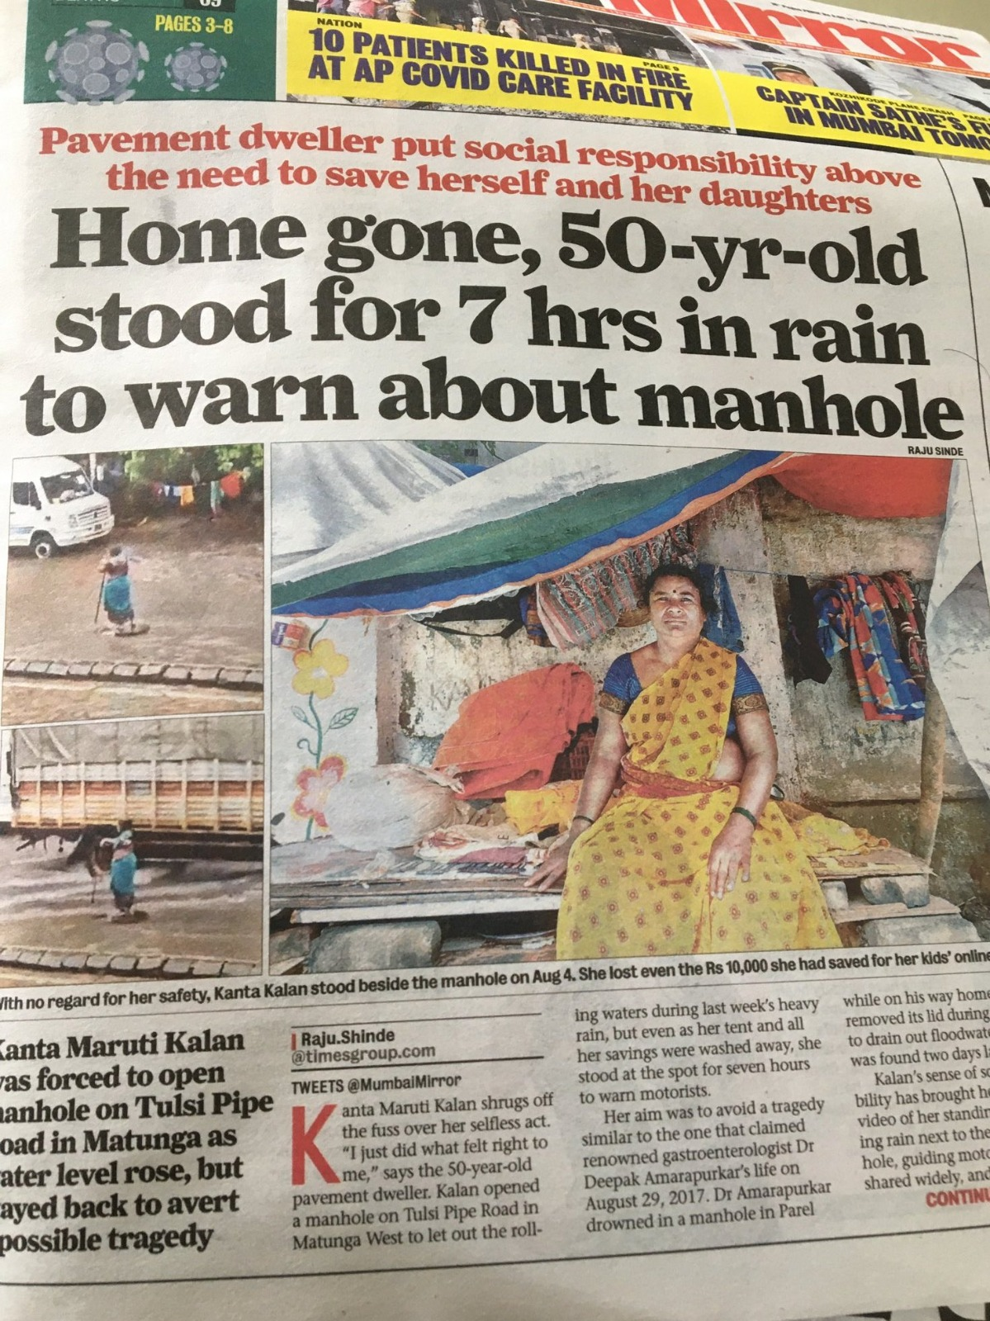
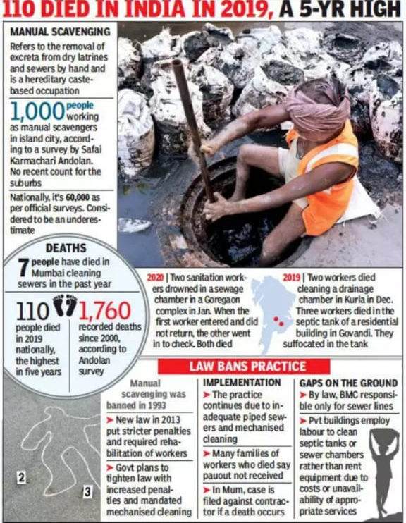
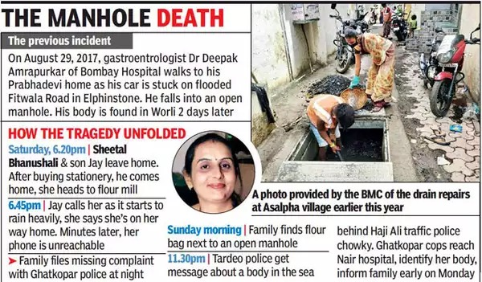
PROBLEM
STATEMENT
VALIDATION
https://timesofindia.indiatimes.com/city/hyderabad/no-more-uneven-manholes-tech-to-make-ride-smoother/articleshow/67937270.cms
https://twitter.com/manukumarjain/status/1293186306810327041
https://timesofindia.indiatimes.com/city/mumbai/woman-falls-into-open-manhole-in-ghatkopar-body-found-in-worli-sea/articleshow/78503791.cms
https://ncrb.gov.in/
https://images.app.goo.gl/JNCxo9ejmuKQFDNZA

Slide 6
Research / Facts / Market & Industry Study
Number of Manholes- Approx 60 million in India i.e. 5 manholes per km
Number of accidents due to the manholes- At least 2 people die every day (5393
since 2015)
Market Size - Globally, Manhole Covers was valued at USD 5.4 billion in 2022 and is projected to grow up to USD 7.74 billion by 2029
Expected Growth Rate - In India, the sector is expected to grow more than USD 12.2 billion making a CAGR of more than 10%
https://maximizemarketresearch.com/market-report/global-manhole-covers-market/16306/
https://timesofindia.indiatimes.com/india/preventable-deaths-in-india-at-least-2-die-each-day-due-to-open-pits-manholes/articleshow/87917848.cms

Slide 7

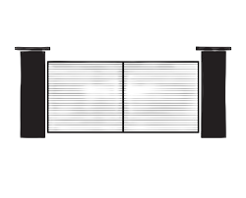
Target User - Customer
Municipalities and City Governments
Utility Companies
Construction Companies
Industrial facilities
Gated communities
Malls (Underground Parking Lots)

Slide 8
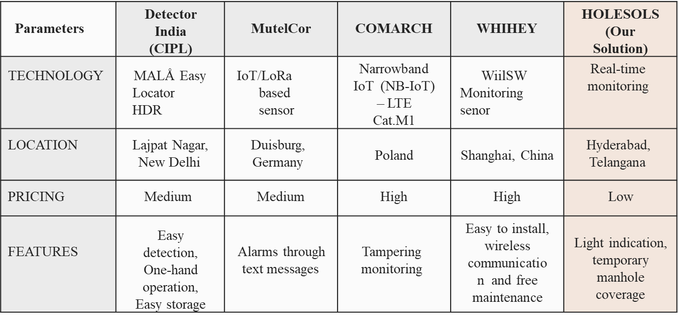
Competitors / Benchmarks

Slide 9


Concept/Idea/Prototype/Product/Solution
IoT-based detector
Alarm management system
Alert system through light signal/indication
Public notification through the app
Temporary manhole coverage
Geographical manhole indication
SDG GOALS
WE MEET

Slide 10

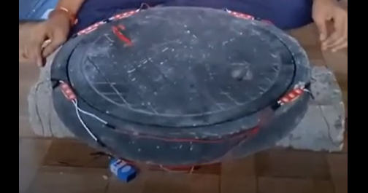
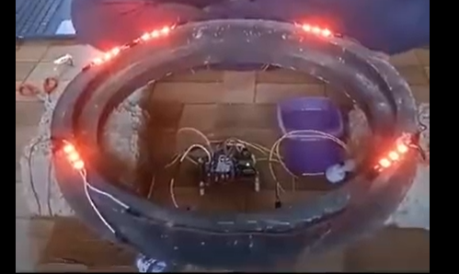

Images/Storyboard/Architecture

Slide 11
DESIGN METHODOLOGY (Concept to Product)
CONCEPT DEVELOPMENT
MOTIVATION TOWARDS PROBLEM STATEMENT
CUSTOMER SURVEY
(PROBLEM STATEMENT DEVELOPMENT)
MARKET RESEARCH
COMPETITIVE ANALYSIS
SOLUTION SURVEY
FAILURE MODES EFFECT ANALYSIS (FMEA)
VIRTUAL PROTOTYPE
TECHNICAL SPECIFICATIONS AND FEATURE DEVELOPMENTS
TECHNICAL CALCULATIONS
PROTOTYPE DESIGN UPDATES
PROTOTYPE BUILD
TESTING
POST TESTING UPDATES AND DESIGN FINALISATION

Slide 12
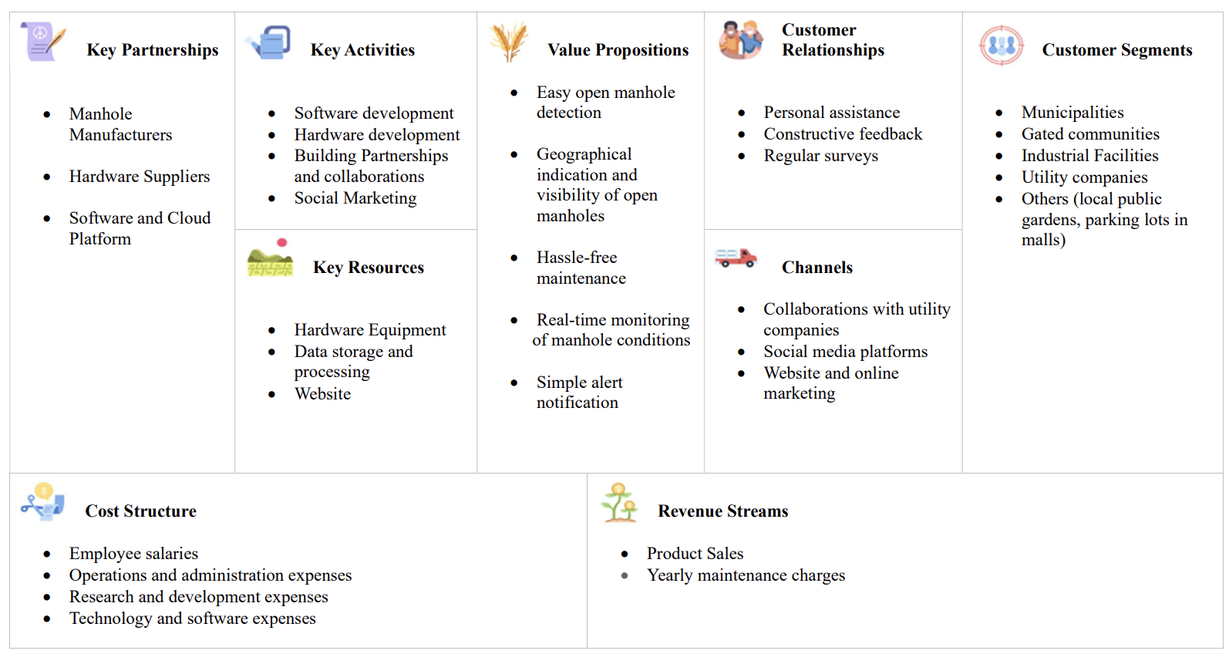
Business Model

Slide 13
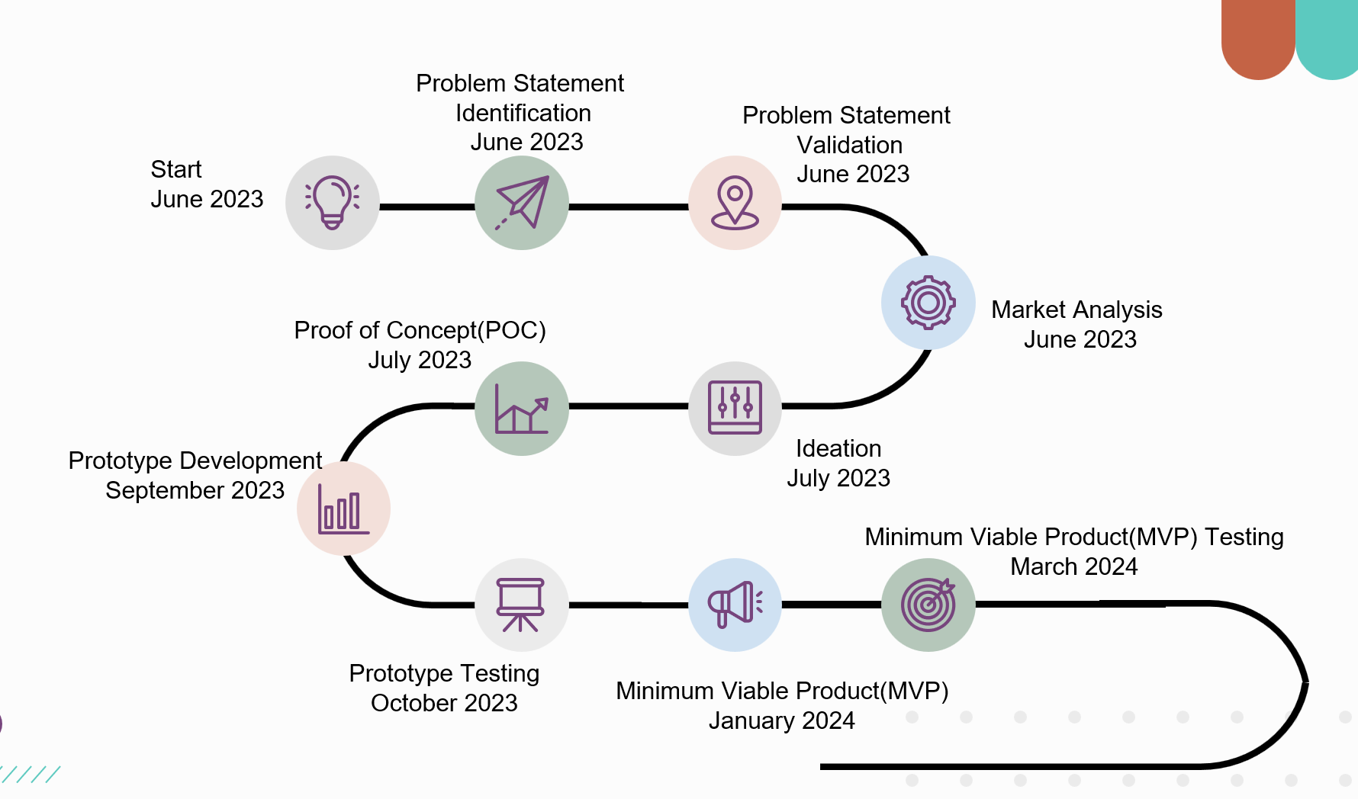
Roadmap/Timeline

