Slide 1
Group functions

Slide 2
Group functions
Define and show examples of the use of group functions:
Sum, avg, count, min, max, stddev, and variance
Write SQl query using group functions

Slide 3
Group functions
In sql group functions can operate on a whole table or a group of rows
Each function returns just one result

Slide 4
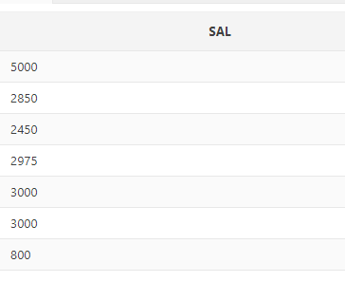

Group functions
SELECT MIN(sal)
FROM emp;
Min: used on any data type to return the minimum value
Max: used on any data type to return the maximum value

Slide 5

Group functions
SELECT SUM(sal)
FROM emp;
Sum: used on numeric data to find the total or sum of values
Avg: used on numeric data to find the average

Slide 6
Group functions
Count: returns the number of rows
Variance: used on numeric data to calculate the spread of data around the mean
Stddev: used on numeric data to calculate the spread of data around the mean

Slide 7

Group functions
Group functions are written in the select clause
They cannot be written in the where clause
SELECT last_name, first_name
from emp
where sal= min(salary);

Slide 8
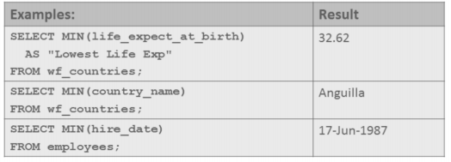
Group functions
Min used with any data type

Slide 9
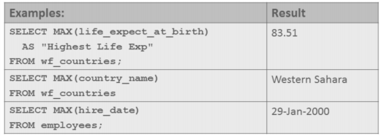
Group functions
Max used on any data type

Slide 10
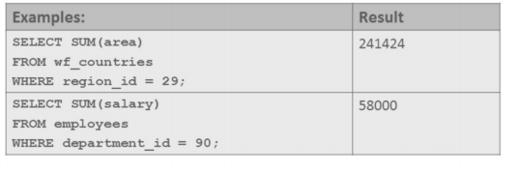
Group functions
Sum used on numeric data

Slide 11
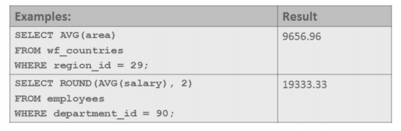
Group functions
AVG used on numeric data

Slide 12
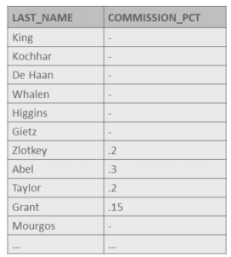

Group functions
Group functions ignore null values
select avg(commission_pct)
from emp;

Slide 13

Group functions
You can have more than one group function in the select clause, on the same or different columns
Select max(sal), min(sal), min(emp_id)
From emp;

Slide 14

Group functions
Count returns the number of non-null values in the column
Select count(job_id)
From emp;

Slide 15
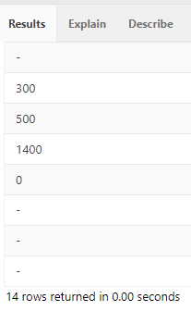
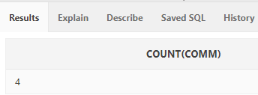
Group functions
14 rows in the emp table
Select comm
From emp;
Adding the count function returned 4
Select count(comm)
From emp;
Null values ignored

Slide 16
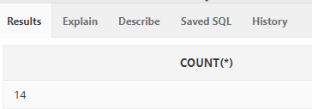
Group functions
Count(*) returns a count of all rows in a table
select count(*)
from emp
where hiredate < ‘01-01-1998’;
We use count when we want to count all rows even those that have nulls

Slide 17
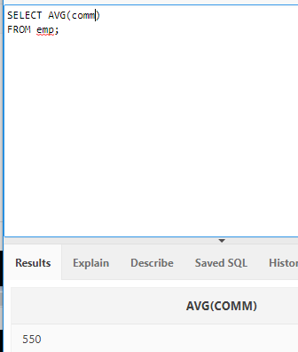
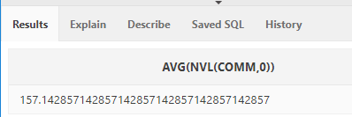
Group functions
Sometimes you want to include null values in group functions
Select avg(nvl(comm,0))
from emp;

