Slide 1
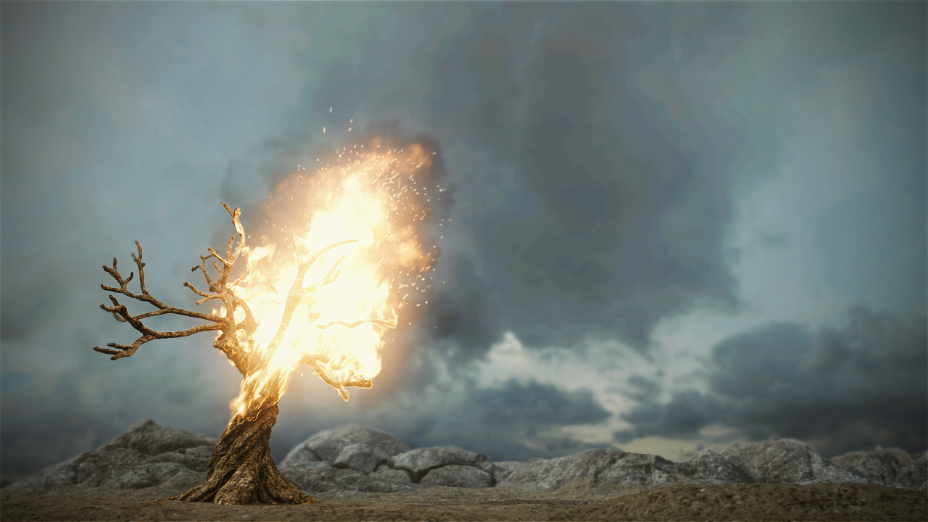
Revoked

Slide 2
