Slide 1
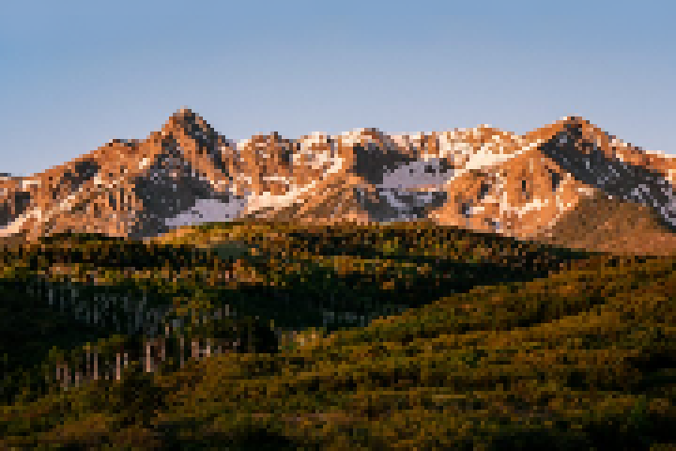



SPACE
A
D
Shoot: ENTER
Mute: M
‘Backspace’ to go to title screen

Slide 2
