Slide 1
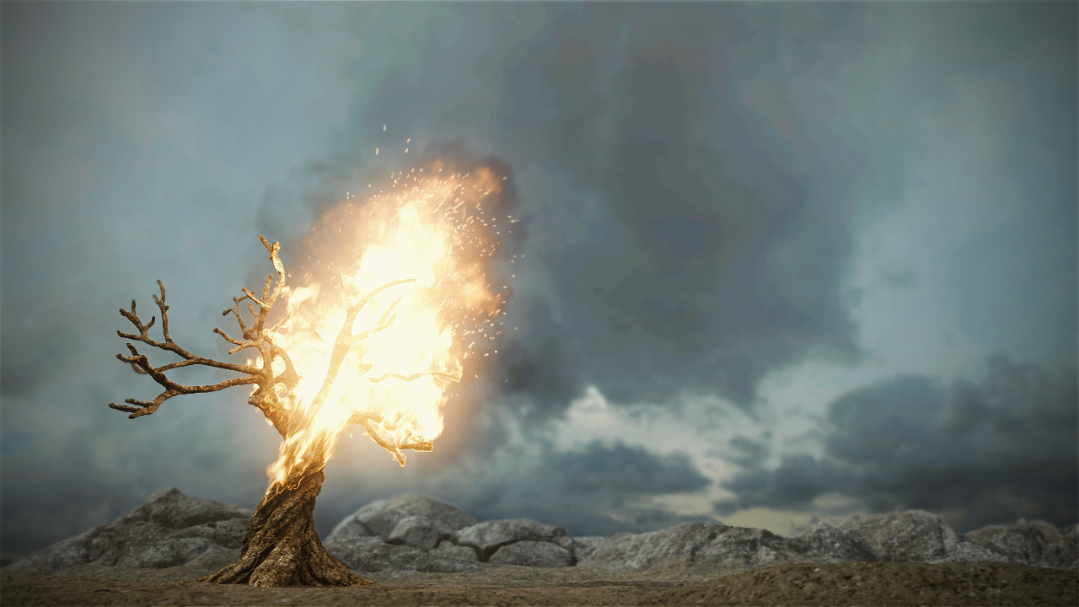
Revoked
Press ‘Enter’ to play!
‘L’ for Leader board
‘I’ for Instructions

Slide 2
