Slide 1
SOFTWARE DELIVERY CONTROL SURFACE
CONDUCTOR
The fleet control layer above Symphony.
A single place to supervise projects, repositories, agent runs, delivery risks, policies, and reports.
healthy
warning
critical
monitor
orchestrate
govern

Slide 2
THE PROBLEM
Why Conductor exists
Symphony runs the work. Conductor runs the fleet.
The important shift is not another agent. It is the operating view over every agent already moving software forward.
Every repo
Every run
Every risk
Portfolio-level visibility across projects, repositories, and Symphony instances.
Live sessions, retries, failures, PRs, and token usage brought into one model.
Blocked work, offline instances, budget pressure, and human review queues surfaced early.
CONDUCTOR
WHY

Slide 3
THE PROMISE
From single-repo automation to software-company control
A company does not need one giant Symphony. It needs a clear command layer above many small ones.
1
2
3
4
Observe
Orchestrate
Govern
Report
Register instances, poll state, and normalize activity.
Start, stop, restart, and provision runtimes safely.
Apply policy, budgets, approvals, and alert rules.
Turn operational telemetry into delivery briefs.
The core promise: supervise Symphony without replacing Symphony.
CONDUCTOR
PROMISE

Slide 4
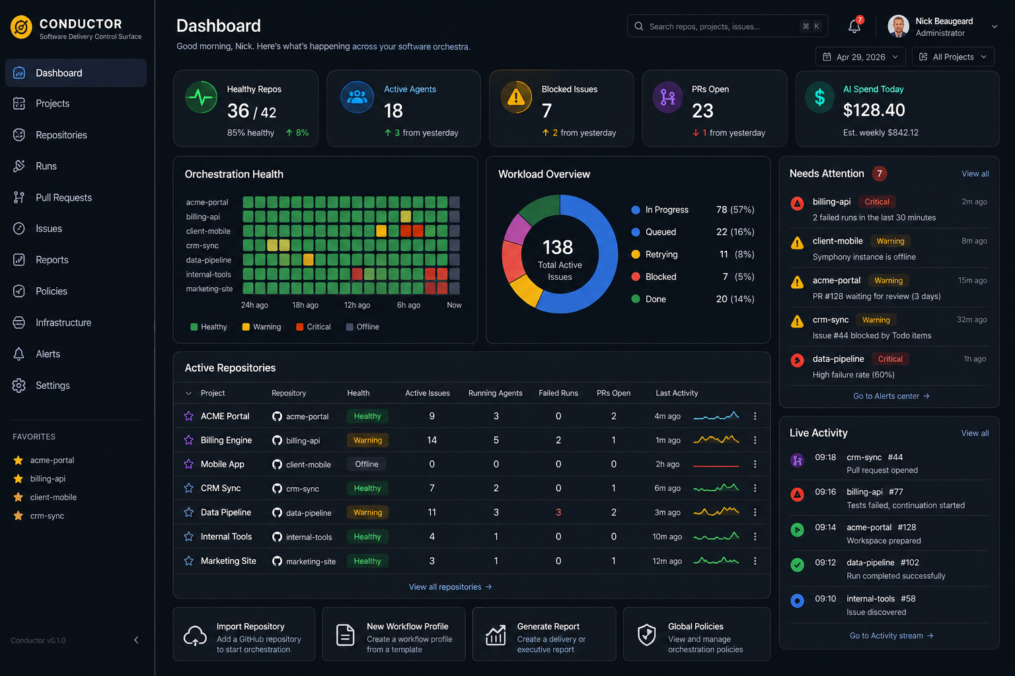
CONTROL SURFACE
The first read is operational clarity
Mission control
Dashboard-first, dark operational surface for scanning fleet health.
Needs attention
Risks are pulled out of the table and placed where operators act.
Company memory
Reports, policies, run timelines, and snapshots turn automation into a system.
CONDUCTOR
UI

Slide 5
SYSTEM MODEL
A modular monolith with clean adapter boundaries
Blazor control surface
Portfolio dashboard, repository command centres, runs, reports, policies, alerts, and infrastructure.
Conductor API
Minimal APIs expose repositories, instances, runs, reports, policies, health, and background operations.
Orchestration core
Scheduler, provisioner, collector, reporter, GitHub sync, secret broker, policy, and alert evaluation.
Infrastructure adapters
SQLite persistence, GitHub, Symphony HTTP, local process, Docker, secrets, reporting, and notifications.
Symphony instances
One managed runtime per repository or workflow profile, each with its own state and credentials.
CONDUCTOR
ARCHITECTURE

Slide 6
RUNNER STRATEGY
Three execution modes, one lifecycle contract
Conductor starts small, but the runner abstraction is designed for serious scale.
Local process
Local Docker
Azure containers
Fastest dev path
First serious target
Designed from day one
Starts Symphony directly on the host.
One Symphony container per repository.
Container Apps, Key Vault, Azure Files, and central logs.
Best for workstation and MVP inspection.
Mounted workflow, SQLite, workspaces, and Codex home.
Managed identity and production observability.
Least isolated, easiest to debug.
Implemented after local runners mature.
Clean restart, cleanup, and isolation.
CONDUCTOR
MODES

Slide 7
CONTROL LOOP
Visibility becomes governance
Concurrency caps, daily token budgets, human approval categories, and pause conditions.
Policy
Automation gets safer when it has tempo.
Offline instances, repeated failures, stalled runs, rate-limit pressure, and waiting PRs.
Alerts
Daily delivery brief, weekly software factory report, and client/project status.
Reports
Conductor is not just a dashboard. It turns fleet telemetry into decisions: pause, retry, restart, escalate, approve, report.
Privileged lifecycle changes, secret operations, policy changes, and provisioning outcomes.
Audit
CONDUCTOR
GOVERNANCE

Slide 8
MVP PATH
The roadmap is deliberately phased
Build the operating view first. Then earn the right to automate more.
1
2
3
4
5
Fleet visibility
Local orchestration
Reporting
Azure runner
Governance
Point at existing Symphony instances and see health, state, and work.
Import a repo and run Symphony locally or in Docker.
Generate delivery, reliability, and client-facing briefs.
Move the fleet into managed cloud infrastructure.
Budgets, approvals, drift detection, and global policy.
The end state: a software company can run Symphony across all projects with visibility, control, and trust.
CONDUCTOR
ROADMAP

