Slide 1
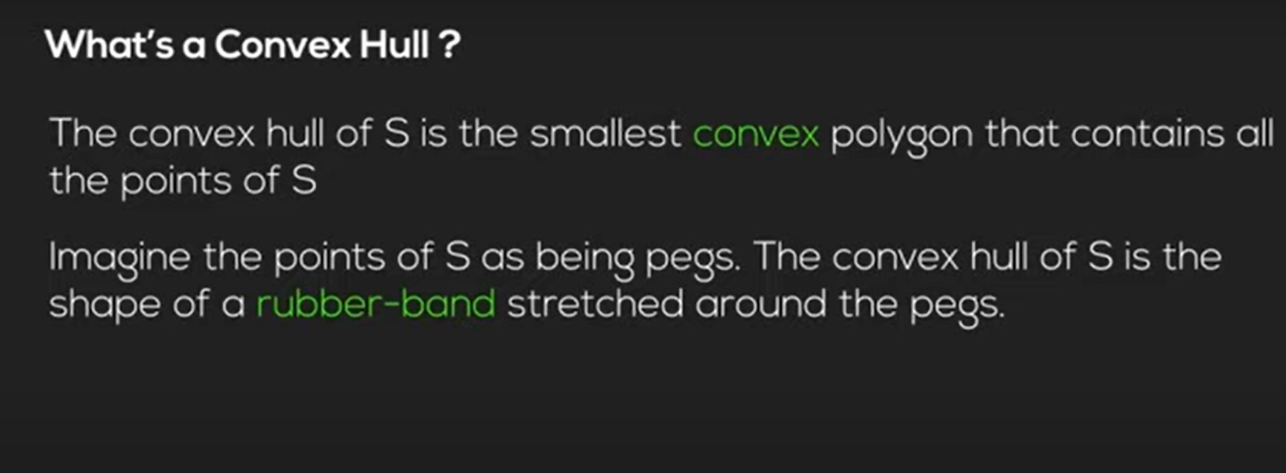
Cont’d-Convex hull

Slide 2
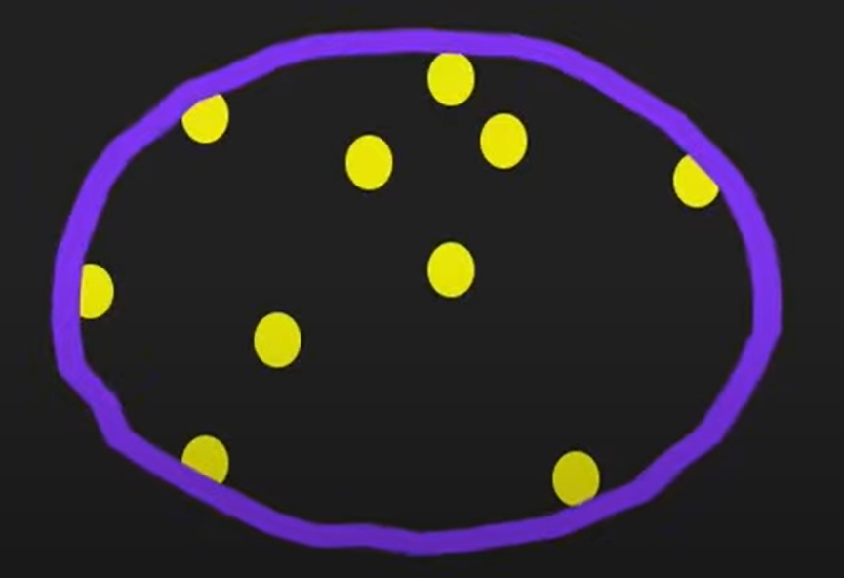
Cont’d

Slide 3
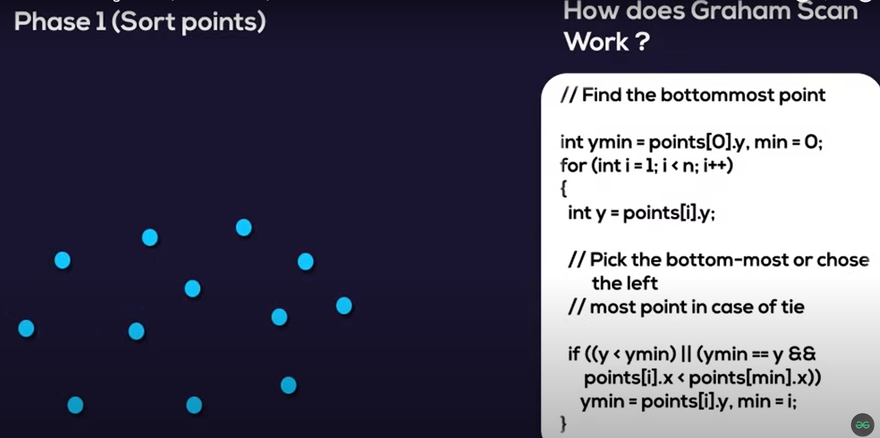
Cont’d

Slide 4
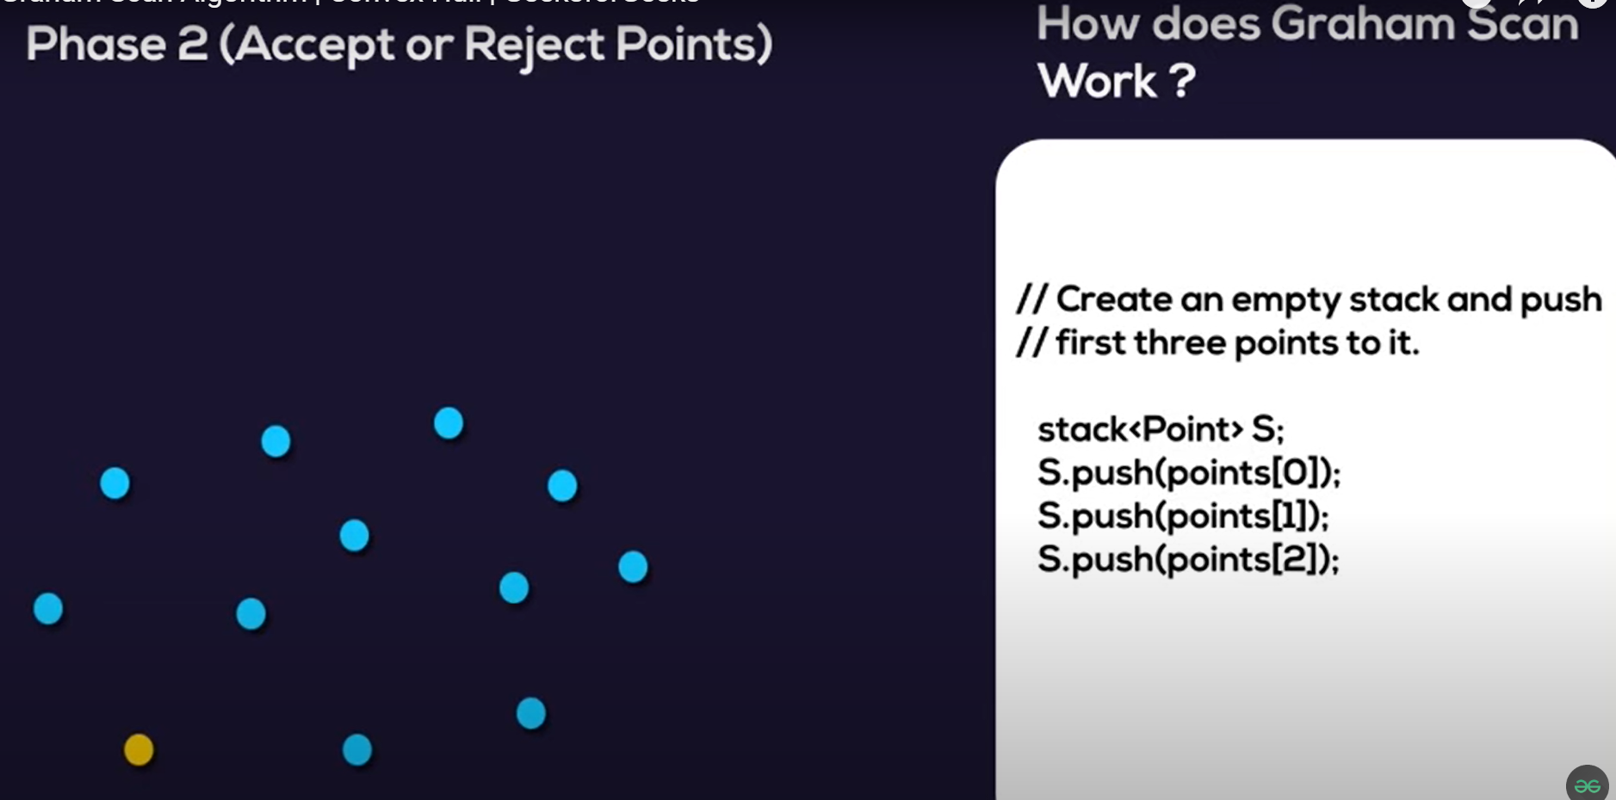


Cont’d

Slide 5
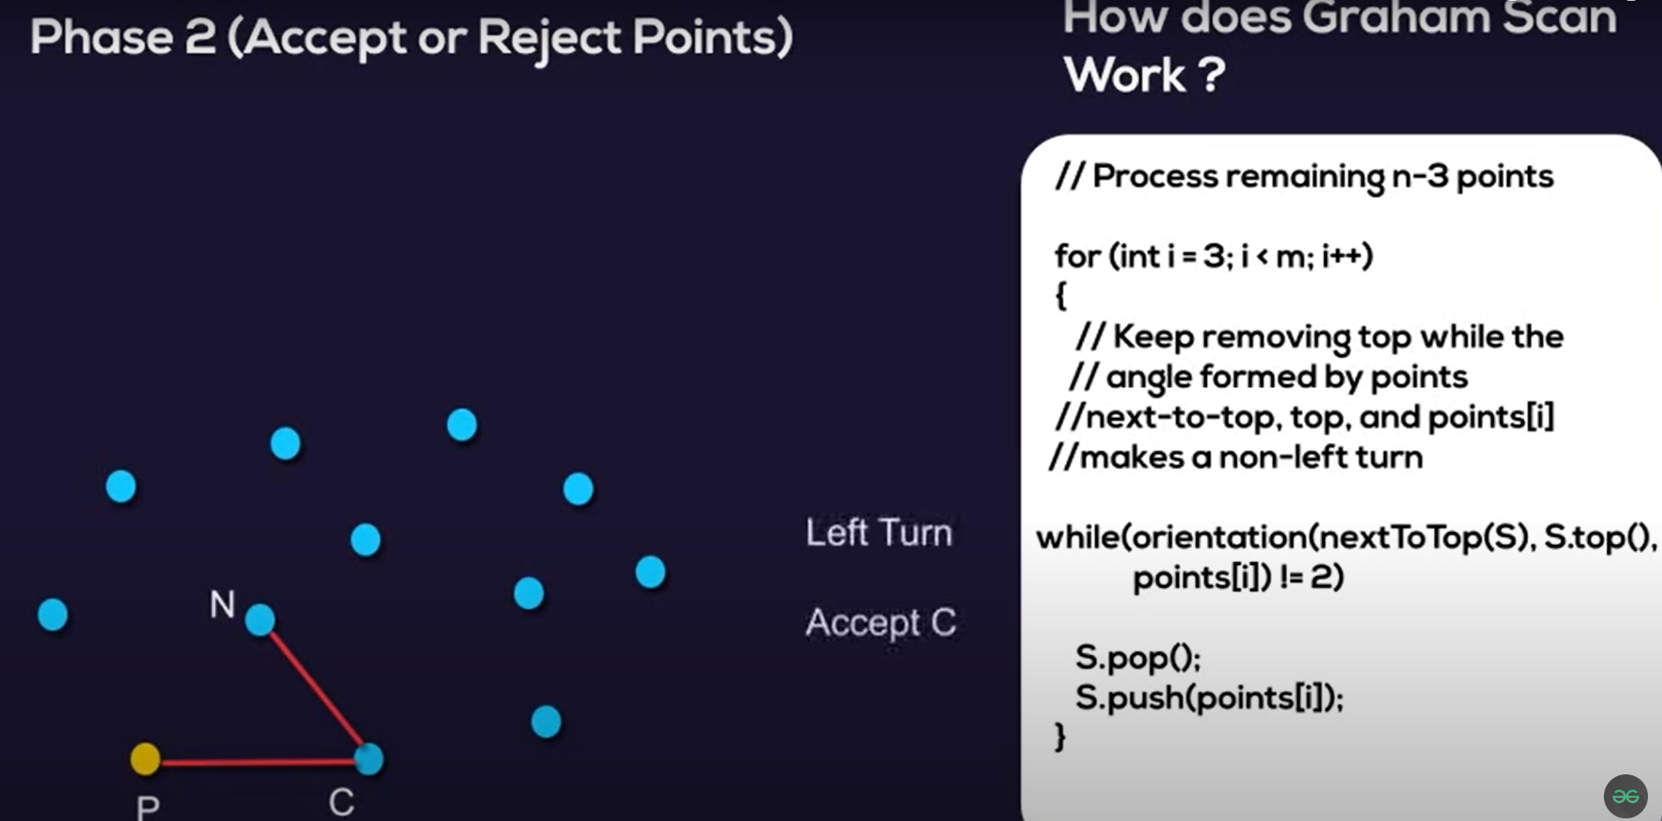
Cont’d

Slide 6
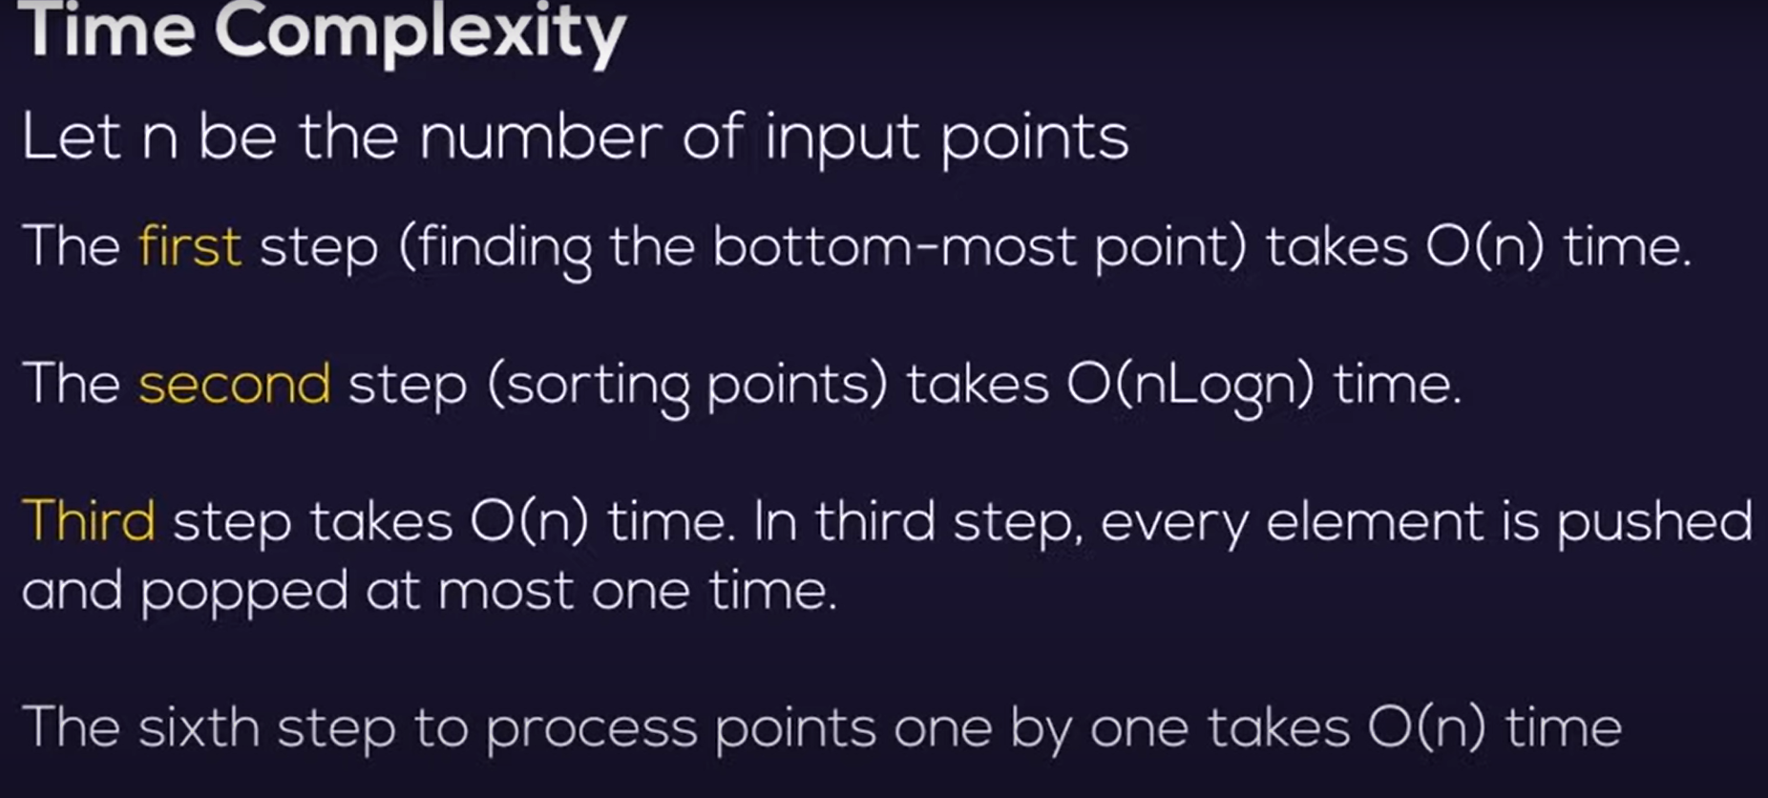
Cont’d

Slide 7

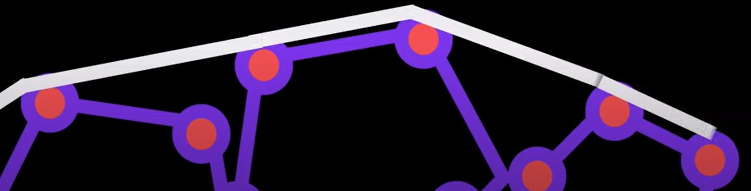
Cont’d

Slide 8
Cont’d
Using Graham’s scan algorithm, we can find Convex Hull in O(nLogn) time. Following is Graham’s algorithm
Let points[0..n-1] be the input array.
Find the bottom-most point by comparing y coordinate of all points. If there are two points with same y value, then the point with smaller x coordinate value is considered. Let the bottom-most point be P0. Put P0 at first position in output hull.
Consider the remaining n-1 points and sort them by polor angle in counterclockwise order around points[0]. If polor angle of two points is same, then put the nearest point first.
After sorting, check if two or more points have same angle. If two more points have same angle, then remove all same angle points except the point farthest from P0. Let the size of new array be m
If m is less than 3, return (Convex Hull not possible)
Create an empty stack ‘S’ and push points[0], points[1] and points[2] to S.

Slide 9
Cont’d
Process remaining m-3 points one by one. Do following for every point ‘points[i]’
4.1) Keep removing points from stack while orientation of following 3 points is not counterclockwise (or they don’t make a left turn).
a) Point next to top in stack
b) Point at the top of stack
c) points[i]
4.2) Push points[i] to S
Print contents of S

Slide 10
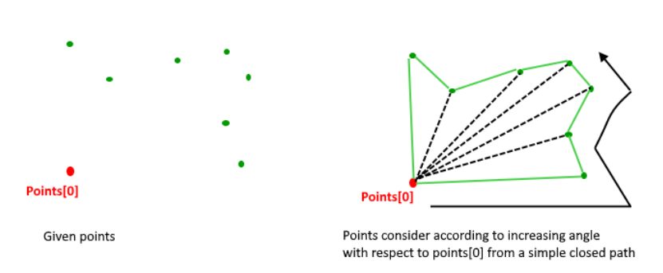
Cont’d
The above algorithm can be divided in two phases.
Phase 1 (Sort points): We first find the bottom-most point. The idea is to pre-process points be sorting them with respect to the bottom-most point. Once the points are sorted, they form a simple closed path.
What should be the sorting criteria?
computation of actual angles would be inefficient since trigonometric functions are not simple to evaluate
The idea is to use the orientation to compare angles without actually computing them

Slide 11
Cont’d
Phase 2 (Accept or Reject Points):
Once we have the closed path, the next step is to traverse the path and remove concave points on this path
How to decide which point to remove and which to keep? Again, orientation helps here
The first two points in sorted array are always part of Convex Hull
For remaining points, we keep track of recent three points, and find the angle formed by them
Let the three points be prev(p), curr(c) and next(n)
If orientation of these points (considering them in same order) is not counterclockwise, we discard c, otherwise we keep it

Slide 12
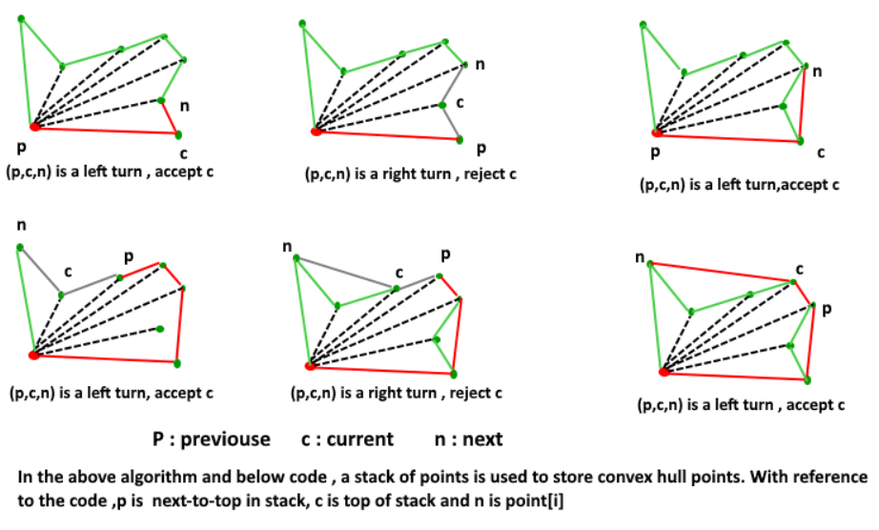
Cont’d
Following diagram shows step by step process of this phase:

Slide 13
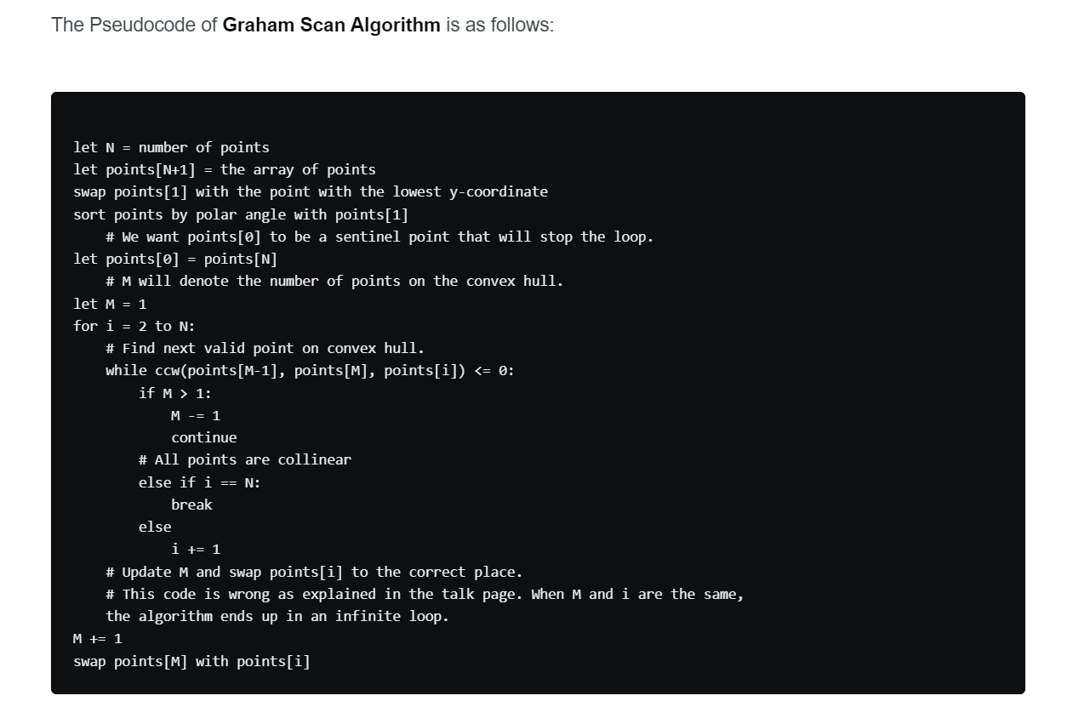
Cont’d

Slide 14
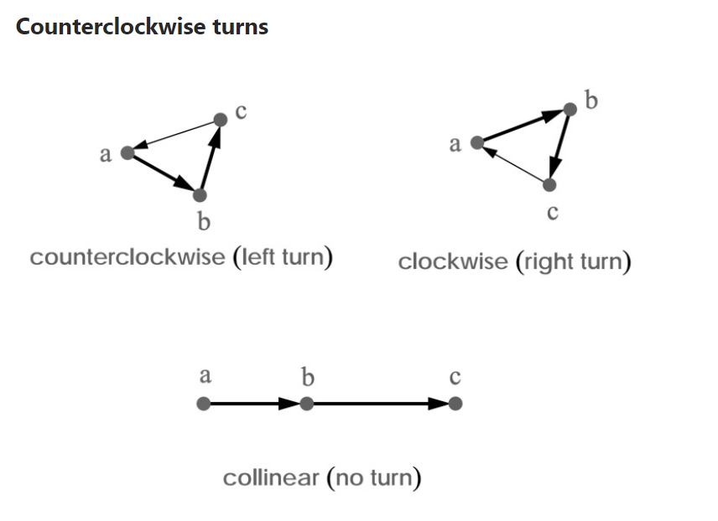
Cont’d

Slide 15
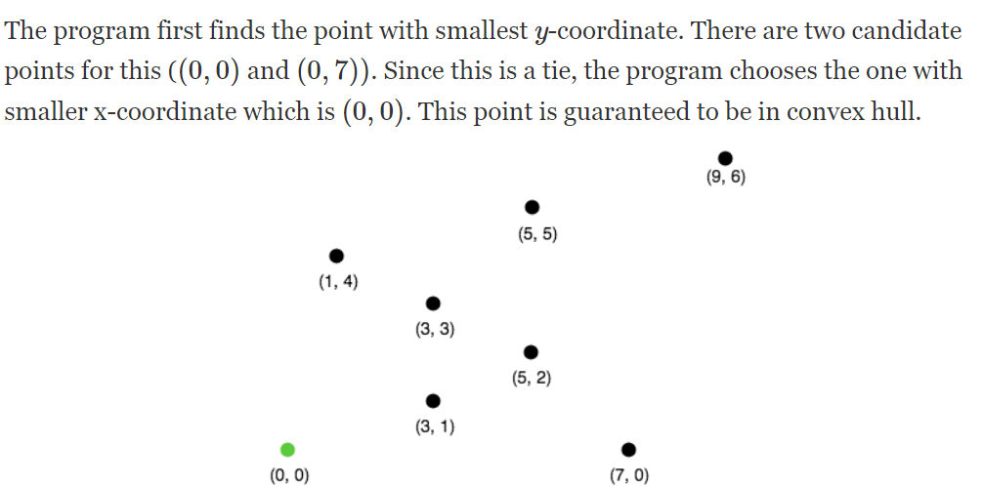
Cont’d

Slide 16
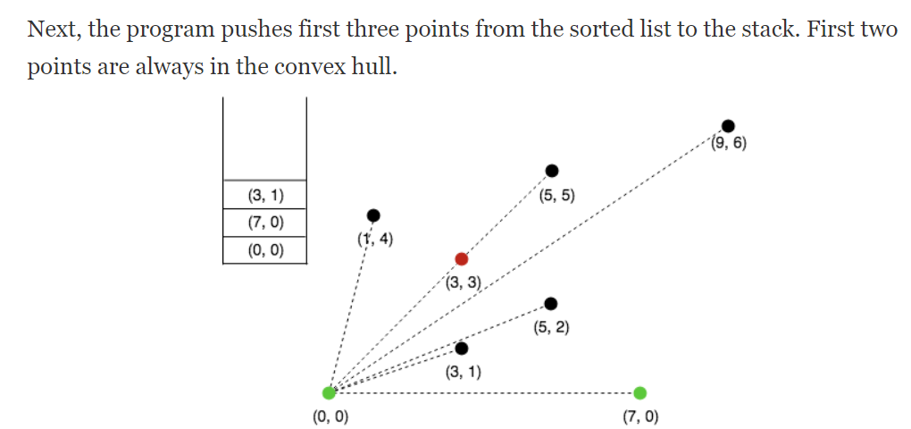
Cont’d

Slide 17
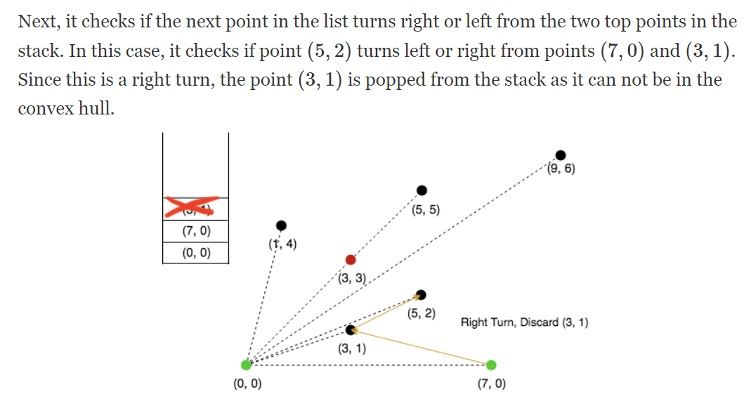
Cont’d

Slide 18
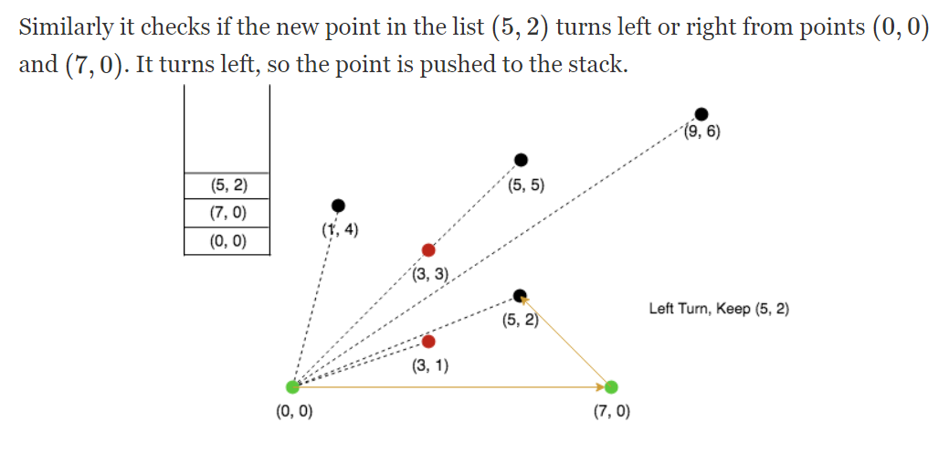
Cont’d

Slide 19
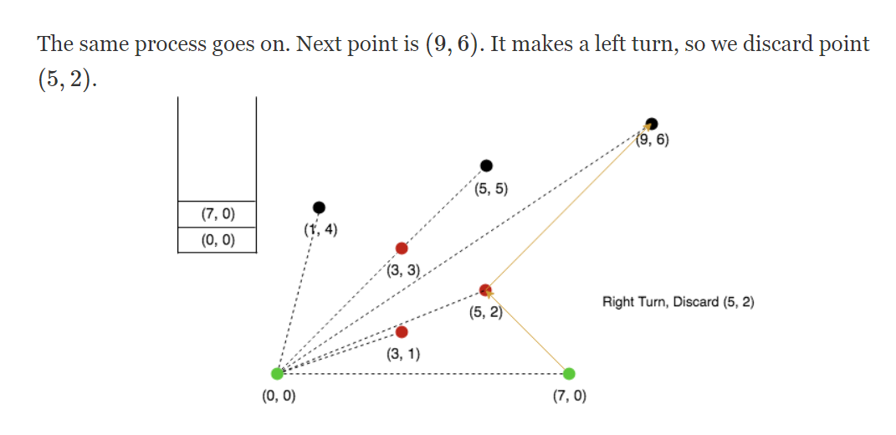
Cont’d

Slide 20
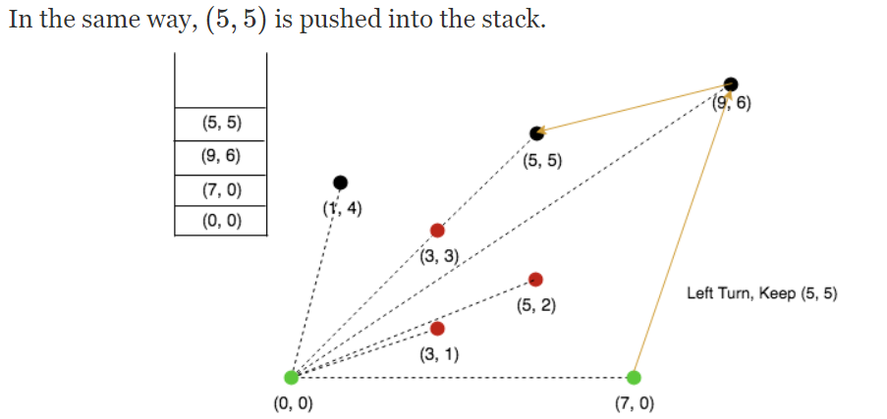
Cont’d

Slide 21
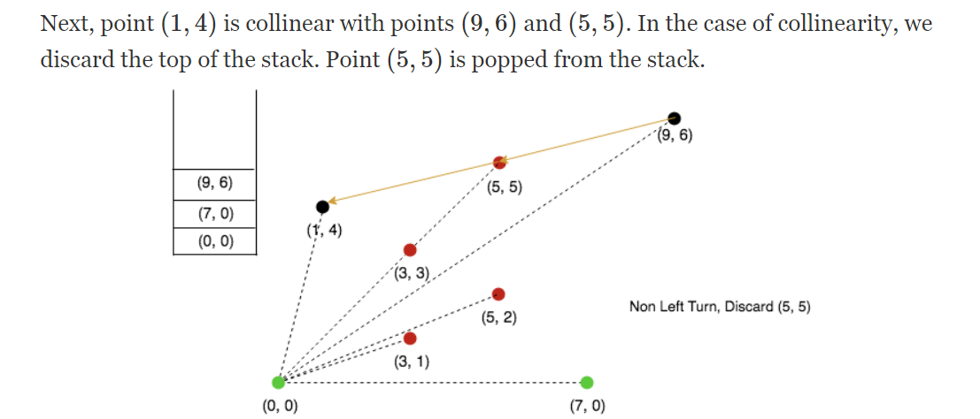
Cont’d

Slide 22
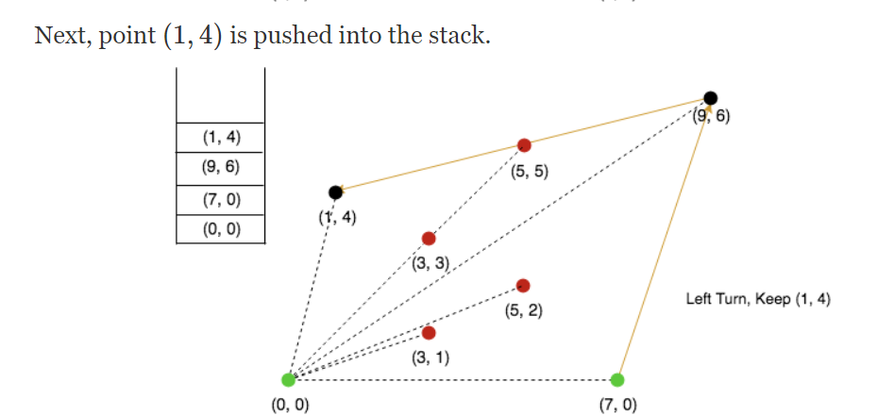
Cont’d

Slide 23
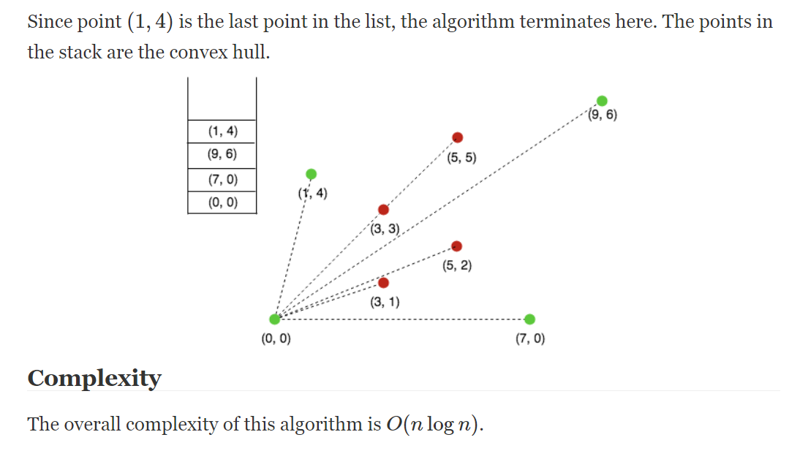
Cont’d

Slide 24
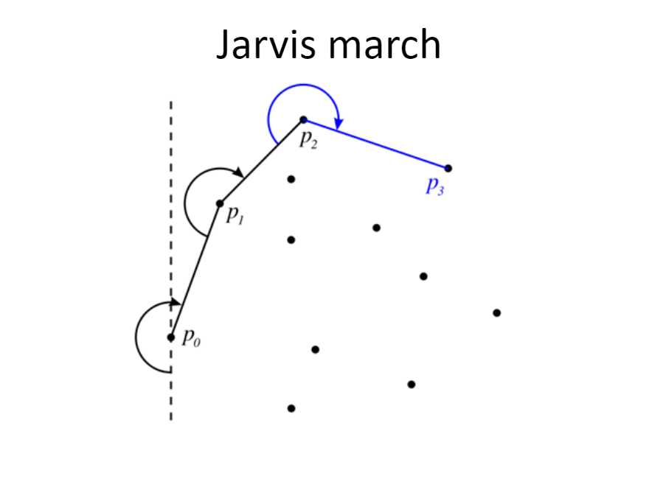
Cont’d

Slide 25
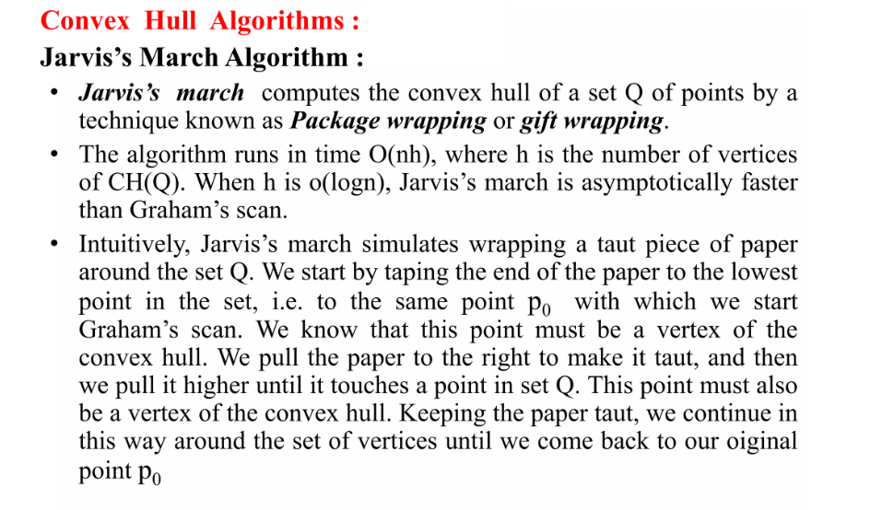
Cont’d

Slide 26
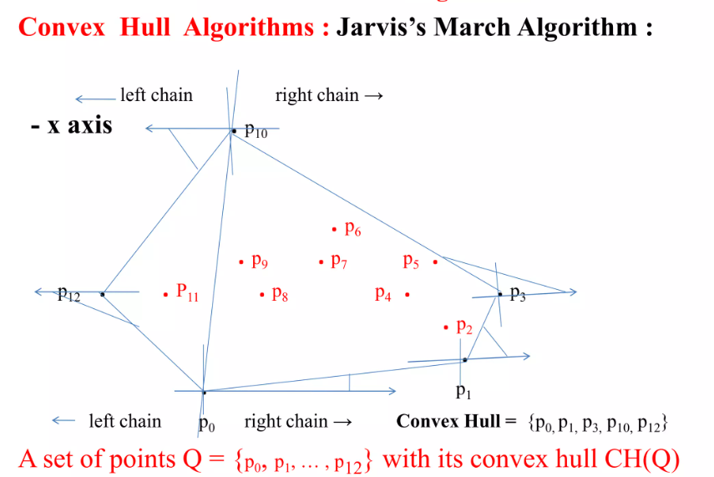
Cont’d

Slide 27
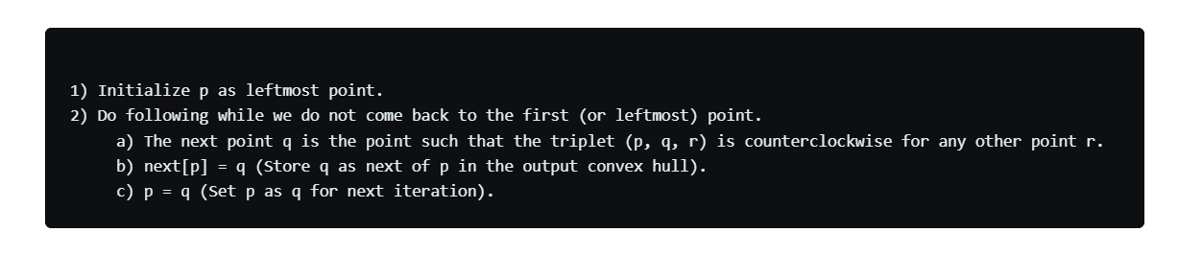
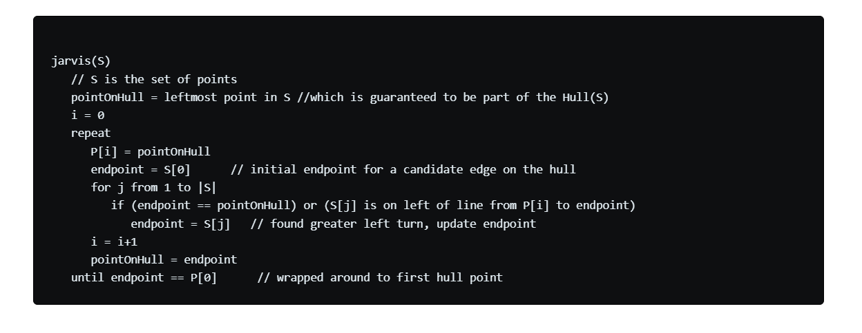
Cont’d

Slide 28
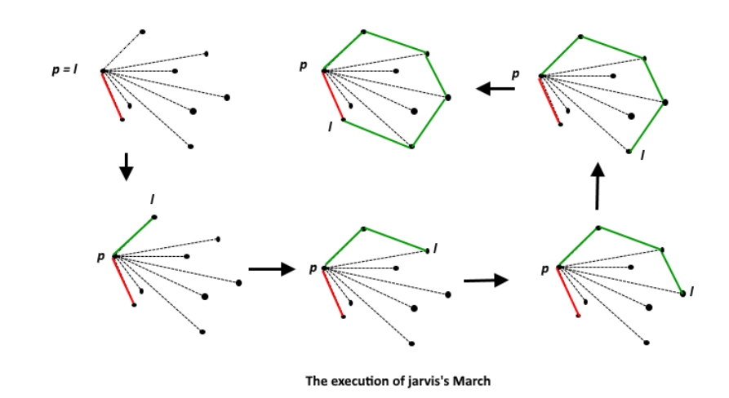
Cont’d

Slide 29
Cont’d
Perhaps the simplest algorithm for computing convex hulls simply simulates the process of wrapping a piece of string around the points
This algorithm is usually called Jarvis’s march, but it is also referred to as the gift-wrapping algorithm
Jarvis’s march starts by computing the leftmost point ` (that is, the point whose x-coordinate is smallest), because we know that the left most point must be a convex hull vertex
Finding l clearly takes linear time
Then the algorithm does a series of pivoting steps to find each successive convex hull vertex, starting with l and continuing until we reach l again
The vertex immediately following a point p is the point that appears to be furthest to the right to someone standing at p and looking at the other points
In other words, if q is the vertex following p, and r is any other input point, then the triple p, q,r is in counter-clockwise order
We can find each successive vertex in linear time by performing a series of O(n) counter-clockwise tests.

Slide 30
Cont’d
Since the algorithm spends O(n) time for each convex hull vertex, the worst-case running time is O(n² )
However, this naïve analysis hides the fact that if the convex hull has very few vertices, Jarvis’s march is extremely fast
A better way to write the running time is O(nh), where h is the number of convex hull vertices
In the worst case, h = n, and we get our old O(n² ) time bound, but in the best case h = 3, and the algorithm only needs O(n) time
Computational geometers call this an output-sensitive algorithm; the smaller the output, the faster the algorithm

Slide 31
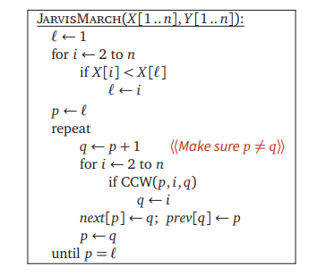
Cont’d

Slide 32
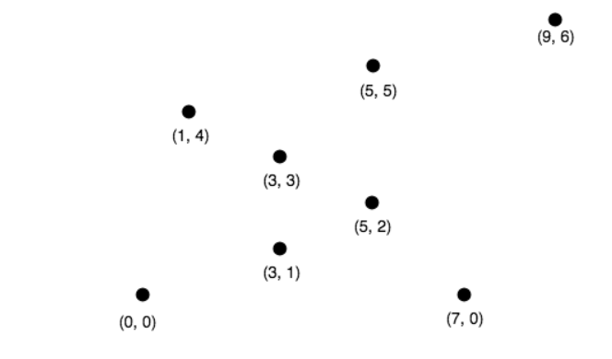
Cont’d-Example

Slide 33
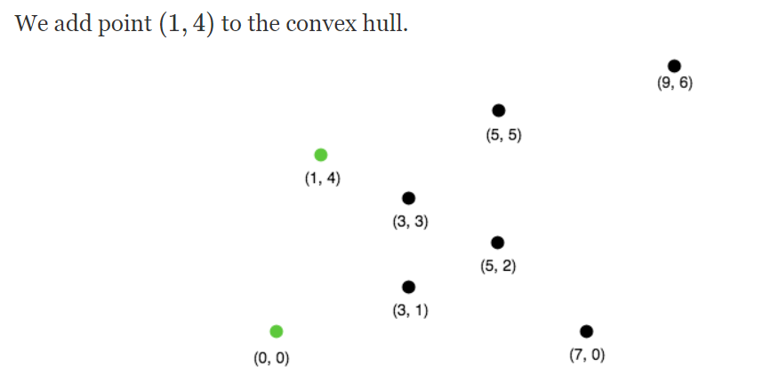
Cont’d

Slide 34
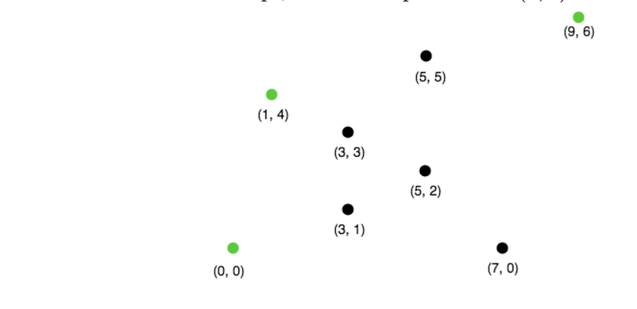
Cont’d

Slide 35
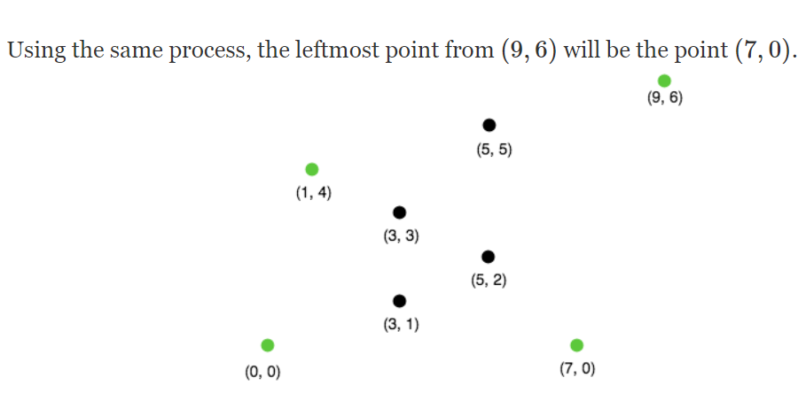
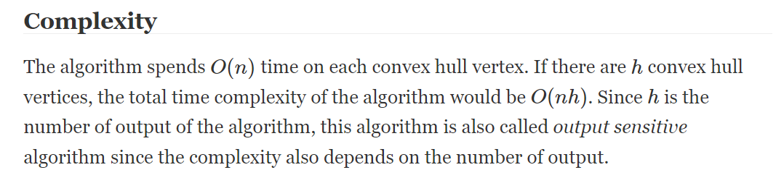
Cont’d

Slide 36
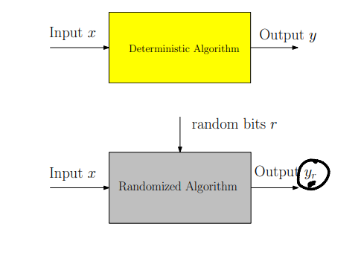
Cont’d
An algorithm that uses random numbers to decide what to do next anywhere in its logic is called a Randomized Algorithm
For example, in Randomized Quick Sort, we use a random number to pick the next pivot (or we randomly shuffle the array)
And in Karger’s algorithm, we randomly pick an edge

Slide 37

Cont’d

Slide 38
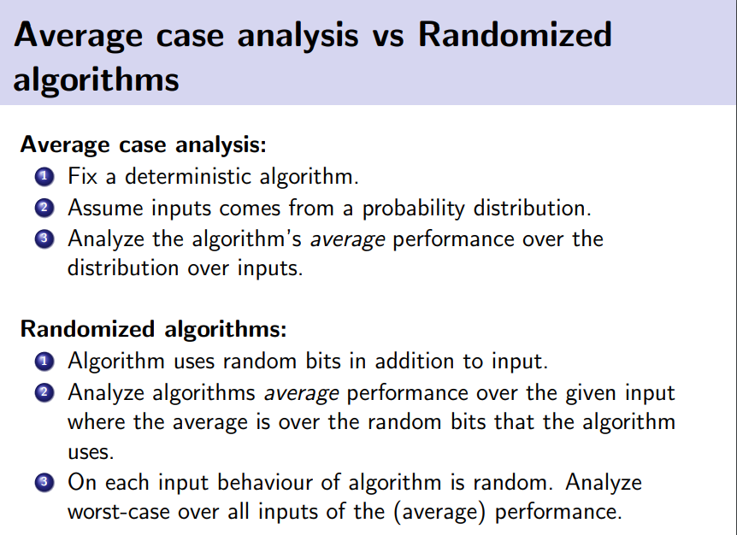
Cont’d

Slide 39
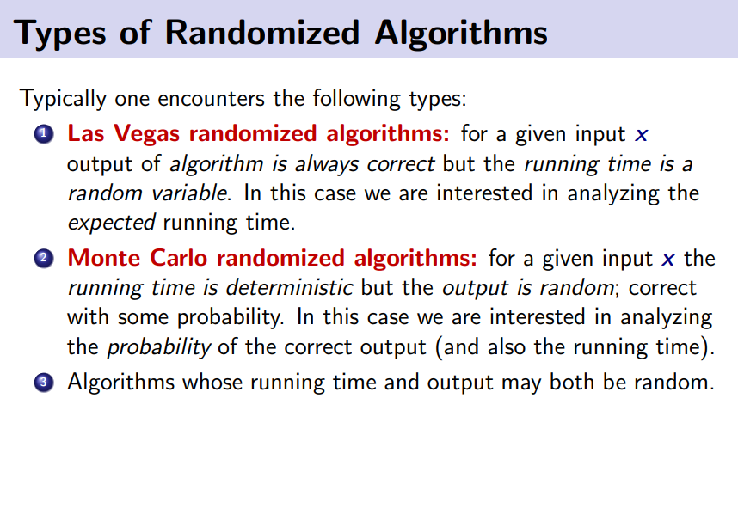
Cont’d

Slide 40
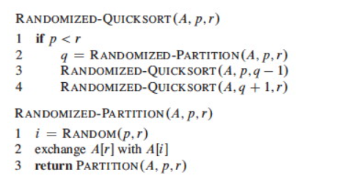
Cont’d
Instead of explicitly permuting the input data (which is expensive), randomization can be accomplished trivially by random sampling of one of the array elements as the pivot.
If we swap the selected item with the last element, the existing PARTITION procedure applies:

Slide 41
The Quick Sort Problem
To sort a given set of numbers
In traditional quick sort algorithm, we pick a particular index element as pivot for splitting.
Worst Case: O(n² )
Average Case: O(n log n)
A good pivot can be selected using median finding algorithm but the total complexity will again be O(n² ).
So, what if we pick a random element uniformly as pivot and do the partition. We will show that this takes expected O(n log n) time.

Slide 42
Randomized Quick Sort algorithm
Assuming all elements are distinct
We pick a random element x as the pivot and partition the input set S into two sets L and R such:
L = numbers less than x
R = numbers greater than x
Recursively sort L and R.
Return LxR

Slide 43
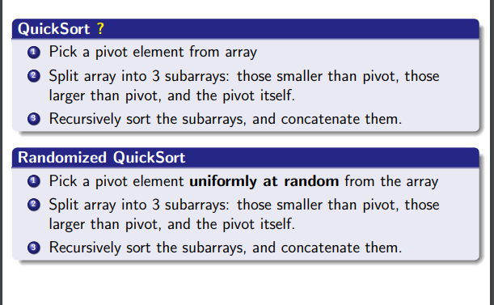
Cont’d

