Slide 1
JobTrack
A clearer view of
your next opportunity
Midpoint prototype
Local application verified
GitHub source uploaded in separate commits
AWS deployment awaits account access
01
Notes:
0:00–0:25. Introduce JobTrack as a personal application tracker. This midpoint package includes a working local dashboard, a Python API, SQLite persistence and a Chrome extension source. AWS configuration is prepared. The source is published in the private GitHub repository. No live AWS deployment is claimed.

Slide 2
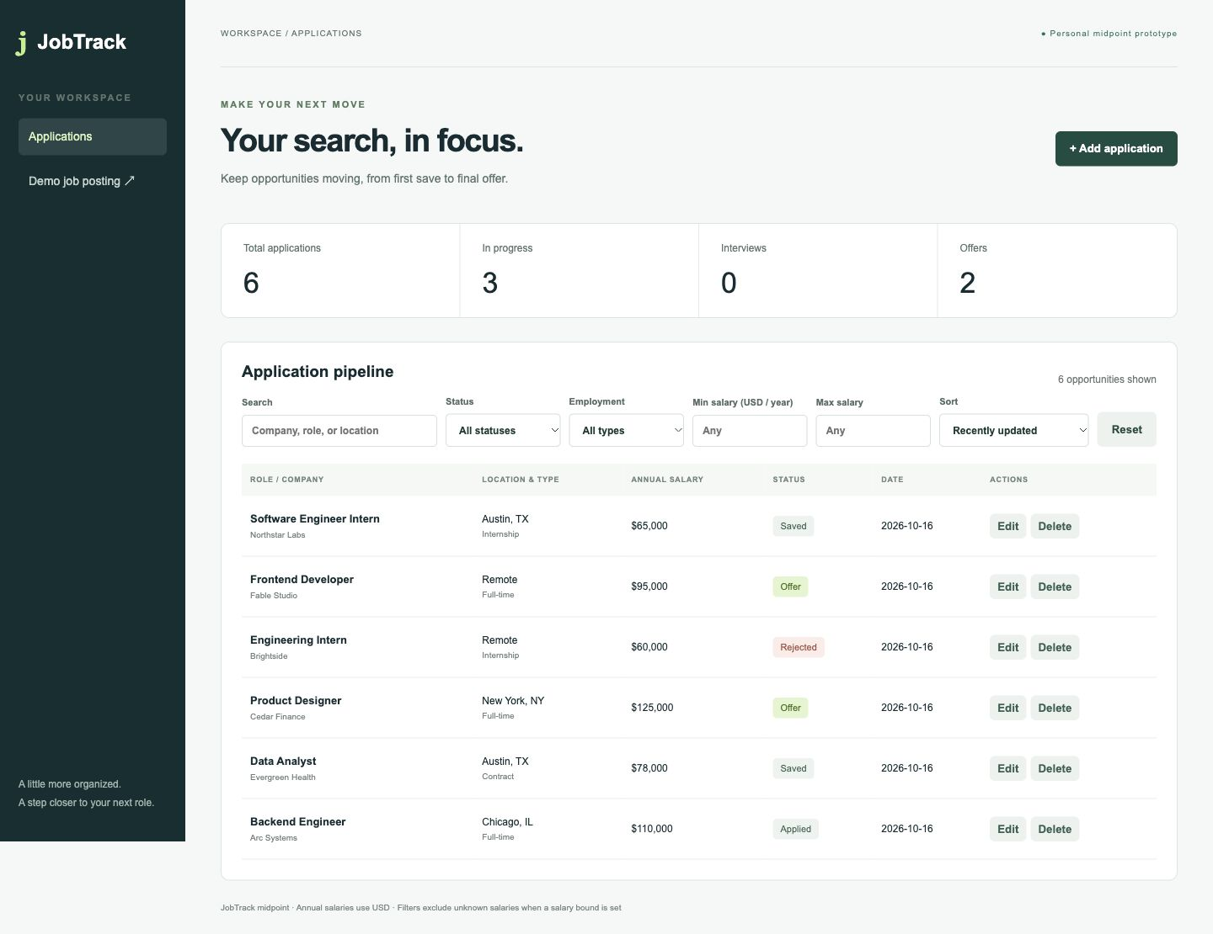
Application dashboard
One place to track
roles and progress
Editable applications
Annual salary in USD
Saved dates and notes
Visible status changes
02
Notes:
0:25–0:55. Screenshot from the running JobTrack app with fictional records. Show total, in-progress, interview and offer counts. Counts summarize all applications. The table reflects current filters. Switch to the browser for the next two sections.

Slide 3
Application management
Create and update
Company, role, location and saved date
Optional salary, posting URL and notes
Status changes persist after refresh
Filter the pipeline
Combine status, employment type and salary bounds
Sort by salary, company, date or latest update
Confirm before deleting a record
03
Notes:
0:55–1:55. In the live browser, add Demo QA at a fictional company with an annual salary of 85000 and status Applied. Save, edit to Interview and refresh. Filter Interview and Full-time, add a salary bound, reset, then sort salary high to low. Delete only the disposable Demo QA record and confirm. Explain unknown salaries appear last and do not satisfy a salary bound.

Slide 4
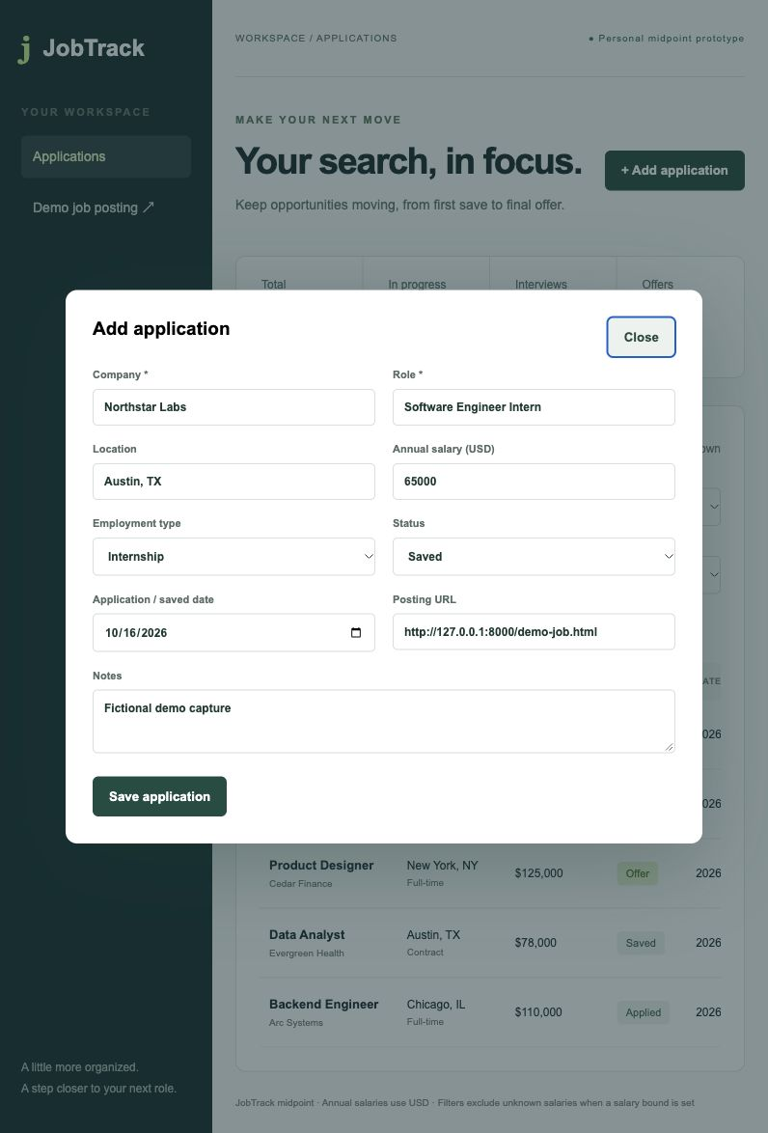
Supported capture flow
Structured job data
Schema.org JobPosting
Bundled demo fixture
Review before saving
Scope
No arbitrary job-board guarantee
Annual USD values only
Manual Chrome toolbar check remains
04
Notes:
1:55–2:50. Open the bundled Northstar Labs page in Chrome. Run Extract current posting in the unpacked extension, review the preview, then Review in dashboard. Correct any fields and save. The screenshot shows the actual dashboard draft review. Extraction unit tests and browser import/save checks passed. Installed-extension toolbar permission flow still requires a manual Chrome check. Official API reference: https://developer.chrome.com/docs/extensions/get-started/tutorial/scripts-activetab

Slide 5
Implemented architecture
Chrome extension
Reads structured data and opens a reviewed draft
Browser dashboard and Python API
Same-origin JSON requests handle application CRUD and queries
SQLite database
One applications table persists records on local disk
Single-user prototype without account isolation
05
Notes:
2:50–3:35. The extension reads active-tab structured data after a user click. It opens a URL-fragment draft in the browser dashboard. Only a reviewed save calls the same-origin REST API. Python validates input and uses parameterized SQLite queries. The database file remains on disk across process restarts. The app currently has one shared application table and no user authentication.

Slide 6
Verification and current limits
16 automated tests pass
API CRUD, validation, filters and restart persistence
Structured-data extraction and unsupported-page errors
Browser workflows checked
CRUD, filters, sorting, reset and draft review/save
Chrome toolbar installation and Docker build remain unverified
06
Notes:
3:35–4:15. Eleven API/database tests and five extraction tests passed. The browser checks covered create, edit, refresh, delete, filters, sorting, reset and import review/save. A Reset button naming conflict was fixed during browser QA. Responsive layout was inspected at desktop and mobile widths. Actual Chrome toolbar loading and Docker build remain unverified.

Slide 7
AWS preparation and remaining work
Prepared
CloudFormation for private EC2 demo
SQLite on encrypted EBS
Session Manager access instructions
Repository source and CI workflow
AWS account access still needed
AWS validation and deployment
Service health verification and backup check
07
Notes:
4:15–5:00. CloudFormation prepares an EC2 instance, encrypted EBS root volume, source-read IAM role and SSM access. It opens no inbound ports. An authorized user accesses port 8000 through Session Manager. SQLite survives stop/start but not instance termination. No live deployment is claimed. AWS account login, VPC/subnet selection, cost approval, deployment validation and health check remain. The private GitHub repository now contains incremental source commits and a test workflow. Consult GitHub Actions for hosted run results. Official references: https://docs.aws.amazon.com/systems-manager/latest/userguide/session-manager-working-with-sessions-start.html and https://docs.aws.amazon.com/AWSCloudFormation/latest/TemplateReference/aws-properties-ec2-instance-ebs.html

Slide 8
Midpoint handoff
Ready for local demonstration
Application source and persistent database implementation
Chrome extension source and supported demo fixture
Tests, README and a timed recording guide
Next: manual extension check and authorized AWS deployment
08
Notes:
5:00–5:15. Close by identifying the source repository package, presentation, demo script and deployment guide. The next steps are the manual extension check and authorized AWS deployment actions. The video recording is intentionally excluded from this work. Do not claim the original course rubric was verified because it was unavailable.

