Slide 1
JobTrack
Capture a job
↓
A private cloud-hosted job application tracker
Review and save
↓
Track progress
CSE 4333 Cloud Computing · Group 42
Ahmad Salem · afs1009@mavs.uta.edu
NoorAldeen Waleed · nxw3312@mavs.uta.edu
Notes:
Introduce the problem and the actual verified deployment status. Course assignment: https://uta.instructure.com/courses/282238/assignments/2405836

Slide 2
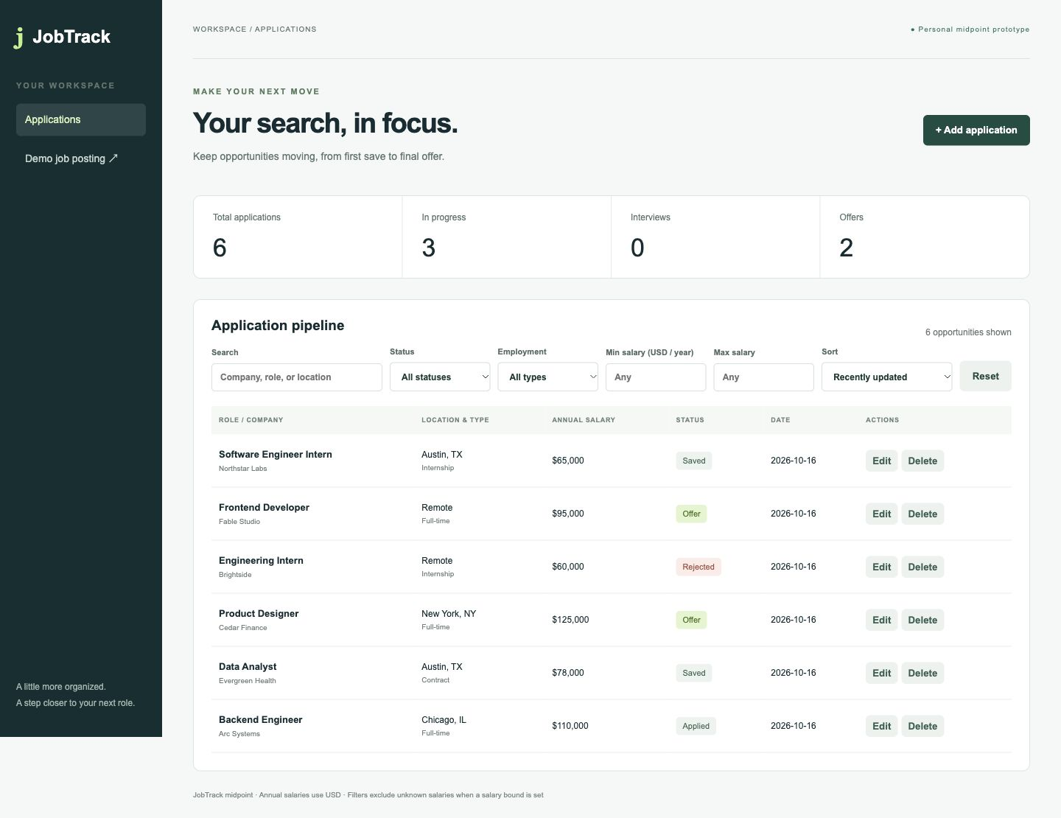
JOBTRACK · GROUP 42
Why JobTrack exists
The problem
Job seekers manage many applications and lose track of dates, status, and next steps.
The users
Students, recent graduates, and anyone applying to multiple jobs or internships.
The outcome
Discover leads and track applications in one place.
Local UI screenshot · fictional records
Notes:
The submitted project proposal describes a tracker for company, title, salary and status. This local screenshot shows fictional records and is not cloud proof. Proposal is in the team handoff package.

Slide 3
JOBTRACK · GROUP 42
User workflow
1 Add
2 Review draft
3 Track
4 Find and act
Open the app, or click the extension on a supported JobPosting page.
Check company, role, salary, type, date, URL, and notes before saving.
Move an application from Saved to Applied, Interview, Offer, or Rejected.
Discover jobs; search, filter, sort, edit, or delete tracked entries.
Discover remote jobs with Remotive; optional JSearch covers more boards. The extension reads structured JobPosting data. JobTrack does not apply to employers.
Notes:
Remotive discovery and structured-posting capture are separate features. JSearch requires a user-owned API key. See README.md for provider limits.

Slide 4
JOBTRACK · GROUP 42
Private AWS architecture
Authorized workstation
AWS account
Posting
App
EC2 · Python API
Encrypted EBS
→
JSON-LD
Extension
Review
CRUD
Static UI + JSON API
Loopback port 8000
SSH from one /32 only
→
SQLite database
Persists stop/start
→
↓
SSH tunnel
CloudFormation provisions · Private S3 holds source ZIP · sandbox myS3Role profile grants S3 access
Trusted client /32
Notes:
Architecture source: deploy/cloudformation-sandbox.json. EC2 has a public IPv4 for bootstrap and SSH restricted to one trusted client /32. The web app listens on loopback only.

Slide 5
JOBTRACK · GROUP 42
Application logic and data
JSON API
One applications table
ID · company · title · location
Annual USD salary · employment type
Status · application date · URL · notes
Created and updated timestamps in UTC
SQLite WAL; parameterized values
GET
/api/health
API and database check
GET
/api/jobs
Discover job listings
POST
/api/applications
Create record
PUT
/api/applications/{id}
Replace editable fields
DELETE
/api/applications/{id}
Delete record
Notes:
The app validates fields and restricts sort keys. API details and limits are documented in README.md. PUT is a full replacement, not a partial patch.

Slide 6
JOBTRACK · GROUP 42
Cloud deployment and access
Verified in us-east-1 on t3.micro
Provision
Connect
Verify
CloudFormation creates EC2, encrypted EBS, and SSH restricted to one /32; it attaches myS3Role.
An authorized user starts an SSH tunnel to forward local port 8000.
Systemd, /api/health, cloud-backed CRUD, refresh, and persistence were checked.
The sandbox session is time-limited. The private demo has no public URL or user accounts. Back up data before instance or stack deletion.
Notes:
Cloud deployment evidence includes stack events, SSH access, service status, health, and cloud-backed workflow. Local-only results are separate.

Slide 7
JOBTRACK · GROUP 42
Verification results
Browser workflow
23
5
Create · edit · filter · sort · refresh · delete
Python tests
extractor tests
Capture check
Built-in browser verified draft review, save, edit, refresh, and deletion. Installed extension toolbar remains unverified.
Notes:
Tests: python3 -m unittest discover -s tests -v; node --test tests/extraction.test.cjs. The original midpoint browser QA is documented in docs/VERIFICATION.md. Update the installed extension claim only after observing it.

Slide 8
JOBTRACK · GROUP 42
Performance evaluation
Health
median 127.66 ms · p95 147.32 ms
List all
median 161.33 ms · p95 214.06 ms
Search
median 124.25 ms · p95 199.81 ms
50 sequential requests per endpoint · 5 records · t3.micro · us-east-1
Notes:
Measurement source: evidence/performance-aws.json, produced by tools/benchmark.py. Includes client and SSH tunnel latency. It is a small single-user sample, not a load/scalability test.

Slide 9
JOBTRACK · GROUP 42
Lessons and next steps
What we fixed
Current limits
Future work
Browser QA revealed a Reset-button conflict. Final API review found database connections left open. Both were repaired and tested.
Single user, no login or public URL, no automated backup. Job discovery uses Remotive and optional JSearch; no machine learning.
Add authentication and user isolation, managed backup/database, HTTPS hosting, monitoring, and broader extraction.
Ahmad Salem and NoorAldeen Waleed — equal co-developers. NoorAldeen built the core tracker and job-discovery features. Ahmad handled final cloud deployment, testing, documentation, poster, and slides. Both shaped the project design.
Notes:
Conclude with the observed final result and limitations. The pair are listed as equal co-developers at the user's direction.

