Slide 1
3-5-degree overlap
30-degree width
40x30 view
61x30 view
40-degree height

Slide 2
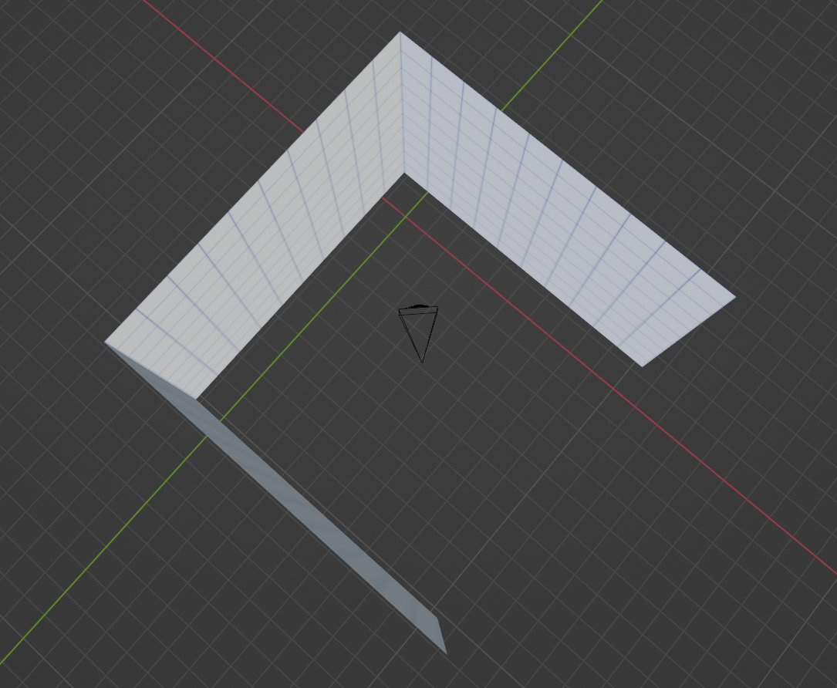
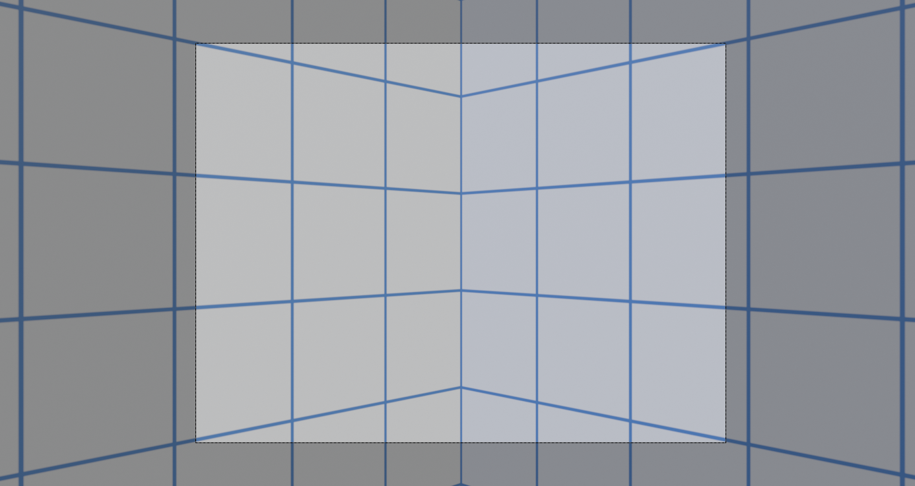

Slide 3
Basic Capture
temperature
Storage
<=3.93GB/s
Capture
<=3.93GB/s
3-25 cameras (MIPI)
Trigger(s)

Slide 4
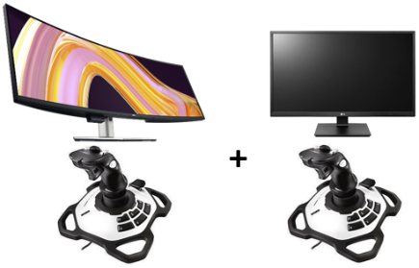
Basic IR Replay
Storage
3.3GB/s
Render + Display

Slide 5
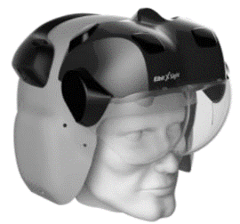
Basic IR Live Xsight
Synch
temperature
3.3GB/s
Capture
Selector
1.44GB/s
Render + Display
3-25 cameras (MIPI)
Trigger
3.3GB/s
Storage

Slide 6
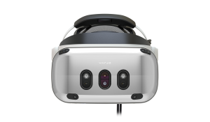
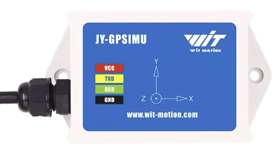
IR Live HMD + deblur
Synch
temperature
3.3GB/s
Capture
Selector
3.3GB/s
Render + Display
3-25 cameras (MIPI)
Triggers
3.3GB/s
Deblur
Storage
INS + GPS

Slide 7
VIS live HMD + Options
Synch
3.93GB/s
Capture
Selector
3.3GB/s
Render + Display
25 cameras (MIPI)
Triggers
3.93GB/s
Depth
629MB/s
Storage
INS + GPS

Slide 8
General System (max bandwidths)
Synch
temperature
3.93GB/s
Capture
Selector
3.93GB/s
Depth +
Render + Display
3-25 cameras (MIPI)
Triggers
3.93GB/s
Neural Tone Map
3.93GB/s
Storage
3.3GB/s
INS + GPS
Neural Render
78.7MB/s
Display
Neural Object Analysis

