Slide 1
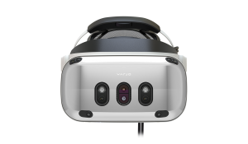
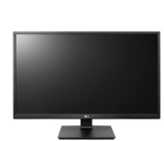
Synch API
Storage, Render,
Analysis
Module(s)
Core Module
(or Storage Module as virtual Core)
Render/Analysis
Module(s)
Image API
Storage API
Control API
Temp API, Pose API

Slide 2
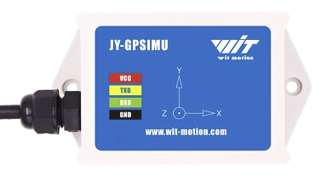
Synch API
Core Module
Trigger
Timing
Control API
Capture
Selector
Image API
Environment
Temp API
Pose API

Slide 3
Synch API
Storage Module
Render/Analysis
Module(s)
Core Module
Image API
Render/Analysis
Module(s)
Storage API
Temp API
Pose API
Control API

Slide 4
Synch API
Render Module
Non-Uniformity Correction (NUC)
Image API
Timing
Histograms
Depth
Control API
Tone Map
Composite
Display
Composite
Display
Temp API
Pose API
Analysis API

Slide 5
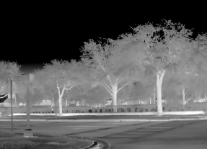
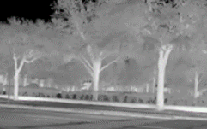
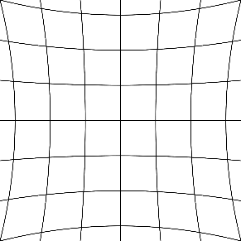
Timing
Display Submodule
Receive last oversized image(s)
Composite
Request oversized image(s)
Find next display scan-out time
Render properly-aligned crop
Predict pose at scan-out
Read pose + velocity
Distortion correction

Slide 6
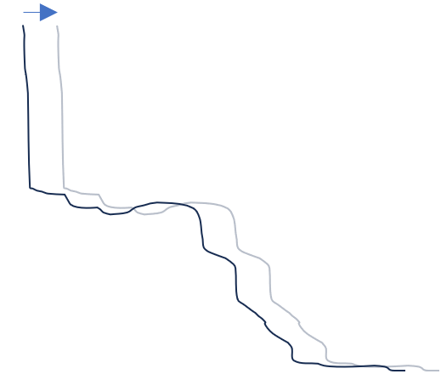

Analysis API
Pose API
Composite Submodule
Optional Depth
Adjust for motion or reprojection
Construct sphere (or depth map)
Receive last subregions
Distortion correction
Image API
Request full & down-sampled subregions
Project & Stitch
Geometric registration
Drone2
Drone1
Overlay
Receive request for view @ time
Pilot gaze
Camera geometry
Display

Slide 7
IR NUC Submodule
Image API
Per-pixel operations
Self-Emission
Vignette
Offset
Gain
Inverse calibration curve
X,Y temperature-dependent table
X,Y temperature-dependent tables
Temp API

Slide 8
VIS NUC Submodule
Image API
Per-pixel operations
Linearize
Vignette
Offset
Gain
Inverse calibration curve

Slide 9
Synch API
Analysis Module
NUC
Timing
Image API
Analysis
Control API
Histograms
Analysis
API
Temp API

