Slide 1
Emerging Failure Mechanisms in the ALCM Power Distribution Box (J-Box)
Bill LaPach
AFNWC/NDMEA
2 Sep 2015

Slide 2
The Problem
The ALCM Power Distribution Box (J-Box) experienced significant functional test failure rates in recent test cycles
  Functional tests are performed on several ALCM LRUs during Analytical Condition Inspection (ACI) at Hill AFB UT
  Functional failure rate for J-Box: FY12 = 45%; FY15 = 66%

Slide 3
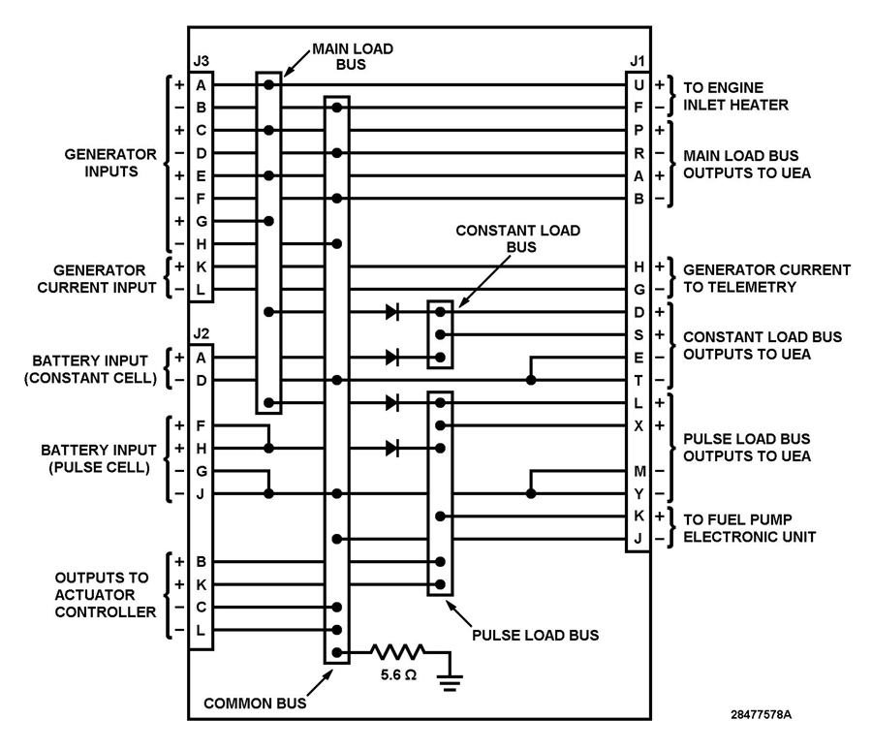
Performance Gap
Measureable detection of trend:
  ALCM Level I Test (TN 0840 – Pulse Load Bus voltage)
  J-Box Level III test (TN 01101 – voltage across diode assy)
    CR4 diode assembly between battery and Pulse Load Bus
    Test parameter limits:
      Min = 0.9 VDC
      Max = 1.0 VDC (+10%)

Slide 4
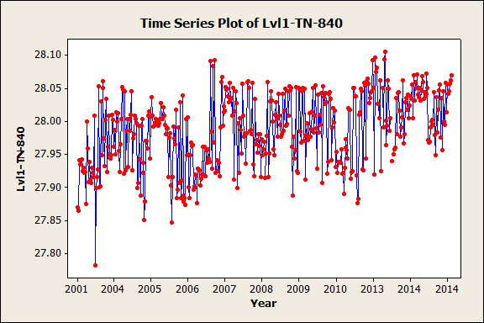
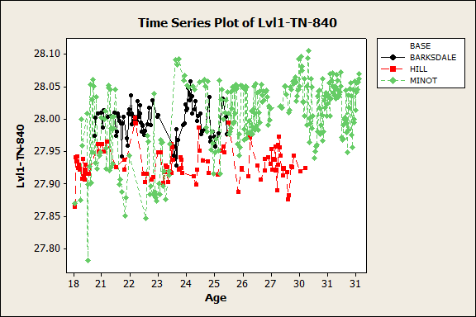
Level I Test Analysis
  Analysis of Level I TN 0840 identified trend in voltage on Pulse Load Bus (.07 volts / year)
Note: Trend seems to be attributable to tests at Minot AFB (possible culprit is thermal cycling)

Slide 5
Level III Functional Test Analysis
Analysis of Level III TN 01101
  Of the first 12 ACI J-Boxes tested in FY2015, 8 tested “HIGH” (over the allowable threshold)
  This 66% test failure rate represents the accumulated risk that the corrosion failure mechanism will be severe enough to cause test failure of TN 01101 in any given J-Box

Slide 6
Research Findings
Hill AFB J-Box repair shop identified excessive corrosion on CR4 diode assembly
ALCM SPO contracted Boeing (ALCM OEM) to conduct J-Box aging study (results June 2014)
  Corrosion on CR4 diode assembly stranded wire splice
  Mounting torque of multiple diodes below spec
Sandia Natl Labs Corrosion Experts
  Condensation caused by capillary action in crimped wires
  Corrosion will continue to increase

Slide 7
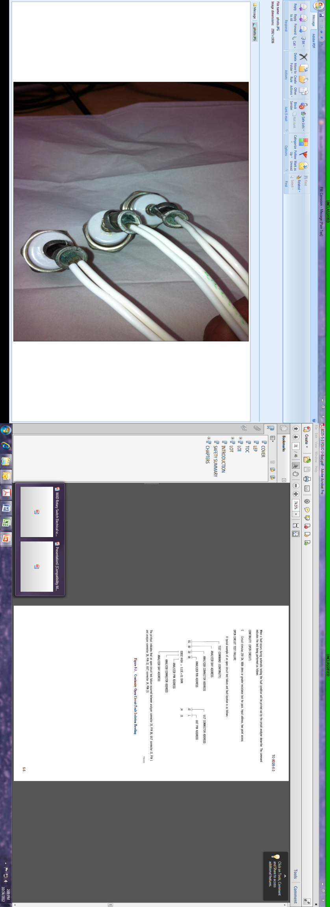
Root Causes
Causes
  Corrosion: J-Box design includes an uncoated stranded wire splice; does not protect from moisture in surrounding air
  Torque: Expansion and contraction due to thermal cycles decreases torque on diode assembly mounting

Slide 8
Performance Risk
Level III test spec for mounted CR4 diode assembly is 1.0 VDC max
“Risk” to operational performance projected to begin when CR4 diode assembly voltage drop exceeds 2.0 VDC (difference between thermal battery nominal voltage and ALCM system rqmts)
  Boeing determined that the critical CR4 diode assembly margin between functional test threshold and nominal operational power requirement is 1 additional volt

Slide 9
Corrosion Maturity Timeline
Stranded wire corrosion in this environment fully matures in approximately 40 years (excessive failure potential)
MIL-HDBK-217B, para 2.14 (crimp connections) - environmental factors will multiply maturity of corrosion in a crimped connection
Projected failure mechanism distribution curve for the Level III functional test indicates an accumulative 10% probability was likely present by 2008, growing to 66% in 2015
  2008 – 10% (undetected)
  2012 – 45% (ACI results)
  2015 – 66% (ACI results)

Slide 10
Projected Reliability Impact
Level I TN 0840 trend (.07 VDC/yr) will span the remaining 0.9 volt margin to nominal operational requirement in 13 years
Test failure rate distribution curve projected 13 years to reflect impending risk to operational performance
Projected operational risk significantly increases in FY 2021
13 years

Slide 11
Summary
J-Box Service Life Projection = FY2021
Recommended Next Steps
  Rate J-Box RED on ALCM Technical Assessment
  Assemble J-Box corrective action IPT
  Develop and track corrective actions
  Confirm and report results

