Slide 1
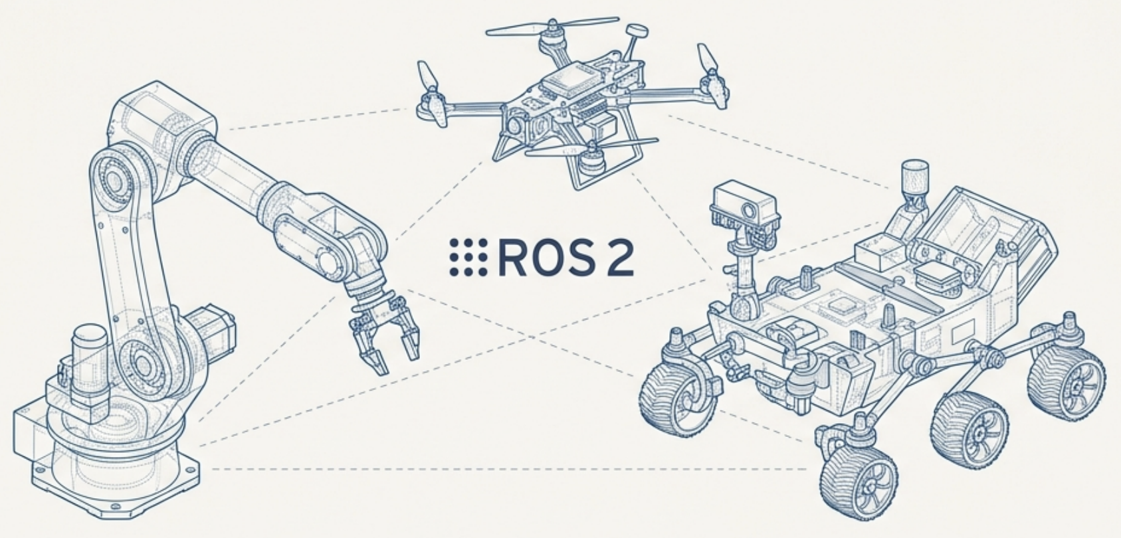
Robotics Accademy
AEA
Lorenzo Ortolani
Gabriel Voss

Slide 2
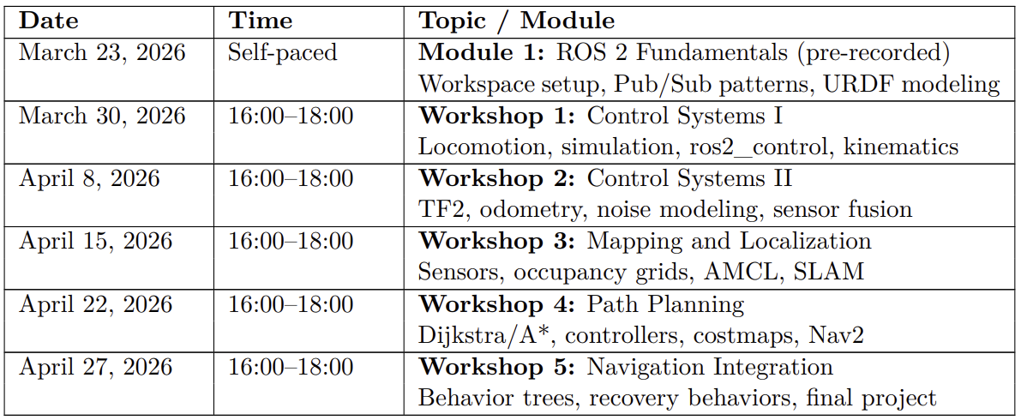
Course Logistics

Slide 3
Exercises
Each session is divided by a theoretical part and a practical part with showcased examples and hands exercises on small tasks that you’ll need to solve by your own with our supervision.
Exercises are necessary for getting familiar with Ros2 framework and with general robotics topics.
We encourage team work for solving the exercises, but for the final project you will deliver it by your own.

Slide 4
Evaluation – Project
Each student will solve a final project that we will evaluate by considering the following criteria:
How you approach the project
Quality of code and code reproducibility for different types of robotic systems
How well your code can be plugged and played on a realistic simulation environment, such as in Gazebo
Overall quality of your GitHub repository:
Documentation quality (e.g. well structured Readme.md by emphasizing your reasoning steps)
Structure of your Ros2 package

Slide 5
Overview Course
Module 1: Introduction and ROS 2 Fundamentals (today’s session):
Module 2: Control Systems and State Estimation
Module 3: Mapping, Localization, and SLAM
Module 4: Path Planning and Navigation

Slide 6
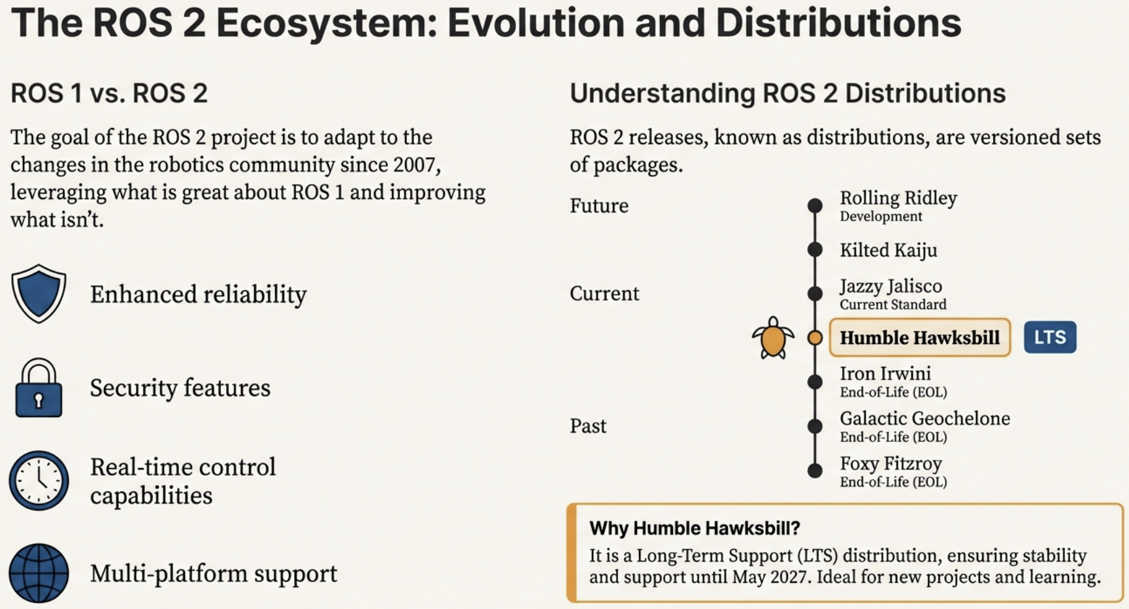
The Ros2 ecosystem: Evolution and Distributions

Slide 7
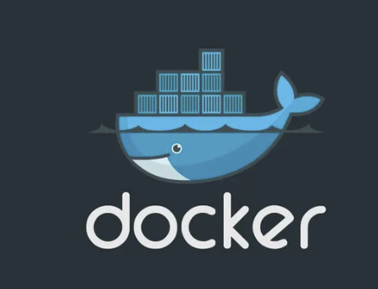
Setting up your environment with docker
What is Docker? Docker is a virtualized operating system, which delivers software packages in containers. Docker automates the deployment of applications within lightweight containers, enabling them to run consistently across different computing environments.
Why we need to use Docker? Docker is essential for letting you run different types of dependencies that in principle are not compatible for all operating systems. So for the seek of simplicity, we will all work in the same environment such that everyone has the same framework setup.
Guide for installing docker engine: https://docs.docker.com/engine/install/

Slide 8
Setting up your environment with docker

